Slide 1
Active Learning with High Dimensional Inputs using Bayesian Convolutional Neural Networks
Riashat Islam, Yarin Gal and Zoubin Ghahramani
Riashat Islam
Supervisors: Zoubin Ghahramani and Yarin Gal

Slide 2
Outline of Experiments
Performance using Dropout Acquisition Functions when used with Bayesian ConvNet and avoid over-fitting when using small datasets
Comparison of Dropout Acquisition Functions with Other Baseline active learning acquisition functions
Significance of Query Rate per acquisition
Comparison of performance using only softmax and uncertainty estimates from test-time dropout
Significance of model architecture and non-linearity for different uncertainty estimates for use of active learning with deep models
Comparison with combination of SSL and AL (Minimum Bayes Risk for Binary Classification)
Comparison of our approach with other recent methods for data-efficiency in deep learning
Acquisition Functions using Dropout + Random uncertainty estimates in active learning
Summary of Experimental Results

Slide 3
Acquisition Functions
Dropout Acquisition Functions
Dropout Bayesian Active Learning By Disagreement
Dropout Variation Ratio
Dropout Bayes Segnet
Dropout Maximum Entropy
Dropout Least Confident
Other baseline acquisition functions used in active learning
Uncertainty Sampling – Maximum Entropy
Uncertainty Sampling – Best vs Second Best Search (BvSB)
Maximum Entropy
Random acquisition

Slide 4
Experimental Setup
Number of Experiments = 3-5 for averaged results
LeNet5 architecture
Number of Epochs = 50
Starting training data: 20 - 100 data points, using up to 1000 training labelled samples
10,000 test samples on MNIST
Number of Queries made at each acquisition: 1, 5 or 10
100 Dropout MC Samples for uncertainty estimates
Weighted inputs in the loss function
ADAM optimizer

Slide 5
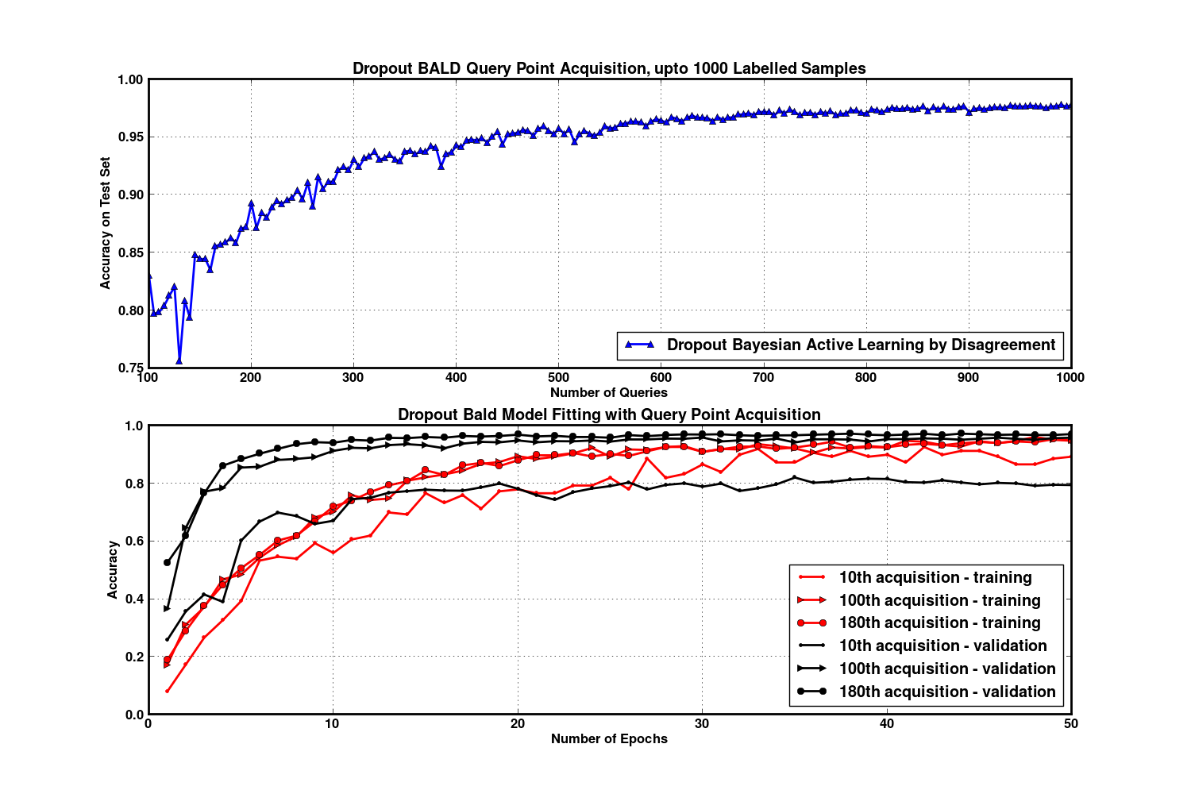

Dropout Bayesian Active Learning by Disagreement

Slide 6
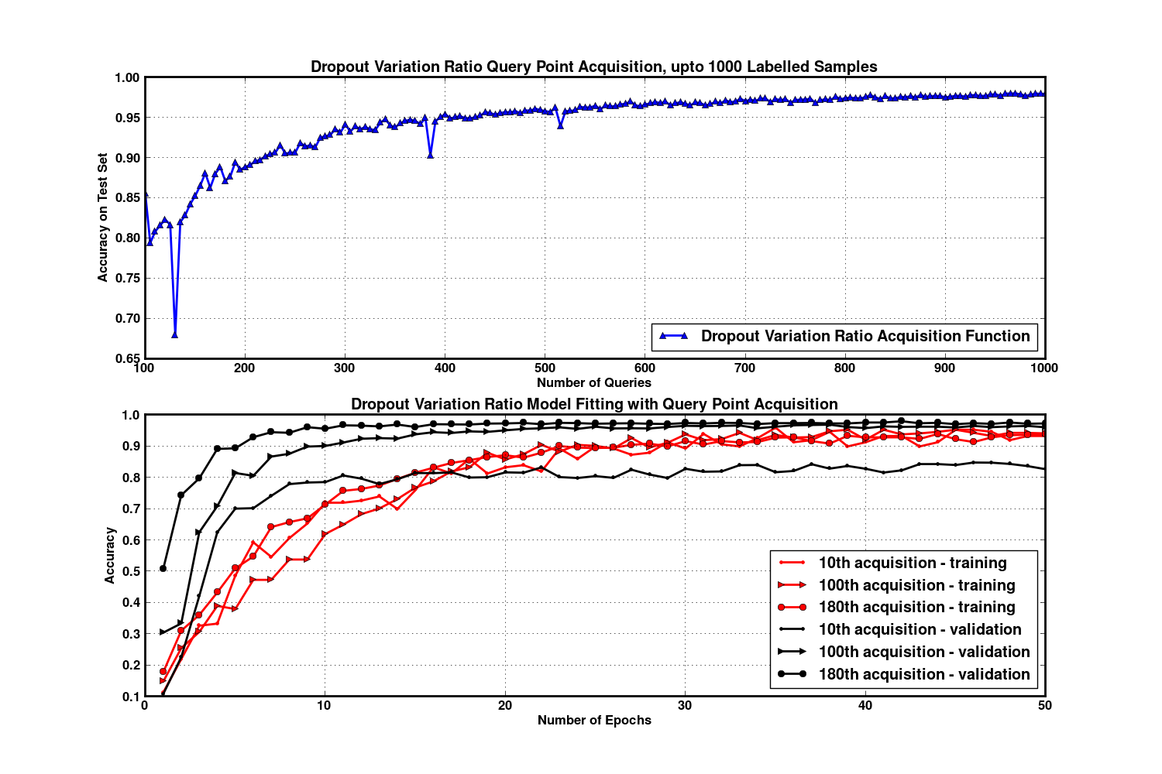
Dropout Variation Ratio

Slide 7
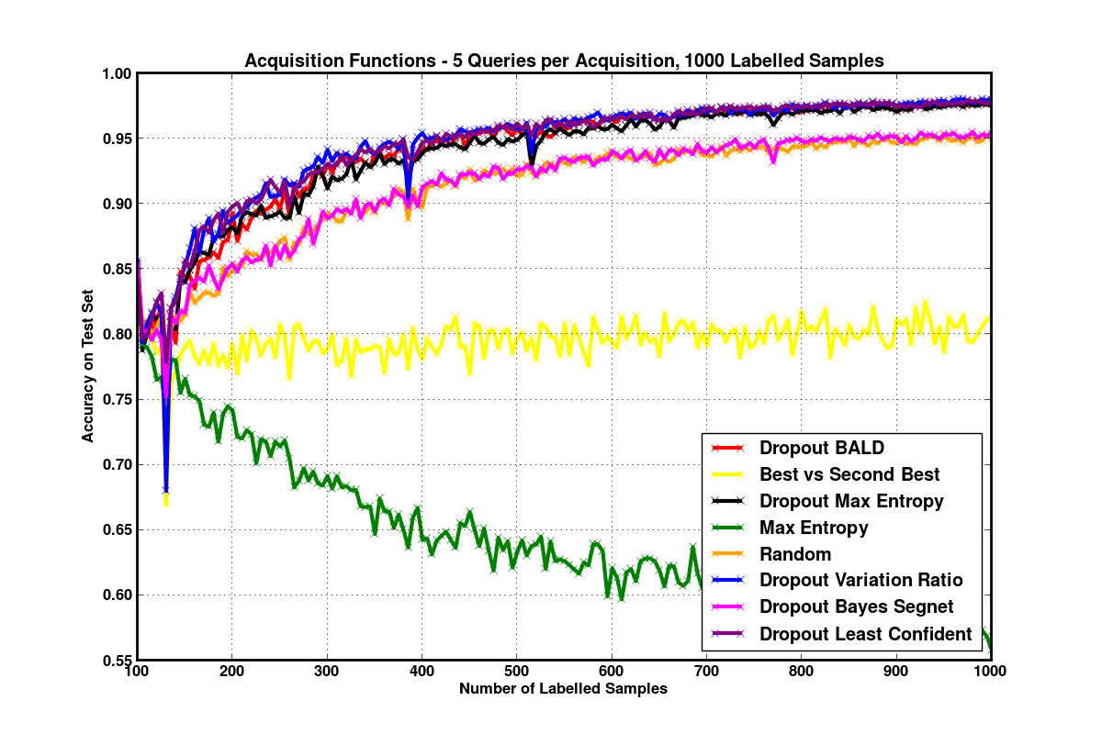
Comparison of Acquisition Functions

Slide 8
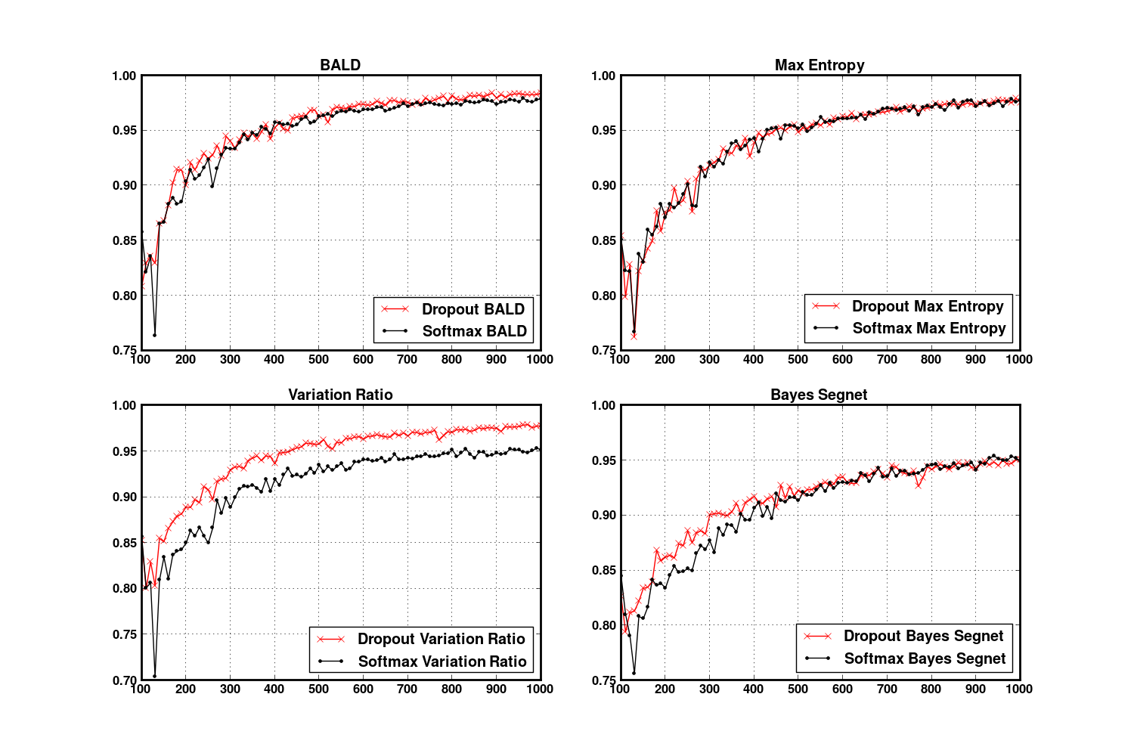
Significance of Uncertainty Estimates

Slide 9
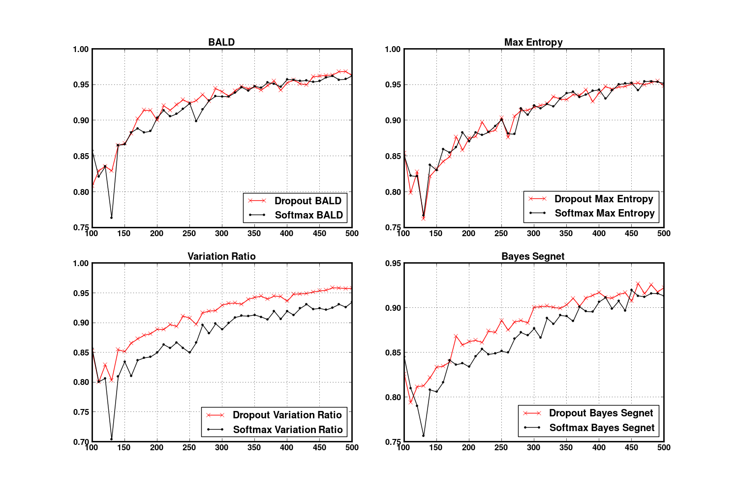
Significance of Uncertainty Estimates
Effect of test-time dropout more significant in small data settings

Slide 10
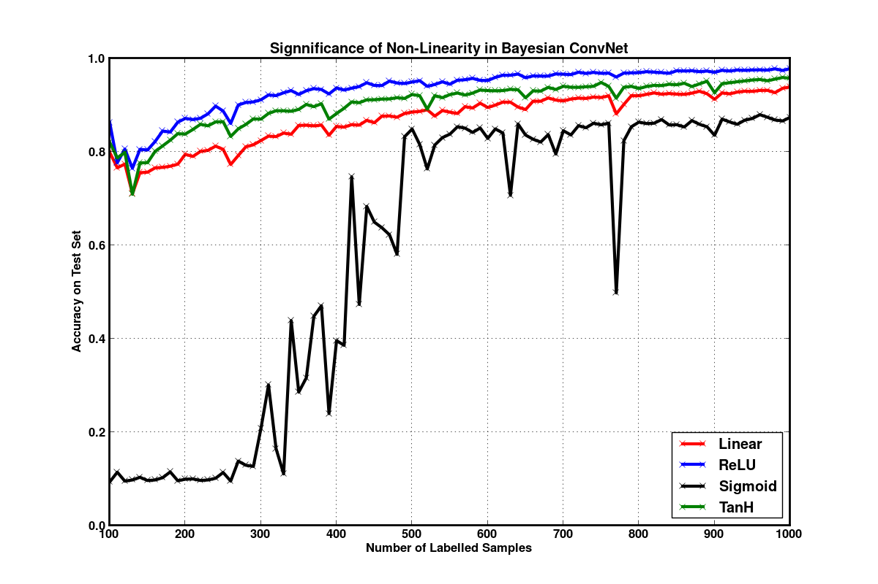
Non-Linearity

Slide 11
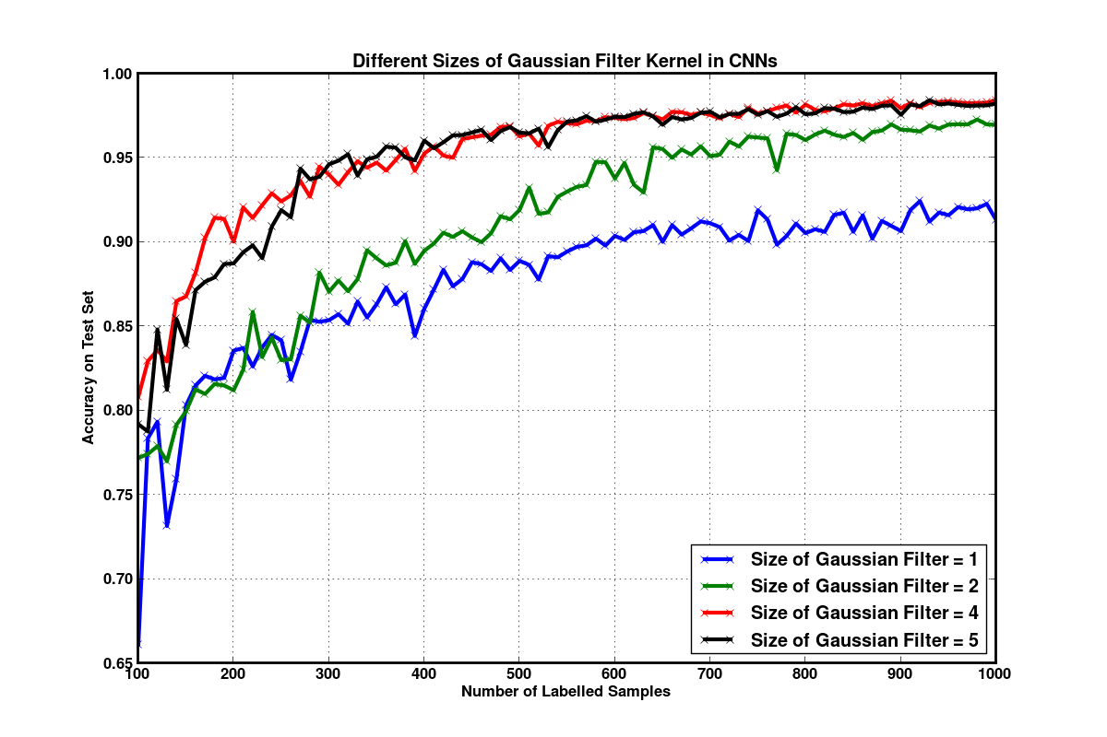
Kernel Filter Size

Slide 12
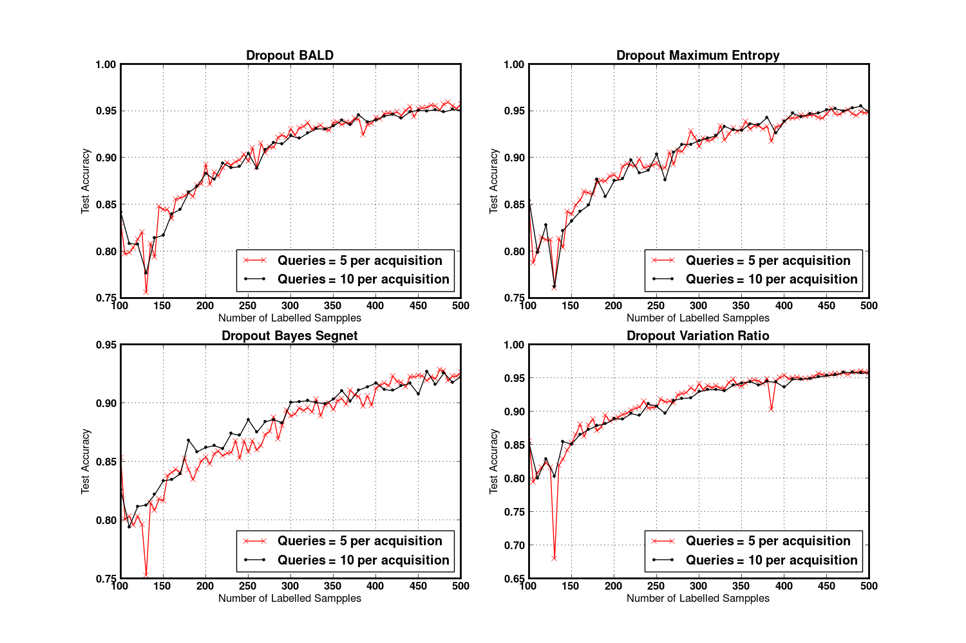
Significance of Query Rate for Computational Efficiency

Slide 13
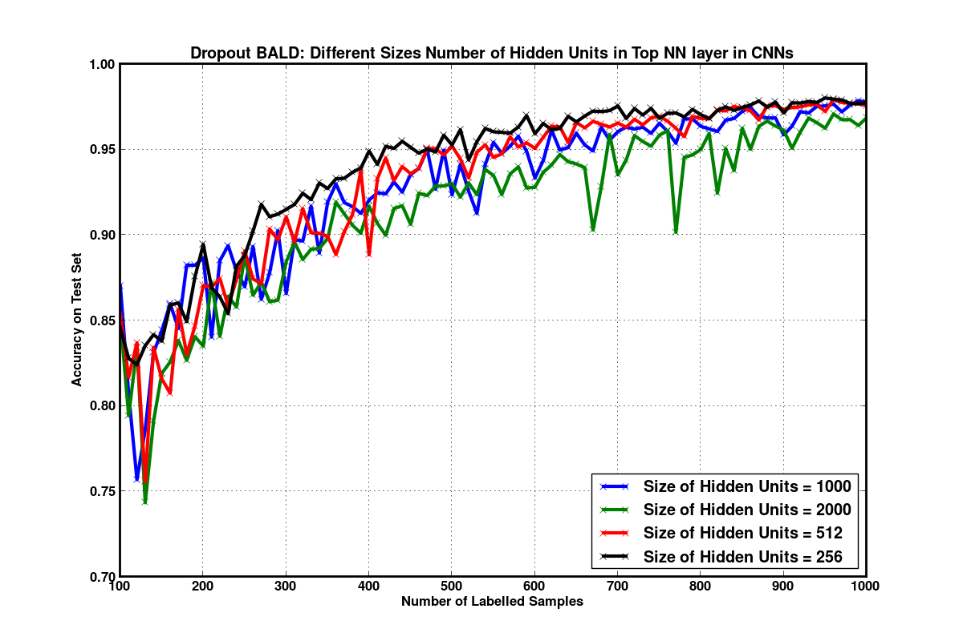
Number of Hidden Units

Slide 14
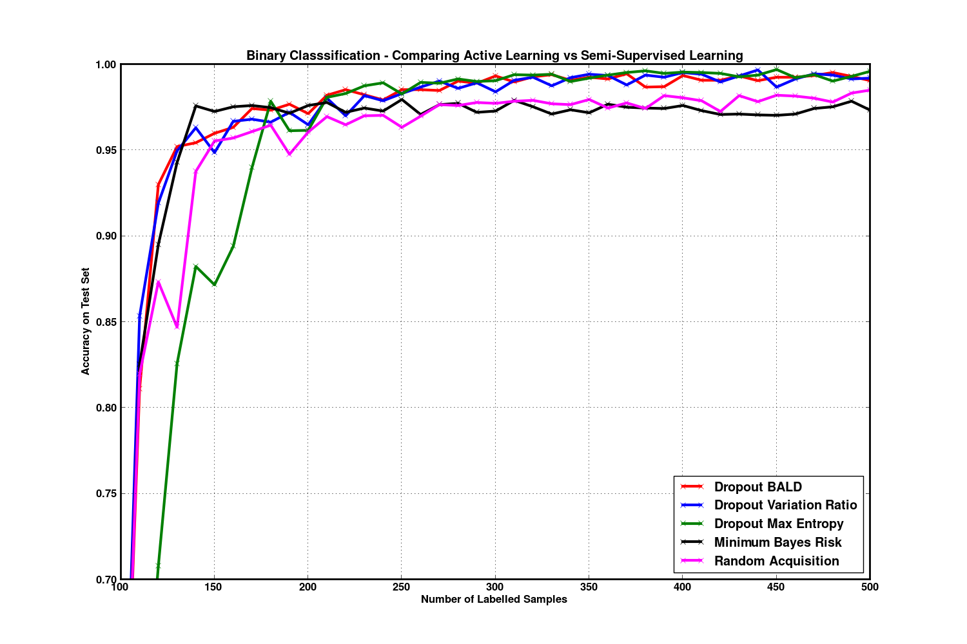
Binary Classification – Comparing with Minimum Bayes Risk

Slide 15
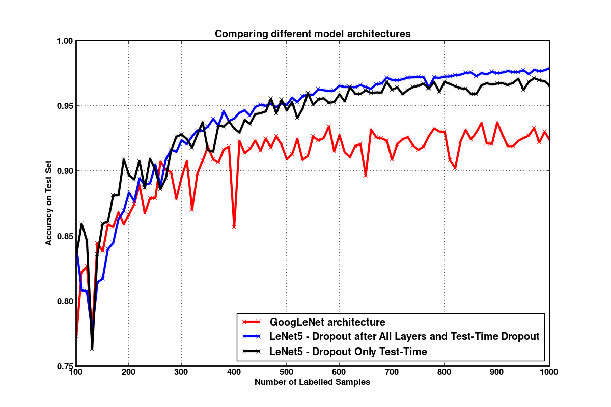
Model Architectures

Slide 16
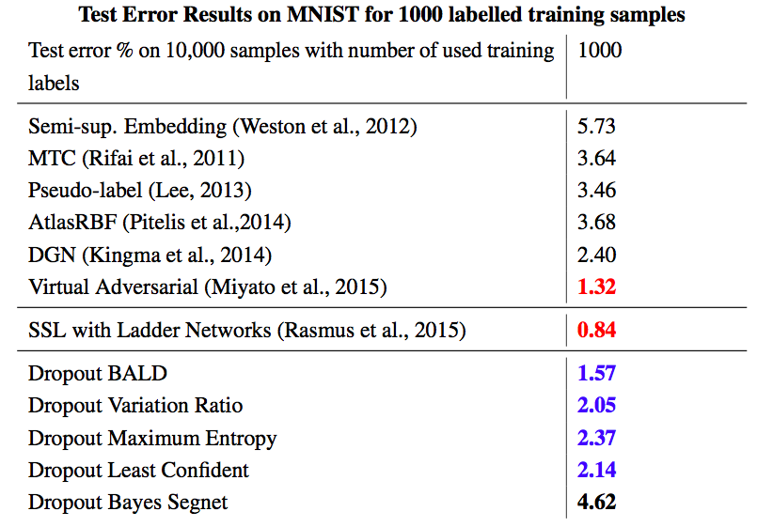
Comparison with SSL Methods

Slide 17
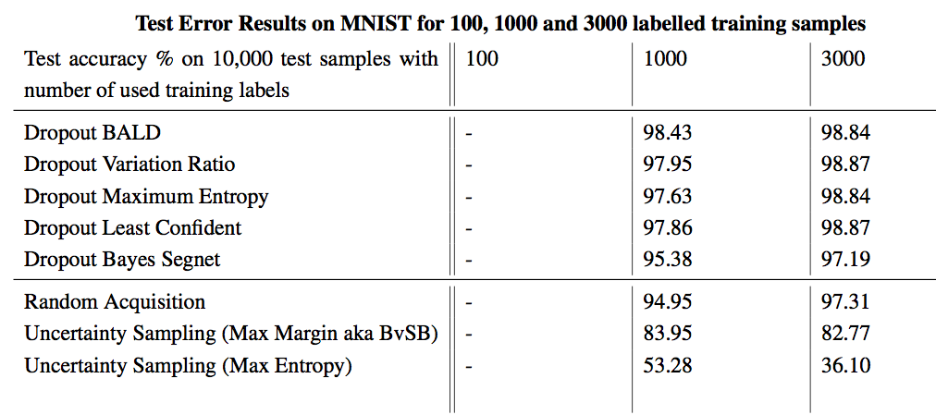
Summary of Results

Slide 18
Dropout + Random Uncertainty Estimates

