Slide 1

CUSTOMER SHOPPING BEHAVIOR ANALYSIS
Uncovering spending patterns, segments, and preferences from 3,900 transactions

Slide 2
DATASET AT A GLANCE
3,900
18
TRANSACTIONS
FEATURES
37
$59.76
MISSING VALUES
AVG. PURCHASE
Review Rating only
Demographics, purchase details, and shopping behavior across 4 product categories.

Slide 3

DATA PREPARATION IN PYTHON
CLEAN
ENGINEER
Imputed missing Review Ratings by category median
Created age_group and purchase_frequency_days
INTEGRATE
Loaded cleaned DataFrame into PostgreSQL

Slide 4
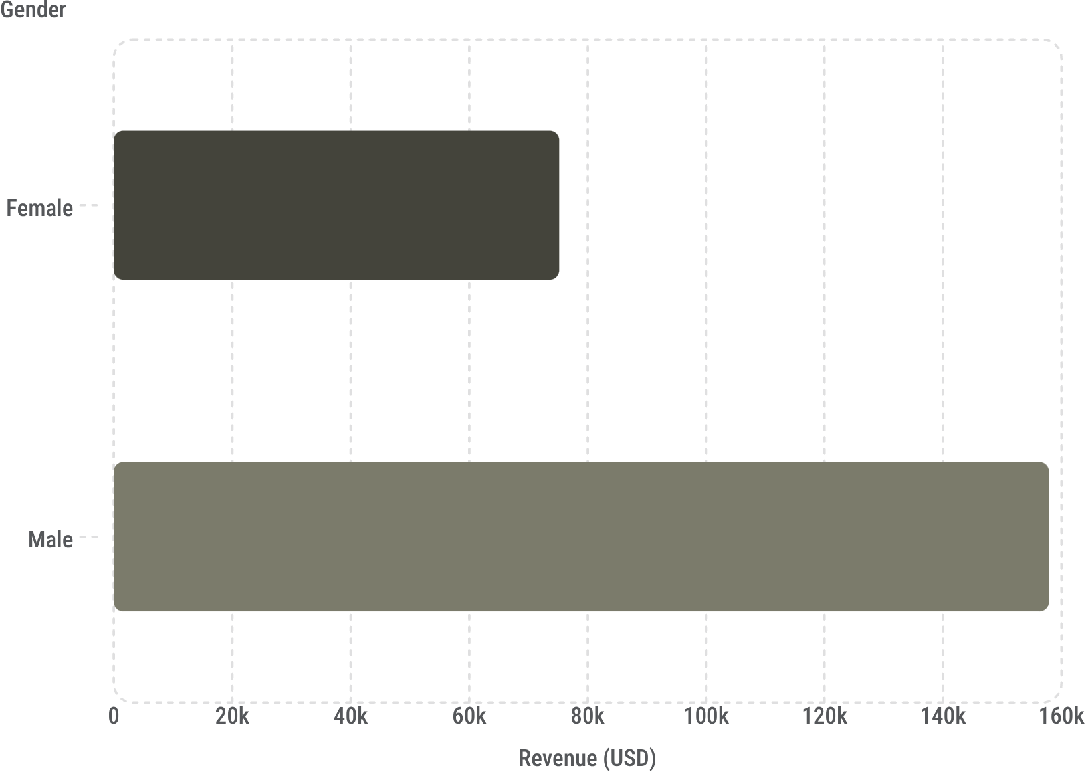
REVENUE BY GENDER
MALE CUSTOMERS DRIVE 2× MORE REVENUE
Male: $157,890 vs. Female: $75,191
A significant gap worth investigating for targeted campaigns.

Slide 5
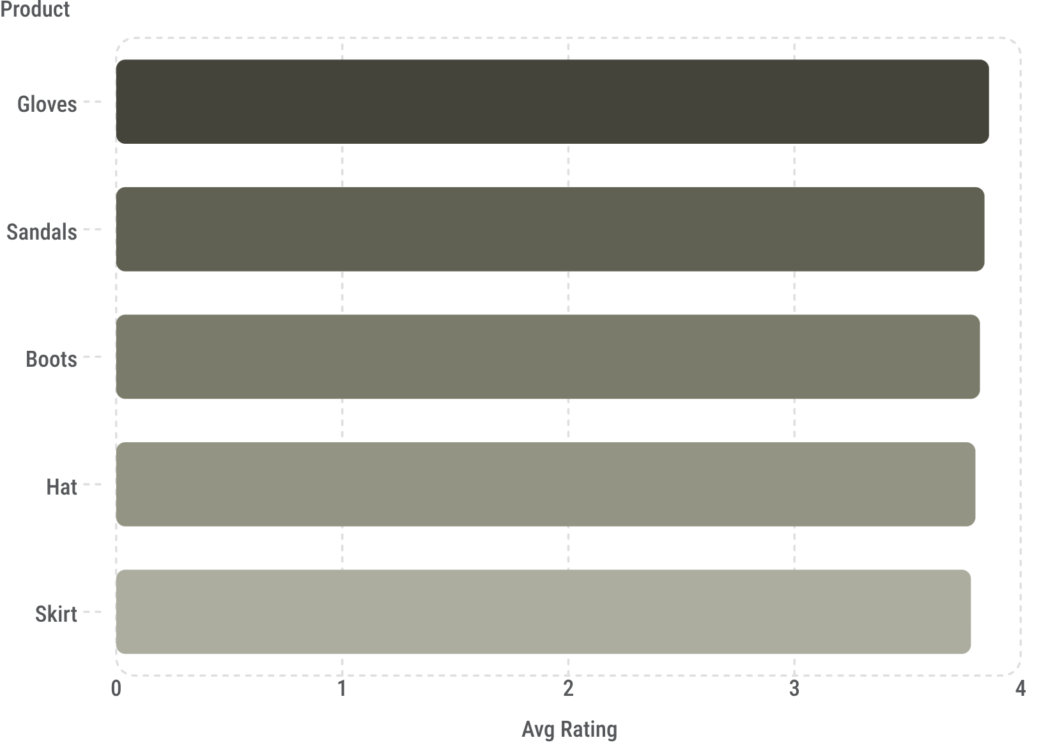
PRODUCT & SHIPPING INSIGHTS
TOP 5 PRODUCTS BY RATING
SHIPPING COMPARISON
Express: $60.48 avg purchase
Standard: $58.46 avg purchase
MOST DISCOUNT-DEPENDENT
Hat (50%), Sneakers (49.7%), Coat (49.1%)

Slide 6

CUSTOMER SEGMENTATION
🏆 LOYAL
🔁 RETURNING
3,116 customers
701 customers
🆕 NEW
83 customers
839 customers used discounts yet spent above average — high-value discount users.

Slide 7
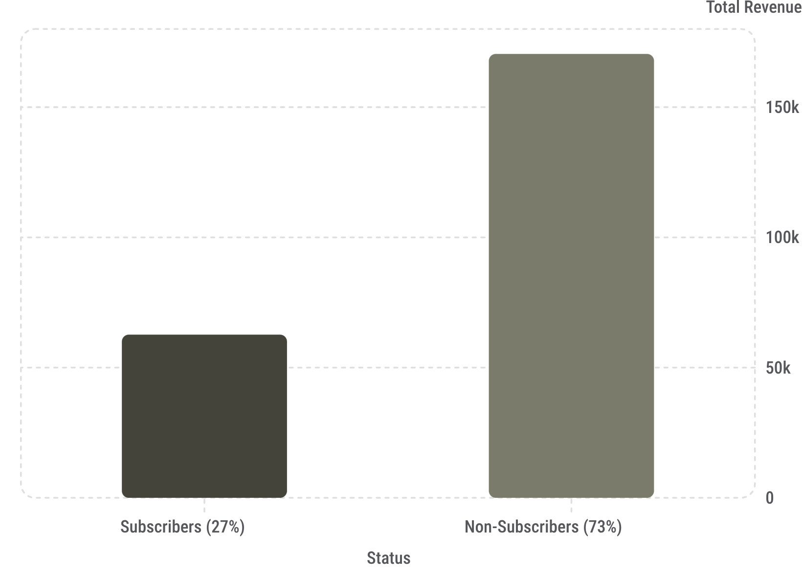

SUBSCRIBERS VS. NON-SUBSCRIBERS
KEY FINDINGS
Avg spend is nearly identical: $59.49 vs. $59.87
Non-subscribers generate 2.7× more total revenue due to volume.
958 repeat buyers (>5 purchases) are not subscribed — conversion opportunity.

Slide 8
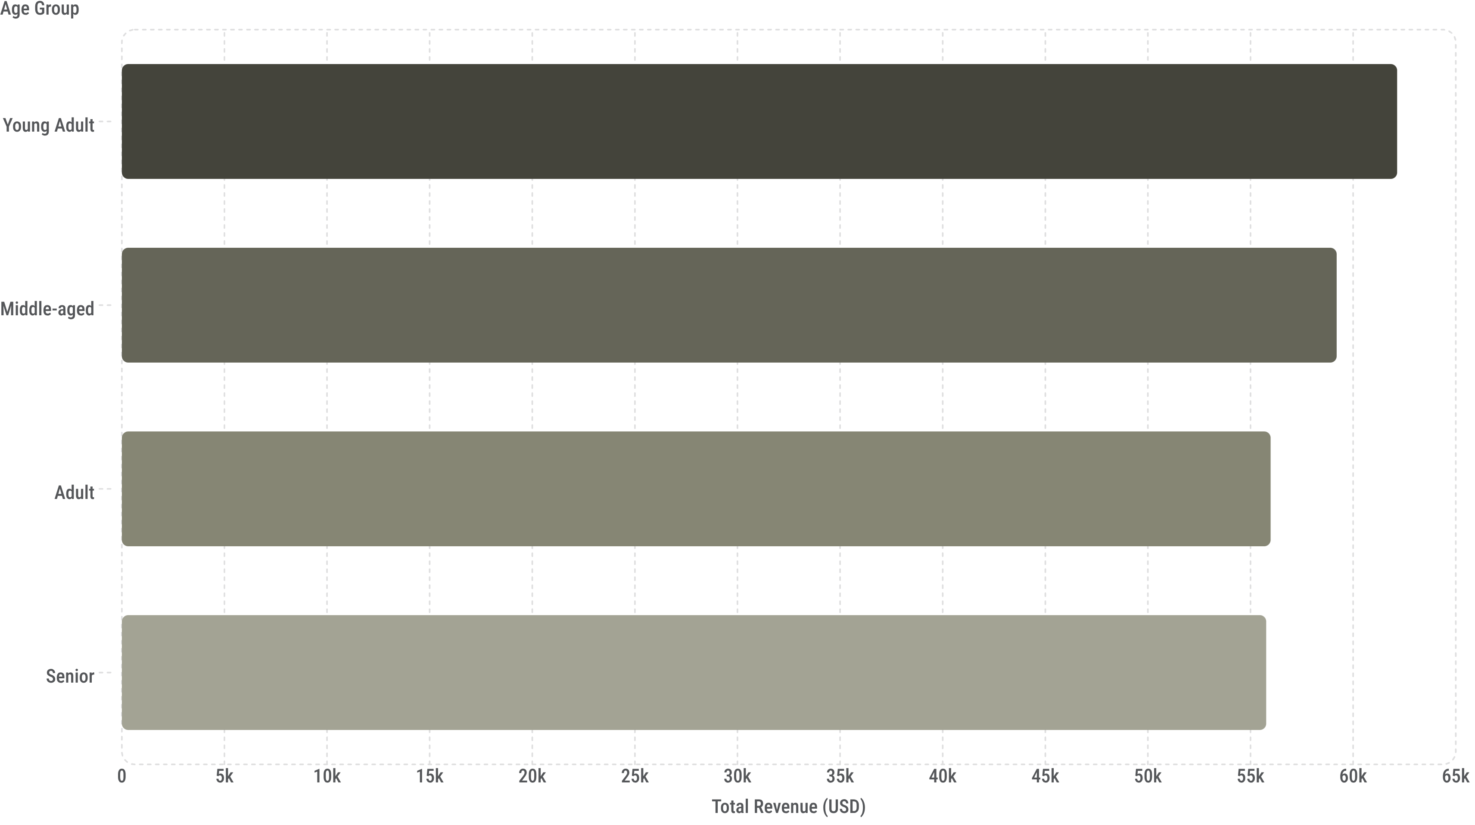
REVENUE BY AGE GROUP
Young Adults lead revenue, but all groups contribute relatively evenly — broad targeting works.

Slide 9
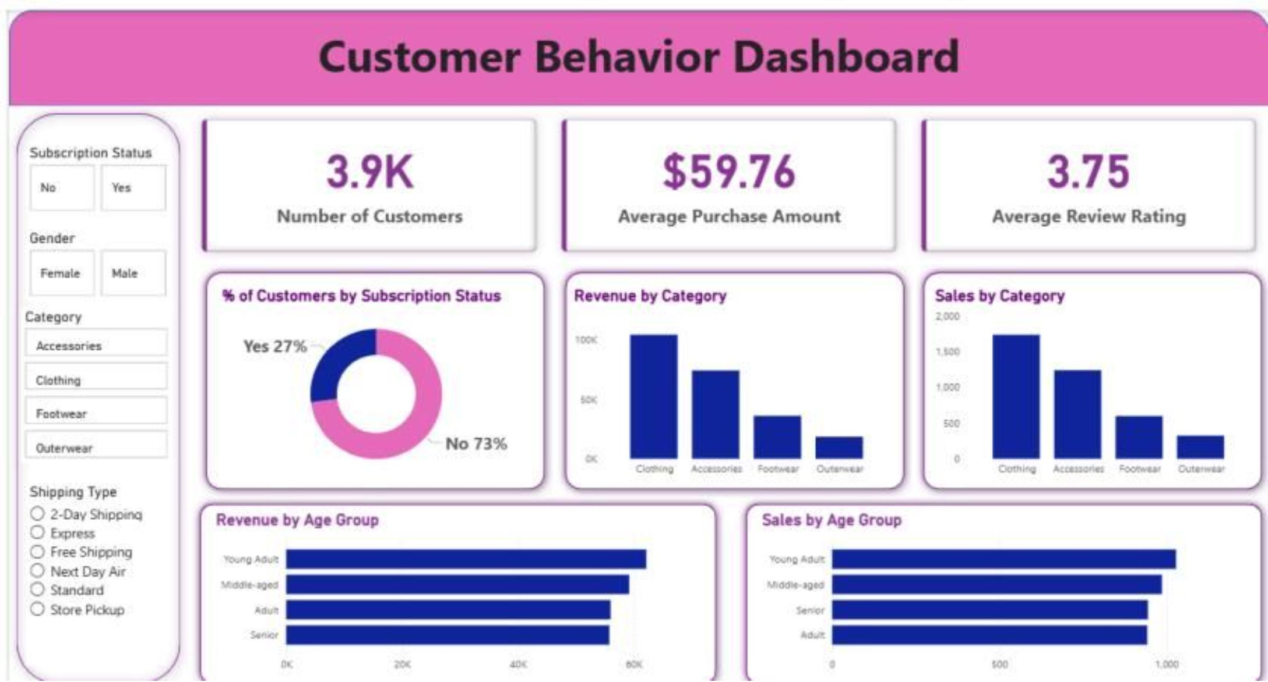

POWER BI DASHBOARD
KEY METRICS VISUALIZED
3.9K CUSTOMERS
Avg purchase $59.76, avg rating 3.75
REVENUE BY CATEGORY
Clothing leads at ~$90K
SUBSCRIPTION SPLIT
27% Yes · 73% No

Slide 10





BUSINESS RECOMMENDATIONS
BOOST SUBSCRIPTIONS
Promote exclusive subscriber benefits
LOYALTY PROGRAMS
Reward repeat buyers toward "Loyal" segment
REVIEW DISCOUNT POLICY
Balance sales lift with margin control
TARGETED MARKETING
Focus on high-revenue age groups & express-shipping users

