Slide 1
Data Visualization Topic- “Back To School”
Submitted By-
Swetha
Sargam Jain
Ramakrishna
Riba Khan

Slide 2
Objective of the Dashboard
The main objective of the dashboard is to track the usage of different systems across the Campus

Slide 3

Target Audience
Back to school team
Chief information officer
Technical support specialists

Slide 4
KPI’s
Total Interactions
Total Systems
Total Stats Recorded

Slide 5
Visualizations Covered
System usage and traffic by Date
Systems usage and traffic by team
Breakdown by year/semester
Breakdown by BTS Day/Year*

Slide 6
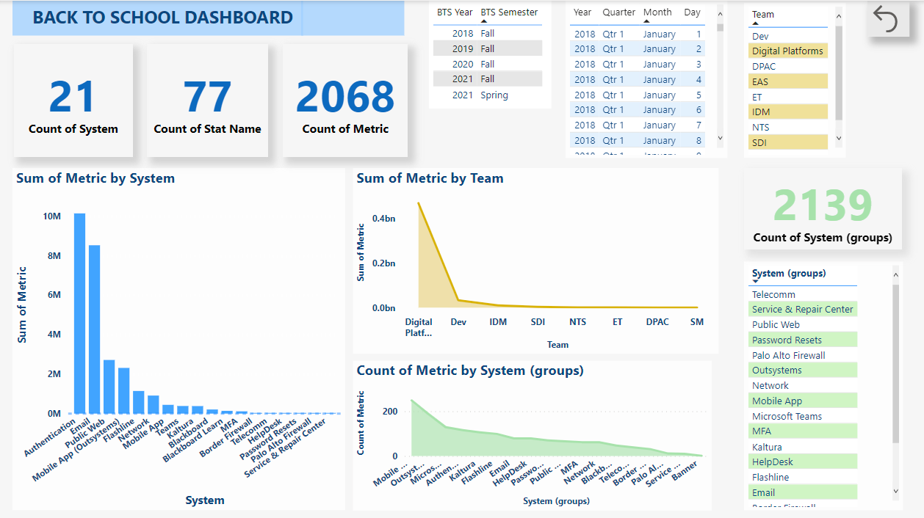
Dashboard Screenshot

