Slide 1

Code Unit
Proposal Prsentation

Slide 2
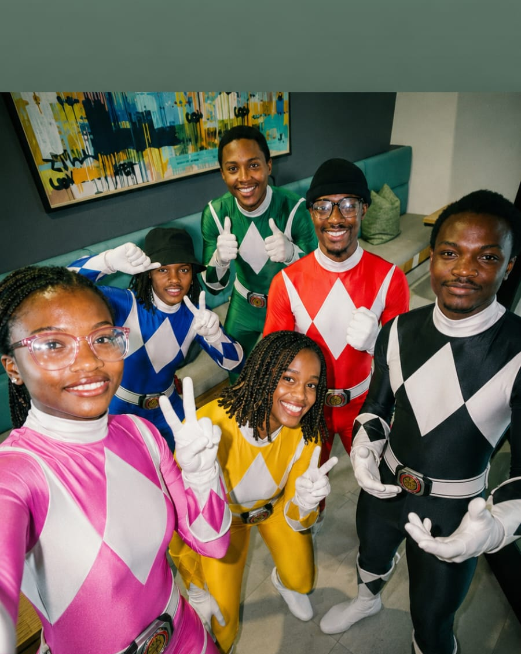
Group Members
Khensani Maluleke ST10451309 Gr2
Khumo-Thato Chabeli ST10448834 Gr3
Orearabetse Riba ST10446648 Gr2
Tinotenda Nyakatsari ST10437488 Gr2
Denzel Pawandiwa ST10457186 Gr2

Slide 3
About the Client
Flexispace (Pty) Ltd
Company Info
Key Questions
Industry: Modular construction & mobile buildings
Employees: Estimated 20–50 (SME)
Services offered:
Mobile offices & park homes
Prefabricated site offices & ablutions
Portable classrooms & clinics
Custom modular buildings
Rentals, delivery & installation
Target customers: Construction, mining, government, schools, clinics, events
Vision: Deliver affordable, durable, flexible mobile space solutions across South Africa.
Who is the client?
A South African company providing modular and mobile building solutions.
What do they do?
Design, build, sell, and rent prefabricated structures for a range of industries.
Who are their customers?
Construction firms, mines, government, schools, event organisers and private clients.
Why is technology important?
Powers the website and online quoting
Enables CAD(Computer Aided Design) design and manufacturing
Supports logistics and tracking
Drives marketing (SEO, social media)
Improves communication and scalability

Slide 4
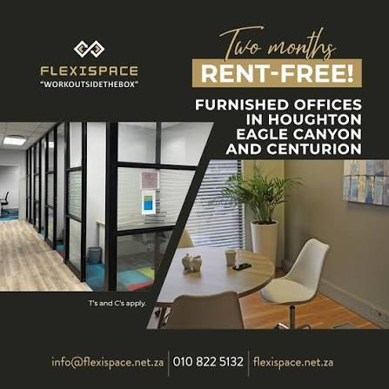
Slide 3 – Current Business Process
FlexiSpace Multi-Boardroom Booking System — Proposal Presentation
Current business process — FlexiSpace boardroom bookings
1. A customer or staff member wants to book a boardroom, so they contact the relevant location directly (phone or email) — there is no central platform.
2. The Centre Manager for that location manually checks their own Outlook calendar to see if the room is free at the requested time.
3. If it looks available, the Centre Manager manually creates an Outlook calendar entry to hold the booking.
4. The Centre Manager replies to the requester manually to confirm — there is no automatic confirmation.
5. This is repeated separately for every location — there is no shared visibility, so a customer needing rooms at two sites must contact two different managers.
6. Booking history only exists as whatever is left in each Outlook calendar — there is no reporting or audit trail.

Slide 5
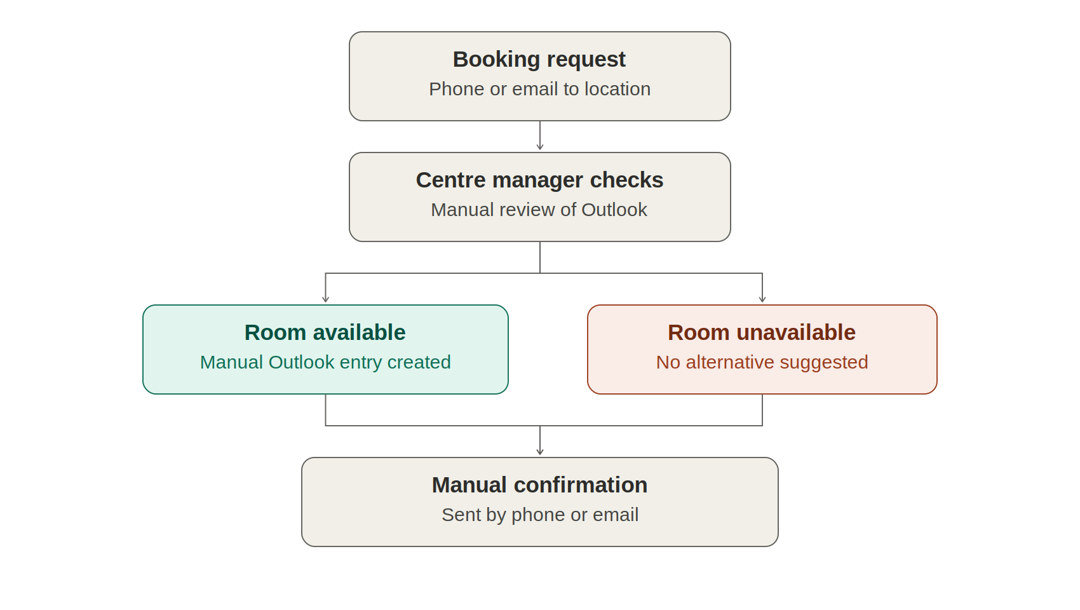
Process flowchart

Slide 6

Current System continuation
Is the process manual? Yes — entirely manual, from the initial request through to checking the calendar and confirming the booking.
Is there an existing system? No dedicated booking system. Outlook calendars are used informally as the only record.
Who performs each task? The Centre Managers handle everything for their site: Centurion's Centre Manager, Rebecca at Houghton, and Antoinette & Lesego jointly at Eagle Canyon.
Why this matters for the proposal
This manual process is exactly why double bookings happen — there is no single source of truth, and at Eagle Canyon two people (Antoinette and Lesego) manage the same calendar and rooms, increasing the risk of both booking the same slot without knowing. This directly justifies the proposed solution in slide 6: a centralized system with live availability and automatic conflict checking.

Slide 7
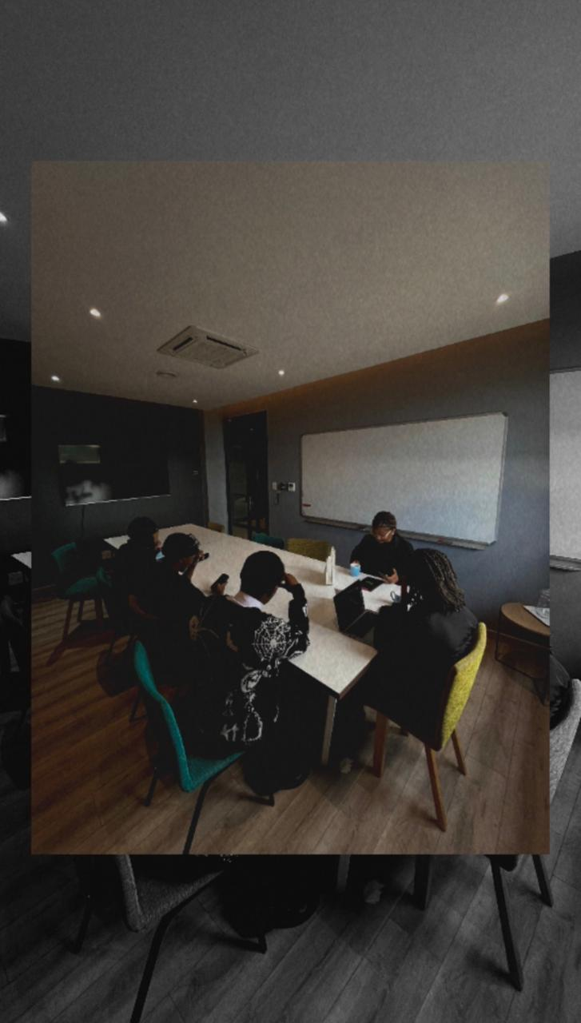
Current Business Problems
Business Problem
The current booking process is inefficient and relies heavily on manual intervention.
Managing bookings becomes more difficult as the business expands to more locations.
Customers cannot instantly book or view live room availability.
Causes
No dedicated booking system to manage reservations.
Centre Managers manually check room availability
No real-time synchronization between bookings and Outlook calendars.
No automatic conflict detection to prevent double bookings.

Slide 8
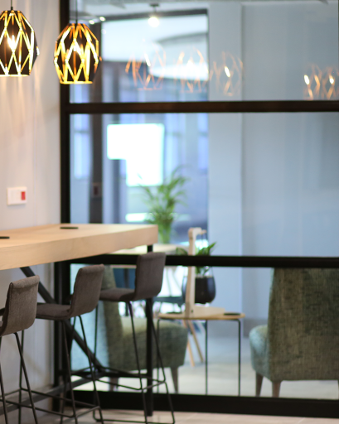
Current Business Problems
Impact
Slower booking confirmations.
Increased risk of double bookings and scheduling conflicts.
More administrative work for Centre Managers.
Poor customer experience due to the manual booking process.
Difficult to scale as new FlexiSpace locations are added.

Slide 9

Proposed solution
System Name
FlexiSpace Boardroom Booking System
Main features
One booking platform for Centurion, Houghton & Eagle Canyon
Live, real-time boardroom availability
Two-way sync with Outlook calendars (Microsoft Graph API)
Automatic conflict detection – no double bookings
Auto-generated booking confirmations & reminders (24 hr / 1 hr)
Full booking history and usage reports
Built to scale to future FlexiSpace locations

Slide 10
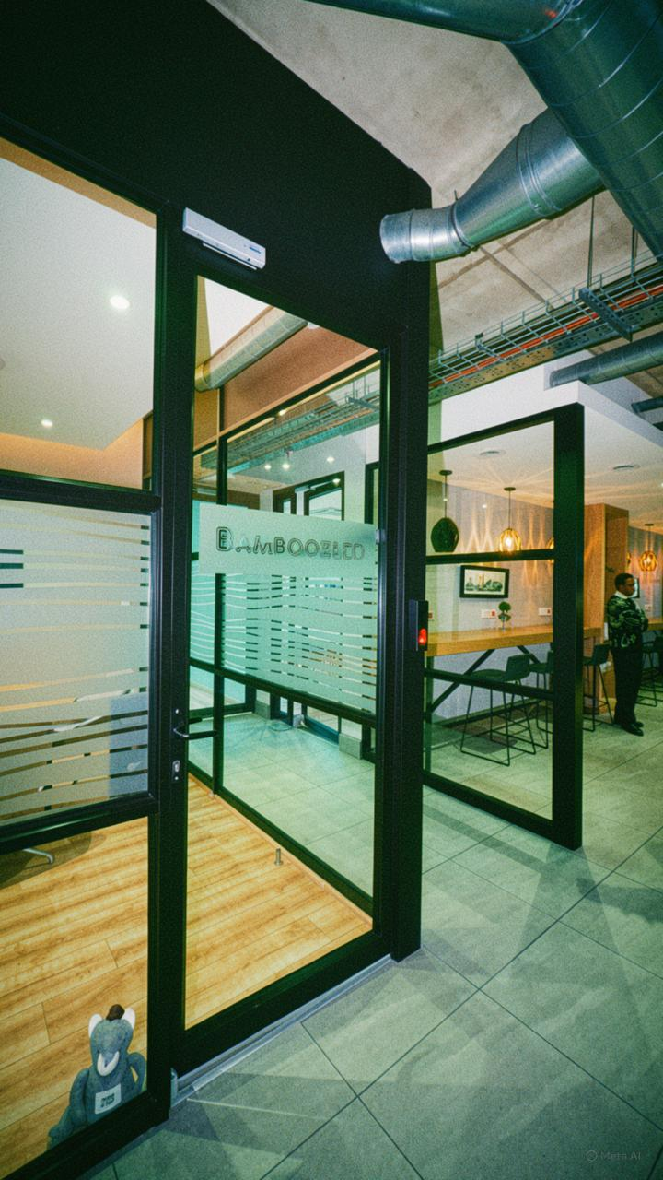
Proposed solution
Users
Administrators – manage locations, rooms, users & reports
Centre Managers – view, approve, block, edit & cancel bookings
Staff – book rooms and manage their own reservations
Clients – online self-service booking & payment
Technologies
Front End: React, Microsoft Fluent UI
Backend: .NET 8 Web API, Microsoft Graph API
Database: Microsoft SQL Server
Auth: Microsoft Entra ID
Hosting: Microsoft Azure

Slide 11
Benefits of the Booking System
1.Prevents Double Bookings
Staff no longer need to manage bookings manually. Users can quickly view available rooms and make bookings in just a few clicks.
3. Centralized Management
All FlexiSpace locations are managed through one system, making it easier for Centre Managers to monitor and control bookings.
4. Improves Accuracy
The system checks room availability in real time before confirming a booking, ensuring that the same boardroom cannot be booked twice.
2. Saves Time
Automatic synchronization with Microsoft Outlook reduces human error and keeps booking information up to date.

Slide 12
Benefits of the Booking System Continued
5. Enhances Customer Experience
Users receive instant booking confirmations and reminders, creating a faster and more professional booking process.
6. Better Reporting
The system tracks booking history and room usage, helping management make informed business decisions.
7. Supports Future Growth
The system is scalable, allowing new locations and boardrooms to be added as FlexiSpace expands.

Slide 13
Conclusion
FlexiSpace (Pty) Ltd currently books boardrooms across its three sites manually, using phone/email requests and separate Outlook calendars, which causes double bookings, slow confirmations, and heavy admin work with no way to scale.
The proposed FlexiSpace Boardroom Booking System solves this with one centralised platform offering real-time availability, automatic Outlook sync and conflict detection, instant confirmations, and full reporting.
This will eliminate double bookings, save time, reduce errors, improve customer experience, and let FlexiSpace scale smoothly as it grows.

