Slide 1


TODAY AT HOCKLEY MINT
Good morning, co-owners
A quick look at the notices, events, birthdays, values and useful updates for the workshop today.
WORKSHOP HOURS
07:30 - 17:00

Slide 2

ANNOUNCEMENTS
Annual co-owners' meeting
When
All co-owners are invited to the main workshop. Agenda: FY results, Aurora collection, sustainability update and open Q&A.
Friday 16 May 15:00
01
Refreshments from 14:30
02
RSVP on the kitchen sign-up sheet
03
Questions welcome in advance

Slide 3
BIRTHDAY CELEBRATION
Happy Birthday, Aisha
Wishing you a wonderful day from everyone at Hockley Mint. Thank you for the care and craft you bring to the workshop.
Add a photo
FROM
Your Hockley Mint team

Slide 4
UPCOMING EVENTS
This fortnight at the workshop
Key dates and useful reminders for everyone on site.
08 May
Co-owners coffee - Kitchen - 09:00
13 May
Fire drill - whole building - 11:30
22 May
Aurora press preview - Showroom - 10:00

Slide 5
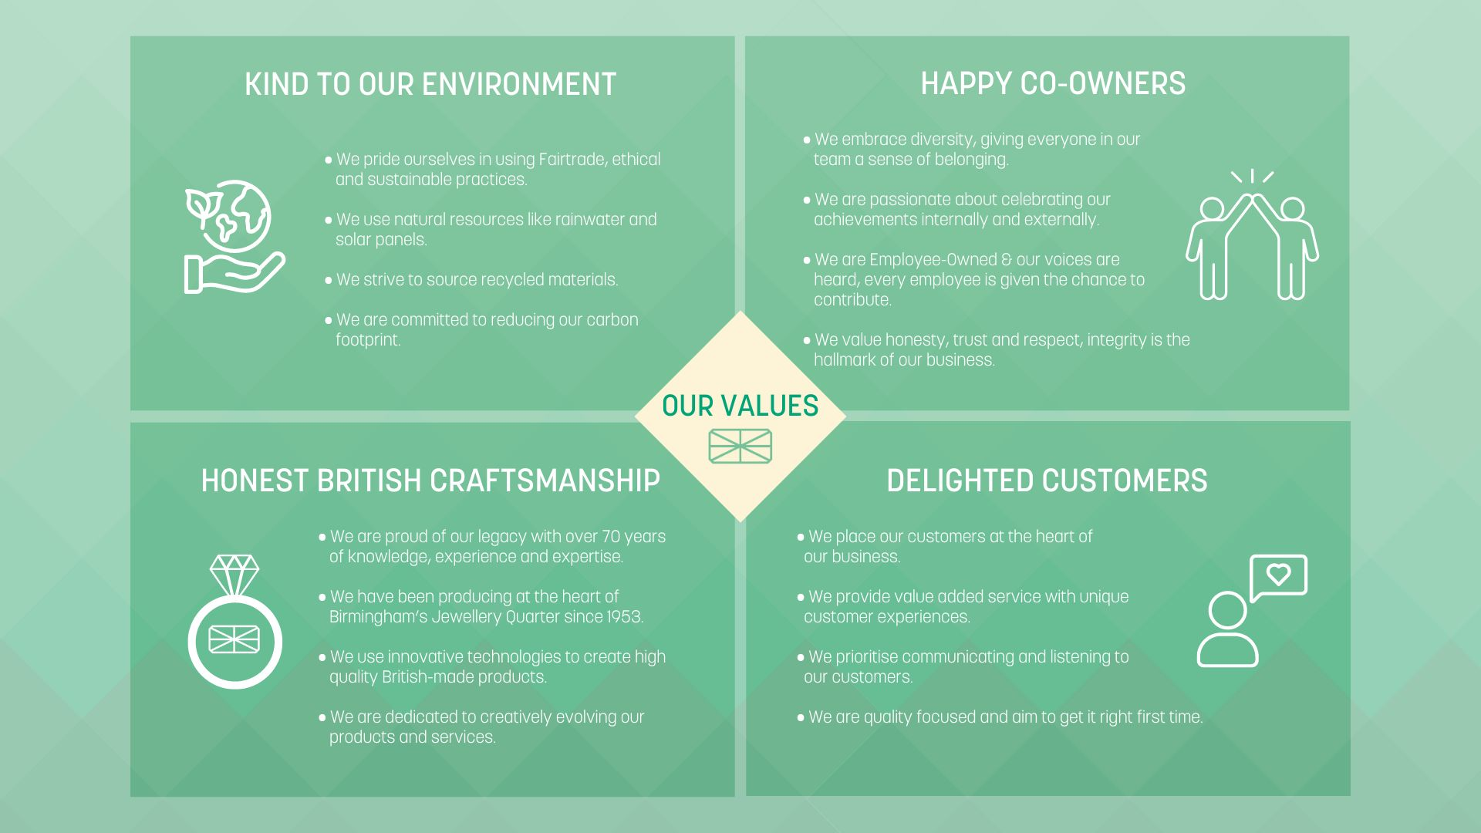

Slide 6
SAFETY
Fire drill on Tuesday
Time
Scheduled drill for all departments. Please leave by your nearest route and meet at the east car park assembly point.
Tuesday, 11:30
✓
Do not use lifts
✓
Take visitors with you
✓
Return only when cleared by Facilities

Slide 7
SHOUT-OUTS
Kudos from the workshop
Small notes of appreciation from around the business.
C
C
D
Casting team
CAD team
Despatch
Q1 wedding band run shipped a day early
Bespoke commission turned around in 48 hours
Every next-day parcel out before cut-off

Slide 8
USEFUL DOCUMENT
Brand Guidelines V2
PDF
The latest brand guidelines are available for anyone preparing internal or customer-facing materials.
PDF
P4707 Hockley Mint Brand Guidelines V2

