Slide 1
Ariadne’s thread
Navigating the maze of Biology (without getting lost)
Giulio Benedetti
European Bioconductor Conference
Turku, June 4, 2026

Slide 2
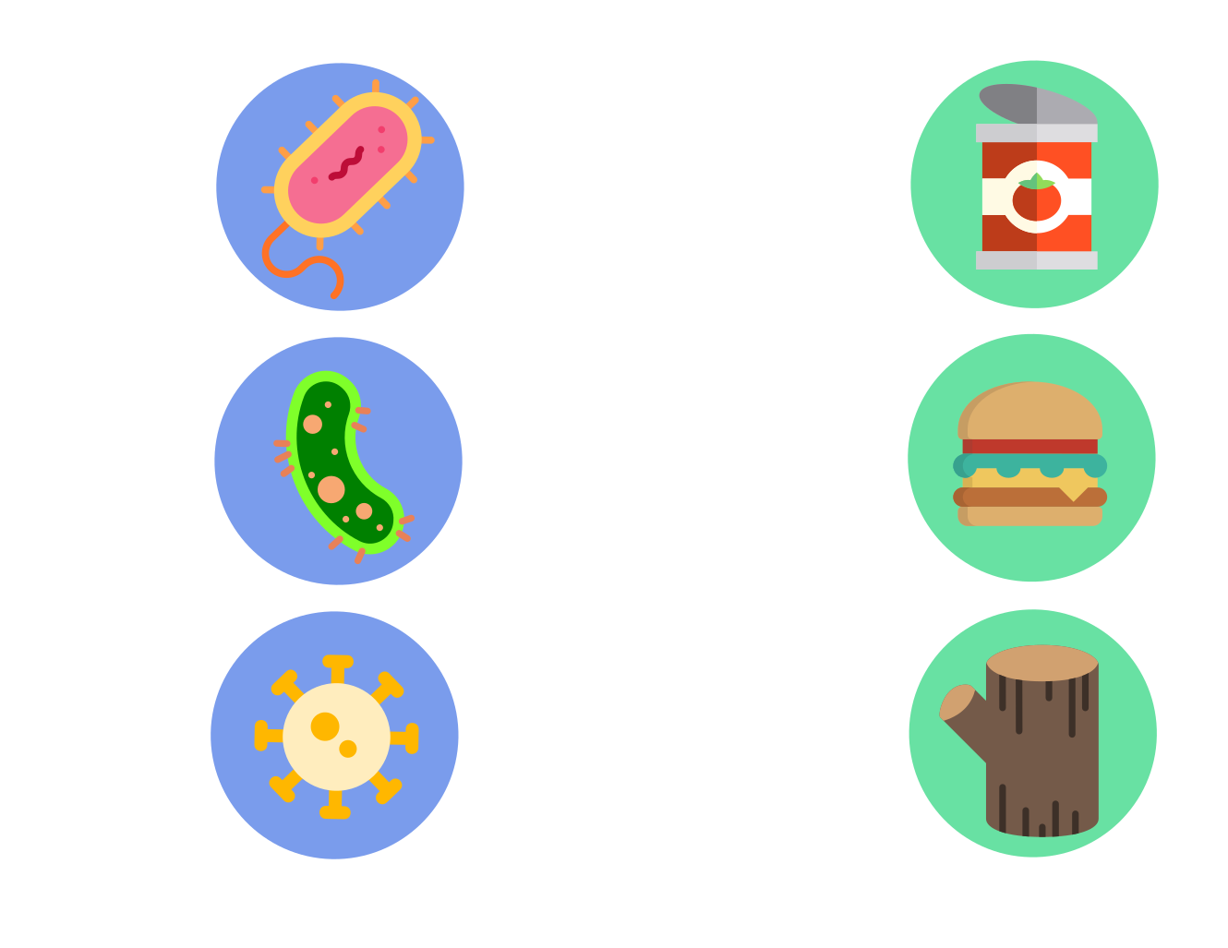

Slide 4
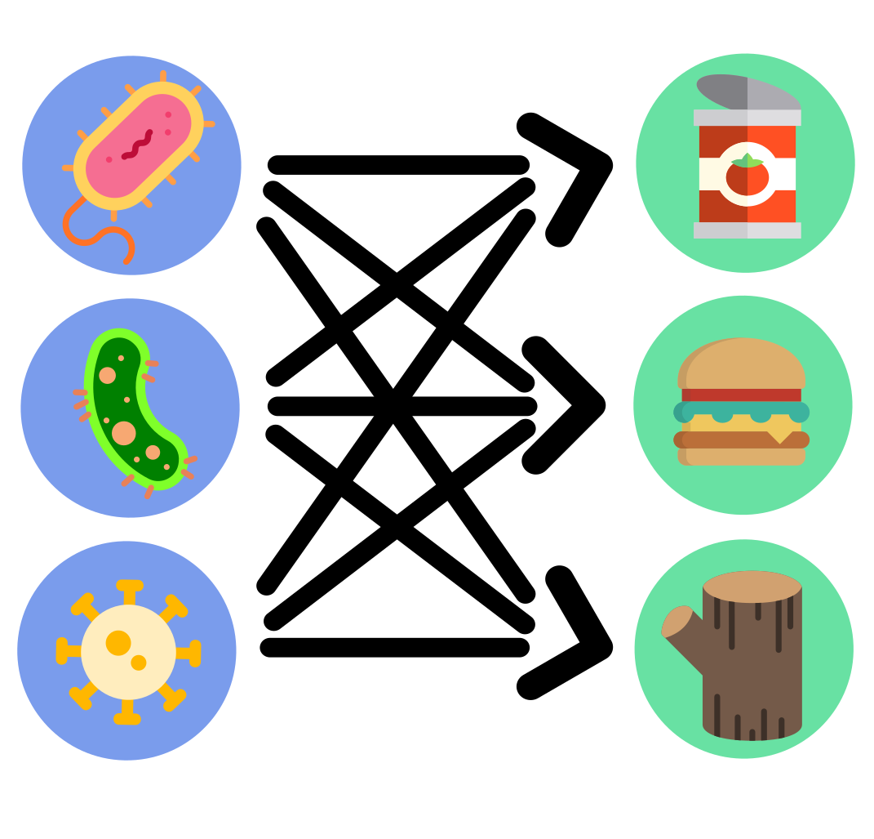

Slide 5
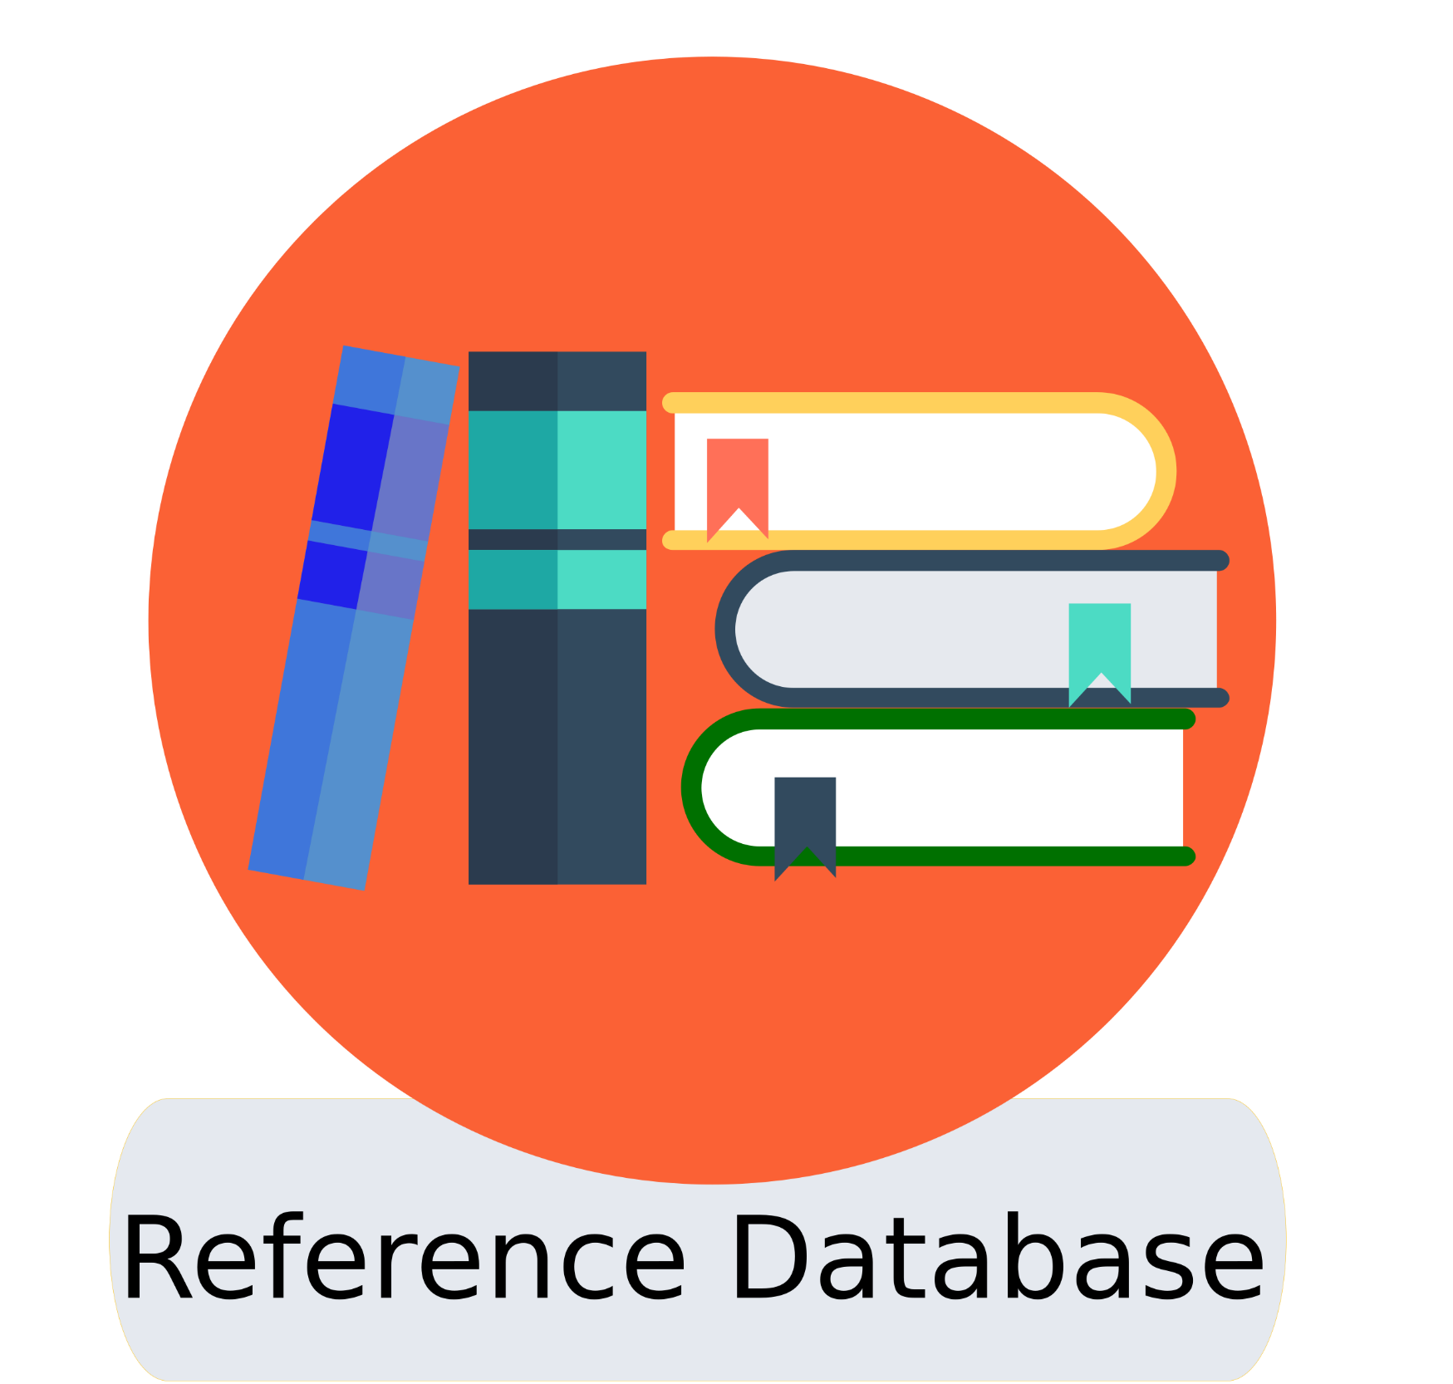
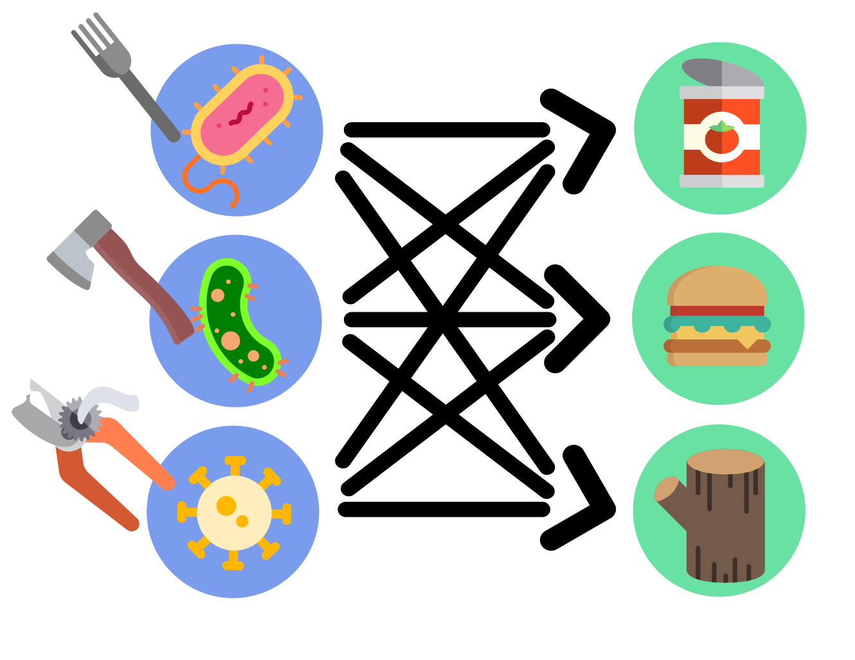

Slide 6
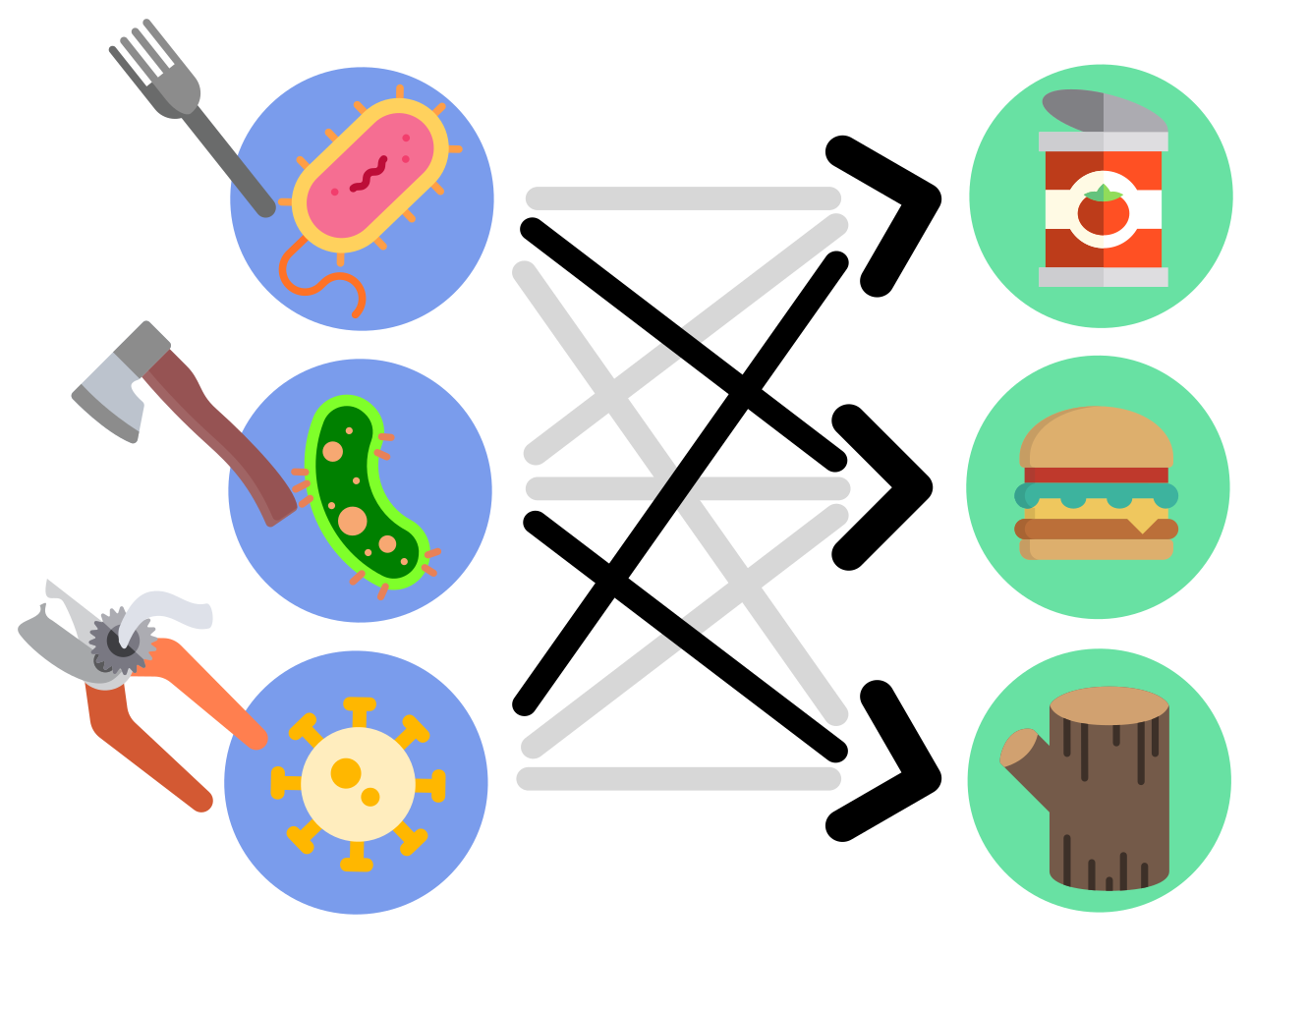

Slide 7

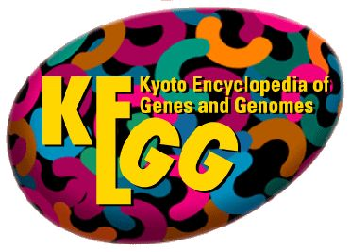

Databases are a goldmine of knowledge
Proteome
unique proteins
protein clusters
redundant proteins
Genome
gene orthologues
organisms
metabolic pathways
Reactome
reactions
enzymes
compounds

Slide 8
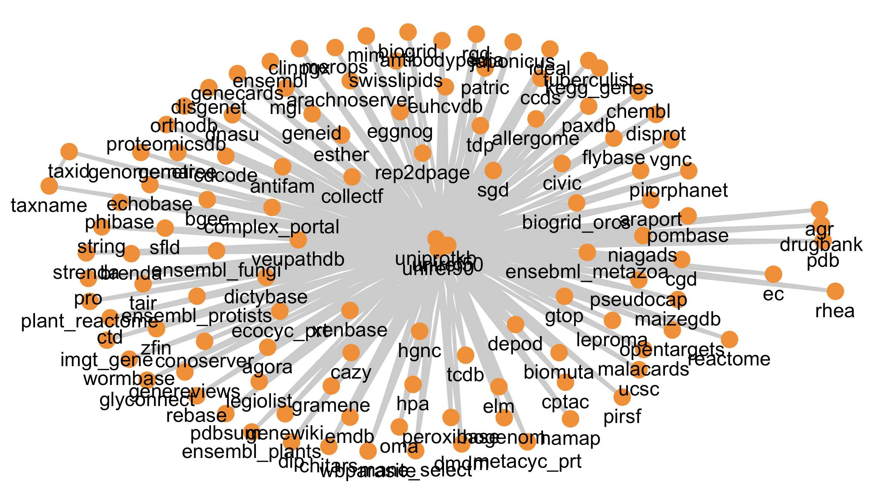
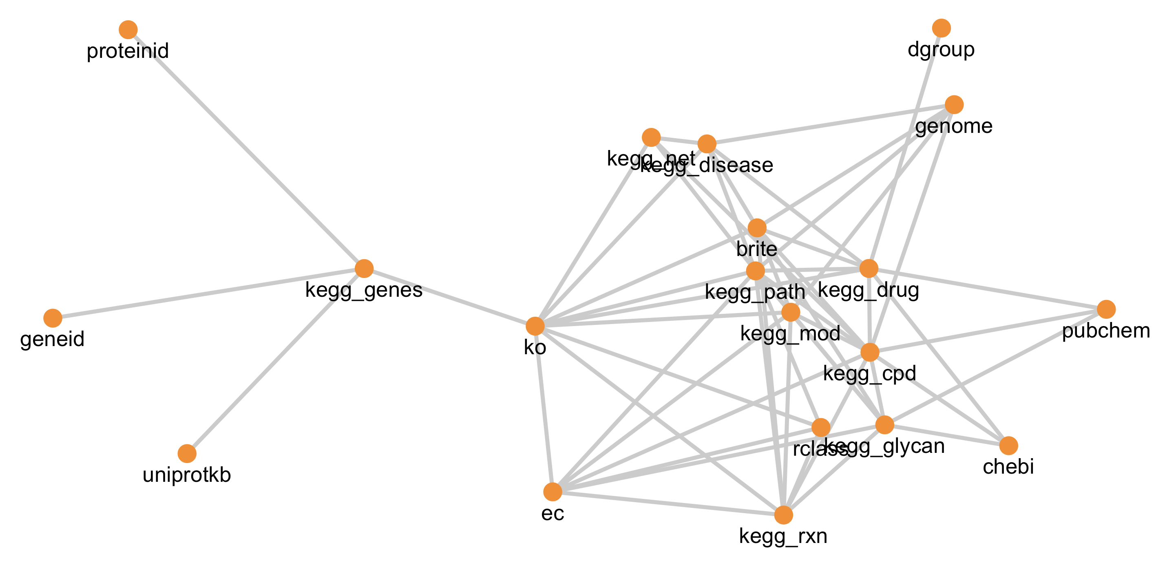
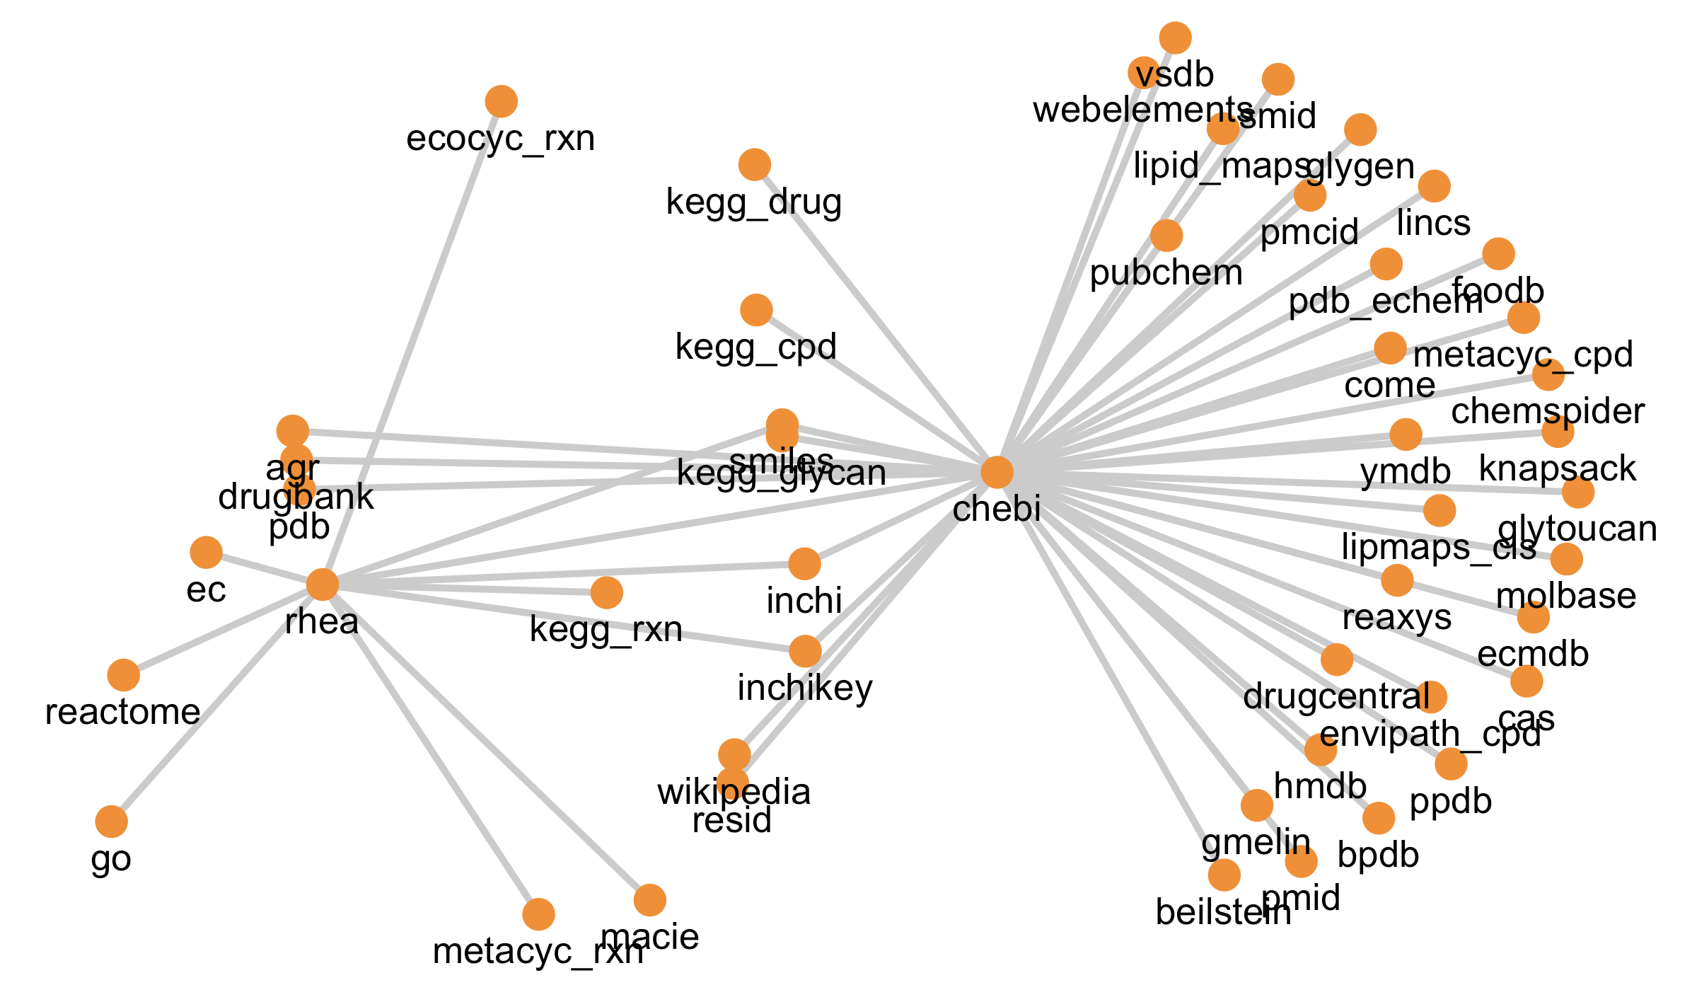
Databases are networks!

Slide 9
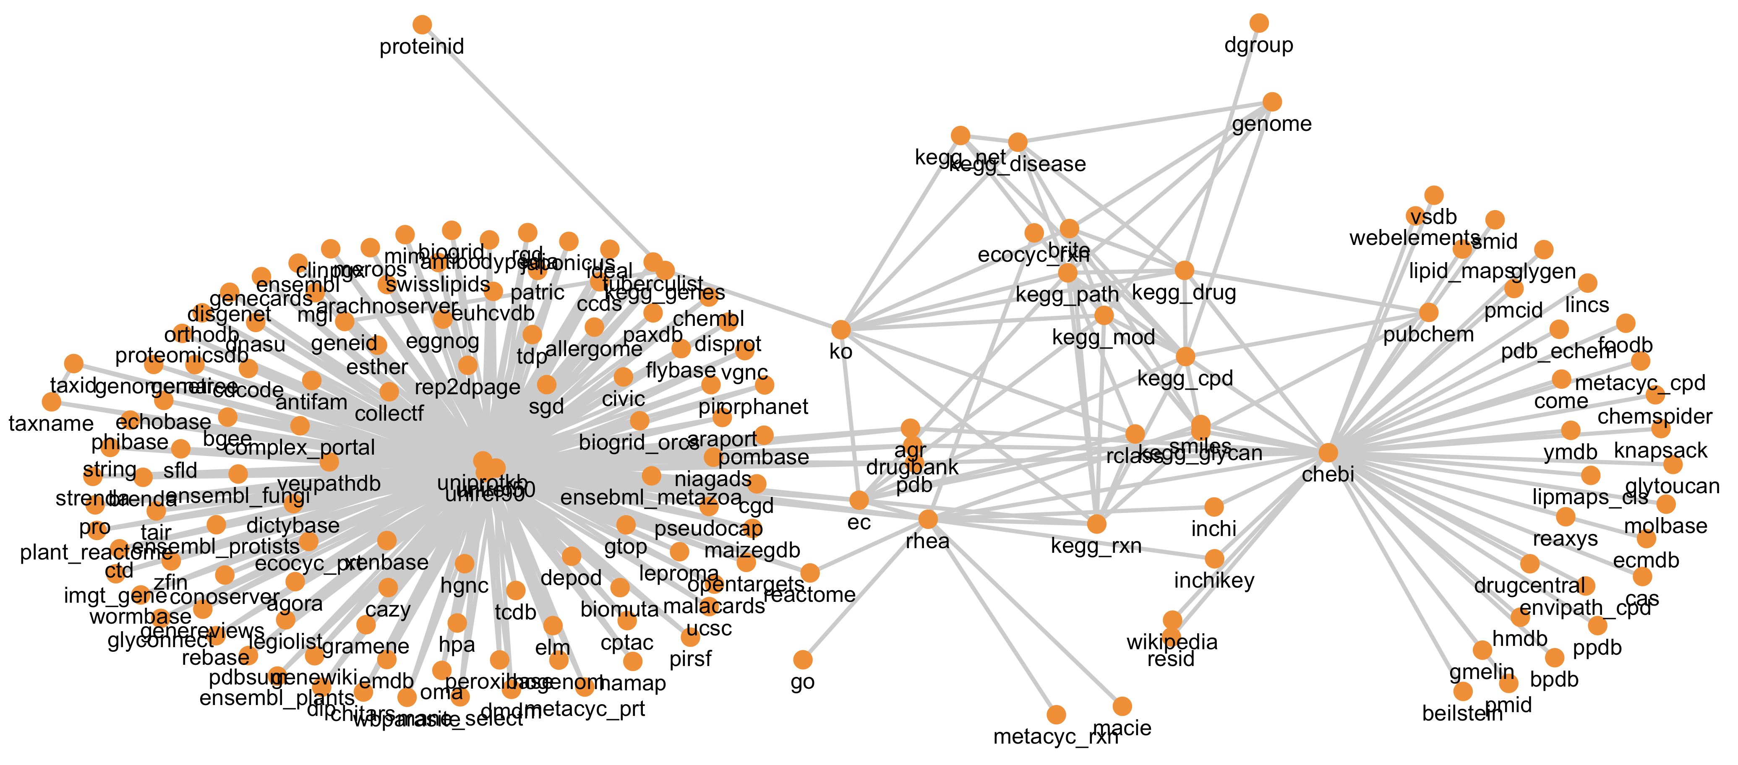
The sum of the parts is greater than the whole
+
+

Slide 10
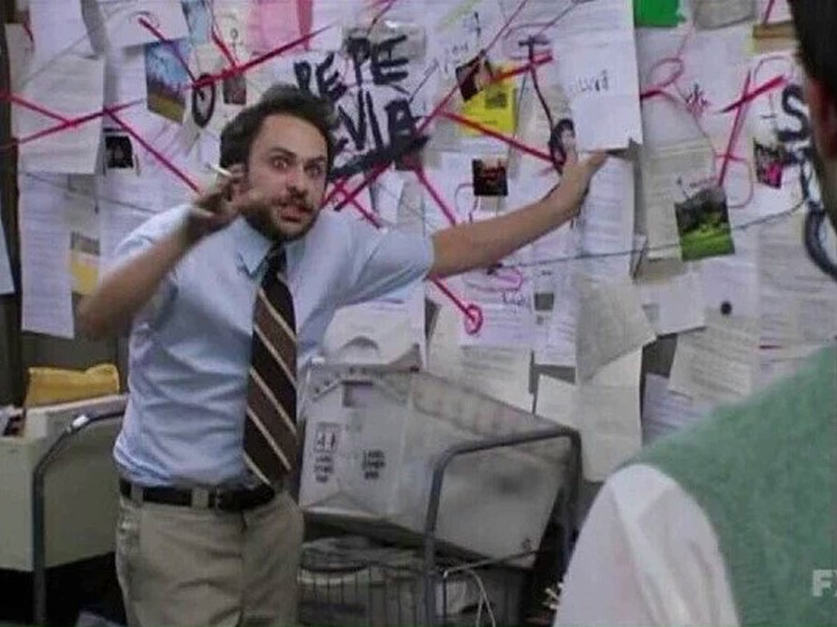
Knowledge integration is complicated

Slide 11
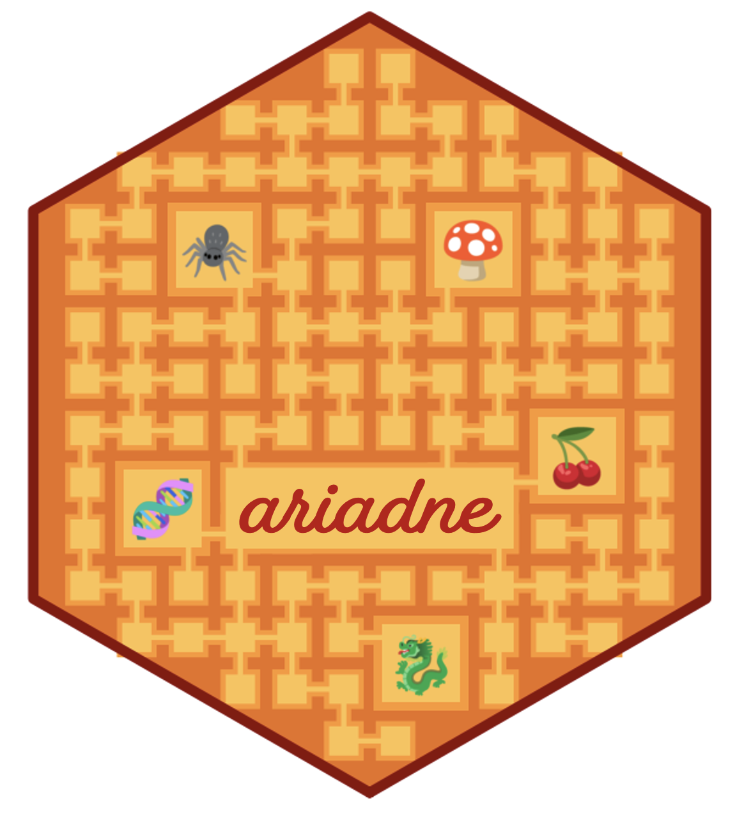
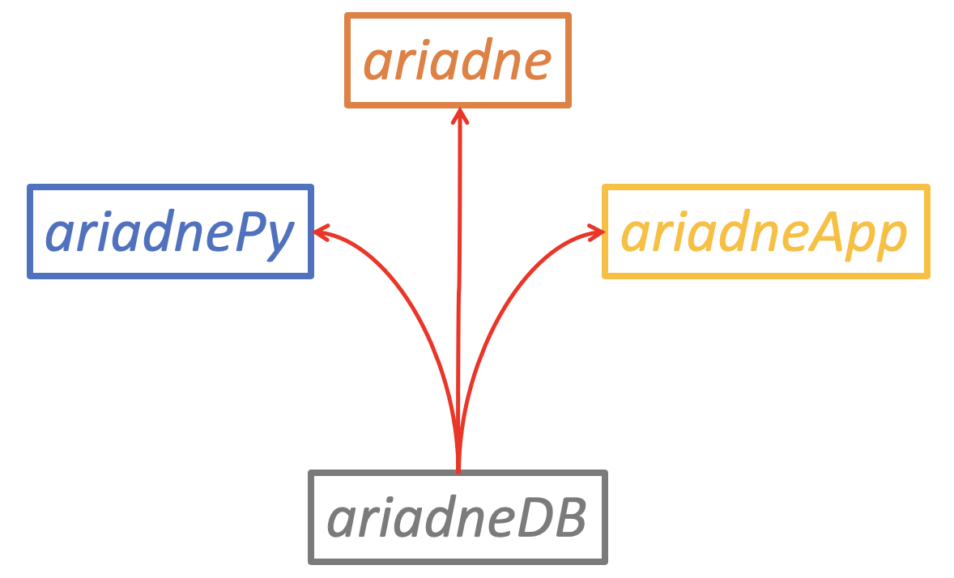
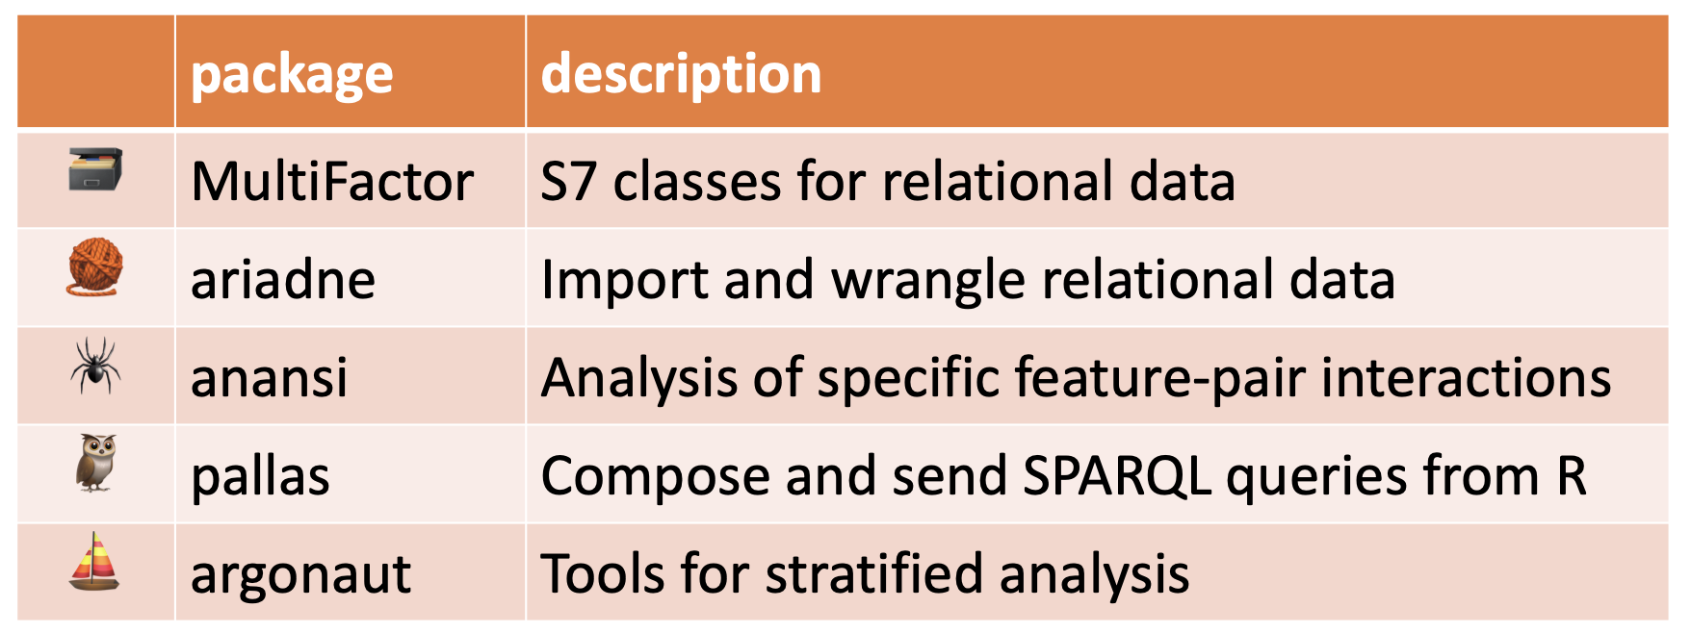
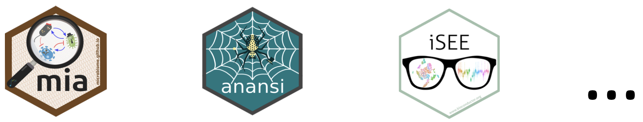
ariadne is here to help!
ariadne technical summary
Graph database built with igraph
Fast data retrieval with SPARQL
Efficient storage with arrow
High performance with data.table
Weaving paths with MultiFactor
ariadne components
MinotauR framework

Slide 12
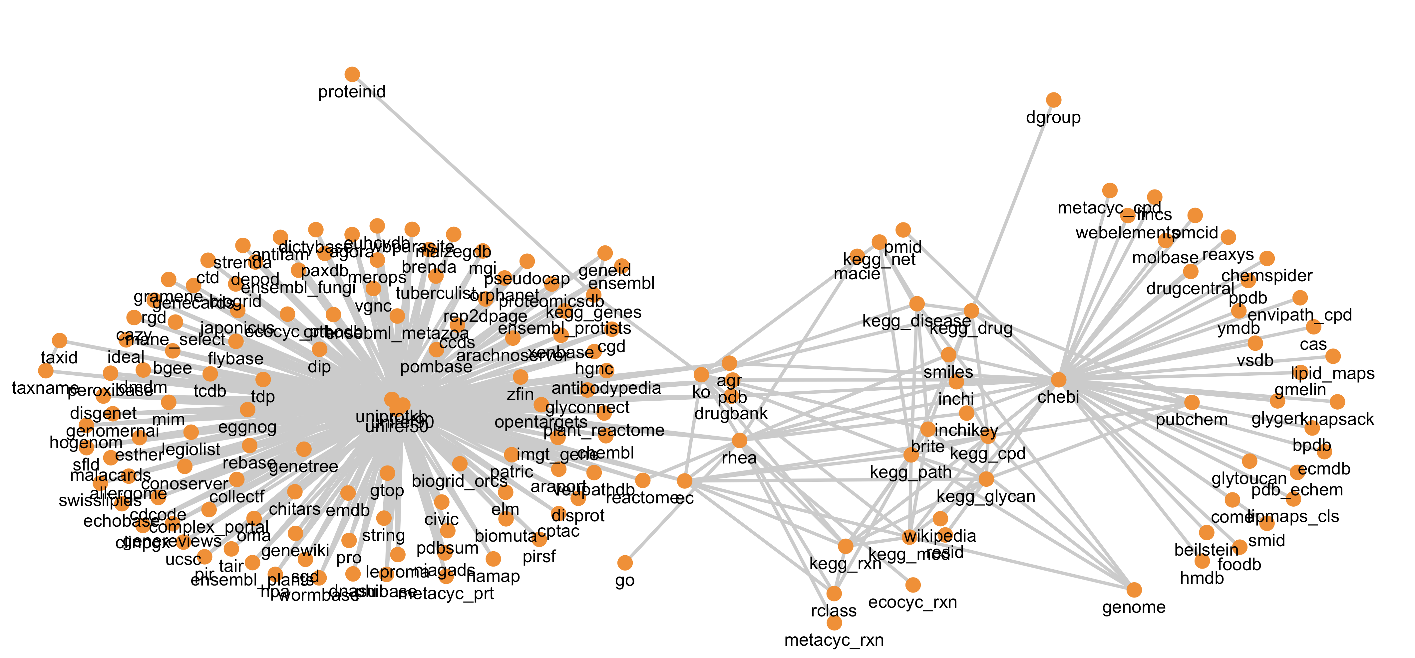
> graph <- ariadne()
> weavePath(graph, taxid ~ chebi)
START
END

Slide 13
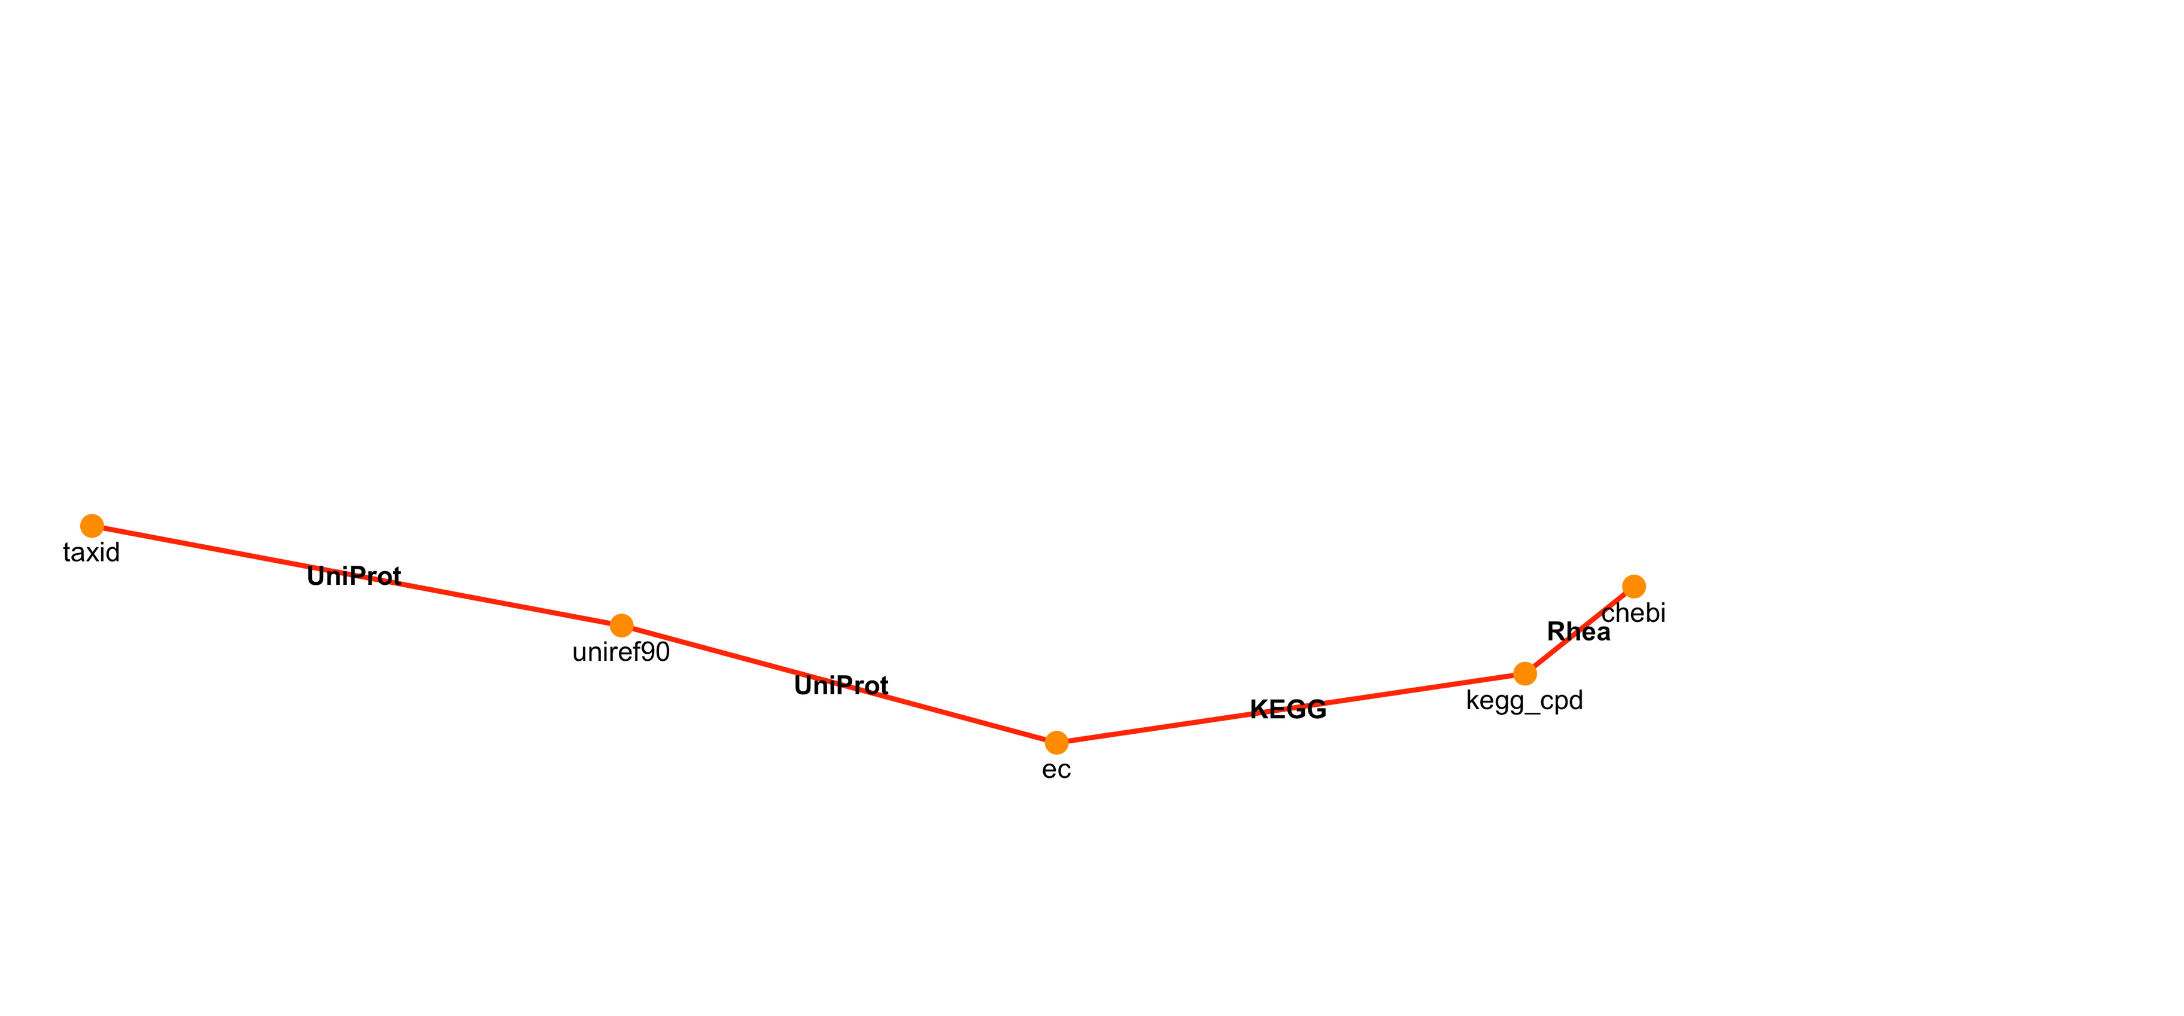
> graph <- ariadne()
> weavePath(graph, taxid ~ chebi)
taxid | chebi
A | X
A | Y
B | Y

Slide 14
Applications
Functional annotation
Knowledge-driven stratified analyses
Gene/Microbe-set enrichment analysis
Pathway enrichment analysis
And more…

Slide 15
Conclusions
General framework for biological knowledge integration
Takes care of all tedious tasks
Useful to:
> Annotate or stratify features
> Perform pathway or set enrichment analyses
Your favourite database is missing?
> Contribute to ariadne or open an issue

Slide 16


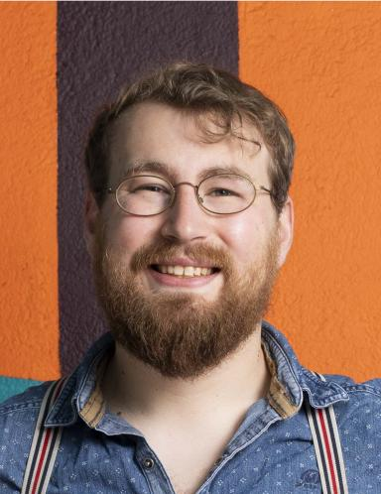
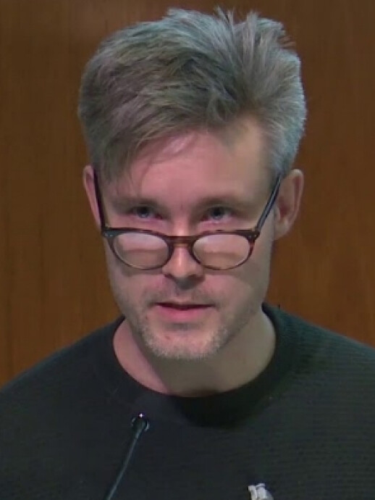
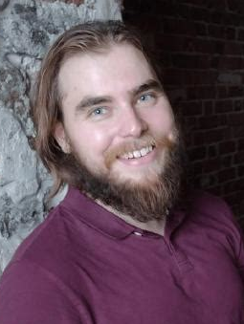
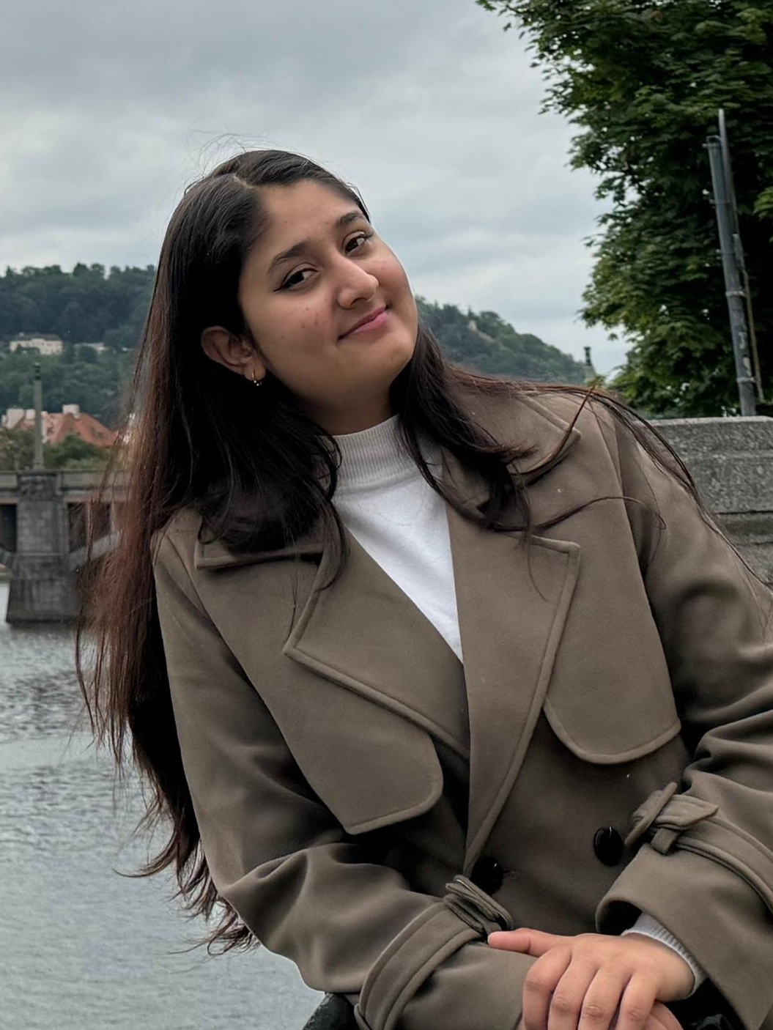
Acknowledgements
Thomaz F. S. Bastiaanssen
Leo Lahti
Tuomas Borman
Aditi Adhikari
And my colleagues at the Turku Data Science Group 🙏

Slide 17
