Slide 1
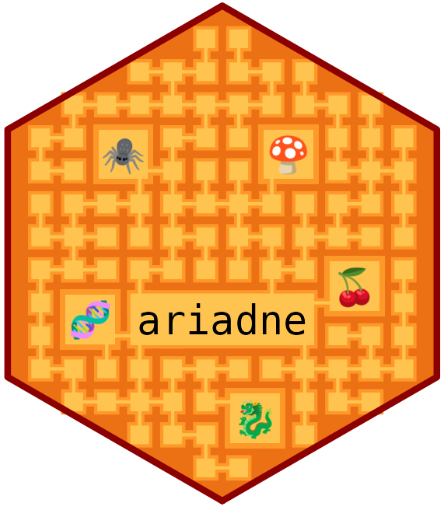




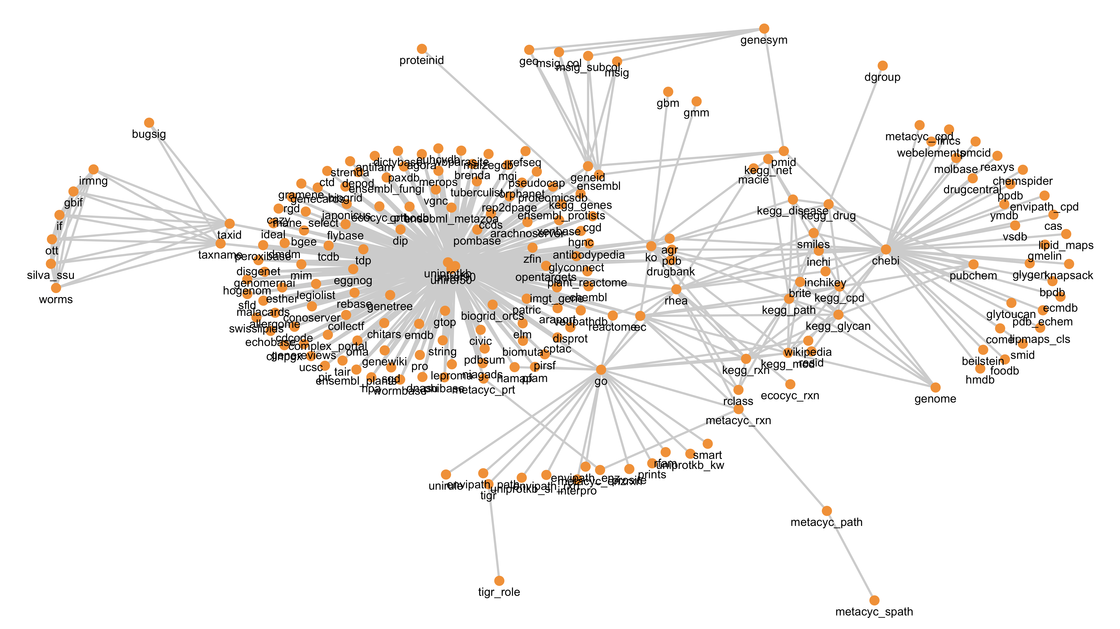
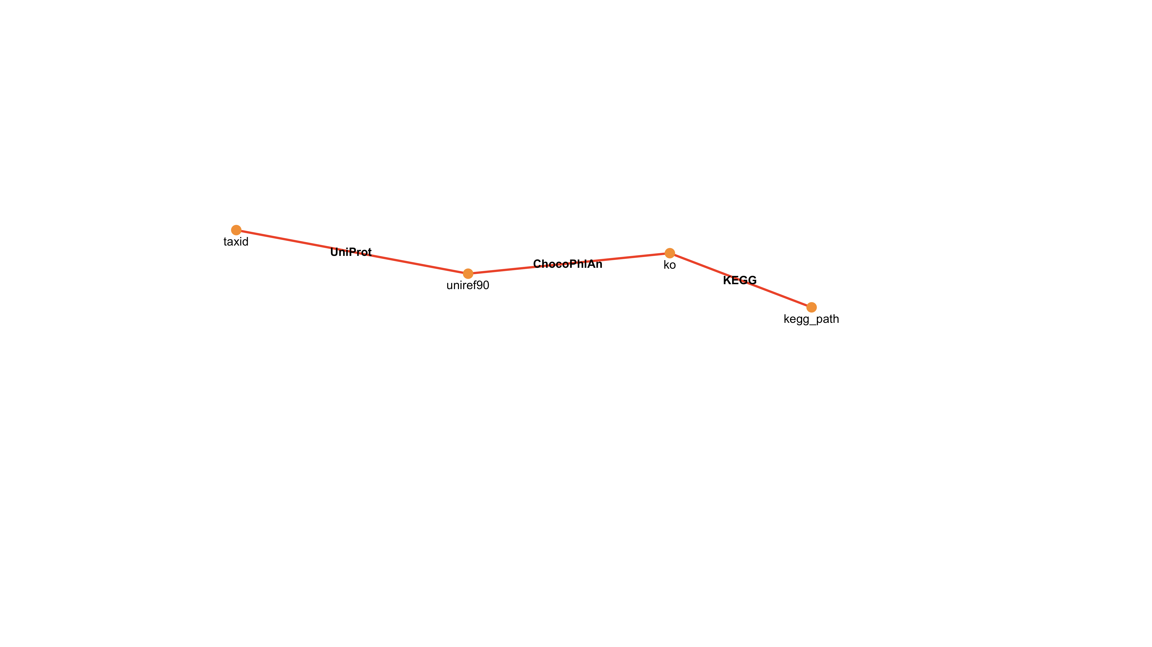
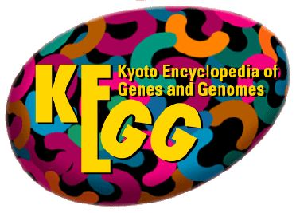

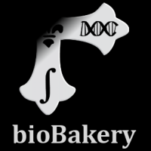
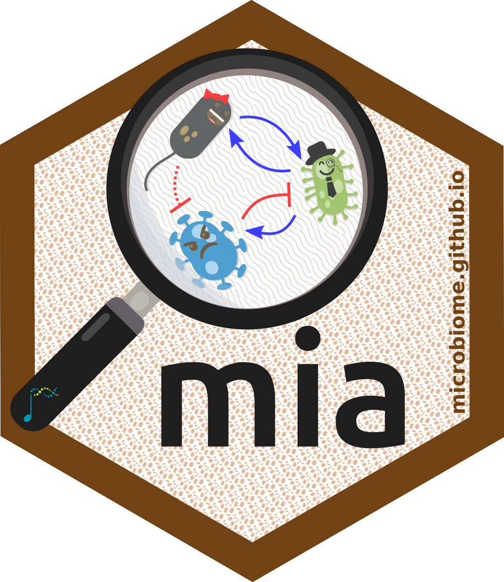
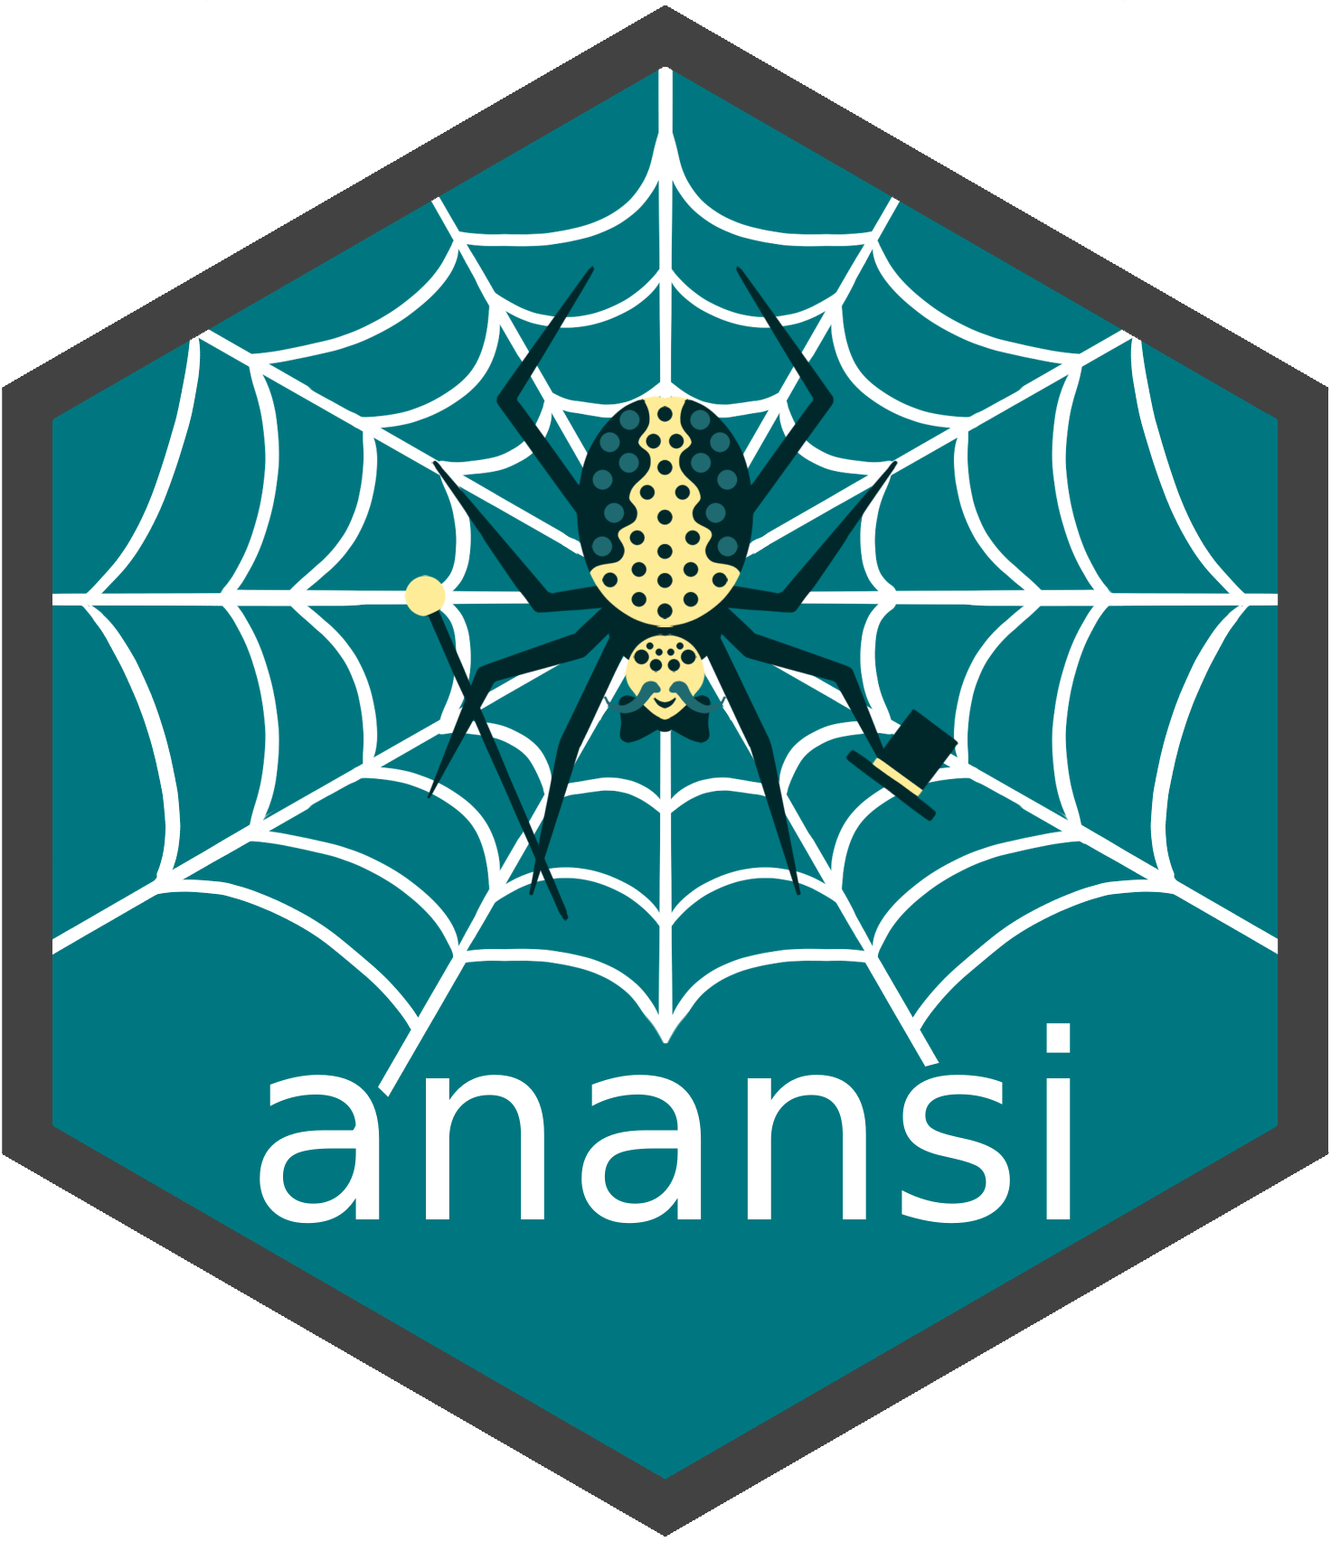
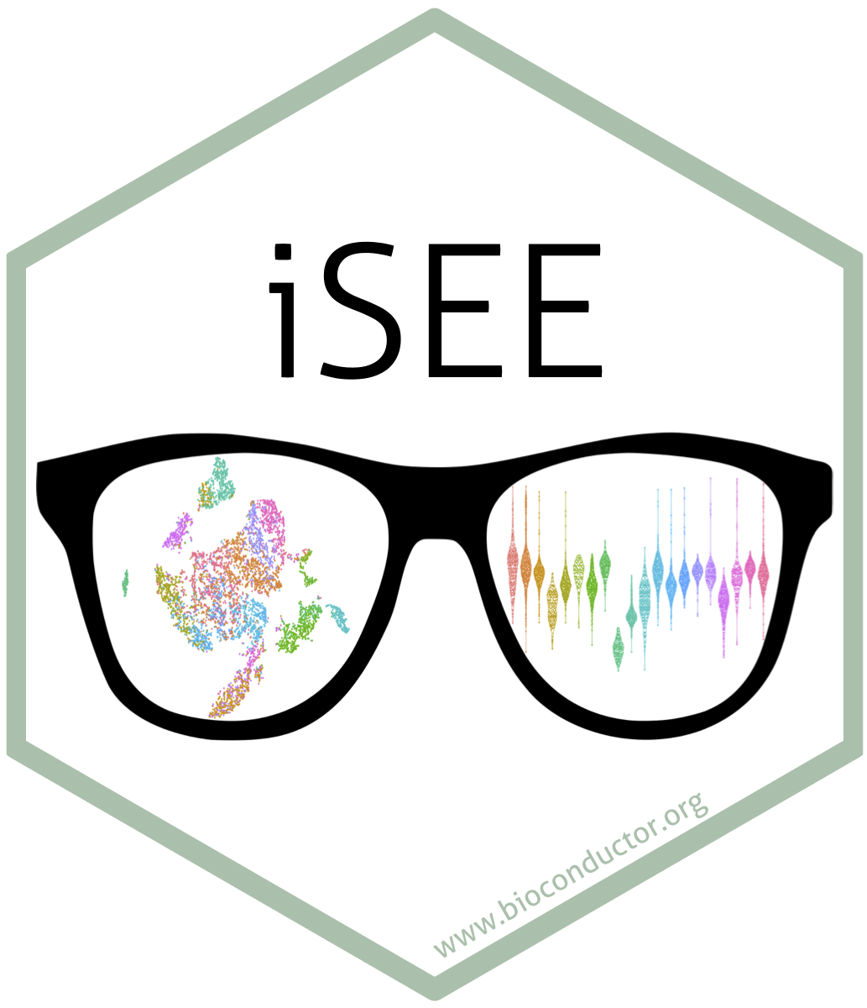
ariadne: enriching your ‘omics analyses with
prior knowledge from public databases
Giulio Benedetti*, Thomaz Bastiaanssen, Aditi Adhikari, Tuomas Borman, Leo Lahti
*giulio.benedetti@utu.fi
github.com/Minotau-R/ariadne
The problem
The framework
Sometimes biology seems like a huge labyrinth with no simple paths between its different items (genes, proteins, organisms, etc.). Even when the path to take is clear, many obstacles may hide on the way: sluggish server responses, massive file volumes, incompatible data formats, just to name a few. Crossing the labyrinth without a strategy is a seriously boring and discouraging task.
ariadne technical summary:
Graph database built with igraph
Fast data retrieval with SPARQL
Efficient storage with arrow
High performance with data.table
Weaving paths with MultiFactor
ariadne
ariadnePy
ariadneApp
The solution
ariadneDB
Luckily, ariadne is here to help. By “Assembling Relational Information Across the Database Network”, ariadne provides a harmonised graph of interlinked resources and a rich toolkit to navigate its uncharted paths. This expands the capabilities of the existing mia framework with public prior knowledge [1]. The harmonised knowledge graph is reproducible and openly available in ariadneDB [2].
 | package | description
🗃️ | MultiFactor | S7 classes for relational data
🧶 | ariadne | Import and wrangle relational data
🕷️ | anansi | Analysis of specific feature-pair interactions
🦉 | pallas | Compose and send SPARQL queries from R
⛵️ | argonaut | Tools for stratified analysis
Applications
There are as many use cases for ariadne as there are bioinformaticians. But its most natural applications include a) annotating or stratifying features based on prior knowledge and b) grounding pathway or X-set enrichment analyses.
1. Import knowledge graph
2. Explore paths between nodes
# Import ariadne database
graph <- ariadne()
# View knowledge graph
plotPath(graph)
# Search 5 shortest paths
searchPath(graph, taxid ~ kegg_path, k = 5)
# View 4th shortest path
plotPath(graph, taxid ~ kegg_path, k = 4)
3. Weave selected path
4. Integrate with your dataset
# Get simple links between taxa and KEGG pathways
tax2path <- weavePath(
graph, taxid ~ kegg_path, k = 4
)
# Get complex links between taxa and KEGG pathways
tax2path <- weaveComplex(
graph, taxid ~ kegg_path, k = 4
)
# Annotate dataset rows
se <- addModules(se, tax2path)
taxid | kegg_path
216816 | map05205
216816 | map05418
216816 | map00030
47715 | map00051
47715 | map00052
47715 | map00061
+
The output is a linkmap:
taxid | kegg_path
216816 | map05205
216816 | map05418
216816 | map00030
47715 | map00051
47715 | map00052
47715 | map00061
Analysis continues with:
Adapted from [3].
…
References:
1. Borman, T., Benedetti, G., Muluh, G., Raulo, A., Valderrama, B., Sannikov, A., ... & Lahti, L. (2025). Orchestrating Microbiome Analysis with Bioconductor. bioRxiv. 10.1101/2025.10.29.685036.
2. Benedetti, G., Bastiaanssen, T., & Lahti, L. (2026). ariadneDB [Data set]. Zenodo. 10.5281/zenodo.18788725.
3. Morgan M, Obenchain V, Hester J, Pagès H (2026). SummarizedExperiment: A container (S4 class) for matrix-like assays. Bioconductor. 10.18129/B9.bioc.SummarizedExperiment.

