Slide 1




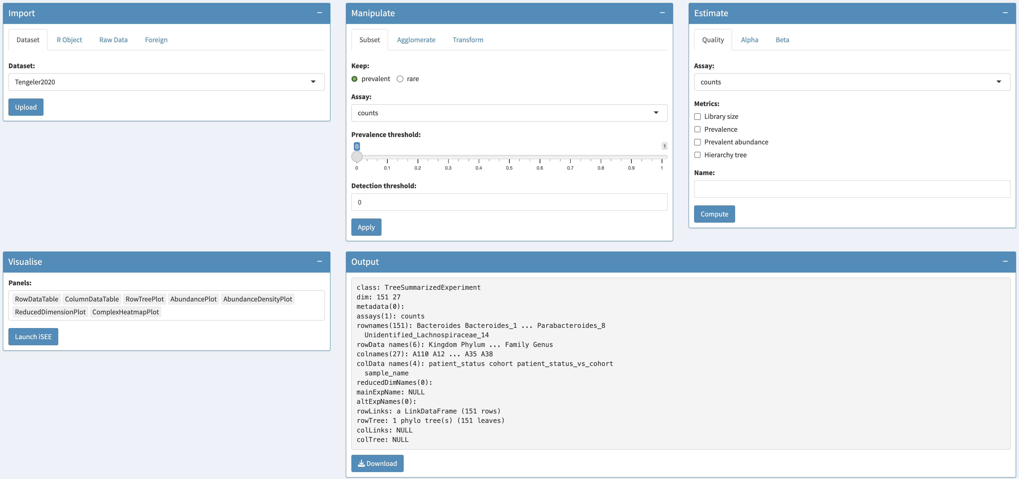


miaDash: a web app for reproducible and interactive microbiome analysis and visualisation
Giulio Benedetti,
email: giulio.benedetti@utu.fi
Co-authors: Ely Seraidarian, Theotime Pralas, Akewak Jeba, Tuomas Borman, Leo Lahti
+
The problem
The framework
Microbes are everywhere and are essential for keeping ecosystems in balance. As microbiome research advances, microbiome datasets continue to grow. The Bioconductor framework provides methods for microbiome data analysis, but they are not yet accessible to non-programmers. To lower the entry threshold, we developed miaDash, a web app to interactively analyse and visualise microbiome data. Our goal is to make microbiome data science accessible to anyone who needs it, with or without progamming skills.
miaDash emerges from the combination of three key packages: mia, iSEE and TreeSummarizedExperiment (TreeSE). mia provides the toolkit for microbiome analysis, iSEE creates the graphical user interface and the TreeSE data container stores all the elements of a microbiome dataset, including assays, side information on features and samples, hierarchy trees, alternative experiments and reduced dimensions [3]. This framework promotes data integration and reproducibility.
The solution
Standardised data
Analyse
iSEEtree
miaDash provides an intuitive graphical user interface reflecting the four common steps of microbiome data analysis: Import a dataset from several available sources; Manipulate data with routine operations; Estimate quality and diversity metrics; and Visualise multiple aspects of the dataset using iSEEtree [1, 2]. For each panel, users can transform data (Data params), control aesthetics (Visual params) and subset data (Selection params). Data, plots and R scripts can then be downloaded.
TreeSE object
Import
Visualise
The future
Adapted from [1].
In the upcoming versions of miaDash, we aim to enhance method coverage, accessibility and reproducibility by expanding the analytical toolkit, making panels more interactive and generating R scripts that completely replicate the analyses.
Acknowledgements
This project has received funding from the European Union’s Horizon 2020 research and innovation programme (grant 952914) and from Research Council of Finland (grant 330887).
References:
1. Benedetti, G., Seraidarian, E., Pralas, T., Jeba, A., Borman, T., & Lahti, L. (2025). iSEEtree: interactive explorer for hierarchical data. Bioinformatics Advances, 5(1), vbaf107.
2. Rue-Albrecht K, Marini F, Soneson C, Lun ATL (2018). “iSEE: Interactive SummarizedExperiment Explorer.” F1000Research, 7, 741.
3. Huang, R., Soneson, C., Ernst, F. G., Rue-Albrecht, K. C., Yu, G., Hicks, S. C., & Robinson, M. D. (2021). TreeSummarizedExperiment: a S4 class for data with hierarchical structure. F1000Research, 9, 1246.

