Slide 1

Task-oriented Grasp analysis: for a manipulator with adhesion
Internship: Technical specifications for in-hand and dexterous manipulation at the lab LASR of CEA Nano-Innov
Ricardo RICO URIBE

Slide 2


FLOW & Elements
From a .stl file we can create a STL object, we can use a method to declare the contact points in the surface according to their coordinates. With several contact points we can create a Grasp object and use the alpha quality metric to later obtain the force such grasp configuration needs.

Slide 3
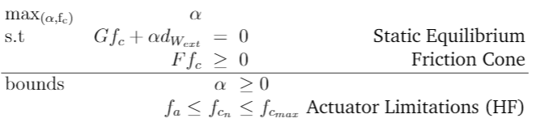
Alpha quality metric
By maximizing alpha we obtain the maximum force the grasp can resist in a specific direction.

Slide 4
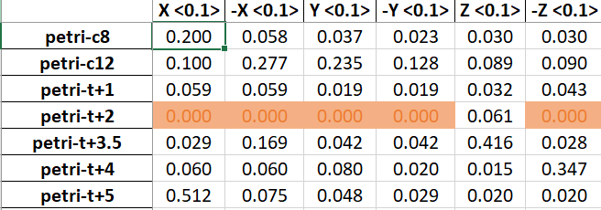
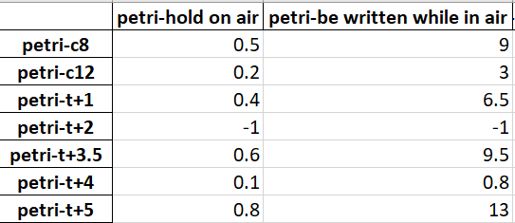
Force RESULTS
With a full description of the perturbation we can determine the force required for each grasp with the metric
α
Alpha gives us the maximal force in a specific direction with a maximal allowed force
We these results we can determine the torque for the motors so that the force at the contact points is at least the value found, for instance:
For the grasp c-12 to resist the task of being written we need to apply at the contact points at least 3 N

