Slide 1
3D Model
FOR each Object
STL object
Use the physical information of the object
For each Grasp of the Object
Contact objects
For each Perturbation of the Object
Use the desired contact point configuration
Grasp object
Force required to perform the task
Force Information
Search for specific perturbation
α
Quality
Metric

Slide 2
grasps
Excel data generation
Data Types
Quality Metrics
alpha
forces
Joint
Math Functions
Finger
Functions
Excel File
Class Grasp
Config Files
Contact
Class STL
Class Jacobian
Object Description
Update
raw perturbations

Slide 3
Joint
Jacobian
joint_id : int
joint_origin : [3,]
joint_z : [3,]
joint_contact_id : int
joint_revolute : bool
fingers : [#,](Finger)
C : [#,3]
R : [#,3,3]
h: [#,](string)
nq : int
Joint(jointID : int , frameOrigin : [3,] , unitVectorZ : [3,] , affectedContactIndex : id , revolute : bool = True)
Jacobian(fingers : [#,](Finger) , C : [#,3] , R : [#,3,3] , h : [#,](string) = None)
S(r : [3,]) : [3,3]
Hi(h : string) : [#,6]
H() : [#,#]
Zi(Ci : [3,] , cid : int) : [6,nq]
pJi(Ri : [3,3] , Zi : [6,nq]) : [6,nq]
getJ() : [#,nq]
JacobianClassification(printBool : bool = False) : bool , bool
getRank() : int
printHandSpecifications()
testForceClosure(grasp : GraspMap) : [#,]
Finger
finger_id : int
finger_joints : [#,](Joint)
Joint(fingerID : int , joints : [#,](Joint))
GraspMap
STL
p : [3,]
C : [#,3]
R : [#,3,3]
h: [#,](string)
mesh : numpy-stl.mesh.Mesh
cog : [3,]
triangles : [#,3,3]
edges : [#,2,3]
vertices : [#,3]
GraspMap(p : [3,] , C : [#,3] , R : [#,3,3] , h : [#,](string) = None)
S(r : [3,]) : [3,3]
Pi(ci : [3,]) : [6,6]
pGi_t(Ri : [3,3] , Pi : [6,6]) : [6,6]
Hi(h : string) : [#,6]
H() : [#,#]
getGt() : [#,6]
GraspClassification(printBool : bool = False) : bool , bool
getRank() : int
calcFFormClosure(ng : int = 8 , mu : double = 0.3) : double , [#,]
STL(path : string)
genRandCR(nc : int) : [3,] , [3,3] , [3,] , [3,3] , [3,] , [3,3]
getCRofCoord(coord : [3,] , location : string = “T”) : [3,] , [3,3]
view()
view(C : np.array [#,3],R : np.array[#,3,3])

Slide 4
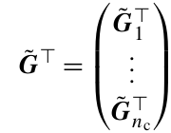
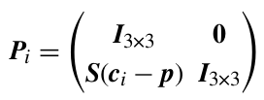


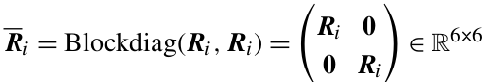
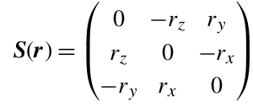


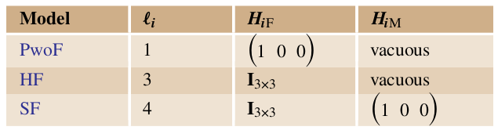
h

