Slide 1
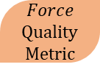
For a Specific Object
Center of Mass
3D Model
For an Specific Grasp
Contact Location according to Human taxonomy
STL object
For a Specific Task
Contact objects
External Perturbations
Grasp object
α
Quality
Metric
$$Force$$
Quality
Metric
Search for specific perturbation
Force required to perform the task

Slide 2
grasps
Excel data generation
Math Functions
Quality Metrics
Data Types
alpha
forces
Joint
Excel File
Class Grasp
Config Files
Finger
Class STL
Object Description
Update
Class Jacobian
Contact
raw perturbations
Functions

Slide 3
Joint
Jacobian
joint_id : int
joint_origin : [3,]
joint_z : [3,]
joint_contact_id : int
joint_revolute : bool
fingers : [#,](Finger)
C : [#,3]
R : [#,3,3]
h: [#,](string)
nq : int
Joint(jointID : int , frameOrigin : [3,] , unitVectorZ : [3,] , affectedContactIndex : id , revolute : bool = True)
Jacobian(fingers : [#,](Finger) , C : [#,3] , R : [#,3,3] , h : [#,](string) = None)
S(r : [3,]) : [3,3]
Hi(h : string) : [#,6]
H() : [#,#]
Zi(Ci : [3,] , cid : int) : [6,nq]
pJi(Ri : [3,3] , Zi : [6,nq]) : [6,nq]
getJ() : [#,nq]
JacobianClassification(printBool : bool = False) : bool , bool
getRank() : int
printHandSpecifications()
testForceClosure(grasp : GraspMap) : [#,]
Finger
finger_id : int
finger_joints : [#,](Joint)
Joint(fingerID : int , joints : [#,](Joint))
GraspMap
STL
p : [3,]
C : [#,3]
R : [#,3,3]
h: [#,](string)
mesh : numpy-stl.mesh.Mesh
cog : [3,]
triangles : [#,3,3]
edges : [#,2,3]
vertices : [#,3]
GraspMap(p : [3,] , C : [#,3] , R : [#,3,3] , h : [#,](string) = None)
S(r : [3,]) : [3,3]
Pi(ci : [3,]) : [6,6]
pGi_t(Ri : [3,3] , Pi : [6,6]) : [6,6]
Hi(h : string) : [#,6]
H() : [#,#]
getGt() : [#,6]
GraspClassification(printBool : bool = False) : bool , bool
getRank() : int
calcFFormClosure(ng : int = 8 , mu : double = 0.3) : double , [#,]
STL(path : string)
genRandCR(nc : int) : [3,] , [3,3] , [3,] , [3,3] , [3,] , [3,3]
getCRofCoord(coord : [3,] , location : string = “T”) : [3,] , [3,3]
view()
view(C : np.array [#,3],R : np.array[#,3,3])

Slide 4
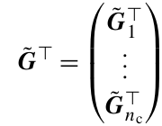
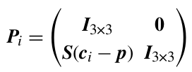


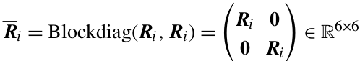
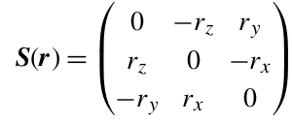


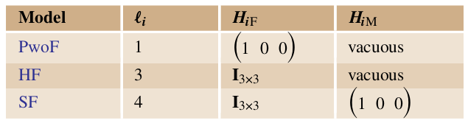
h

