Slide 1
Advancements 13/04 – 19/04
Week 1
Internship: Technical specifications for in-hand and dexterous manipulation at the lab LASR of CEA Nano-Innov
Ricardo RICO URIBE

Slide 2
Accomplished Tasks
Take a security course (E-learning)
Acquire Knowledge about the project and its context
Code the viewing of STL objects in Python
Code the calculation of the Grasp Matrix in Python

Slide 3
Project and Context information
Read the Cordis Site
Unable to access CEA specific information

Slide 4
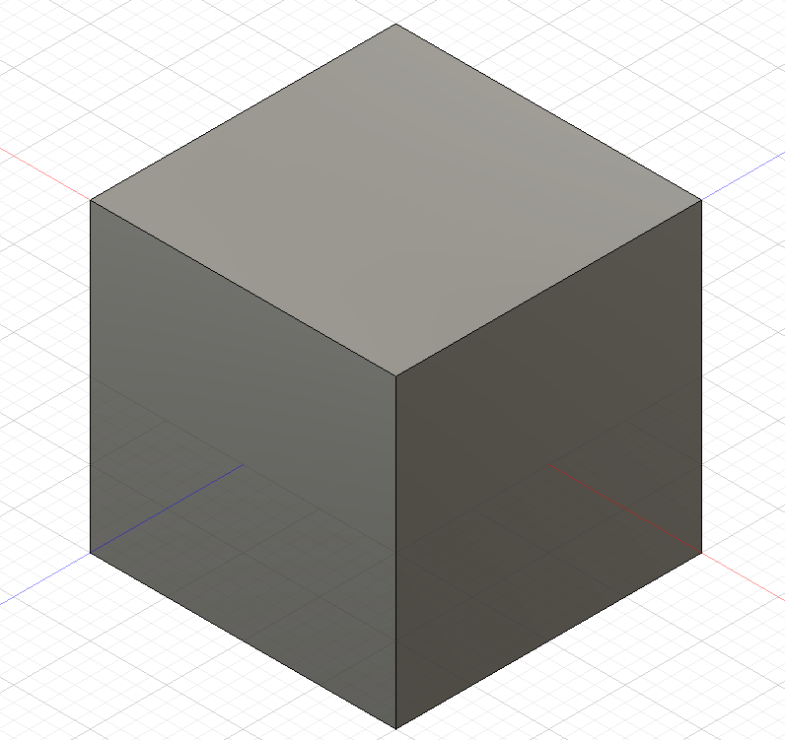
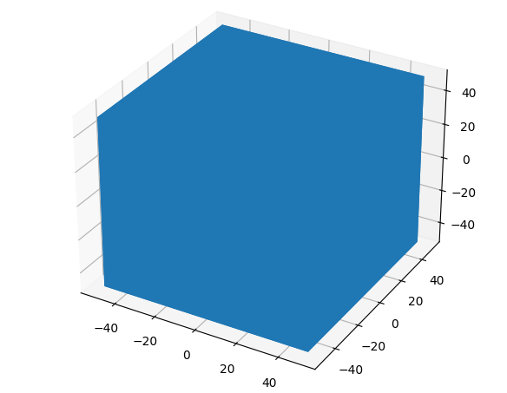
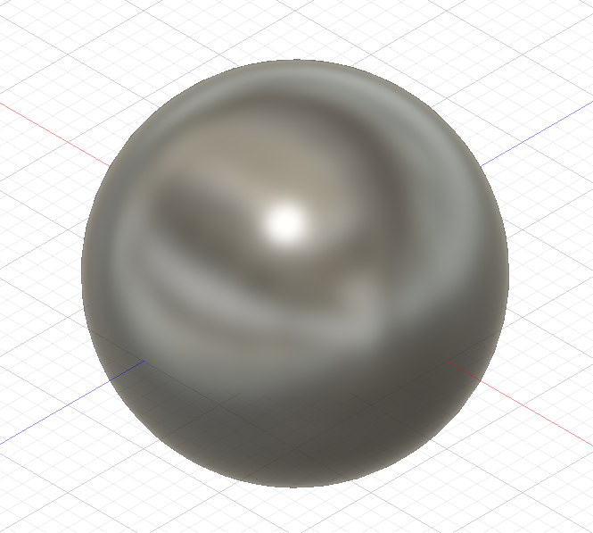
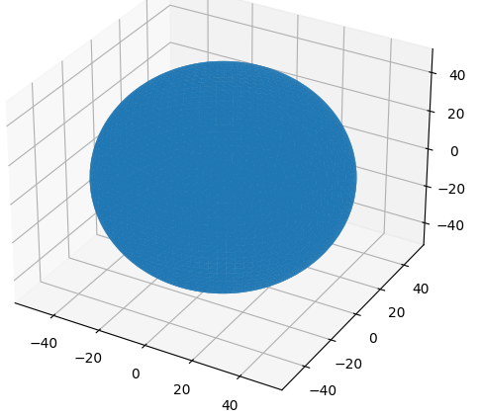

STL objects in Python
Library numpy-stl
Creation of a cube and a sphere
Python display via matplot-lib and basic information regarding the object provided by the library

Slide 5
Grasp Matrix
Inputs:
Arrays: all from {N}
R (rotation of each contact frame {Ci})
C (position of each contact point ci)
Position of {B} (p)

Slide 6
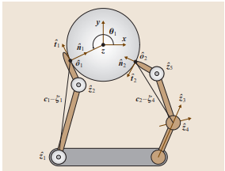
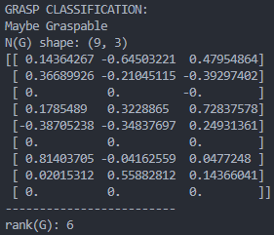
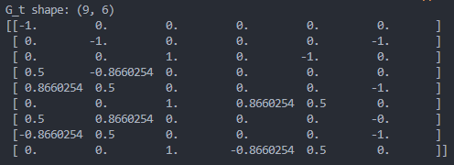
Grasp Matrix
Code based on the Example1 of Chapter 28 (Grasping) Springer Handbook of Robotics
An analysis of results is necessary, the example doesn’t provide a good comparison.
R and C are defined as the example, 3 contact points at theta = 0, 120° and 240°

Slide 7

Questions
From the stl we want to choose random points and calculate the grasp?
How to define the 3d rotation of the contact point?
Do you have solved problems to test the code?
How to test for Force Closure without a hand (Jacobian)?
Explanation of Friction Models (Cones)
How does force closure gives hand specification?

