Slide 1
Advancements 20/04 – 26/04
Week 2
Internship: Technical specifications for in-hand and dexterous manipulation at the lab LASR of CEA Nano-Innov
Ricardo RICO URIBE

Slide 2
Accomplished Tasks
Transformation of previously created Code into Classes
Creation of a Jacobian Calculating Class
Creation of a point of contact creation class with wireframe view
Test of Jacobian and Grasp Classes

Slide 3
Classes
StlView: provides the 3D view of a .stl file
StlRandom: provides with random C and R from a .stl file
GraspMap: returns the Gt matrix from a given contact with grasp classification
Jacobian: returns the J matrix from a given hand architecture and contact with grasp classification
Joint: Data structure to create a hand architecture

Slide 4
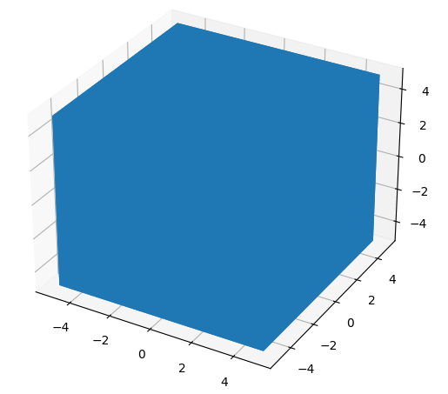
Stl view
Input:
.stl path
Methods:
View
MassProperties

Slide 5
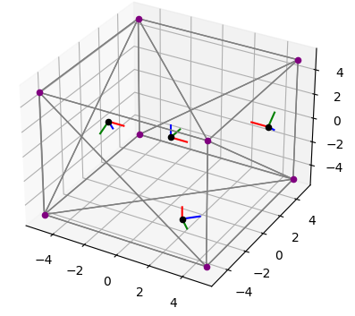
Stl Random
Input:
.stl path
nc (points of contact)
Methods:
ViewWire
getCR

Slide 6
GraspMap
Input:
P (origin of frame of the object)
C (location of points of contact)
R (Rotation of frames of contact)
h (type of contact)
Output:
Gt
Classification of Grasp

Slide 7
jacobian
Input:
joints (declared as type Joint)
C (location of points of contact)
R (Rotation of frames of contact)
h (type of contact)
Output:
J
Classification of Grasp
Joint:
Id
Origin
Z direction
Contact Index
Type

Slide 8

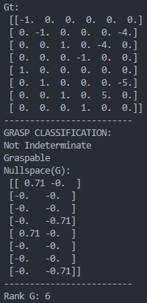
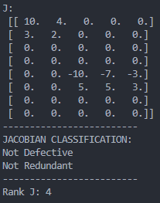
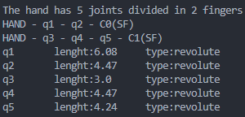
Test
y
y
x
x
y
(-3,10)
p (2,10)
x
(6,10)
(-6,7)
(8,6)
(-8,3)
y
x
(-8,0)
(0,0)
(9,0)

