Slide 1
Advancements 28/04 - 04/05
Week 3
Internship: Technical specifications for in-hand and dexterous manipulation at the lab LASR of CEA Nano-Innov
Ricardo RICO URIBE

Slide 2
Notation
G: Grasp Matrix: Mathematical description of how a rigid body is grasped by a mechanical hand.
J: Grasp Jacobian: Description of a hand where each finger has it own jacobian relating its joints to the contact point
{N}: origin of coordinates of the world.
C: array of contact points, where each contact point is a 3d vector giving the localisation of the contact (expressed at {N}).
R: array of contact rotations, each rotation represent the rotation made to the origin to get the correct frame at the contact, the frame of rotation has to have the normal vector pointing towards the inside of the object. *the normal vector is taken as x*
H: array of contact definitions, each contact definition describes the forces that the hand can imprint on the object through the specific contact point.
PwoF: point contact without friction, is a contact where only a force in the same direction as the normal vector can be applied. (li = 1)
HF: Hard Finger. Is a contact where the three translational forces can be imprinted on the object. (li = 3)
SF: Soft Finger, like HF but it can also produce a rotation along the normal axis. (li = 4)
L: Total number of force components being passed, it’s the sum of li of each contact.
File .stl: File format for objects in 3d space, it saves the information of the object surface as being a combination of triangles.

Slide 3
Notation
nc: amount of contacts.
nv: degrees of freedom of the object.
nq: number of joints of the hand.
ng: number of faces for the friction cone

Slide 4
Goals:
Class STL allows for a random choosing of an edge or vertex of a triangle of the mesh. This allows for objects to be grasped at corners or edges
Class STL allows for the search of a desired coordinate and returns the corresponding Contact and Rotation information.
Class GraspMap can calculate the linear problem of Frictional Form Closure.
Cone facetization is calculed with the option of choosing the amount of faces.

Slide 5
Class: STL
This class uses the library numpy-stl to access the triangles or mesh of a stl file.
With the triangles we can calculate a contact point in the object and the correct rotation of the frame associated with this contact.
The class allows for the visualization of the 3d object surface or a wireframe view with the information regarding contact points, the latter is very resource intensive and is recommended to be use only with low triangle count files.

Slide 6
Class: STL
Constructor:
Path to the .stl file (object = STL(path))
Attributes:
volume
cog (geometric center of triangles)
inertia
triangles (describes the surface)
edges (sides of the triangles without repetition)
vertices (vertices of the triangles without repetition)

Slide 7
Class: STL
Methods:
view():
Plots the surface of the object
genRandCR(nc):
Generates nc random contact points with their respectively rotation, located at the center of nc triangles, at the center of nc edges or at nc vertices.
Returns Ct, Rt, Ce, Re, Cv, Rv (t:triangles,e:edges,v:vertices)
To combine the C matrices between them (R resp.) a concatenation of rows needs to be made, take into account that this will modify the total number of nc.
getCRofCoord(coordinate,location):
When passed a coordinate (works for 1 point, not an array of points) it calculates the closest point to the surface according to the location parameter and generates the C and R of the found point.
Location is T for the center of the closest triangle, E for the center of the closest edge or V for the closest vertex.
viewCR(C,R):
In a wireframe view shows the object and the passed contact points with their assigned frame.

Slide 8
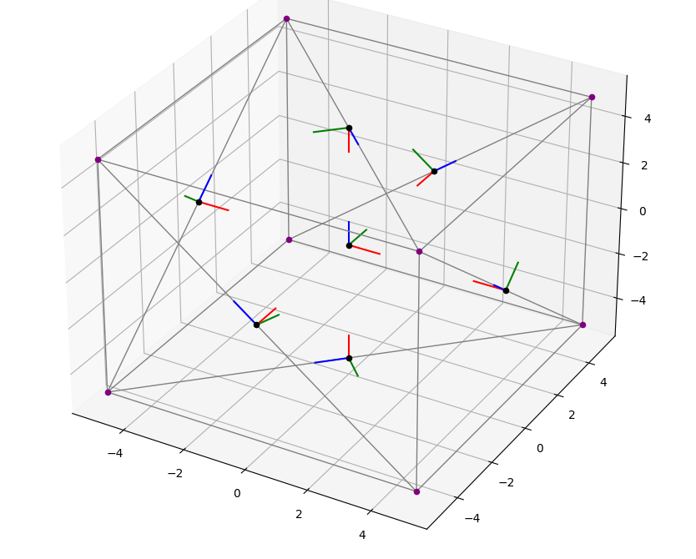
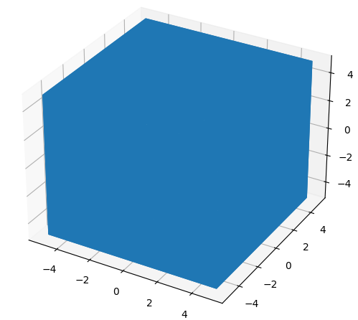
Class: STL
Case: The cube has a side of 10, its centered at 0,0,0 and its surface is described by 12 triangles
C,R = mesh.getCRofCoord(np.array([0,0,-5]),'E') this gets the information of a contact point in the center of a face, E was specified because we know that there is an edge running through each face.
Ct,Rt,Ce,Re,Cv,Rv = mesh.genRandCR(3) this generates 3 random contact points, in the center of 3 of the 12 triangles, in the middle of 3 of the 18 edges or in 3 of the 8 vertices.
viewCR() of the cube with a contact point in each face and {N}
view() of the cube

Slide 9
Internal workings of the Class STL
The construction of a new object of the class can take minutes if the surface is populated by many triangles because in the declaration the program separates the edges and vertices and deletes the repeated ones.
When generating random C and R a element is chosen randomly from their respective list, the method choses a different element from the list to avoid choosing the same element, this is why the lists are originally created to have unique elements.
Triangle: a triangle from the list is chosen, we locate its barycenter. The normal is the cross product of two vectors from the center to 2 vertices (the vertices of the triangle are arranged anticlockwise by convention of the file format) so by choosing correctly the 2 vertices we guarantee that the normal will go towards the interior, the Tangential vector is just one of the two vectors.
Vertex: A vertex from the list is chosen, then the triangles are checked to find the triangles contacting this vertex, from them their normal is averaged to define the normal of the vertex. The tangential vector is the cross product of the normal and the tangential vector of the first triangle, the remaining vector is the cross product of the normal and the tangential.
Edge: An edge from the list is chosen, then the triangles are checked to find the triangles contacting it (it’s always 2) the contact point is the middle of the edge, the normal is the average of the triangle normals and the tangential vector is the vector that goes from the middle to an extrema of the edge

Slide 10
Class: GraspMap
Calculates the grasp matrix of an object being grasped at different contact points.
Constructor: (grasp = GraspMap(p,C,R,h))
p: center of the object normally is cog
C: array of contact points
R: array of rotation matrix of each contact point
h: Contact model of each contact point (P for PwoF, H for HF and S for SF)
Attributes:
p
C
R
h
Methods:
getGt(): returns the transposed of G
GraspClassification(print): Prints in console if the grasp is indeterminate and graspable and if the print argument is true, if is False, it returns a boolean indicating if is indeterminate and graspable respectively
getRank: returns the rank of G
calcFFormClosure(ng,mu) this method only works for all HF contacts
ng is the number of faces the friction cone will be approximated
mu is the friction coefficient of the contacts
Returns d, lambda if the linear problem has a solution or -1, -1 if it doesn’t

Slide 11
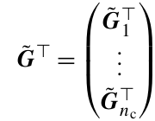
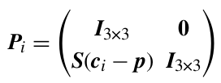


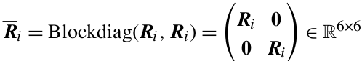
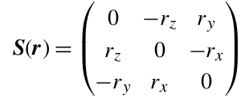


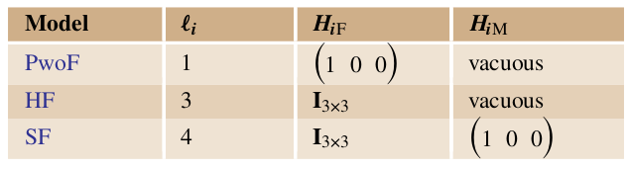
Internal workings of GraspMap: getGt()
C is composed of ci, R is composed of Ri
h

Slide 12
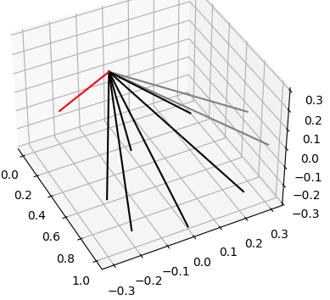

Cone Facetization
Cone facetized in 8 faces
In red the normal vector to the vectors in gray, showing that we are looking for lambdas inside the friction Cone

Slide 13

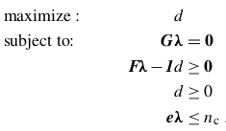
Internal workings of GraspMap: calcFFormClosure()
Before any can be done we have to make sure that the rank of G is 6 and that the object is graspable
For an HF contact, row j of Fi can be computed as the cross product of sj and si+j, Fi has a shape of ng x 3
We are searching for d and Lambda, d is a distance that if zero there isn’t friction form closure, and lambda represents the forces being applied at each contact.
We are using SCIPY to solve the linear problem, for this we transform the problem into a minimization problem and the inequality constraints into less than.

Slide 14
Application
A cube being grasp in the middle of each face. Determine its classification and if it has friction form closure.
path = '../stl/cube_low.stl'
nc = 6
mesh = STL(path)
C1,R1 = mesh.getCRofCoord(np.array([5,0,0]),'E')
C2,R2 = mesh.getCRofCoord(np.array([0,5,0]),'E')
C3,R3 = mesh.getCRofCoord(np.array([0,0,5]),'E')
C4,R4 = mesh.getCRofCoord(np.array([-5,0,0]),'E')
C5,R5 = mesh.getCRofCoord(np.array([0,-5,0]),'E')
C6,R6 = mesh.getCRofCoord(np.array([0,0,-5]),'E')
C = np.concatenate((C1,C2,C3,C4,C5,C6))
R = np.concatenate((R1,R2,R3,R4,R5,R6))
h = np.array(['H','H','H','H','H','H']) #All contacts are HF
grasp = GraspMap(mesh.cog,C,R,h)
d, l = grasp.calcFFormClosure()
grasp.GraspClassification(True)
print(d, l)
>> GRASP CLASSIFICATION:
>> Nullspace(Gt): trivial --> Not Indeterminate
>> Nullspace(G): not trivial --> Graspable
>> 0.6363961030678924 [10. 0. 0. 10. 0. 0. 10. 0. -0. 10. -0. -0. 10. 0. 0. 10. 0. -0.] #d, lambda

Slide 15
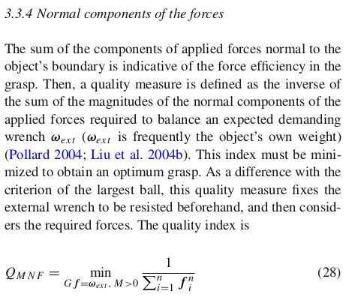
Grasp Quality Measures

Slide 16
All formulas were taken from chapter 28: Grasping of the Springer Handbook of Robotics ed.2008

