Slide 1

Progress Presentation #4
Internship: Technical specifications for in-hand and dexterous manipulation at the lab LASR of CEA Nano-Innov
Ricardo RICO URIBE

Slide 2
Accomplished Tasks
Jacobian Class:
The possibility for multiple contact points inside the same finger was added.
Tested with Example3 of chapter 28 (Grasping) of springer handbook of robotics ed.2008
Added the test for Form Closure
STL Class:
The calculation for the center of geometry (cog) was changed from the library to a coded calculation.
The generation time was improved by removing the elimination of repeated edges and vertices.
View functions have been updated to present a translucent mesh with cog, world origin and contact points* (with the specific function)
Real Task Objects:
Analyzed videos to determine which objects are needed and where they are touched
Documentation:
Started Code Documentation with class diagrams
Calculated the Jacobian for the proposed finger architecture

Slide 3
Documentation: Classes description
STL
GraspMap
mesh : numpy-stl.mesh.Mesh
cog : [3,]
triangles : [#,3,3]
edges : [#,2,3]
vertices : [#,3]
p : [3,]
C : [#,3]
R : [#,3,3]
h: [#,](string)
STL(path : string)
genRandCR(nc : int) : [3,] , [3,3] , [3,] , [3,3] , [3,] , [3,3]
getCRofCoord(coord : [3,] , location : string = “T”) : [3,] , [3,3]
view()
view(C : np.array [#,3],R : np.array[#,3,3])
GraspMap(p : [3,] , C : [#,3] , R : [#,3,3] , h : [#,](string) = None)
S(r : [3,]) : [3,3]
Pi(ci : [3,]) : [6,6]
pGi_t(Ri : [3,3] , Pi : [6,6]) : [6,6]
Hi(h : string) : [#,6]
H() : [#,#]
getGt() : [#,6]
GraspClassification(printBool : bool = False) : bool , bool
getRank() : int
calcFFormClosure(ng : int = 8 , mu : double = 0.3) : double , [#,]
legend
Class Name
To avoid the repetition of numpy.array
This [ ] will represent a numpy array.
In the interior will be the shape (# represents a number that will be defined during the execution and a missing value represents that is one dimensional)
unless specified otherwise the arrays contain numerical values
Public Attribute : variable type
Private Attribute : variable type
Public Method(argument name : variable type = default value) : method variable type return
Private Method(argument name : variable type = default value) : method variable type return

Slide 4
Documentation: Classes description
Joint
Jacobian
joint_id : int
joint_origin : [3,]
joint_z : [3,]
joint_contact_id : int
joint_revolute : bool
fingers : [#,](Finger)
C : [#,3]
R : [#,3,3]
h: [#,](string)
nq : int
Joint(jointID : int , frameOrigin : [3,] , unitVectorZ : [3,] , affectedContactIndex : id , revolute : bool = True)
Jacobian(fingers : [#,](Finger) , C : [#,3] , R : [#,3,3] , h : [#,](string) = None)
S(r : [3,]) : [3,3]
Hi(h : string) : [#,6]
H() : [#,#]
Zi(Ci : [3,] , cid : int) : [6,nq]
pJi(Ri : [3,3] , Zi : [6,nq]) : [6,nq]
getJ() : [#,nq]
JacobianClassification(printBool : bool = False) : bool , bool
getRank() : int
printHandSpecifications()
testForceClosure(grasp : GraspMap) : [#,]
Finger
finger_id : int
finger_joints : [#,](Joint)
Joint(fingerID : int , joints : [#,](Joint))
legend
Class Name
To avoid the repetition of numpy.array
This [ ] will represent a numpy array.
In the interior will be the shape (# represents a number that will be defined during the execution and a missing value represents that is one dimensional)
unless specified otherwise the arrays contain numerical values
Public Attribute : variable type
Private Attribute : variable type
Public Method(argument name : variable type = default value) : method variable type return
Private Method(argument name : variable type = default value) : method variable type return

Slide 5
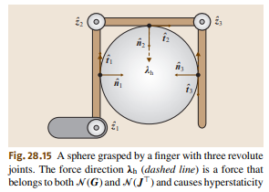
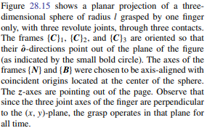
Jacobian: Example 3 and multi Contact in same finger
import numpy as np
from scipy.linalg import block_diag, null_space
from numpy.linalg import matrix_rank
from Jacobian import Jacobian, Joint, Finger
from GraspMap import GraspMap
import math
zv = np.array([0, 0, 1]).reshape(3, 1)
p = np.array([0, 0, 0])
h = np.array(["H", "H", "H"])
l = 2
c1 = np.array([math.cos(math.pi), math.sin(math.pi), 0]) * l
c2 = np.array([math.cos(math.pi / 2), math.sin(math.pi / 2), 0]) * l
c3 = np.array([math.cos(0), math.sin(0), 0]) * l
C = np.array([c1, c2, c3])

Slide 6
Jacobian: Example 3 and multi Contact in same finger
R1 = np.array(
[
[-math.cos(math.pi), math.sin(math.pi), 0],
[-math.sin(math.pi), -math.cos(math.pi), 0],
[0, 0, 1],
]
) R2 = np.array(
[
[-math.cos(math.pi / 2), math.sin(math.pi / 2), 0],
[-math.sin(math.pi / 2), -math.cos(math.pi / 2), 0],
[0, 0, 1],
]
) R3 = np.array(
[
[-math.cos(0), math.sin(0), 0],
[-math.sin(0), -math.cos(0), 0],
[0, 0, 1]
]
)
R = np.array([R1, R2, R3])

Slide 7
Jacobian: Example 3 and multi Contact in same finger
q1c = np.array([-l, -l, 0])
q2c = np.array([-l, l, 0])
q3c = np.array([l, l, 0])
q1 = Joint(1, q1c, zv, 0)
q2 = Joint(2, q2c, zv, 1)
q3 = Joint(3, q3c, zv, 2)
f1 = Finger(1, np.array([q1, q2, q3]))
f = np.array([f1])

Slide 8
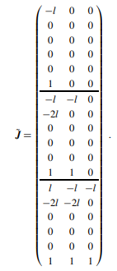
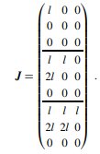
Jacobian: Example 3 and multi Contact in same finger
Jacob = Jacobian(f, C, R, h)
J = Jacob.getJ()
print("J shape:", J.shape)
print("J:\n", J)
Jacob.JacobianClassification(True)
Jacob.printHandSpecifications()
J shape: (9, 3)
J:
[[-2. 0. 0.]
[-0. 0. 0.]
[ 0. 0. 0.]
[-2. -2. 0.]
[-4. -0. 0.]
[ 0. 0. 0.]
[ 2. -2. -2.]
[-4. -4. 0.]
[ 0. 0. 0.]]
-------------------------
JACOBIAN CLASSIFICATION:
Nullspace(Jt): not trivial --> Defective
Nullspace(J): trivial --> Not Redundant
-------------------------
Hand Specifications
The hand has 3 joints divided in 1 fingers
Finger1: HAND - q1[C1(HF)] - q2[C2(HF)] - q3[C3(HF)]
q1 lenght:4.0 type:revolute
q2 lenght:4.0 type:revolute
q3 lenght:2.0 type:revolute
-------------------------

Slide 9
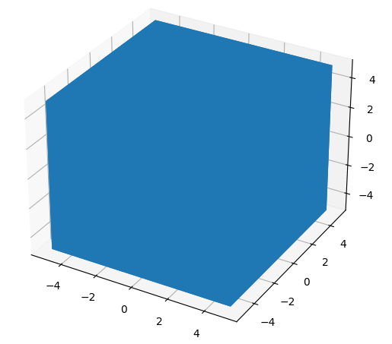
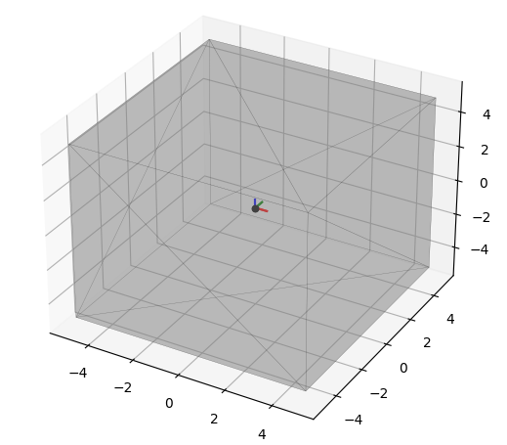
STL: View() comparison

Slide 10
STL: COG calculation
To avoid this error caused by the library, I coded my own function to determine the COG
from StlClass import STL
import numpy as np
path = "../stl/rinse_glass.stl“
mesh = STL(path)
Your mesh is not closed, the mass methods will not function correctly on this mesh. For more info:
https://github.com/WoLpH/numpy-stl/issues/69
Library cog: [ 9.29935996 -0.08354308 97.23261417]
Calculated cog: [9.07005503 0.05475031 9.47344942]

Slide 11
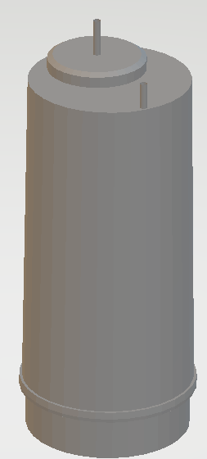
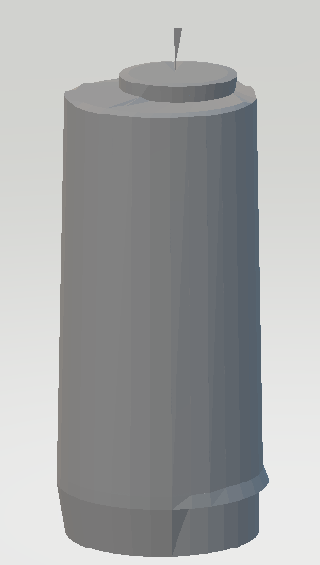
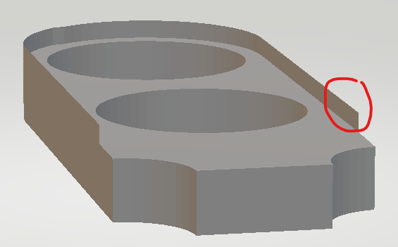
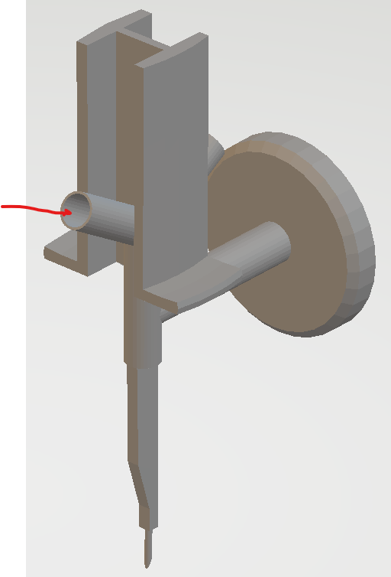
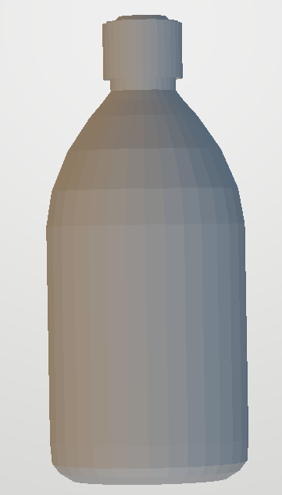
REAL TASK Objects: Problems with MESH
When lowering the resolution of the meshes some artifacts appeared
The meshes are hollow on the inside, creating the double amount of triangles
The objects have unnecessary parts for the grasp

Slide 12
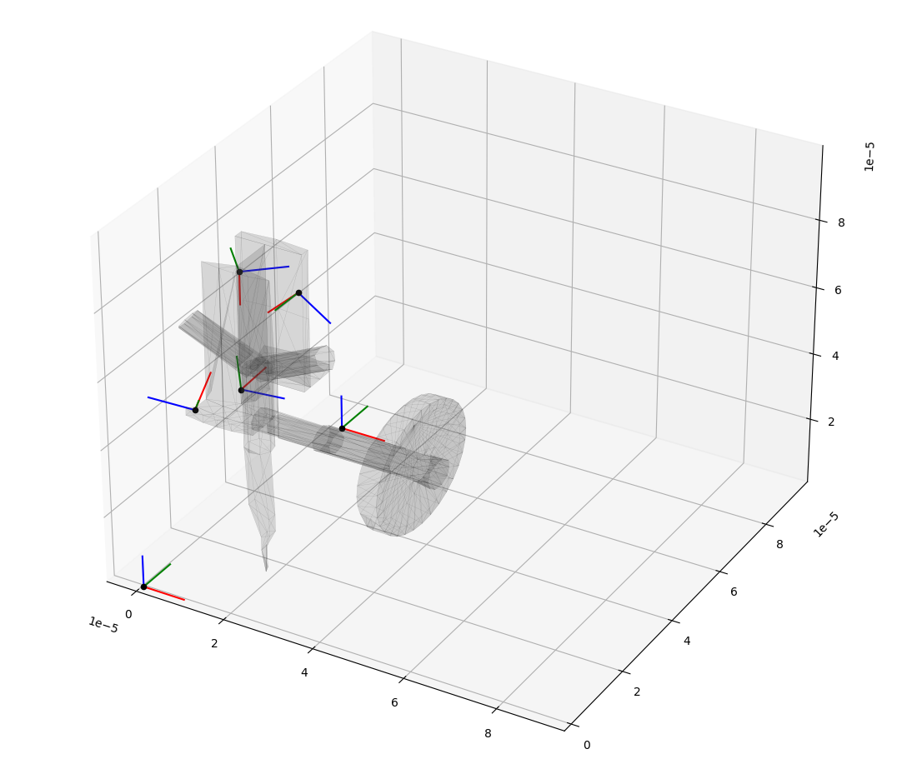
Grasp for Transfer Needle
from StlClass import STL
from GraspMap import GraspMap
import numpy as np
path = "../stl/TransferNeedle-new.stl"
mesh = STL(path)
C1, R1 = mesh.getCRofCoord(np.array([2e-5, -3e-6, 0.0001]), "T")
C2, R2 = mesh.getCRofCoord(np.array([2e-5, 1e-5, 6e-5]), "T")
C3, R3 = mesh.getCRofCoord(np.array([2e-5, 5e-5, 8e-5]), "T")
C4, R4 = mesh.getCRofCoord(np.array([1e-5, 4e-6, 6e-5]), "T")
C = np.concatenate((C1, C2, C3, C4)) R = np.concatenate((R1, R2, R3, R4))
mesh.viewCR(C, R) h = np.array(["H", "H", "H", "H"])
grasp = GraspMap(mesh.cog, C, R)
print("Gt = \n", grasp.getGt())
d, l = grasp.calcFFormClosure()
grasp.GraspClassification(True)
Gt =
[[ 0. 0. -1. 0.00000639 -0.0000179 0. ]
[-0.67480518 0.73799592 0. -0.00003127 -0.0000286 -0.00001753]
[ 0.73799592 0.67480518 0. -0.0000286 0.00003127 -0.00000736]
[-0.04216738 0.99911056 0. -0.00000928 -0.00000039 -0.00001794]
[-0.0801431 -0.00338243 0.99677763 -0.00000722 0.00001685 -0.00000052]
[ 0.99589106 0.0420315 0.08021444 -0.00000097 0.00001067 0.00000651]
[-0.09139234 -0.99581496 0. 0.00002902 -0.00000266 0.00001441]
[-0.59594999 0.05469416 -0.80115676 -0.00000751 -0.00002842 0.00000364]
[ 0.79780389 -0.07321959 -0.59845455 -0.00000228 0.000015 -0.00000488]
[ 0.07654131 0.50143694 0.86180185 -0.0000128 0.00002164 -0.00001146]
[-0.43655216 0.79394043 -0.4231794 0.00000207 -0.00001225 -0.00002511]
[-0.89641711 -0.34383075 0.27967262 -0.0000021 0.00000329 -0.00000269]]
Friction Form Closure Exist with d = 0.050848424085795915
-------------------------
GRASP CLASSIFICATION:
Nullspace(Gt): trivial --> Not Indeterminate
Nullspace(G): not trivial --> Graspable
The Scale of the object caused for incorrect positioning of the selected coordinates, because of the difficulty to read the mouse position.

Slide 13
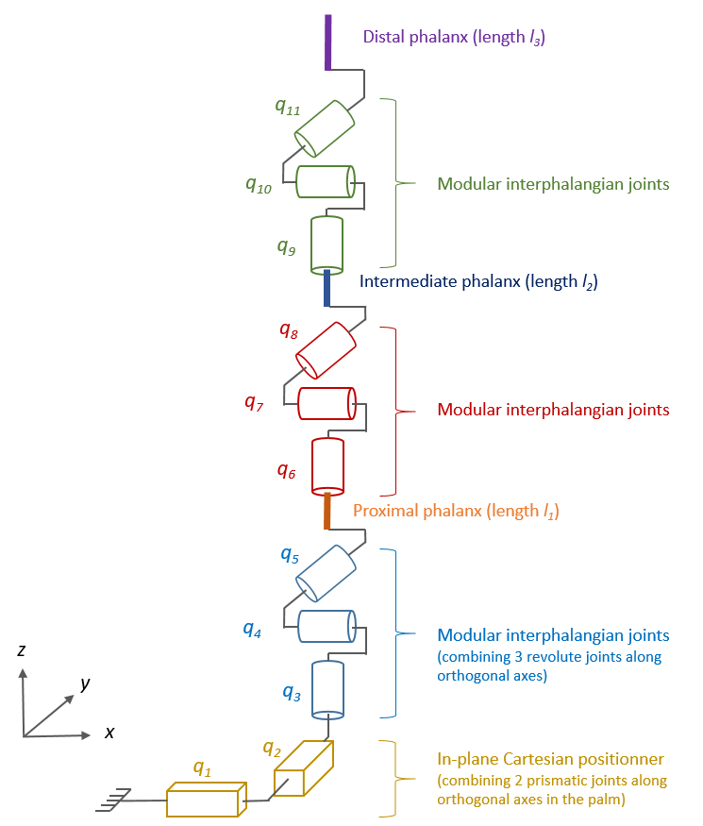
Jacobian for Proposed finger architecture
I calculated the Jacobian of the proposed finger, but because my calculation requires a configuration the finger was disposed as being fully upright contacting and object at the finger tip. The base of the finger is at 0,0 and all phalanx lengths are 1. Only joints q1, q2, q4, q4, q7 and q10 were taking into account.
import numpy as np
from Jacobian import Jacobian, Joint, Finger
xv = np.array([1, 0, 0]).reshape(3, 1)
yv = np.array([0, 1, 0]).reshape(3, 1)
zv = np.array([0, 0, 1]).reshape(3, 1)
h = np.array(["H"])
l0 = 1
l1 = 1
l2 = 1
l3 = 1
c1 = np.array([0, 0, l0 + l1 + l2 + l3]) R1 = np.array([[1, 0, 0], [0, 1, 0], [0, 0, 1]]) C = np.array([c1])
R = np.array([R1])

Slide 14
Jacobian for Proposed finger architecture
q1c = np.array([0, 0, 0])
q2c = np.array([0, 0, 0])
q3c = np.array([0, 0, l0])
q4c = np.array([0, 0, l0])
q5c = np.array([0, 0, l0 + l1])
q6c = np.array([0, 0, l0 + l1 + l2])
q1 = Joint(1, q1c, xv, -1, False) # q1
q2 = Joint(2, q2c, yv, -1, False) # q2
q3 = Joint(3, q3c, zv, -1) # q3
q4 = Joint(4, q4c, xv, -1) # q4
q5 = Joint(5, q5c, xv, -1) # q7
q6 = Joint(6, q6c, xv, 0) # q10
f1 = Finger(1, np.array([q1, q2, q3, q4, q5, q6]))
f = np.array([f1])
Jacob = Jacobian(f, C, R, h)
Jclass = Jacob.getJ()
print(Jclass.shape)
print("Jclass\n", Jclass)
(3, 6)
Jclass
[[ 1. 0. 0. 0. 0. 0.]
[ 0. 1. 0. -3. -2. -1.]
[ 0. 0. 0. 0. 0. 0.]]

Slide 15
Video Analysis
After consulting the videos for the tasks, I determined that the following actions require a precise movement from the hand, this will be accomplished by the fingers.
Write with the marker
Open the kit
Open the plug bag
Put the plugs (they may require a twist motion)
block the tubes
aspiring with the needle from the glass vials
cutting the tubes with scissors
All other task use force or have a large range of movement, like:
pluging in the needle into the bottle caps
moving the glass blottles around and inverting them

Slide 16
Proposed Work
Real Task Objects:
Create their correct .stl file, and from this derive the stl file for grasping
Valve for rinse glass, Marker, Plugs for canisters, Tube, Transfer Needle and Transfer Needle Cap, Petri Dish, Kit packaging, Tube blocker, Metallic petri holder for cleaning at the end, Glass vials, Canister, Rinse Glass, Scissors
Create a concise documentation for the code, with examples and comments inside.
Start the report to prepare for the mid-presentation

