Slide 1

Task-oriented Grasp analysis Code
Internship: Technical specifications for in-hand and dexterous manipulation at the lab LASR of CEA Nano-Innov
Ricardo RICO URIBE

Slide 2
What can you do?
STL: with simple x,y,z coordinates you get the full contact point information.
GRASP: with Contact Points you can get the grasp matrix and the grasp dependent classification of the grasp system
JACOBIAN: with Contact Points and Architecture description (described in the finger data type, that is itself described in the joint data type) you can get the grasp jacobian matrix and the jacobian dependent classification of the grasp system.
Quality Metrics: with Grasp or Jacobian information you can get the solution of the linear programming problem that describes de quality metric.

Slide 3
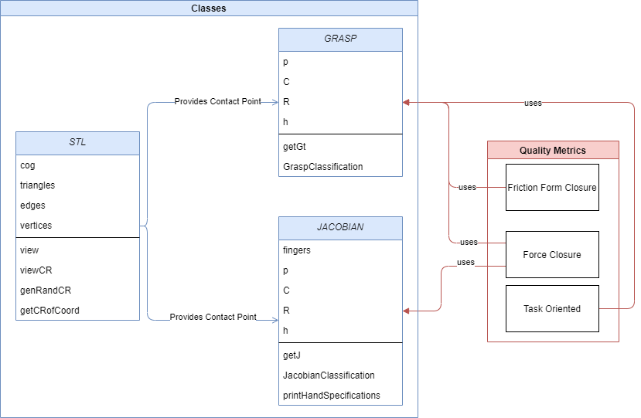
Flow

Slide 4
Documentation: Classes description
STL
GraspMap
mesh : numpy-stl.mesh.Mesh
cog : [3,]
triangles : [#,3,3]
edges : [#,2,3]
vertices : [#,3]
p : [3,]
C : [#,3]
R : [#,3,3]
h: [#,](string)
STL(path : string)
genRandCR(nc : int) : [3,] , [3,3] , [3,] , [3,3] , [3,] , [3,3]
getCRofCoord(coord : [3,] , location : string = “T”) : [3,] , [3,3]
view()
view(C : np.array [#,3],R : np.array[#,3,3])
GraspMap(p : [3,] , C : [#,3] , R : [#,3,3] , h : [#,](string) = None)
S(r : [3,]) : [3,3]
Pi(ci : [3,]) : [6,6]
pGi_t(Ri : [3,3] , Pi : [6,6]) : [6,6]
Hi(h : string) : [#,6]
H() : [#,#]
getGt() : [#,6]
GraspClassification(printBool : bool = False) : bool , bool
getRank() : int
calcFFormClosure(ng : int = 8 , mu : double = 0.3) : double , [#,]
legend
Class Name
To avoid the repetition of numpy.array
This [ ] will represent a numpy array.
In the interior will be the shape (# represents a number that will be defined during the execution and a missing value represents that is one dimensional)
unless specified otherwise the arrays contain numerical values
Public Attribute : variable type
Private Attribute : variable type
Public Method(argument name : variable type = default value) : method variable type return
Private Method(argument name : variable type = default value) : method variable type return

Slide 5
Documentation: Classes description
Joint
Jacobian
joint_id : int
joint_origin : [3,]
joint_z : [3,]
joint_contact_id : int
joint_revolute : bool
fingers : [#,](Finger)
C : [#,3]
R : [#,3,3]
h: [#,](string)
nq : int
Joint(jointID : int , frameOrigin : [3,] , unitVectorZ : [3,] , affectedContactIndex : id , revolute : bool = True)
Jacobian(fingers : [#,](Finger) , C : [#,3] , R : [#,3,3] , h : [#,](string) = None)
S(r : [3,]) : [3,3]
Hi(h : string) : [#,6]
H() : [#,#]
Zi(Ci : [3,] , cid : int) : [6,nq]
pJi(Ri : [3,3] , Zi : [6,nq]) : [6,nq]
getJ() : [#,nq]
JacobianClassification(printBool : bool = False) : bool , bool
getRank() : int
printHandSpecifications()
testForceClosure(grasp : GraspMap) : [#,]
Finger
finger_id : int
finger_joints : [#,](Joint)
Joint(fingerID : int , joints : [#,](Joint))
legend
Class Name
To avoid the repetition of numpy.array
This [ ] will represent a numpy array.
In the interior will be the shape (# represents a number that will be defined during the execution and a missing value represents that is one dimensional)
unless specified otherwise the arrays contain numerical values
Public Attribute : variable type
Private Attribute : variable type
Public Method(argument name : variable type = default value) : method variable type return
Private Method(argument name : variable type = default value) : method variable type return

Slide 6
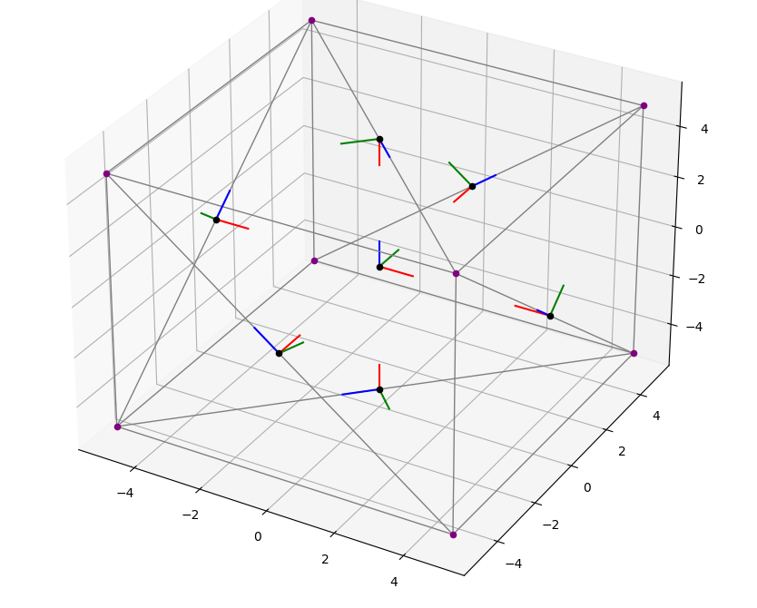
Methods applied
STL: viewCR

Slide 7

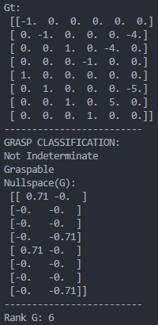
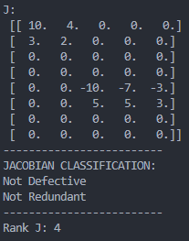
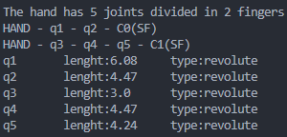
Check for correct class writing
y
y
x
x
y
(-3,10)
p (2,10)
x
(6,10)
(-6,7)
(8,6)
(-8,3)
y
x
(-8,0)
(0,0)
(9,0)

Slide 8
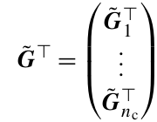
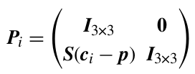


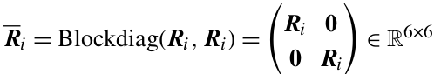
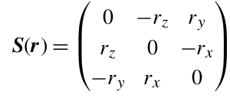


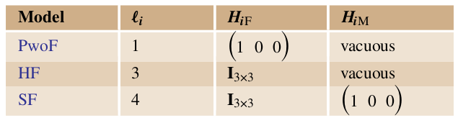
Internal workings of GraspMap: getGt()
C is composed of ci, R is composed of Ri
h

Slide 9
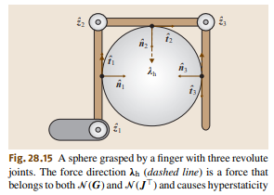
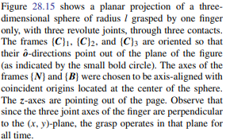
Jacobian: Example 3 and multi Contact in same finger
import numpy as np
from scipy.linalg import block_diag, null_space
from numpy.linalg import matrix_rank
from Jacobian import Jacobian, Joint, Finger
from GraspMap import GraspMap
import math
zv = np.array([0, 0, 1]).reshape(3, 1)
p = np.array([0, 0, 0])
h = np.array(["H", "H", "H"])
l = 2
c1 = np.array([math.cos(math.pi), math.sin(math.pi), 0]) * l
c2 = np.array([math.cos(math.pi / 2), math.sin(math.pi / 2), 0]) * l
c3 = np.array([math.cos(0), math.sin(0), 0]) * l
C = np.array([c1, c2, c3])

Slide 10
Jacobian: Example 3 and multi Contact in same finger
R1 = np.array(
[
[-math.cos(math.pi), math.sin(math.pi), 0],
[-math.sin(math.pi), -math.cos(math.pi), 0],
[0, 0, 1],
]
) R2 = np.array(
[
[-math.cos(math.pi / 2), math.sin(math.pi / 2), 0],
[-math.sin(math.pi / 2), -math.cos(math.pi / 2), 0],
[0, 0, 1],
]
) R3 = np.array(
[
[-math.cos(0), math.sin(0), 0],
[-math.sin(0), -math.cos(0), 0],
[0, 0, 1]
]
)
R = np.array([R1, R2, R3])

Slide 11
Jacobian: Example 3 and multi Contact in same finger
q1c = np.array([-l, -l, 0])
q2c = np.array([-l, l, 0])
q3c = np.array([l, l, 0])
q1 = Joint(1, q1c, zv, 0)
q2 = Joint(2, q2c, zv, 1)
q3 = Joint(3, q3c, zv, 2)
f1 = Finger(1, np.array([q1, q2, q3]))
f = np.array([f1])

Slide 12
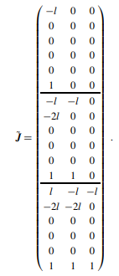
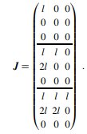
Jacobian: Example 3 and multi Contact in same finger
Jacob = Jacobian(f, C, R, h)
J = Jacob.getJ()
print("J shape:", J.shape)
print("J:\n", J)
Jacob.JacobianClassification(True)
Jacob.printHandSpecifications()
J shape: (9, 3)
J:
[[-2. 0. 0.]
[-0. 0. 0.]
[ 0. 0. 0.]
[-2. -2. 0.]
[-4. -0. 0.]
[ 0. 0. 0.]
[ 2. -2. -2.]
[-4. -4. 0.]
[ 0. 0. 0.]]
-------------------------
JACOBIAN CLASSIFICATION:
Nullspace(Jt): not trivial --> Defective
Nullspace(J): trivial --> Not Redundant
-------------------------
Hand Specifications
The hand has 3 joints divided in 1 fingers
Finger1: HAND - q1[C1(HF)] - q2[C2(HF)] - q3[C3(HF)]
q1 lenght:4.0 type:revolute
q2 lenght:4.0 type:revolute
q3 lenght:2.0 type:revolute
-------------------------

