Slide 1

Task-oriented Grasp analysis Force & alpha
Internship: Technical specifications for in-hand and dexterous manipulation at the lab LASR of CEA Nano-Innov
Ricardo RICO URIBE

Slide 2
Basic Grasp theory
The concept of grasping refers to the action of grasp (take hold) of an object, and move it, being moved by the effect of moving all the manipulator as a whole or being moved by the changes of position of each finger joint; the latter being called dexterous manipulation.
Grasping is represented trough the grasp matrix G. That relies the manipulator’s joints velocities with the object velocity.
Grasping is dependent of contact type: commonly we have Point without Friction (PwoF), Hard Finger(HF) and Soft Finger(SF). For the project we chose HF.
HF hard finger is a contact model that includes tangential friction at the contact location, this friction between the surface of the object and the finger surface allows for the transmission of the three linear components of the contact point.

Slide 3
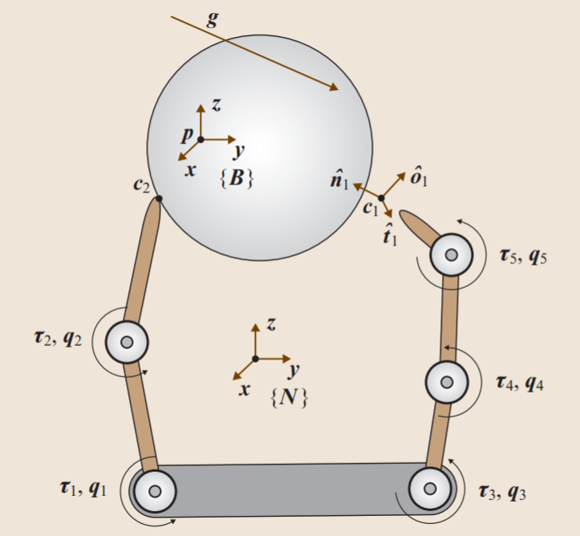
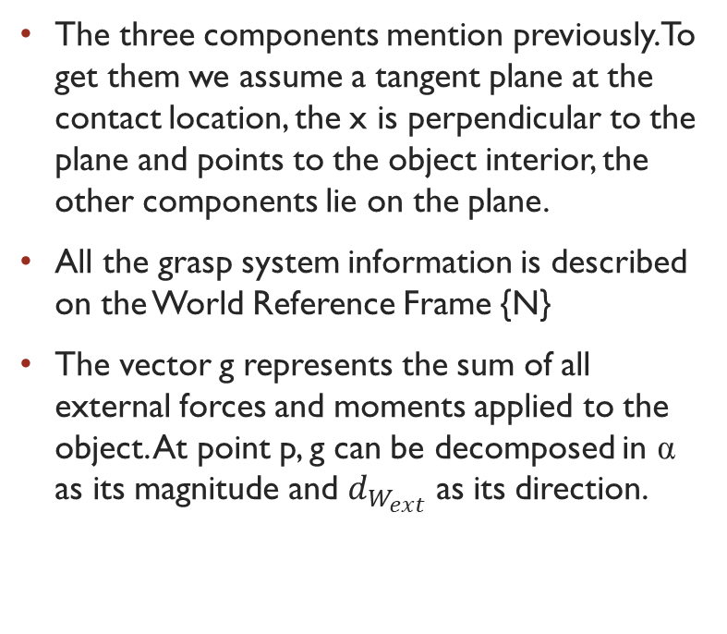
Basic grasp elements
The three components mention previously. To get them we assume a tangent plane at the contact location, the x is perpendicular to the plane and points to the object interior, the other components lie on the plane.
All the grasp system information is described on the World Reference Frame {N}
The vector g represents the sum of all external forces and moments applied to the object. At point p, g can be decomposed in α as its magnitude and $d_{W_{ext}}$ as its direction.

Slide 4
Grasp classification
Indeterminate:
A grasping system is indeterminate if N(GT) is nontrivial.
If a system is indeterminate it means that for an object with 6dof there are some velocities and moments that cannot be imprinted by the manipulator (there are internal object twists that cannot be controlled).
Graspable:
A grasping system is graspable if N(G) is nontrivial.
All internal object forces are controlled, this means that we can augment the contact forces and the object will not move but instead improve the grasp if it is based on friction.

Slide 5
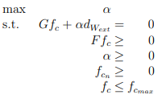
Quality metric
A quality metric is important because it allows us to rank and determine which grasp is better in comparison to another.
The quality metric used is task-oriented and it provide us with the maximum force the grasp system can withstand in a user provided direction taking also into account a predetermined maximal actuator force.

Slide 6
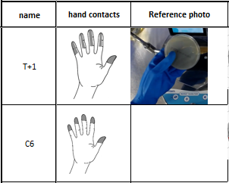
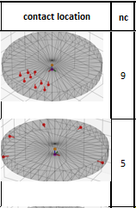
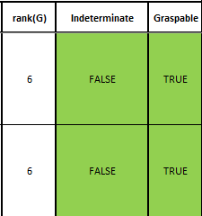
Grasp taxonomy integration
With the taxonomy information, I manual create each contact point location coordinates within the object.
The code then can transform the coordinates into contacts and calculate the corresponding grasp system and its classification.
"petri_t+1": ["petri_dish",[2.5,0,1.5,"e"],[3.2,.73,0,"t"],[2.3,.73,0,"e"],[2.8,1.6,0,"t"],[2.0,1.4,0,"e"],[3.2,-.73,0,"t"],[2.3,-.73,0,"e"],[2.8,-1.6,0,"t"],[2.0,-1.4,0,"e"]]
"petri_c6":["petri_dish",[4,0,.7,'e'],[-3.5,-3.5,.7,'e'],[-4,0,.7,'e'],[-3.5,3.5,.7,'e'],[0,4,.7,'e']]

Slide 7
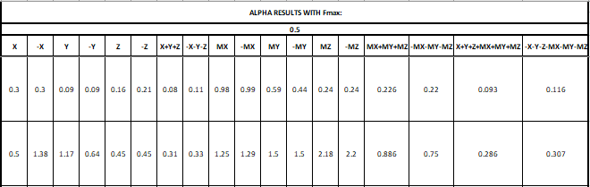
Database for alpha
The code then creates the information of the maximum force that the grasp system can withstand in the predetermined directions.

Slide 8
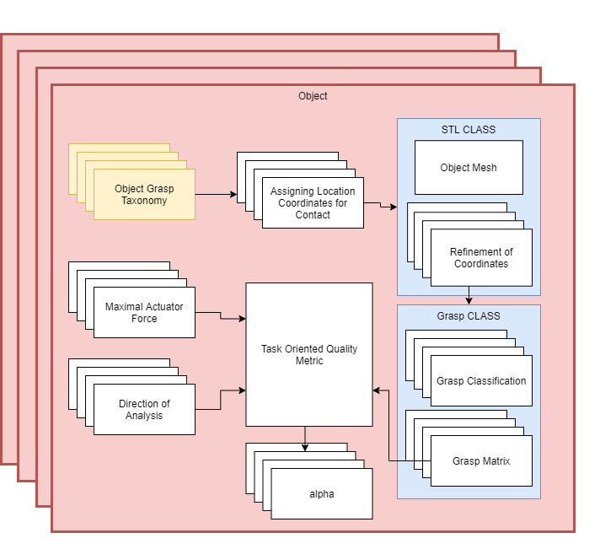
Flow

Slide 9
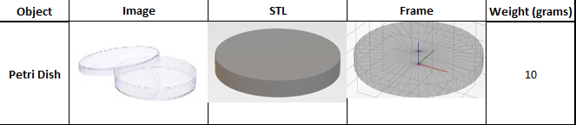
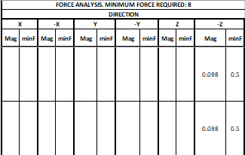
Force Analysis
The analysis results in the initial technical description for the real life manipulator.
We obtained that to perform this grasp under the specified load it is necessary an manipulator architecture capable of applying 0.5 N at all contact locations in the three previously mention directions of the contact frame.
0.5

Slide 10
Scale & Limitations
Currently this process was already made for all objects, and all available grasps, with a range of maximal forces and basic external force assumptions. *Data available in another file*
Right now we are missing a more definitive list of:
Grasp taxonomies
Sub-task of each object
Forces that occur at each sub-task

Slide 11
Current and future work
For the moment I'm working on the automation, completion, understanding and neatness of the mentioned Excel file, and also the correct formatting and documentation of the python code.
For the future work I think that we are missing the analysis of different hand architectures, if not necessary we would use a human model for the robotic manipulator capable of exerting the found force after the full analysis.

