Slide 1
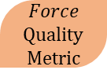
For a Specific Object
Center of Mass
3D Model
For an Specific Grasp
Contact Location according to Human taxonomy
STL object
For a Specific Task
Contact objects
External Perturbations
Grasp object
α
Quality
Metric
$$Force$$
Quality
Metric
Search for specific perturbation
Force required to perform the task

