Slide 1

Task-oriented Grasp analysis: FORCE CALCULATION IMPROVEMENT
Internship: Technical specifications for in-hand and dexterous manipulation at the lab LASR of CEA Nano-Innov
Ricardo RICO URIBE

Slide 2
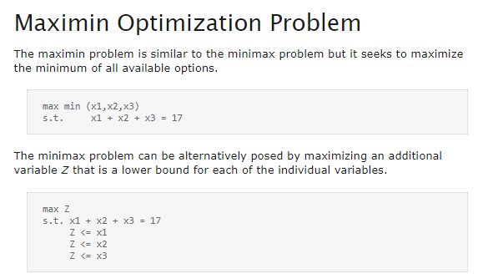
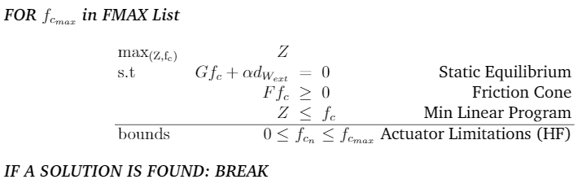
Work Done:
Improved the force calculation:
Via the addition of a calculation based on the table alpha
Via the correction of the force formula with the implementation of maximin
http://apmonitor.com/me575/index.php/Main/MiniMax

Slide 3
WORK TO DO
Add numeration to the grasp view
Divide the code in modules
Improve the force description to include moments
Pre process the contact points and grasp

