Slide 1

CHARITY DAO DEMO

Slide 2
Sections
The app contains 2 main sections:
Reviewers
ERC20 / NFT Launch Pad

Slide 3
1. Reviewers
Reviewers list
Apply to be a new reviewer
Update reviewer information

Slide 4
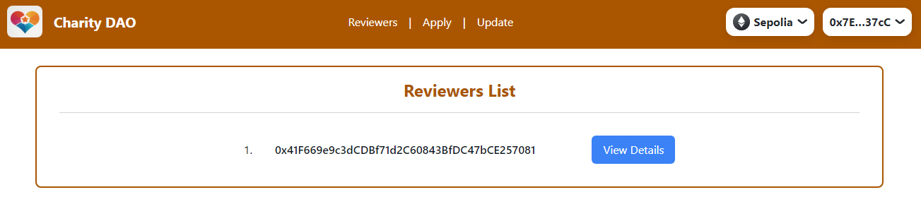
1.1.1 Reviewers list - list
This page will show all the current reviewers (reviewers with Active and Doubted status).

Slide 5
1.1.2 Reviewers list – Reviewer Details
By clicking on the “View Details” button next to the address, reviewer details will be shown below.

Slide 6
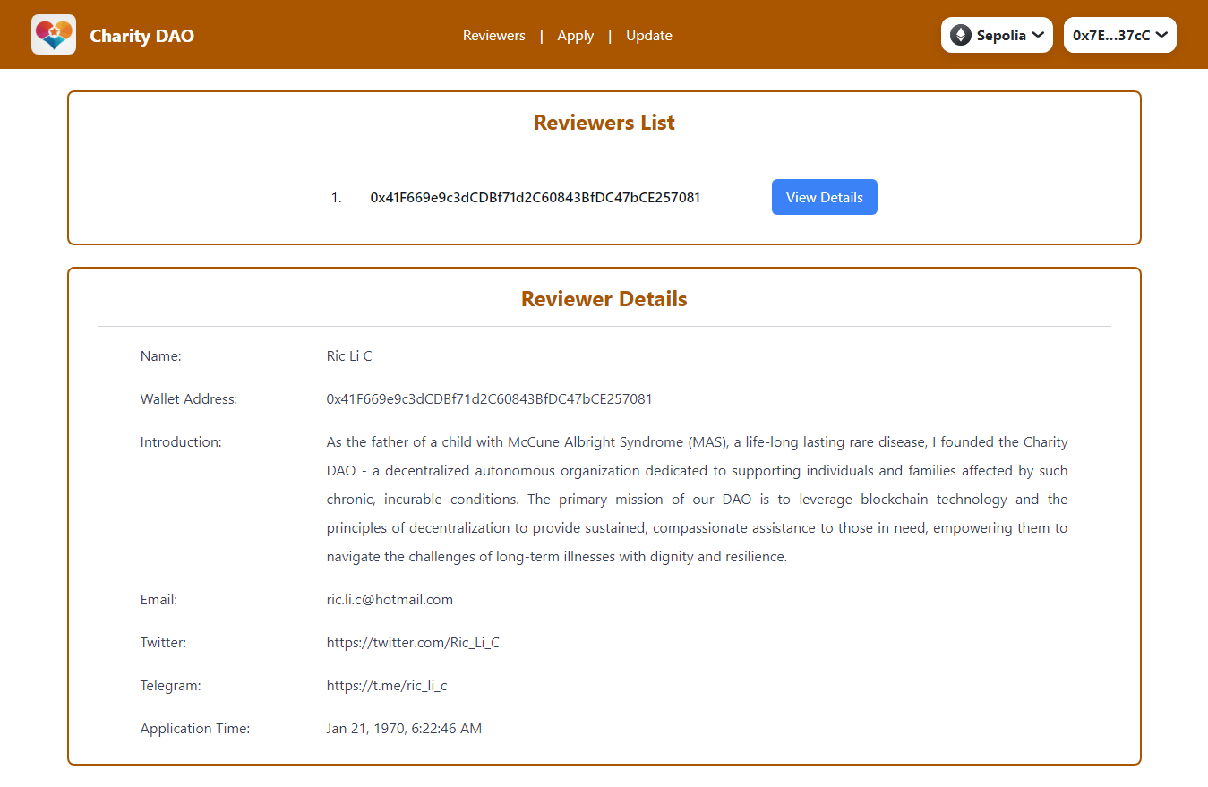

Slide 7
1.1.3 Reviewers list – Doubt
If the user has logged in and the login account is a current reviewer (reviewer with Active and Doubted status), there will be a “Doubt” button.

Slide 8
1.1.3 Reviewers list – Doubt
By clicking on the button, current login account will be able to initialize a new Doubt.

Slide 9
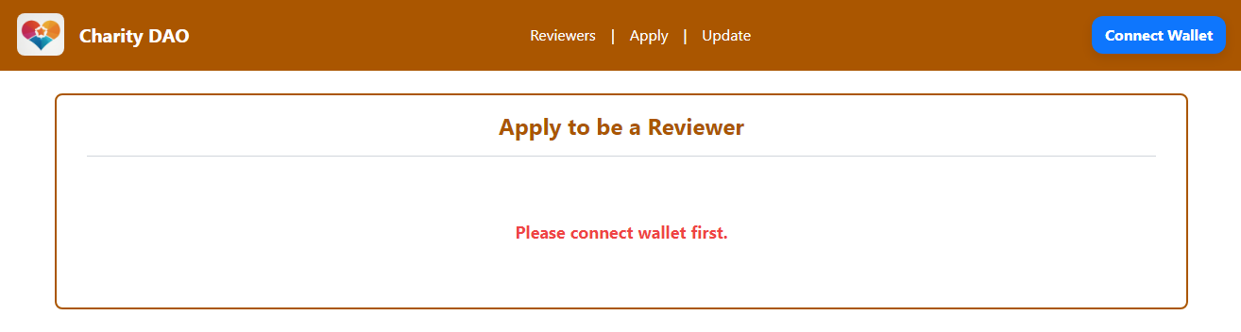
1.2 Apply to be a new reviewer
The user must login to see the content of the page, otherwise a warning message will be shown.

Slide 10
1.2.1 Apply to be a new reviewer - apply
If the login account has not applied to be a reviewer before, he can apply to be a new reviewer.

Slide 11
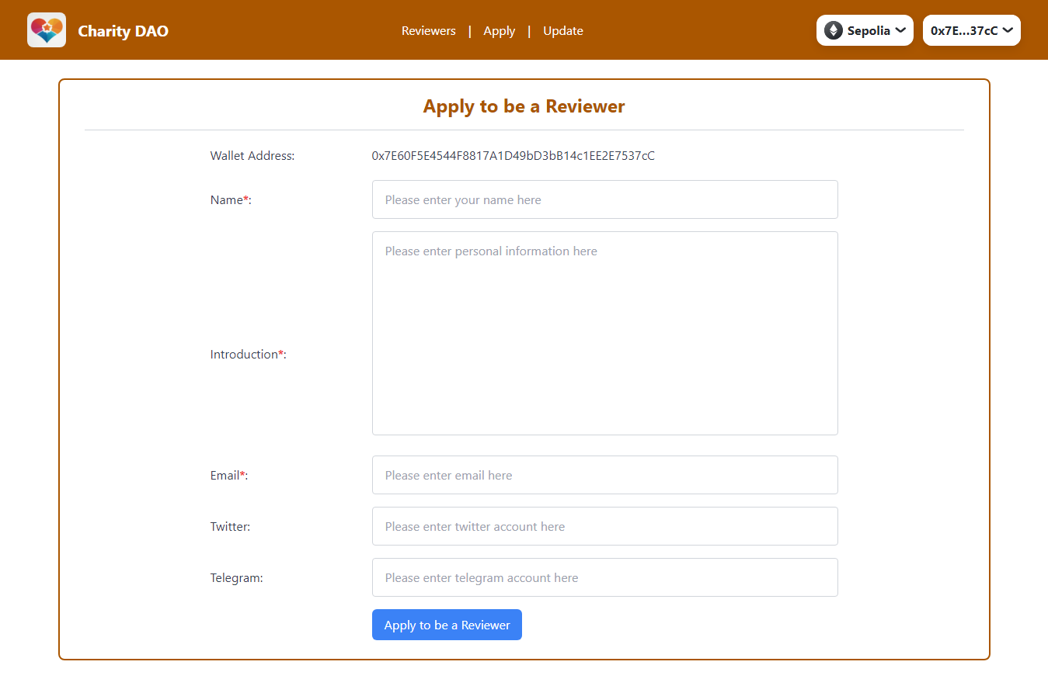

Slide 12
1.2.2 Apply to be a new reviewer – view application
If the login account has applied to be a reviewer before, the application details will be shown.

Slide 13
1.2.3 Apply to be a new reviewer – view reviewer details
If the login account is a reviewer, the reviewer information will be shown.

Slide 14
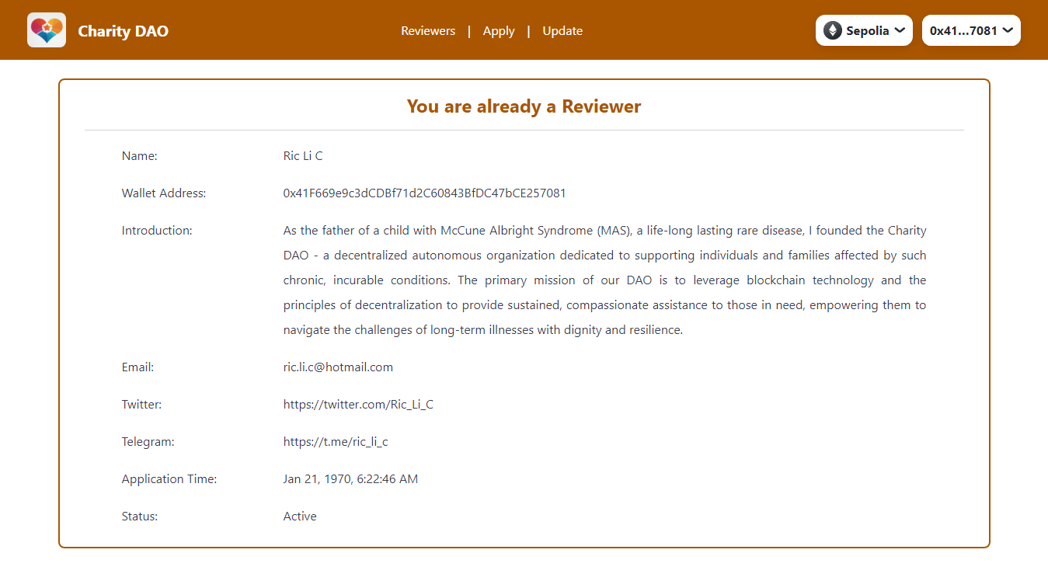

Slide 15
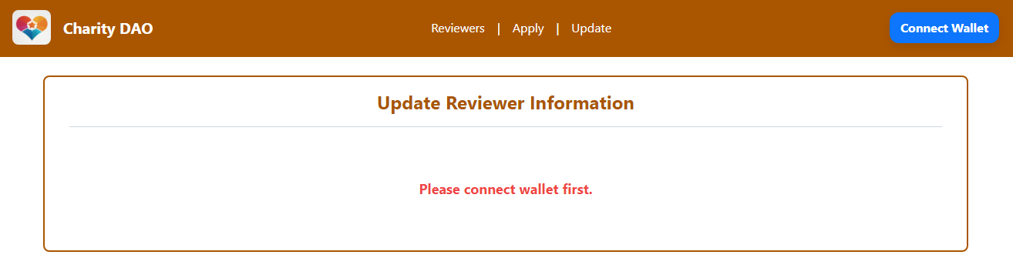
1.3 Update reviewer information
The user must login to see the content of the page, otherwise a warning message will be shown.

Slide 16
1.3.1 Update reviewer information - update
If the login account is a current reviewer (reviewer of Active or Doubted status), he can update his personal information, email, twitter or telegram account information.

Slide 17
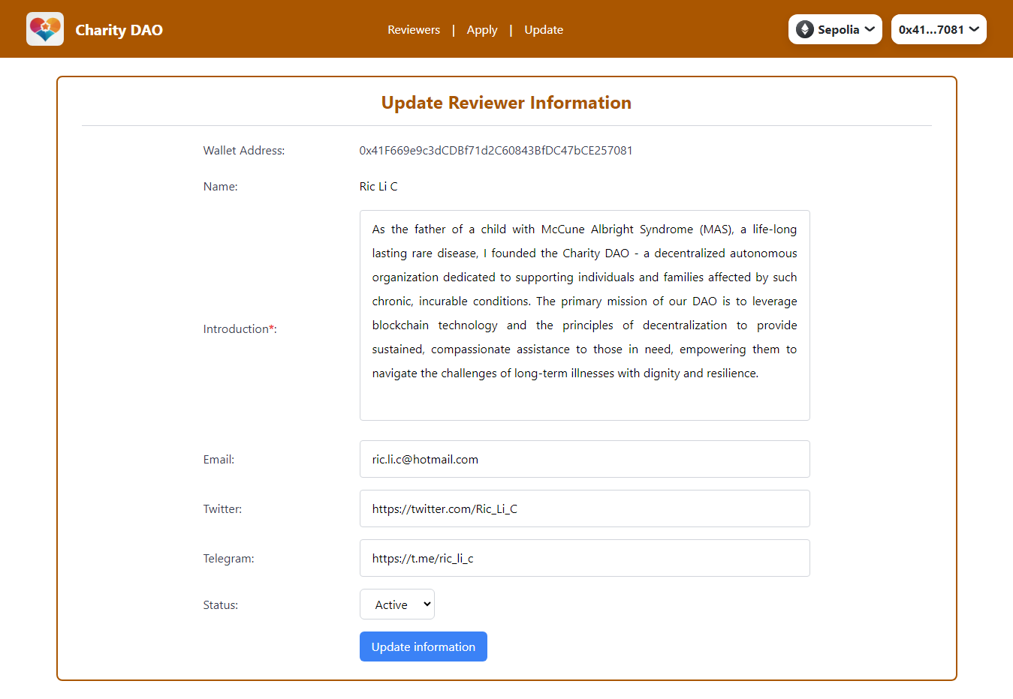

Slide 18
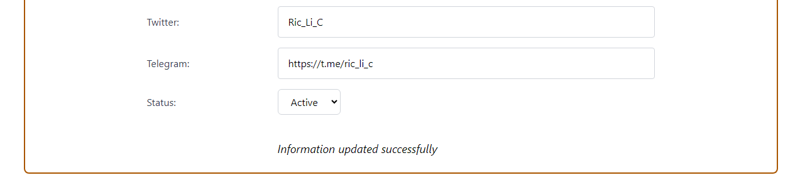
1.3.1 Update reviewer information - update
Once “Update information” button is clicked, connected wallet will be asked to approve transaction. After the transaction is approved and completed, a success message will be displayed.

Slide 19
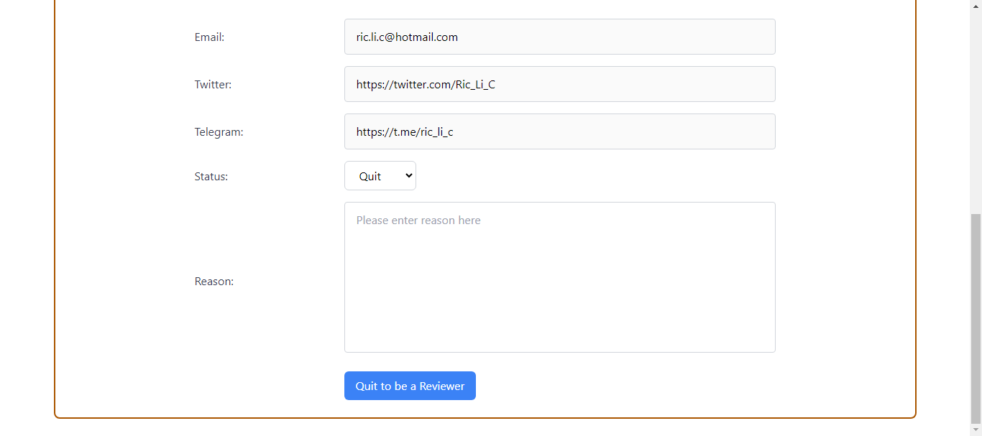
1.3.2 Update reviewer information – quit
If the login account choose “Quit” for status, there will be a text area for him to input reason for quit, and “Quit to be a Reviewer” button will be shown.

Slide 20
1.3.2 Update reviewer information – quit
Once “Quit to be a Reviewer” button is clicked, connected wallet will be asked to approve transaction. After the transaction is approved and completed, the account’s reviewer status will become “Quitted”.

