Slide 1
Challenges
Mini challenge 1

Slide 2
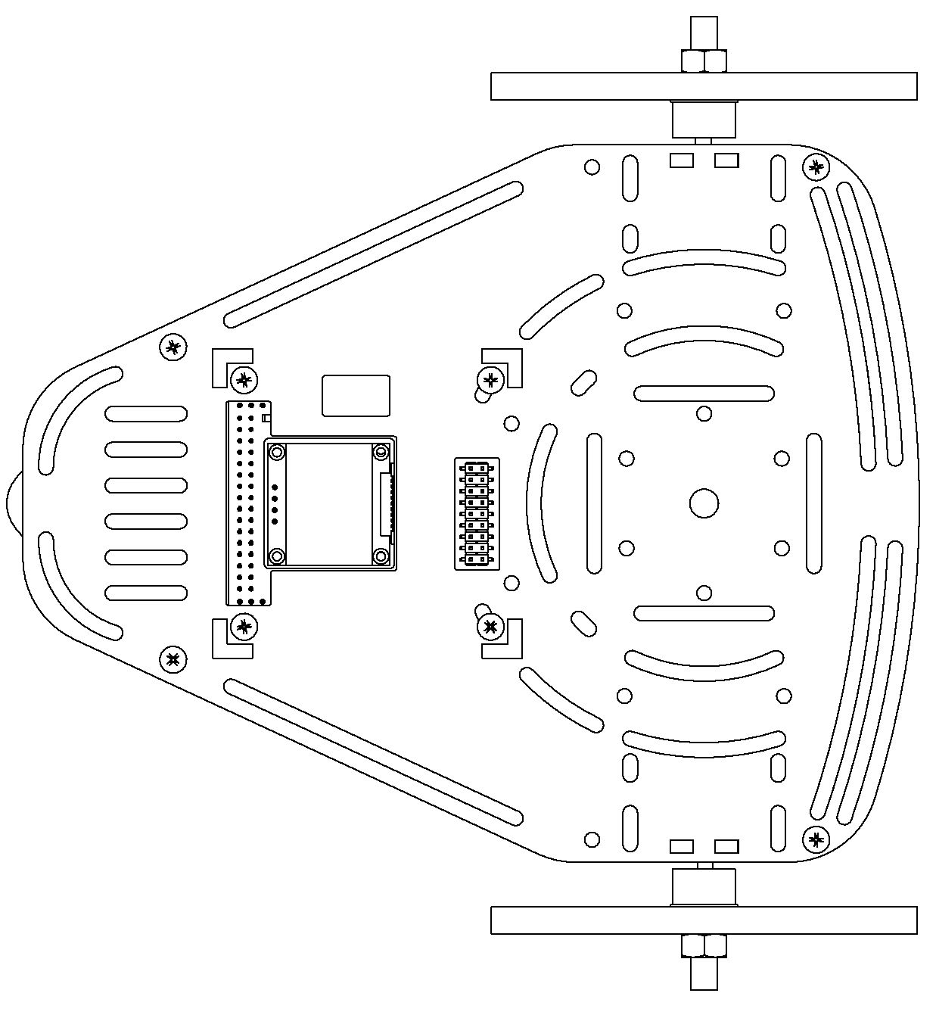

Mini challenge 1
This challenge is intended for the student to review the concepts introduced in this week.
Create a node to drive the gazebo simulated robot in a square path of a side length 2 m.
Use the same node to move the real robot in a square of side length 2 m.
The open loop controller must be robust.
The student must define what is robustness and implement strategies to achieve it with the controller.
The controller must be, auto-tunned
The user selects the speed or the time to finish the path (square figure) and the controller must estimate either the velocities, acceleration or time required.
The controller must take into consideration, perturbation, nonlinearities and noise.
ROS Node
Controller
/cmd_vel
Real Robot /Gazebo Simulation

Slide 3




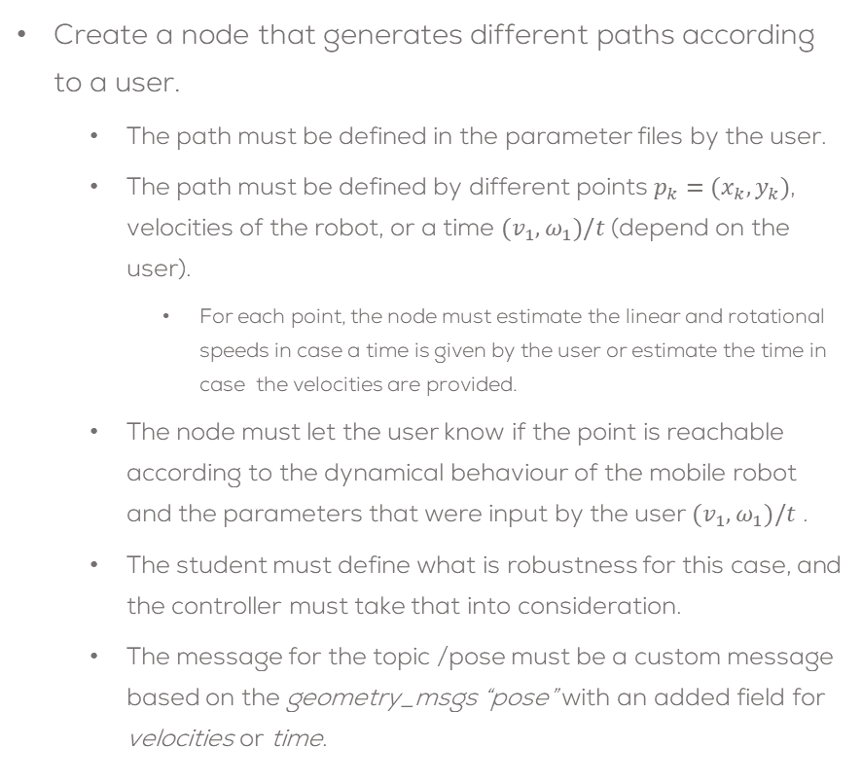


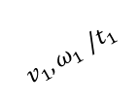

Mini challenge 1
Create a node that generates different paths according to a user.
The path must be defined in the parameter files by the user.
The path must be defined by different points $p_{k}=(x_{k},y_{k})$, velocities of the robot, or a time $(v_{1},ω_{1})/t$ (depend on the user).
For each point, the node must estimate the linear and rotational speeds in case a time is given by the user or estimate the time in case the velocities are provided.
The node must let the user know if the point is reachable according to the dynamical behaviour of the mobile robot and the parameters that were input by the user $(v_{1},ω_{1})/t$ .
The student must define what is robustness for this case, and the controller must take that into consideration.
The message for the topic /pose must be a custom message based on the geometry_msgs “pose” with an added field for velocities or time.
/cmd_vel
Path Generator
/pose
Controller
Real Robot /Gazebo Simulation
$p_{3}=(x_{3},y_{3})$,
$$v_{3},ω_{3} /t_{3}$$
$p_{2}=(x_{2},y_{2})$,
$$v_{2},ω_{2} /t_{2}$$
$$v_{4},ω_{4} /t_{4}$$
$p_{1}=(x_{1},y_{1})$,
$$v_{1},ω_{1} /t_{1}$$
$p_{4}=(x_{4},y_{4})$,

Slide 4
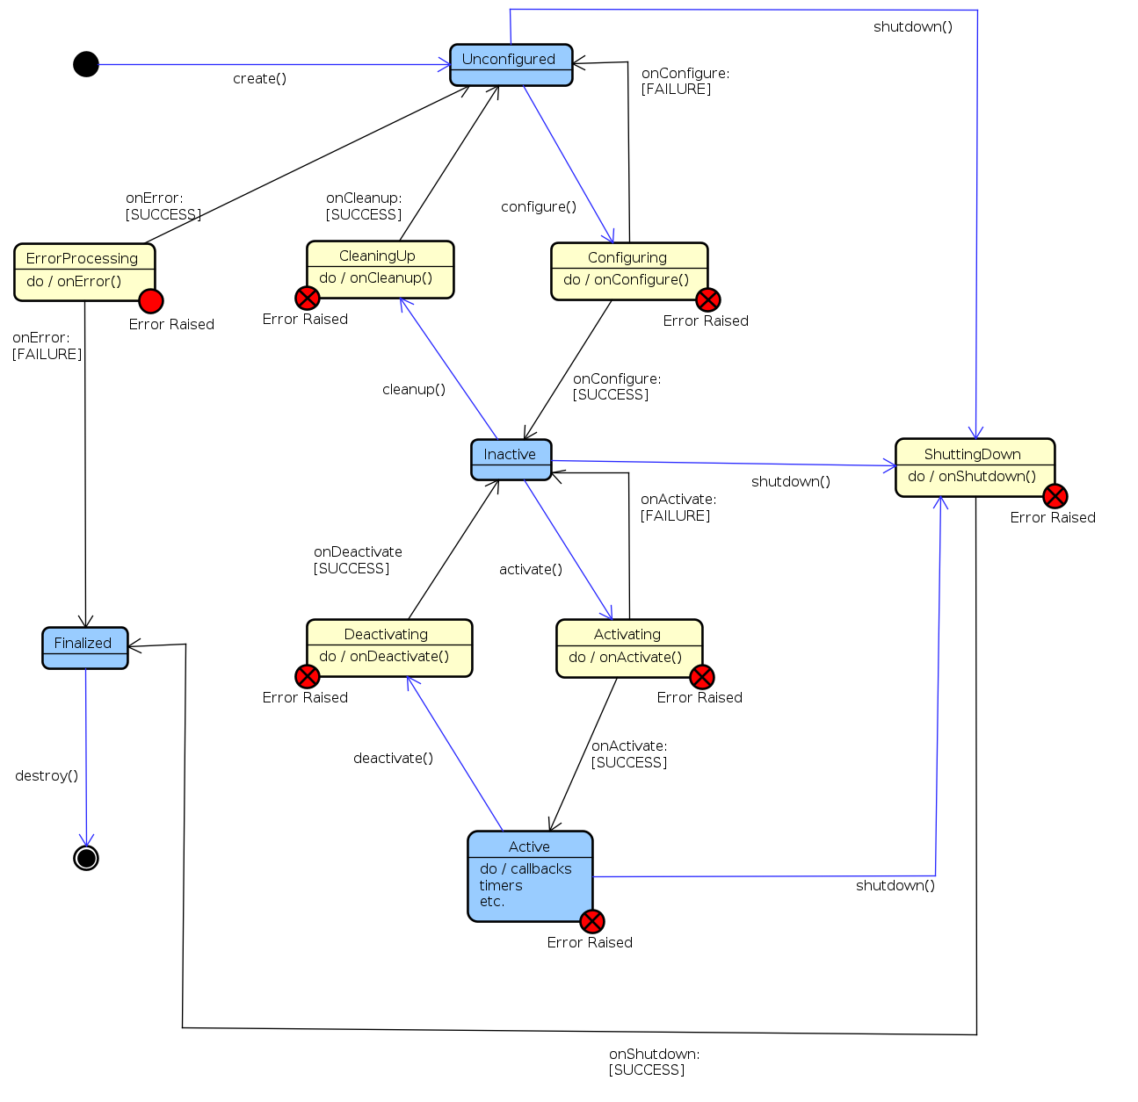
State Machines
Definition
A state machine is a computational model that transitions between predefined states based on inputs or conditions.
Finite State Machines (FSM) - Fixed number of states.
Why use state machines?
Structured way to control robotic behaviour.
Ensures modular, scalable, and readable code.

Slide 5
Tips
Time<t_straight
Straight
Time>=t_straight
Turn
Count++
Start?
Variables ready? Simulation ready?
Time>=t_turn
Time<t_turn
Stop
Count = 0
Start
Count >=N_turns && Time >=t_turn

Slide 6
Rules
This is challenge not a class. The students are encouraged to research, improve tune explain their algorithms by themselves.
MCR2(Manchester Robotics) Reserves the right to answer a question if it is determined that the questions contains partially or totally an answer.
The students are welcomed to ask only about the theoretical aspect of the classed.
No remote control or any other form of human interaction with the simulator or ROS is allowed (except at the start when launching the files).
It is forbidden to use any other internet libraires with the exception of standard libraires or NumPy.
If in doubt about libraires please ask any teaching assistant.
Improvements to the algorithms are encouraged and may be used as long as the students provide the reasons and a detailed explanation on the improvements.
All the students must be respectful towards each other and abide by the previously defined rules.
Manchester robotics reserves the right to provide any form of grading. Grading and grading methodology are done by the professor in charge of the unit.

