Slide 3




When a Sasquatch and a Boar get together (or how to use SASS and Grunt)
Ricardo Castelhano (@riccastelhano)
Fullstack Dev / Technical Manager / Certified Scrum Master / Certified Zend Engineer

Slide 4
Prerequirements

Slide 5


Slide 7
Grunt
Why?
The JavaScript Task Runner
“In one word: automation (…) a task runner can do most of that mundane work for you—and your team—with basically zero effort.”
“The Grunt ecosystem is huge (…), you can use Grunt to automate just about anything(…)”
“Like minification, compilation, unit testing, linting, ...” (just check Grunt Plugins Page)
(src: gruntjs.com)

Slide 8
Grunt
demo
The JavaScript Task Runner
Install Grunt Command Line Interface
Create package.json
Create Gruntfile.js
Install Grunt Task Runner
Install SASS and Watch Tasks
Notes:
npm install –g grunt-cli
npm init
npm install grunt –-save-dev
npm install grunt-contrib-sass –-save-dev
npm install grunt-contrib-watch –-save-dev

Slide 9


Slide 10
SASS
Why?
Syntactically Awesome Style Sheet
“(…)stylesheets are getting larger, more complex, and harder to maintain(...)”
“(…)Sass lets you use features that don't exist in CSS yet like variables, nesting, mixins, inheritance and other nifty goodies that make writing CSS fun again(…)”
(src: sass-lang.com)

Slide 11
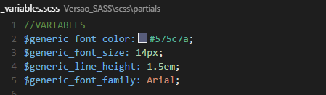
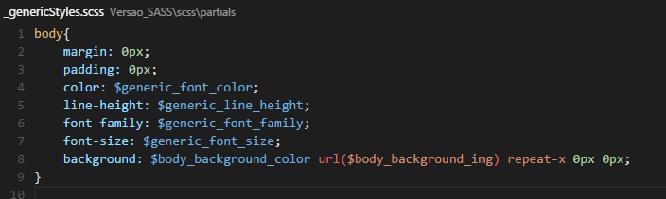
SASS
Variables
Syntactically Awesome Style Sheet
Declaration
Usage
Notes:
npm install –g grunt-cli
npm init
npm install grunt –-save-dev
npm install grunt-contrib-sass –-save-dev
npm install grunt-contrib-watch –-save-dev

Slide 12
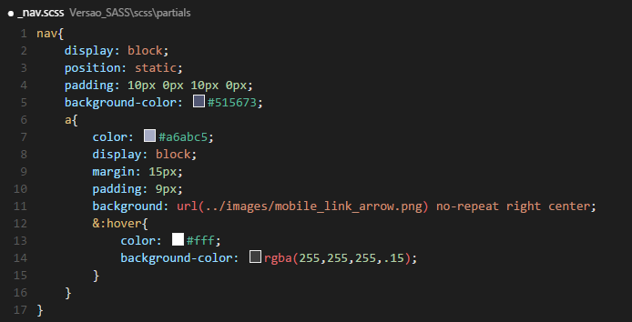
SASS
Nesting
Syntactically Awesome Style Sheet
Notes:
npm install –g grunt-cli
npm init
npm install grunt –-save-dev
npm install grunt-contrib-sass –-save-dev
npm install grunt-contrib-watch –-save-dev

Slide 13
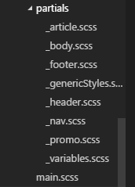
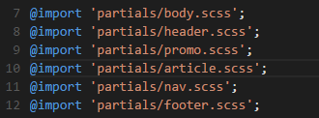

SASS
Partials & Imports
Syntactically Awesome Style Sheet
Notes:
npm install –g grunt-cli
npm init
npm install grunt –-save-dev
npm install grunt-contrib-sass –-save-dev
npm install grunt-contrib-watch –-save-dev

Slide 14
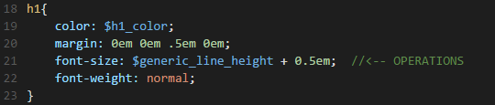
SASS
Operators
Syntactically Awesome Style Sheet
Notes:
npm install –g grunt-cli
npm init
npm install grunt –-save-dev
npm install grunt-contrib-sass –-save-dev
npm install grunt-contrib-watch –-save-dev

Slide 15


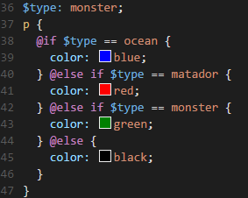


SASS
Control Directives & Expressions
Syntactically Awesome Style Sheet
Notes:
npm install –g grunt-cli
npm init
npm install grunt –-save-dev
npm install grunt-contrib-sass –-save-dev
npm install grunt-contrib-watch –-save-dev

Slide 16

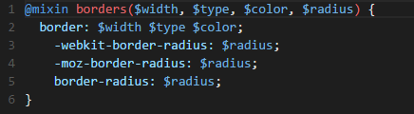


SASS
Mixins
Syntactically Awesome Style Sheet
Notes:
npm install –g grunt-cli
npm init
npm install grunt –-save-dev
npm install grunt-contrib-sass –-save-dev
npm install grunt-contrib-watch –-save-dev

Slide 17
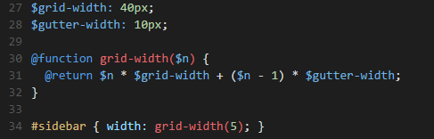
SASS
Functions
Syntactically Awesome Style Sheet
Notes:
npm install –g grunt-cli
npm init
npm install grunt –-save-dev
npm install grunt-contrib-sass –-save-dev
npm install grunt-contrib-watch –-save-dev

Slide 18
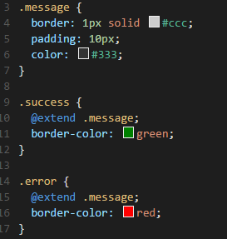
SASS
Inheritance
Syntactically Awesome Style Sheet
Notes:
npm install –g grunt-cli
npm init
npm install grunt –-save-dev
npm install grunt-contrib-sass –-save-dev
npm install grunt-contrib-watch –-save-dev

Slide 19
SASS
demo
Syntactically Awesome Style Sheet
Notes:
npm install –g grunt-cli
npm init
npm install grunt –-save-dev
npm install grunt-contrib-sass –-save-dev
npm install grunt-contrib-watch –-save-dev

Slide 21
Thank You
@riccastelhano
http://www.ricardocastelhano.net

