Slide 1



Performance Comparison of QUIC and TCL+TLS Protocols
in a File Transfer Application
Riccardo Puddu, Simone Zedda

Slide 2



Motivation
Why does this matter?
Data Transfer efficiency
TCP-TLS Drawbacks
QUIC:
Fast by design
Critical for cloud storage, video streaming, and web apps.
Extra handshakes, latency, packet loss issues.
Real-world performance needs verification.
2

Slide 3



Background
TCP-TLS Drawbacks
Separate Layers
Head-of-Line Blocking
Latency Issues
3

Slide 4



Background
QUIC Advantages
CombinedLayers
Works over UDP
Multiplexing
4

Slide 5



Implementation Overview
QUIC
File Download Request
Library Used:
aioquic [Link]
File Upload Request
Built on asyncio
Ping Request
TLS 1.3 built-in
5

Slide 6



Performances Evaluation
Handshake time
RTT and Std.Dev.
Latency Metrics
Upload/Download times
Throughput
Transfer Metrics
Pyshark Analysis
6

Slide 7
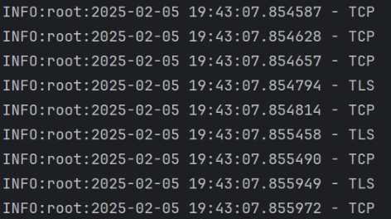
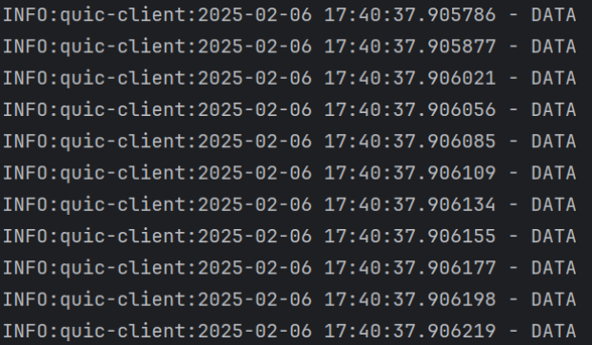
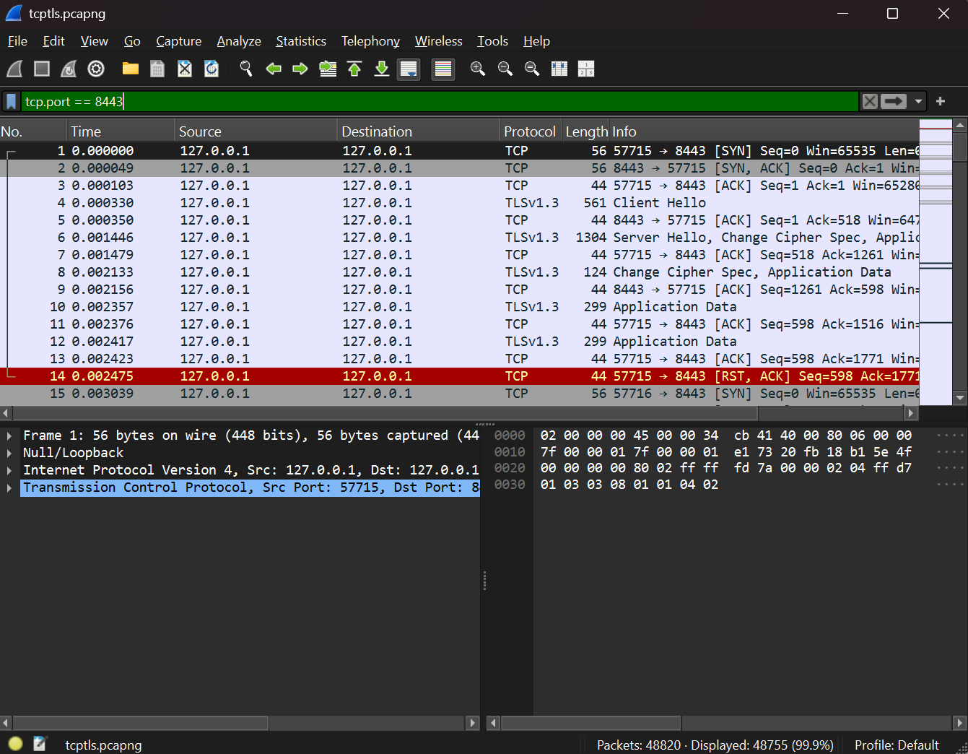
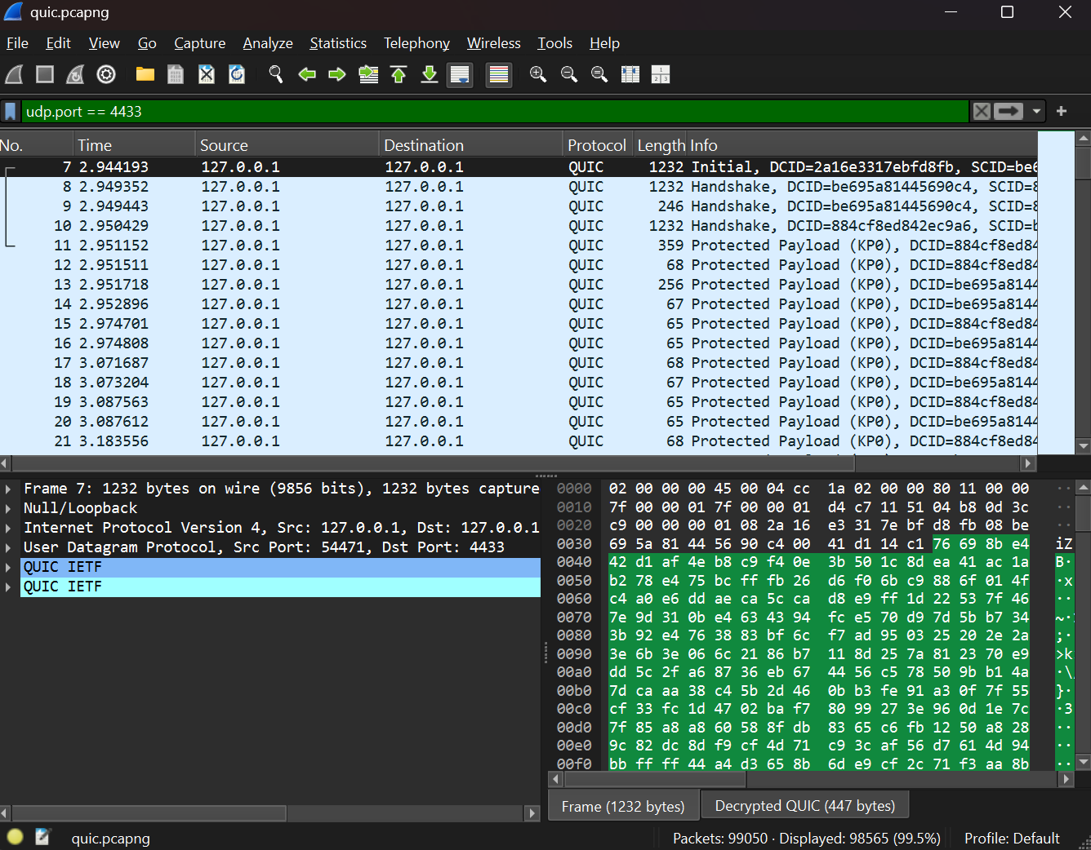
Pyshark Analysis
What does it do?
Filtering on TCP port 8443
Filtering on UDP port 4433
DATA / Protected Payload?
7
48755 packets
98565 packets

Slide 8
quic && frame.len < 100
Results Overview
Metric | TCP+TLS | QUIC
Handshake Time | 0.006s | 0.019s
Average RTT | 0.00095s | 0.0056s
RTT Std. Dev. | 0.00049 | 0.0037
Upload Time (1GB) | 4.42s | 890.67s
Upload Throughput | 246.68 MB/s | 1.15 MB/s
Download Time (1GB) | 4.28s | 885.31s
Download Throughput | 254.56 MB/s | 1.16 MB/s
TCP+TLS is faster in any condition.
Even latency is higher in QUIC.
Possible bottlenecks in QUIC due to implementation.
Why do the results differ this much?
8

