Slide 1



Performance Comparison of QUIC and TCP+TLS Protocols
in a File Transfer Application
Riccardo Puddu, Simone Zedda

Slide 2



Motivation
Why does this matter?
Data Transfer efficiency
TCP-TLS Drawbacks
QUIC:
Fast by design
Critical for cloud storage, video streaming, and web apps.
Extra handshakes, latency, packet loss issues.
Real-world performance needs verification.
2
Notes:
In today’s world, efficient and secure file transfers are more important than ever. Whether it’s cloud storage, real-time data exchange, or large-scale media distribution, speed and reliability are critical. However, the established combination of TCP and TLS - while robust and secure - comes with drawbacks. Increased latency due to extra handshake rounds and issues like head-of-line blocking can slow down data delivery, especially in environments where every millisecond counts. Our goal was to see if QUIC, a protocol designed to integrate transport and security, could significantly improve performance under these conditions.

Slide 3



Background
TCP-TLS Drawbacks
Separate Layers
Head-of-Line Blocking
Latency Issues
3
Notes:
Before diving into the specifics, it’s useful to cover some background. TCP has long been the backbone of the Internet, providing reliable data transmission over a connection-oriented network. With the growing need for secure communication, TLS was added as a separate layer to encrypt the data, which introduced additional processing and extra round trips to establish connections. One of the main issues is what we call head-of-line blocking. In a TCP connection, if one packet is lost or delayed, subsequent packets - even if they’ve been received - cannot be processed until that missing packet is retransmitted. Moreover, the separate TLS handshake adds extra time before data can even start flowing. In scenarios where multiple connections are made rapidly or the network latency is high, these delays can add up, reducing the overall efficiency of the file transfer process.

Slide 4



Background
QUIC Advantages
CombinedLayers
Works over UDP
Multiplexing
4
Notes:
Now, moving on to the advantages of QUIC. QUIC was designed to overcome many of the inherent limitations of TCP + TLS. One key feature is its streamlined connection establishment. By combining transport and security protocols, QUIC reduces the number of round trips required to open a secure connection - sometimes even achieving a 0-RTT connection for repeat communications. This means that data can start flowing much faster than with TCP + TLS. Additionally, QUIC’s architecture is built to address head-of-line blocking by allowing multiple independent data streams within a single connection. This way, if one stream experiences packet loss, it doesn’t hold up the other streams.

Slide 5



Implementation Overview
QUIC
File Download Request
Library Used:
aioquic [Link]
File Upload Request
Built on asyncio
Ping Request
TLS 1.3 built-in
5
Notes:
Let’s take a closer look at out implementation on Slide 5.
For the TCP + TLS setup, we leveraged Python’s standard libraries to build a robust and secure connection foundation. One of the features of our implementation is that the certificates and private keys are generated dynamically through our code.
On the other side, for the QUIC implementation, we chose aioquic - a specialized library built on top of Python’s asyncio. Since aioquic operates in asynchronous mode, it allows us to manage multiple connections concurrently, potentially reducing delays and boosting performance.
In addition to the protocol implementations, our application is designed with three core functionalities in mind. It can either upload a file to the server or download a file from the server, but it also provides a ping capability from both ends, which is essential for measuring latency and ensuring that the connection is responsive.

Slide 6



Performances Evaluation
Handshake time
RTT and Std.Dev.
Latency Metrics
Upload/Download times
Throughput
Transfer Metrics
Pyshark Analysis
6

Slide 7
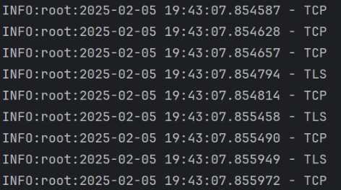
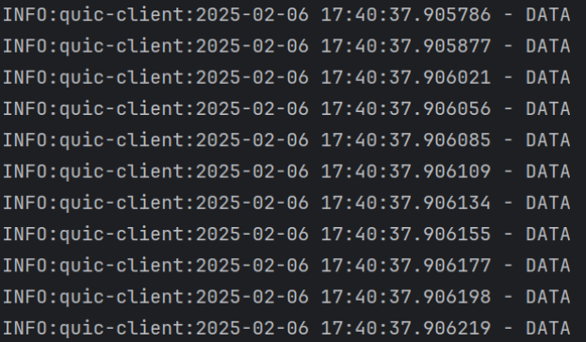
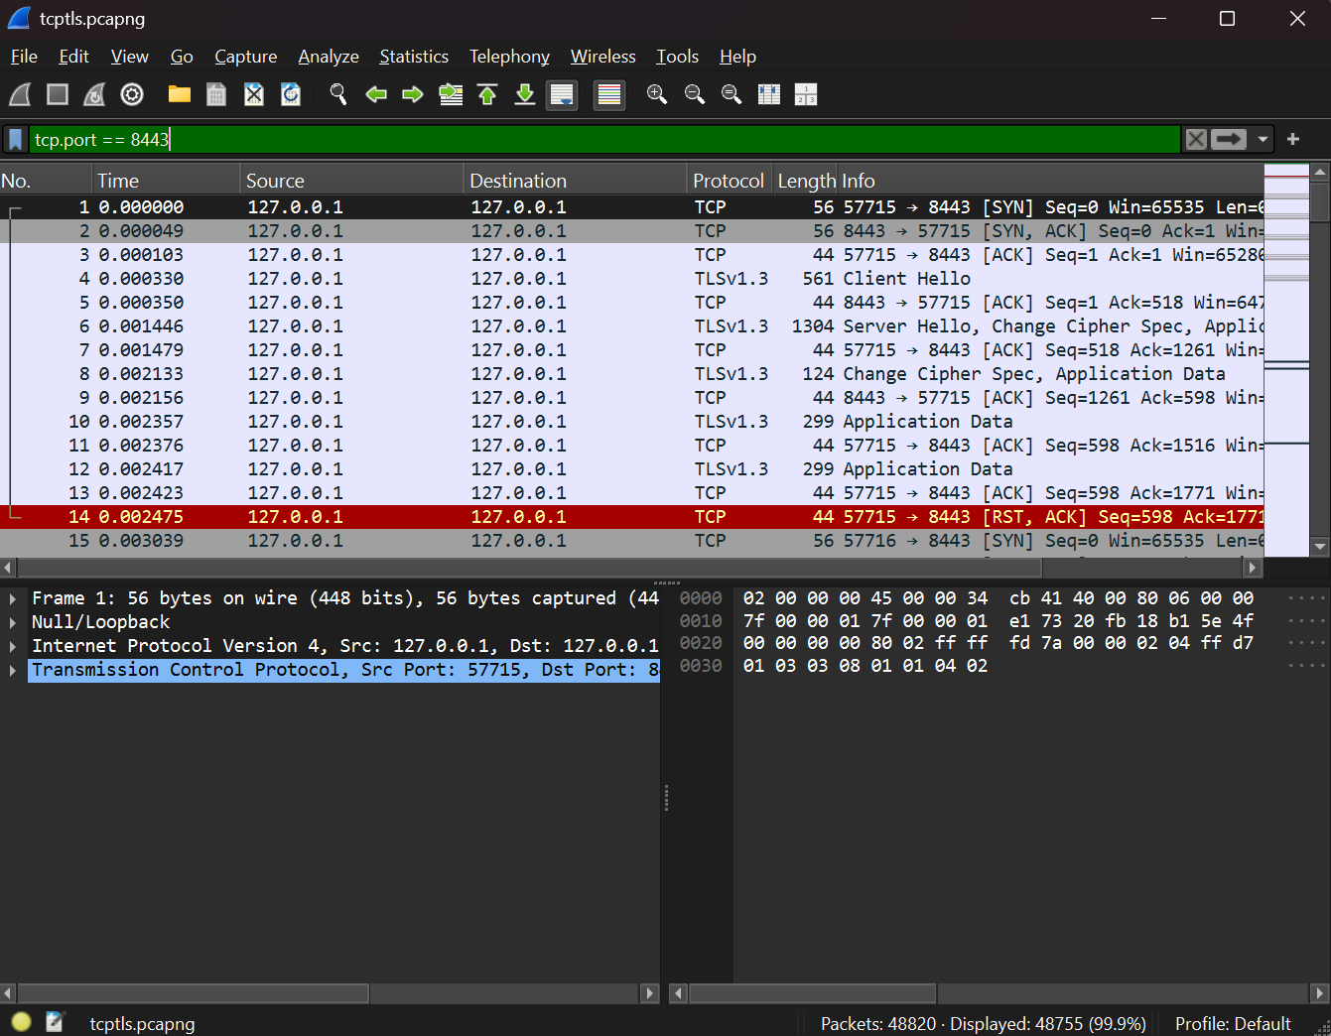
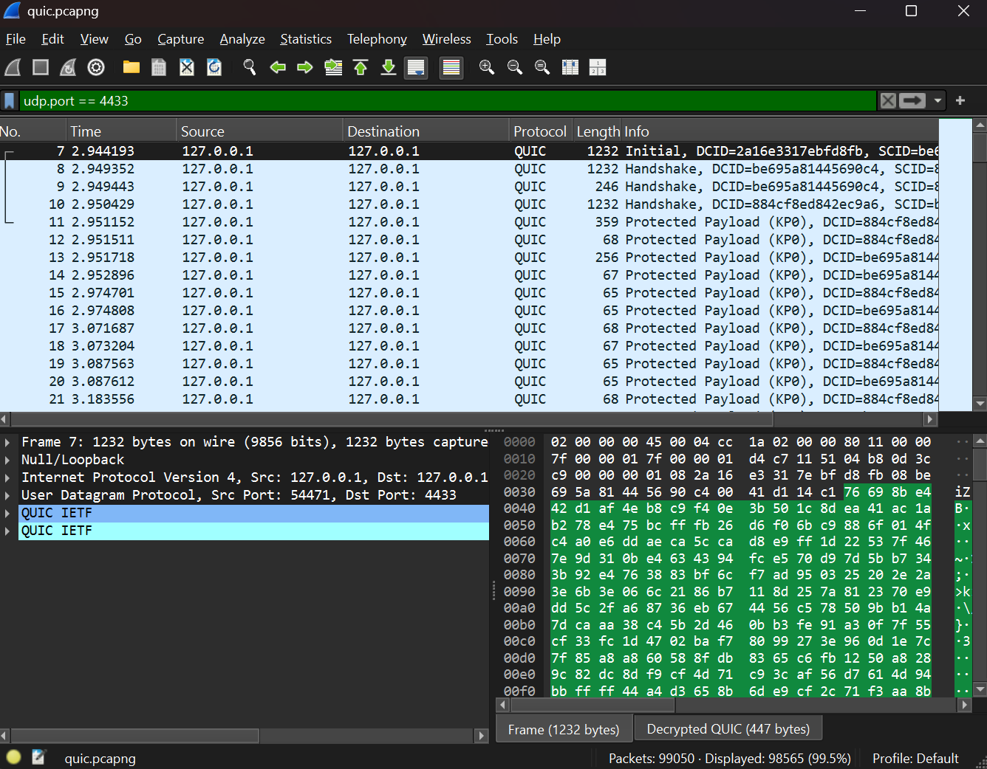
Pyshark Analysis
What does it do?
Filtering on TCP port 8443
Filtering on UDP port 4433
DATA / Protected Payload?
7
48755 packets
98565 packets

Slide 8
quic && frame.len < 100
Results Overview
Metric | TCP+TLS | QUIC
Handshake Time | 0.006s | 0.019s
Average RTT | 0.00095s | 0.0056s
RTT Std. Dev. | 0.00049 | 0.0037
Upload Time (1GB) | 4.42s | 890.67s
Upload Throughput | 246.68 MB/s | 1.15 MB/s
Download Time (1GB) | 4.28s | 885.31s
Download Throughput | 254.56 MB/s | 1.16 MB/s
TCP+TLS is faster in any condition.
Even latency is higher in QUIC.
Possible bottlenecks in QUIC due to implementation.
Why do the results differ this much?
8

