Slide 1



Performance Comparison of QUIC and TCL+TLS Protocols
in a File Transfer Application
Riccardo Puddu, Simone Zedda

Slide 2



Motivation
Why does this matter?
Data Transfer efficiency
TCP-TLS Drawbacks
QUIC:
Fast by design
Critical for cloud storage, video streaming, and web apps.
Extra handshakes, latency, packet loss issues.
Real-world performance needs verification.
2

Slide 3
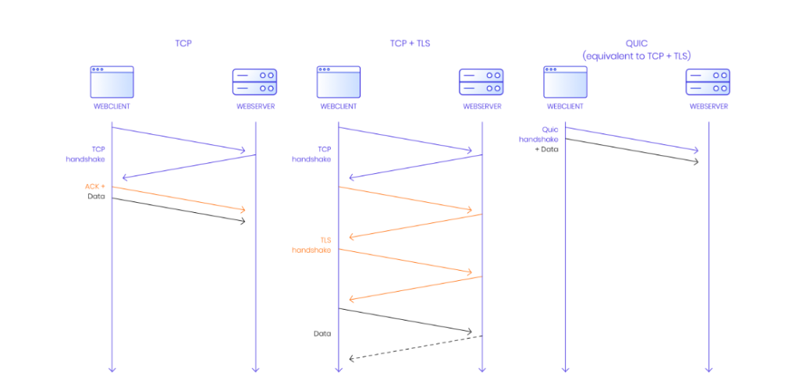
State of the Art
3

Slide 4



Implementation Overview
QUIC
File Download Request
Library Used:
aioquic [Link]
File Upload Request
Built on asyncio
Ping Request
TLS 1.3 built-in
4

