Slide 1

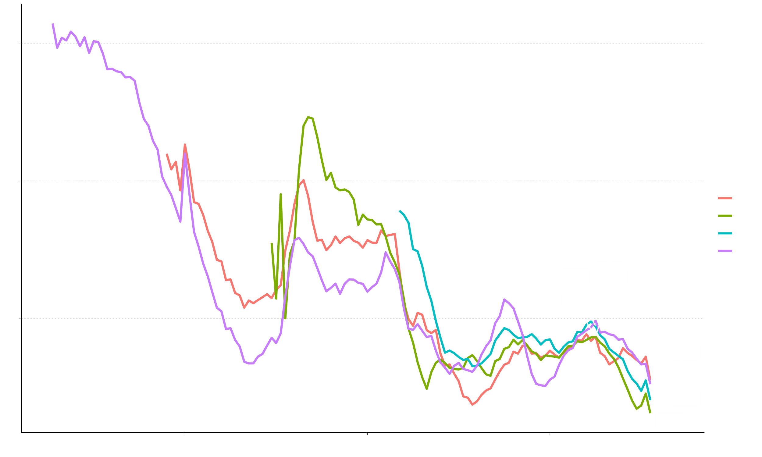
Empirical Prediction Intervals for Forecasts of Nordic Fertility Work in Progress
Ricarda Duerst^{1,2}, Julia Hellstrand², Jonas Schöley¹
¹ Max Planck Institute for Demographic Research ² University of Helsinki

Slide 2
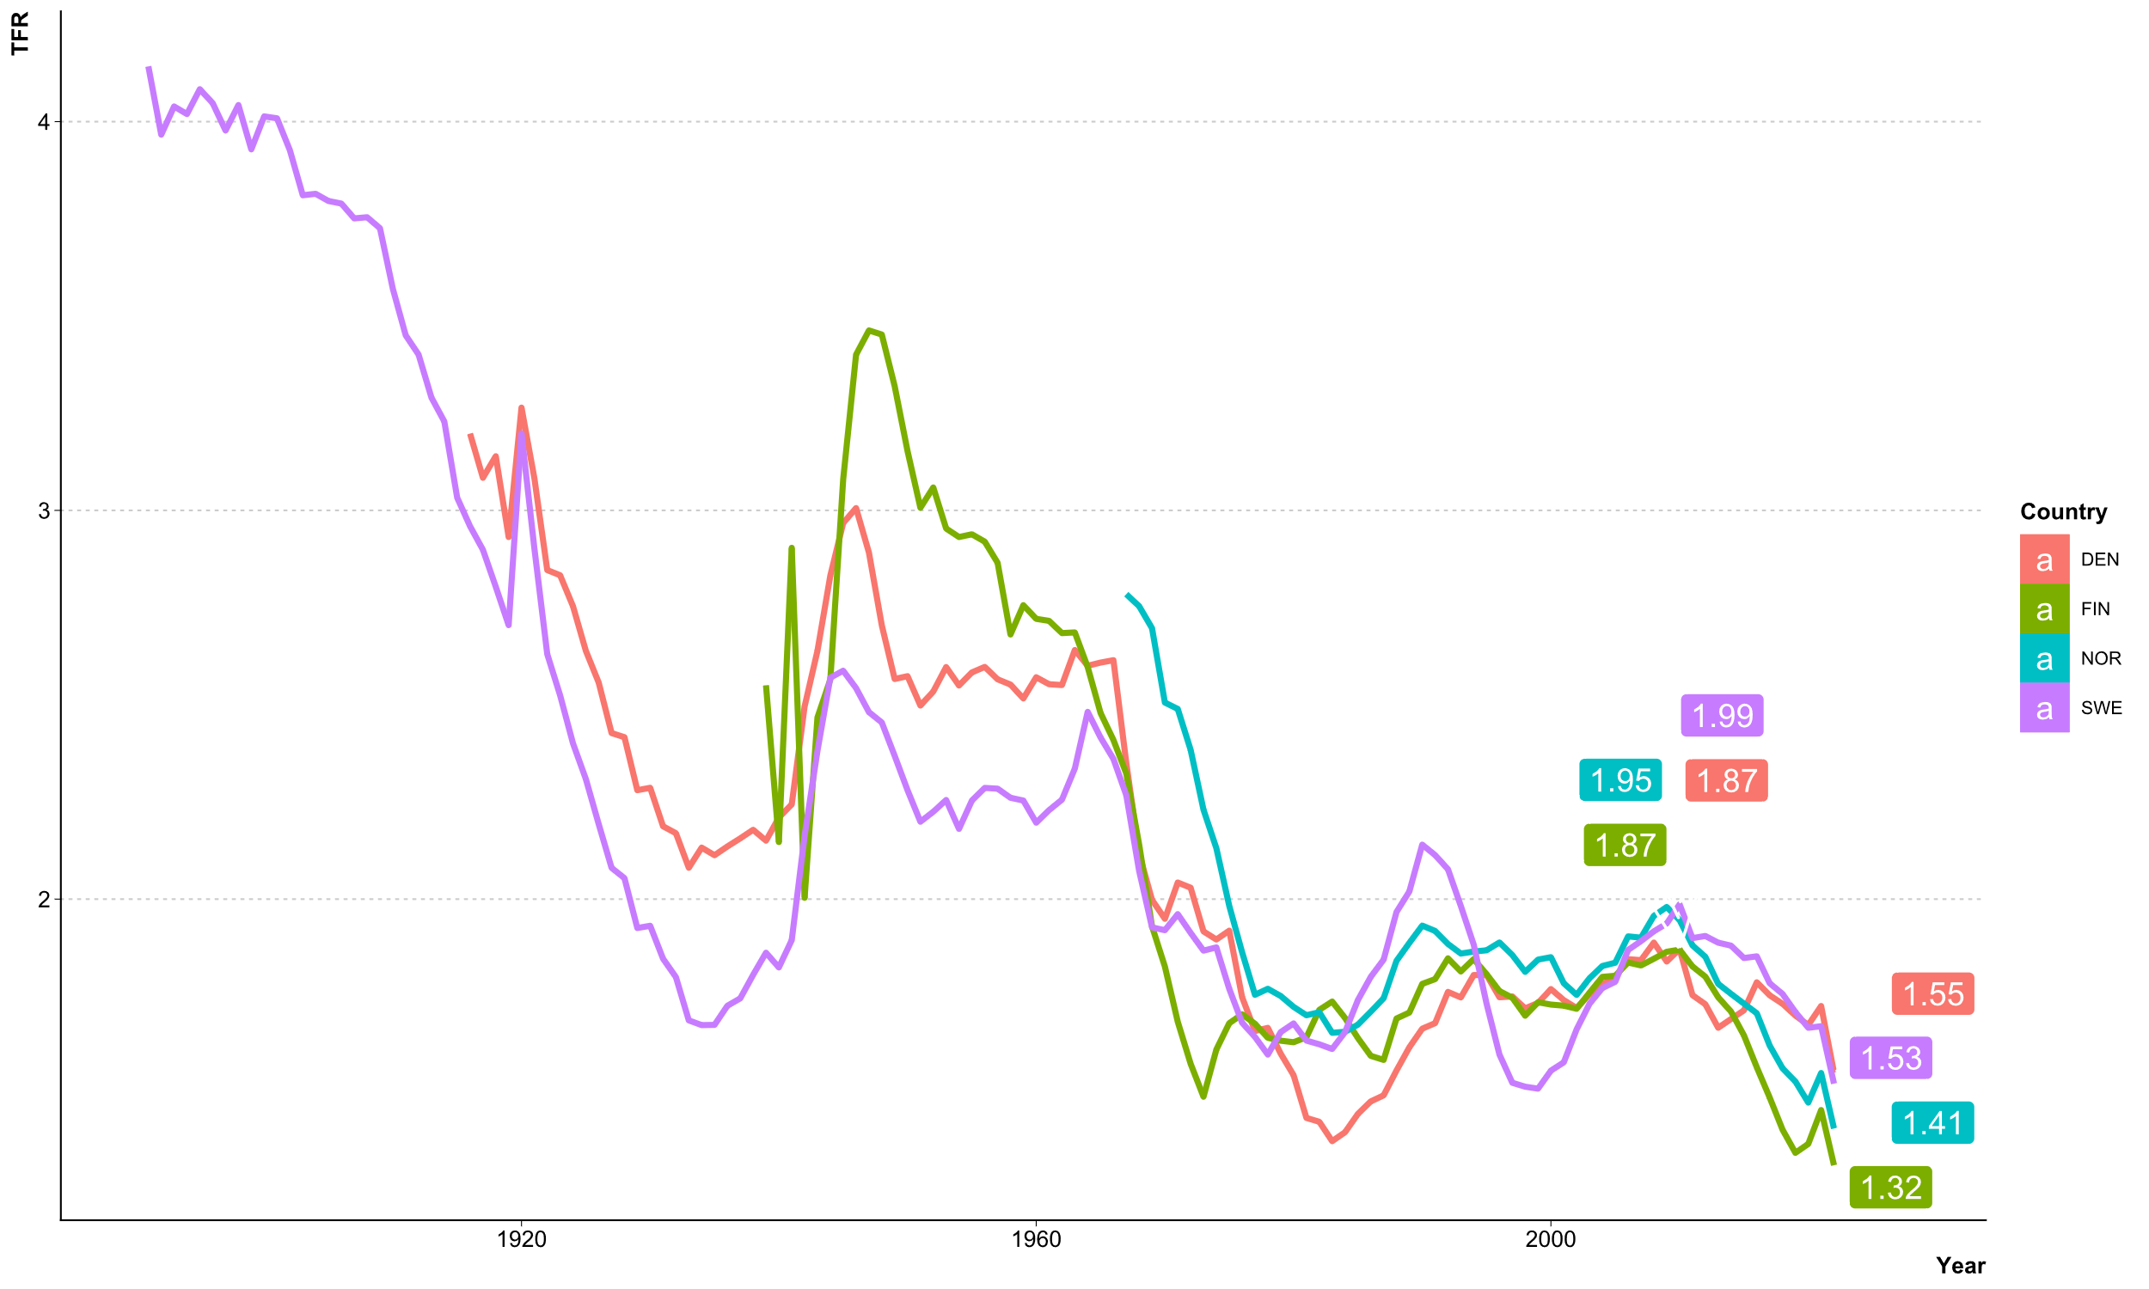
Fertility development in the Nordic Countries
2010
2022

Slide 3
Fertility development in the Nordic Countries
What is needed?
Forecasts of Nordic Fertiliy
With sensible prediction intervals
What do we have?
A variety of forecast models of different types
With model-based prediction intervals that are too narrow

Slide 4
Research Plan
TFR forecasts with empirical prediction intervals
Up to 2050
Quantification of distribution of forecast errors
For forecasts based on: extrapolative models, scenario-based models, and published forecasts
Comparison of prediction intervals
Model-based PIs, empirical PIs based on cross-validation, empirical PIs based on published forecasts
For: Sweden, Denmark, Norway, and Finland

Slide 5
The principle of empirical prediction intervals
A forecast is only as precise as similar forecasts in the past turned out to be.
Calibration
Validation
Application

Slide 6
empirical prediction intervals – A sleeping beauty
Statistics/Economics
Williams & Goodman, 1971: A Simple Method for the Construcion of Empirical Confidence Limits for Economic Forecasts. Journal of the American Statistical Association. https://doi.org/10.1080/01621459.1971.10482340
Demography
Stoto, 1983: The Accuracy of Population Projections. Journal of the American Statistical Association. https://doi.org/10.1080/01621459.1983.10477916
Keilman & Pham, 2004: Time Series Based Errors and Empirical Errors in Fertility Forecasts in the Nordic Countries. International Statistical Review. https://doi.org/10.1111/j.1751-5823.2004.tb00220.x
Machine Learning
Shafer & Vovk, 2008: A Tutorial on Conformal Prediction. Journal of Machine Learning Research. https://www.jmlr.org/papers/volume9/shafer08a/shafer08a.pdf

Slide 7
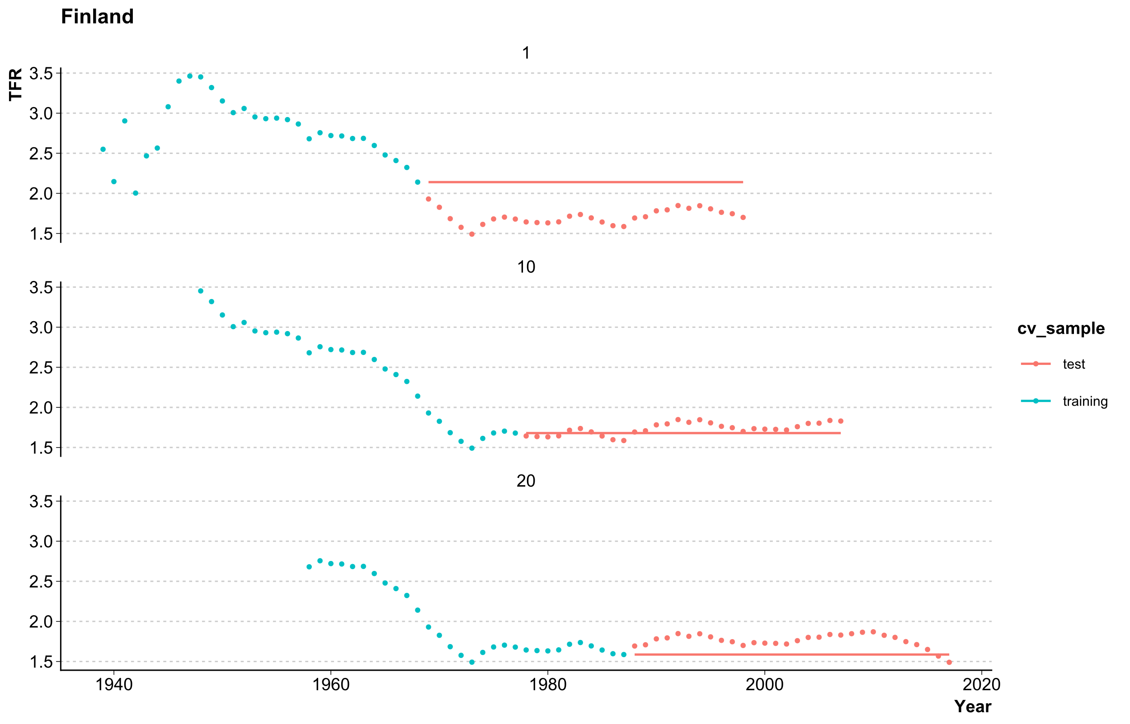
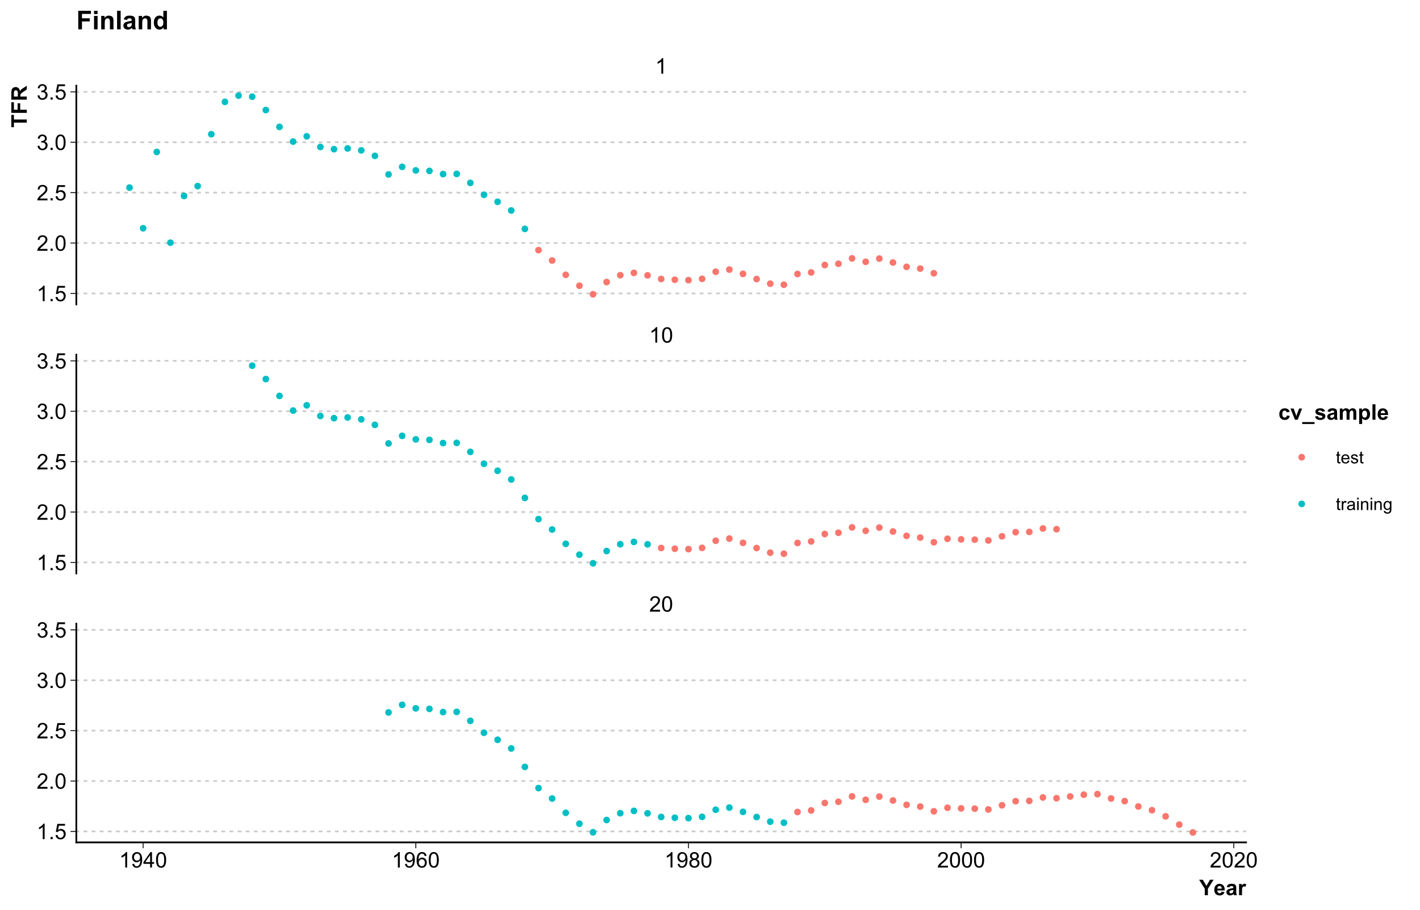

empirical prediction intervals from cross-validation
Country | Training/ Test Length | Nr. of Series | Validation Series
Finland | 30/30 | 25 | Last 5
Sweden | 30/30 | 73 | Last 5
Denmark | 30/30 | 48 | Last 5
Norway | 30/15 | 12 | Last 5
Naive forecast (for demonstration purposes only)
Forecast models
Lee-Carter for age-specific mortality rates
ARCH model for TFR
Scenario-based model by Julia
Published forecasts*

Slide 8
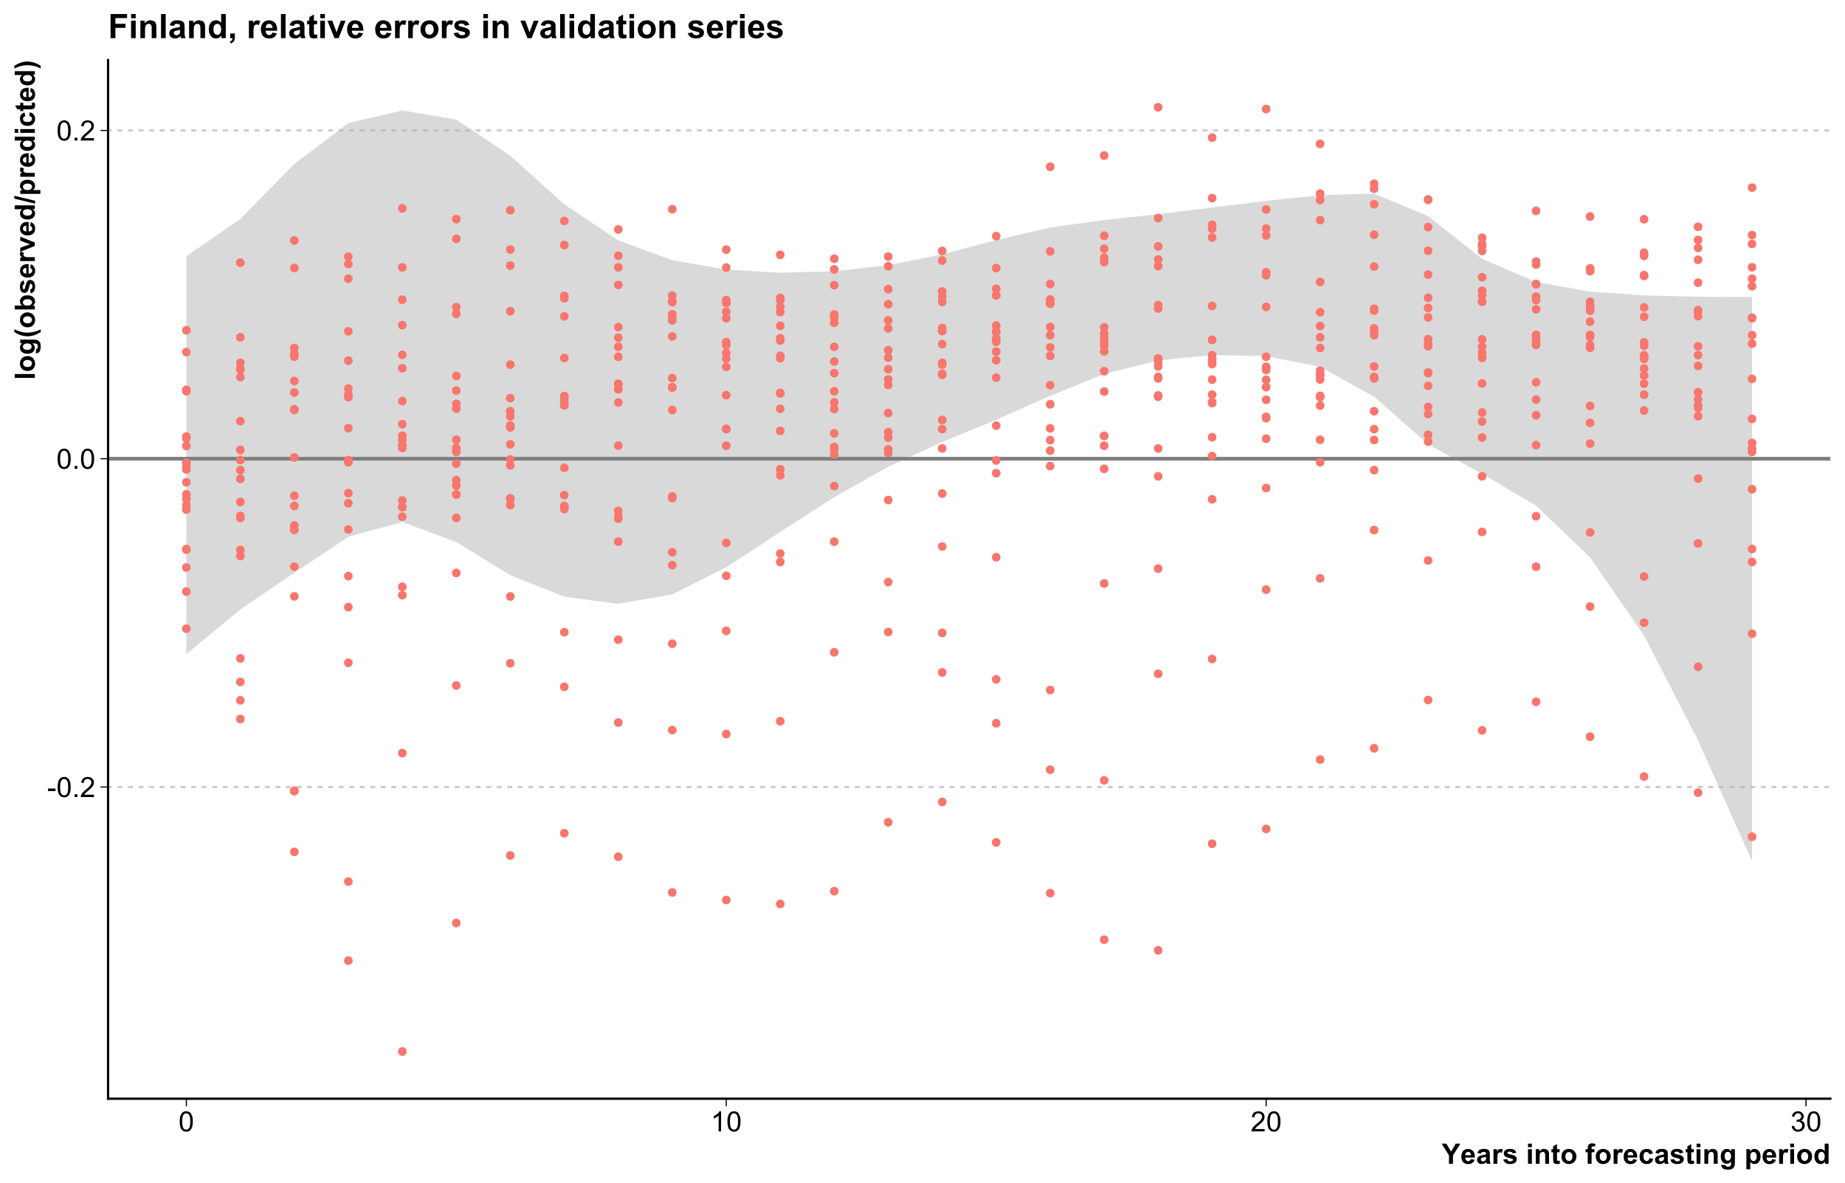

empirical prediction intervals from cross-validation
Naive forecast (for demonstration purposes only)
Forecast models
Lee-Carter for age-specific mortality rates
ARCH model for TFR
Scenario-based model by Julia
Published forecasts*
Forecast Error
Error distribution models
Skew-normal distribution
Raw quantiles

Slide 9

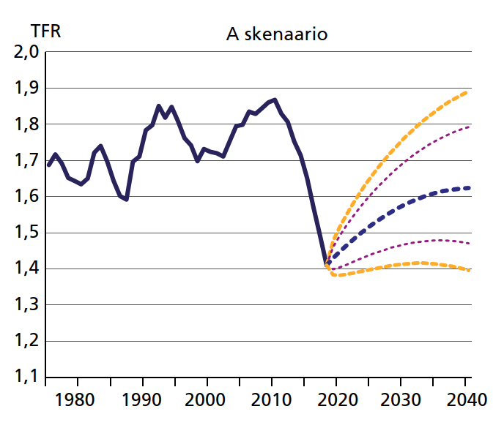
Empirical Prediction intervals For Scenarios
Fertility and its determinants in the coming decades in Finland
Nisén, Hellstrand, Martikainen, Myrskylä, 2020:
Hedelmällisyys ja siihen vaikuttavat tekijät Suomessa lähivuosikymmeninä.
Yhteiskuntapolitiikka. https://urn.fi/URN:NBN:fi-fe2020091669848
Assumption
Fertility postponement will continue, but gradually slow down and eventually stop → tempo-adjusted TFR and TFR will converge by the end of the forecast horizon
How to cross-validate a scenario with historic data to receive empirical prediction intervals?

Slide 10
Empirical Prediction intervals For Scenarios
Fertility postponenment began in the 1970s is the Nordics
Consensus among researchers in the past on slowing down of postponement and ist effects
Application of scenario-based method to fitting time periods

Slide 11
Empirical Prediction intervals From Publications
Keilman & Pham, 2004: Time Series Based Errors and Empirical Errors in Fertility Forecasts in the Nordic Countries. International Statistical Review. https://doi.org/10.1111/j.1751-5823.2004.tb00220.x
Estimation of forecast error distribution from real historical forecasts

Slide 12
Research Plan
TFR forecasts with empirical prediction intervals
Up to 2050
Quantification of distribution of forecast errors
For forecasts based on: extrapolative models, scenario-based models, and published forecasts
Comparison of prediction intervals
Model-based PIs, empirical PIs based on cross-validation, empirical PIs based on published forecasts
For: Sweden, Denmark, Norway, and Finland

Slide 13

Empirical Prediction intervals are great!
Ricarda Duerst
MPIDR University of Helsinki
duerst@demogr.mpg.de
Julia Hellstrand
University of Helsinki
Julia.hellstrand@helsinki.fi
Jonas Schöley
MPIDR
schoeley@demogr.mpg.de

