Slide 1
Ski Rush
Ricardo Antunes + 115243
Introduction to Computer Graphics – 2024/2025

Slide 2
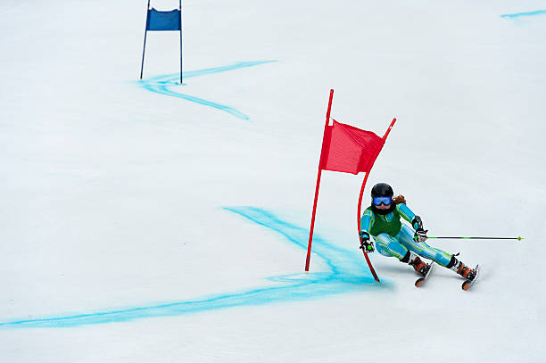
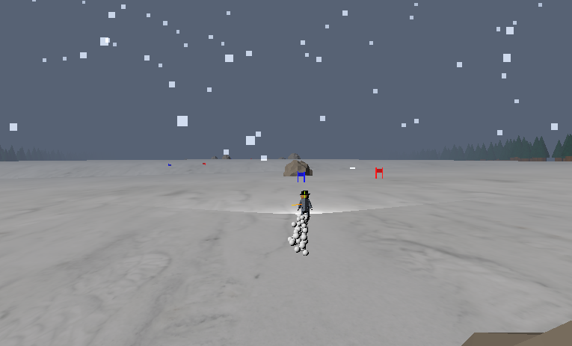
Concept
Skiing Game with single-player and multi-player
Pass through the gates / run away from your opponent
Attempt to mimic real life physics and skiing mechanic

Slide 3
Main ideas
High-speed, high-adrenaline game
User can control the skier and the camera when in first-person
Three.js for rendering and models, SimplexNoise for rock sharpness
URL – https://ricardo-alexandre-antunes.github.io/ICG_Project/

Slide 4
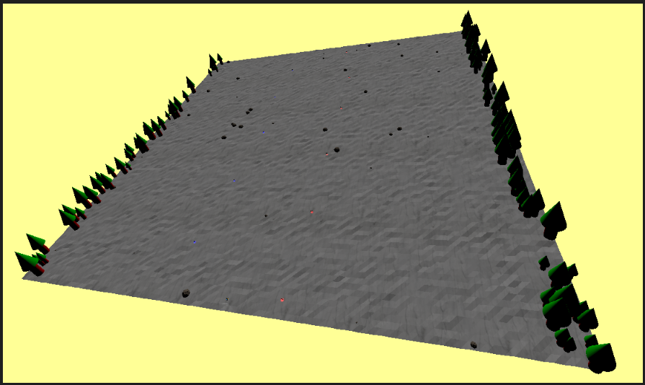
Models
Mountain

Slide 5
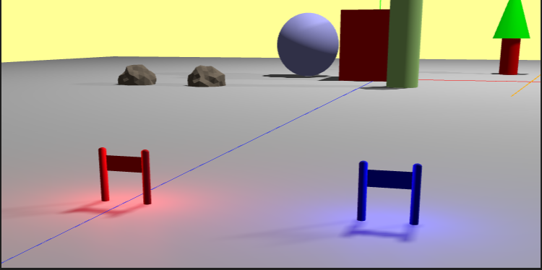
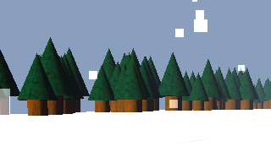
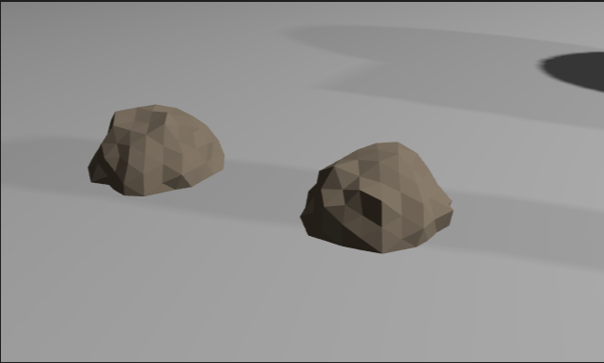
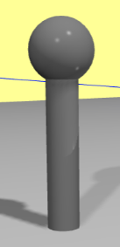
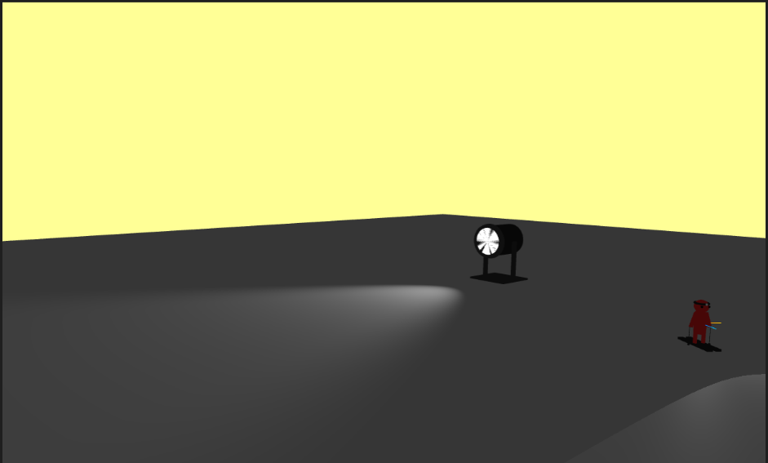
Models - Mountain
Gates
Trees
Rocks
<-
(Not in final product, but present in files)
->
Pole
Spotlight

Slide 6
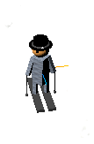
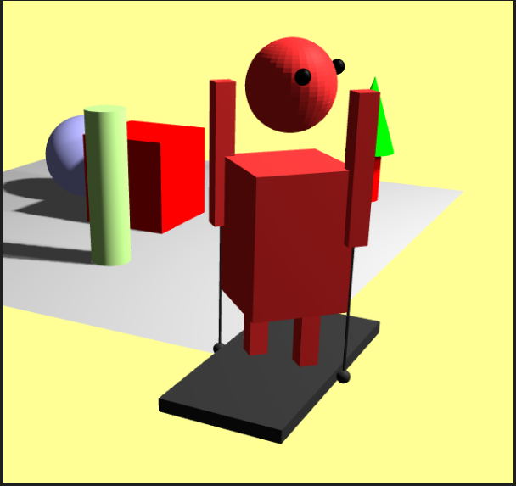
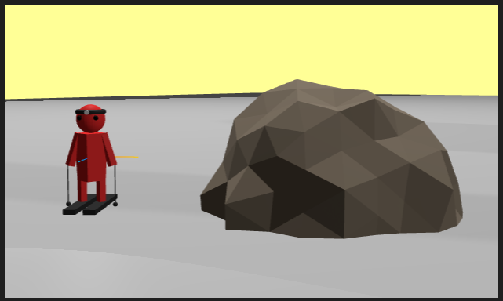
Models
Character

Slide 7
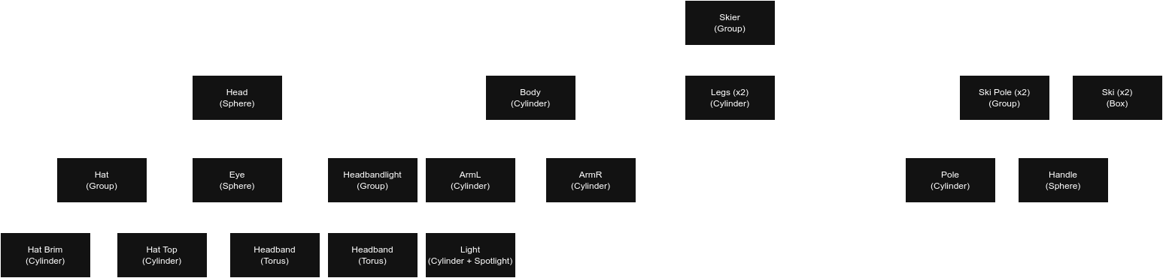
Models - Character

Slide 8
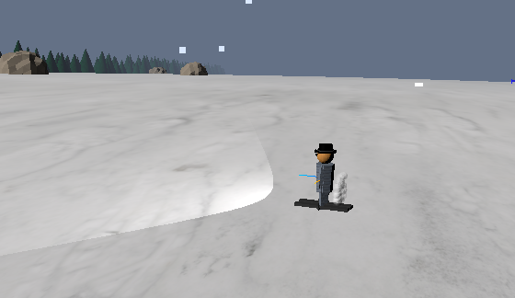
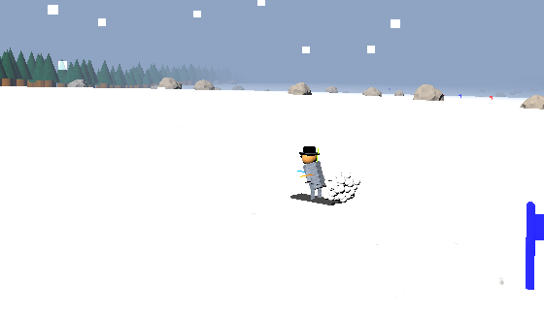
Animation
Skier has one animation triggered on acceleration
Leans forward when accelerating

Slide 9
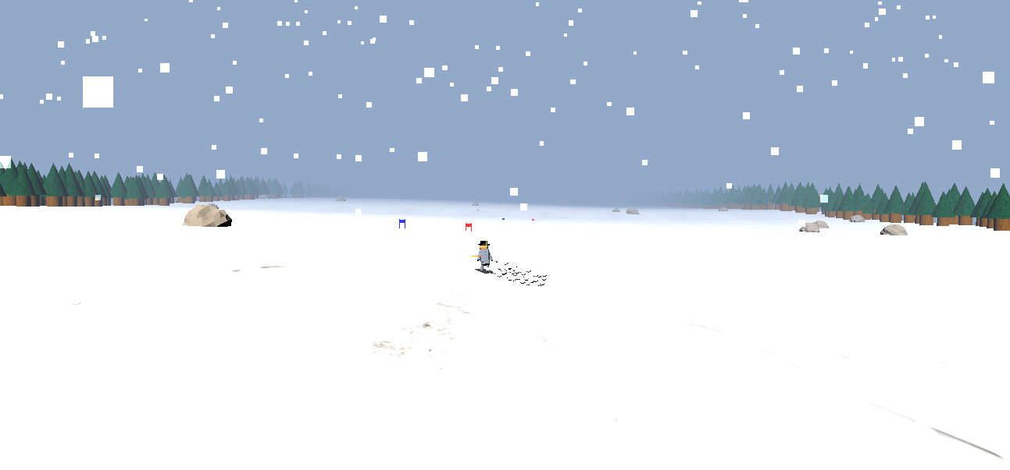
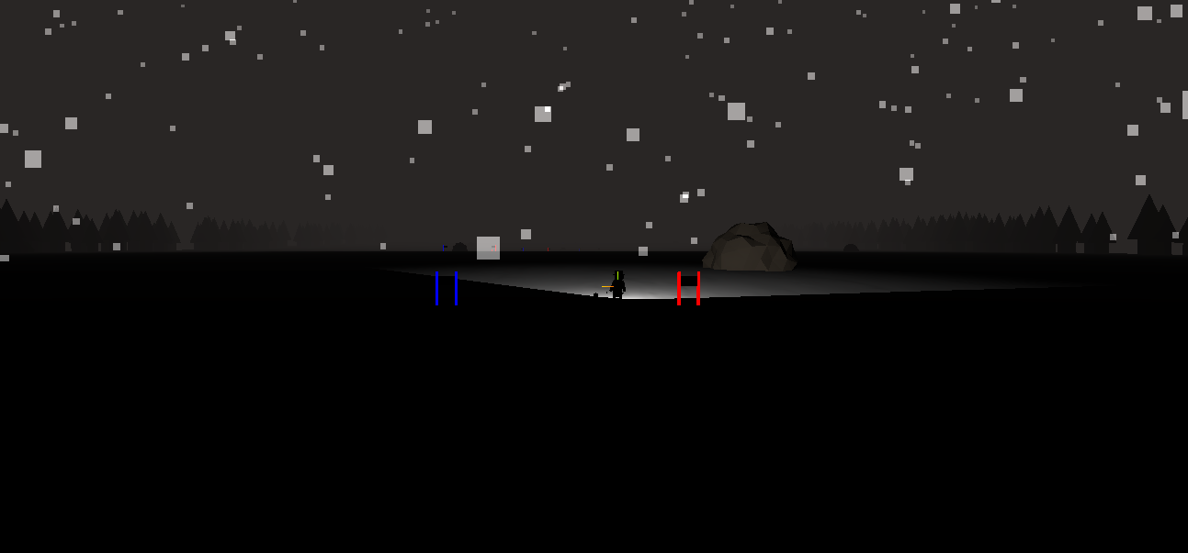
Illumination
There is a Sun entity that emits light (Directional Light), serves as Day / Night Cycle
The Skier has a headlight (SpotLight) that serves to light the road ahead when there is night

Slide 10
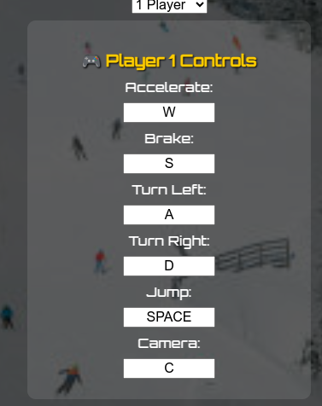
User Interaction
User can setup controls at the beginning of the
game to move and jump
User can switch to first person camera and control
the camera with the mouse

Slide 11
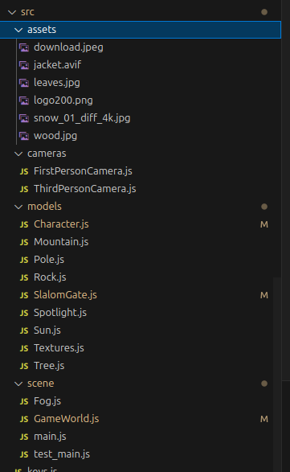
Development
Index.html only contains basic html
Every entity separated in different files
Object-oriented programming
Project complexity was highly increased due to my
personal high-standarts
Couldn’t finish many features nor refine the ones
I have in the way I wanted

Slide 12
Conclusions
This project was a great introduction to managing entities and different aspects such as lighting, shadows and physics
Being able to do a game (free theme) made this much more enjoyable
A LOT of work would need to be put in order to put this in a satisfactory level
Explored a lot of concepts in the classes and in Three.js, especially when creating the skier movement, where manipulating the skier’s position and rotation matrixes was needed

Slide 13
References
References are linked in the code
https://github.com/simondevyoutube → this github and videos helped me structure my code and build my camera objects

