Slide 1


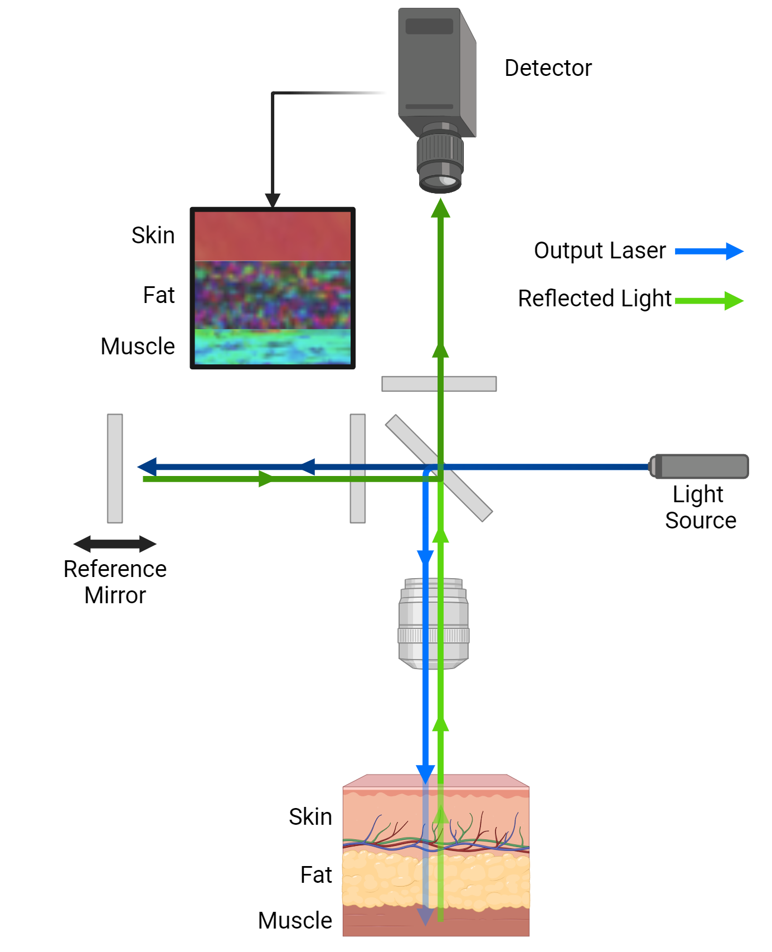
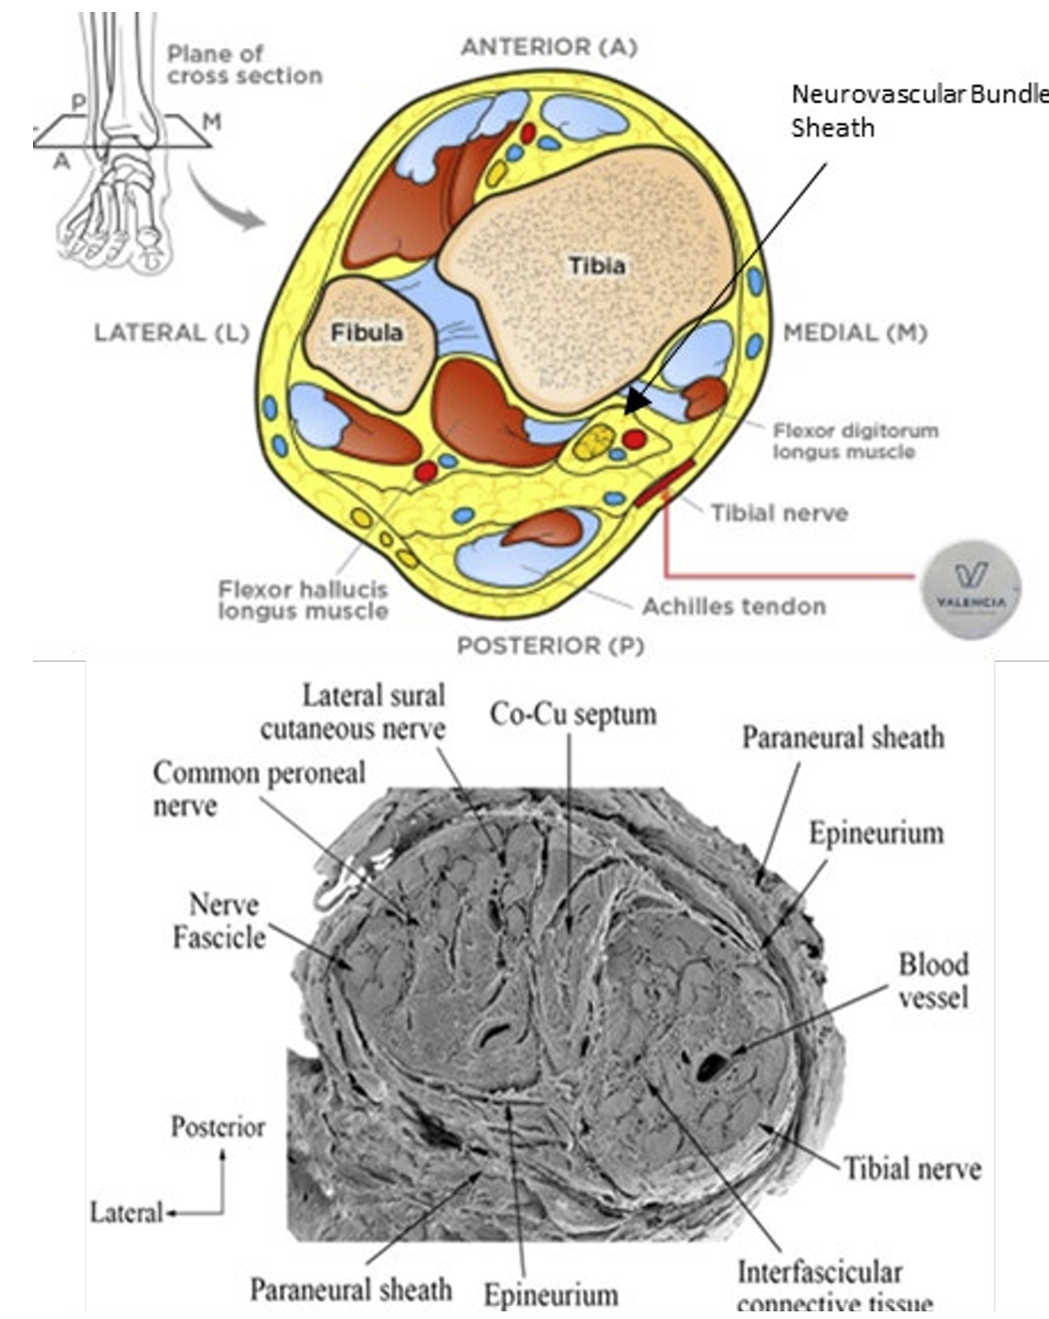
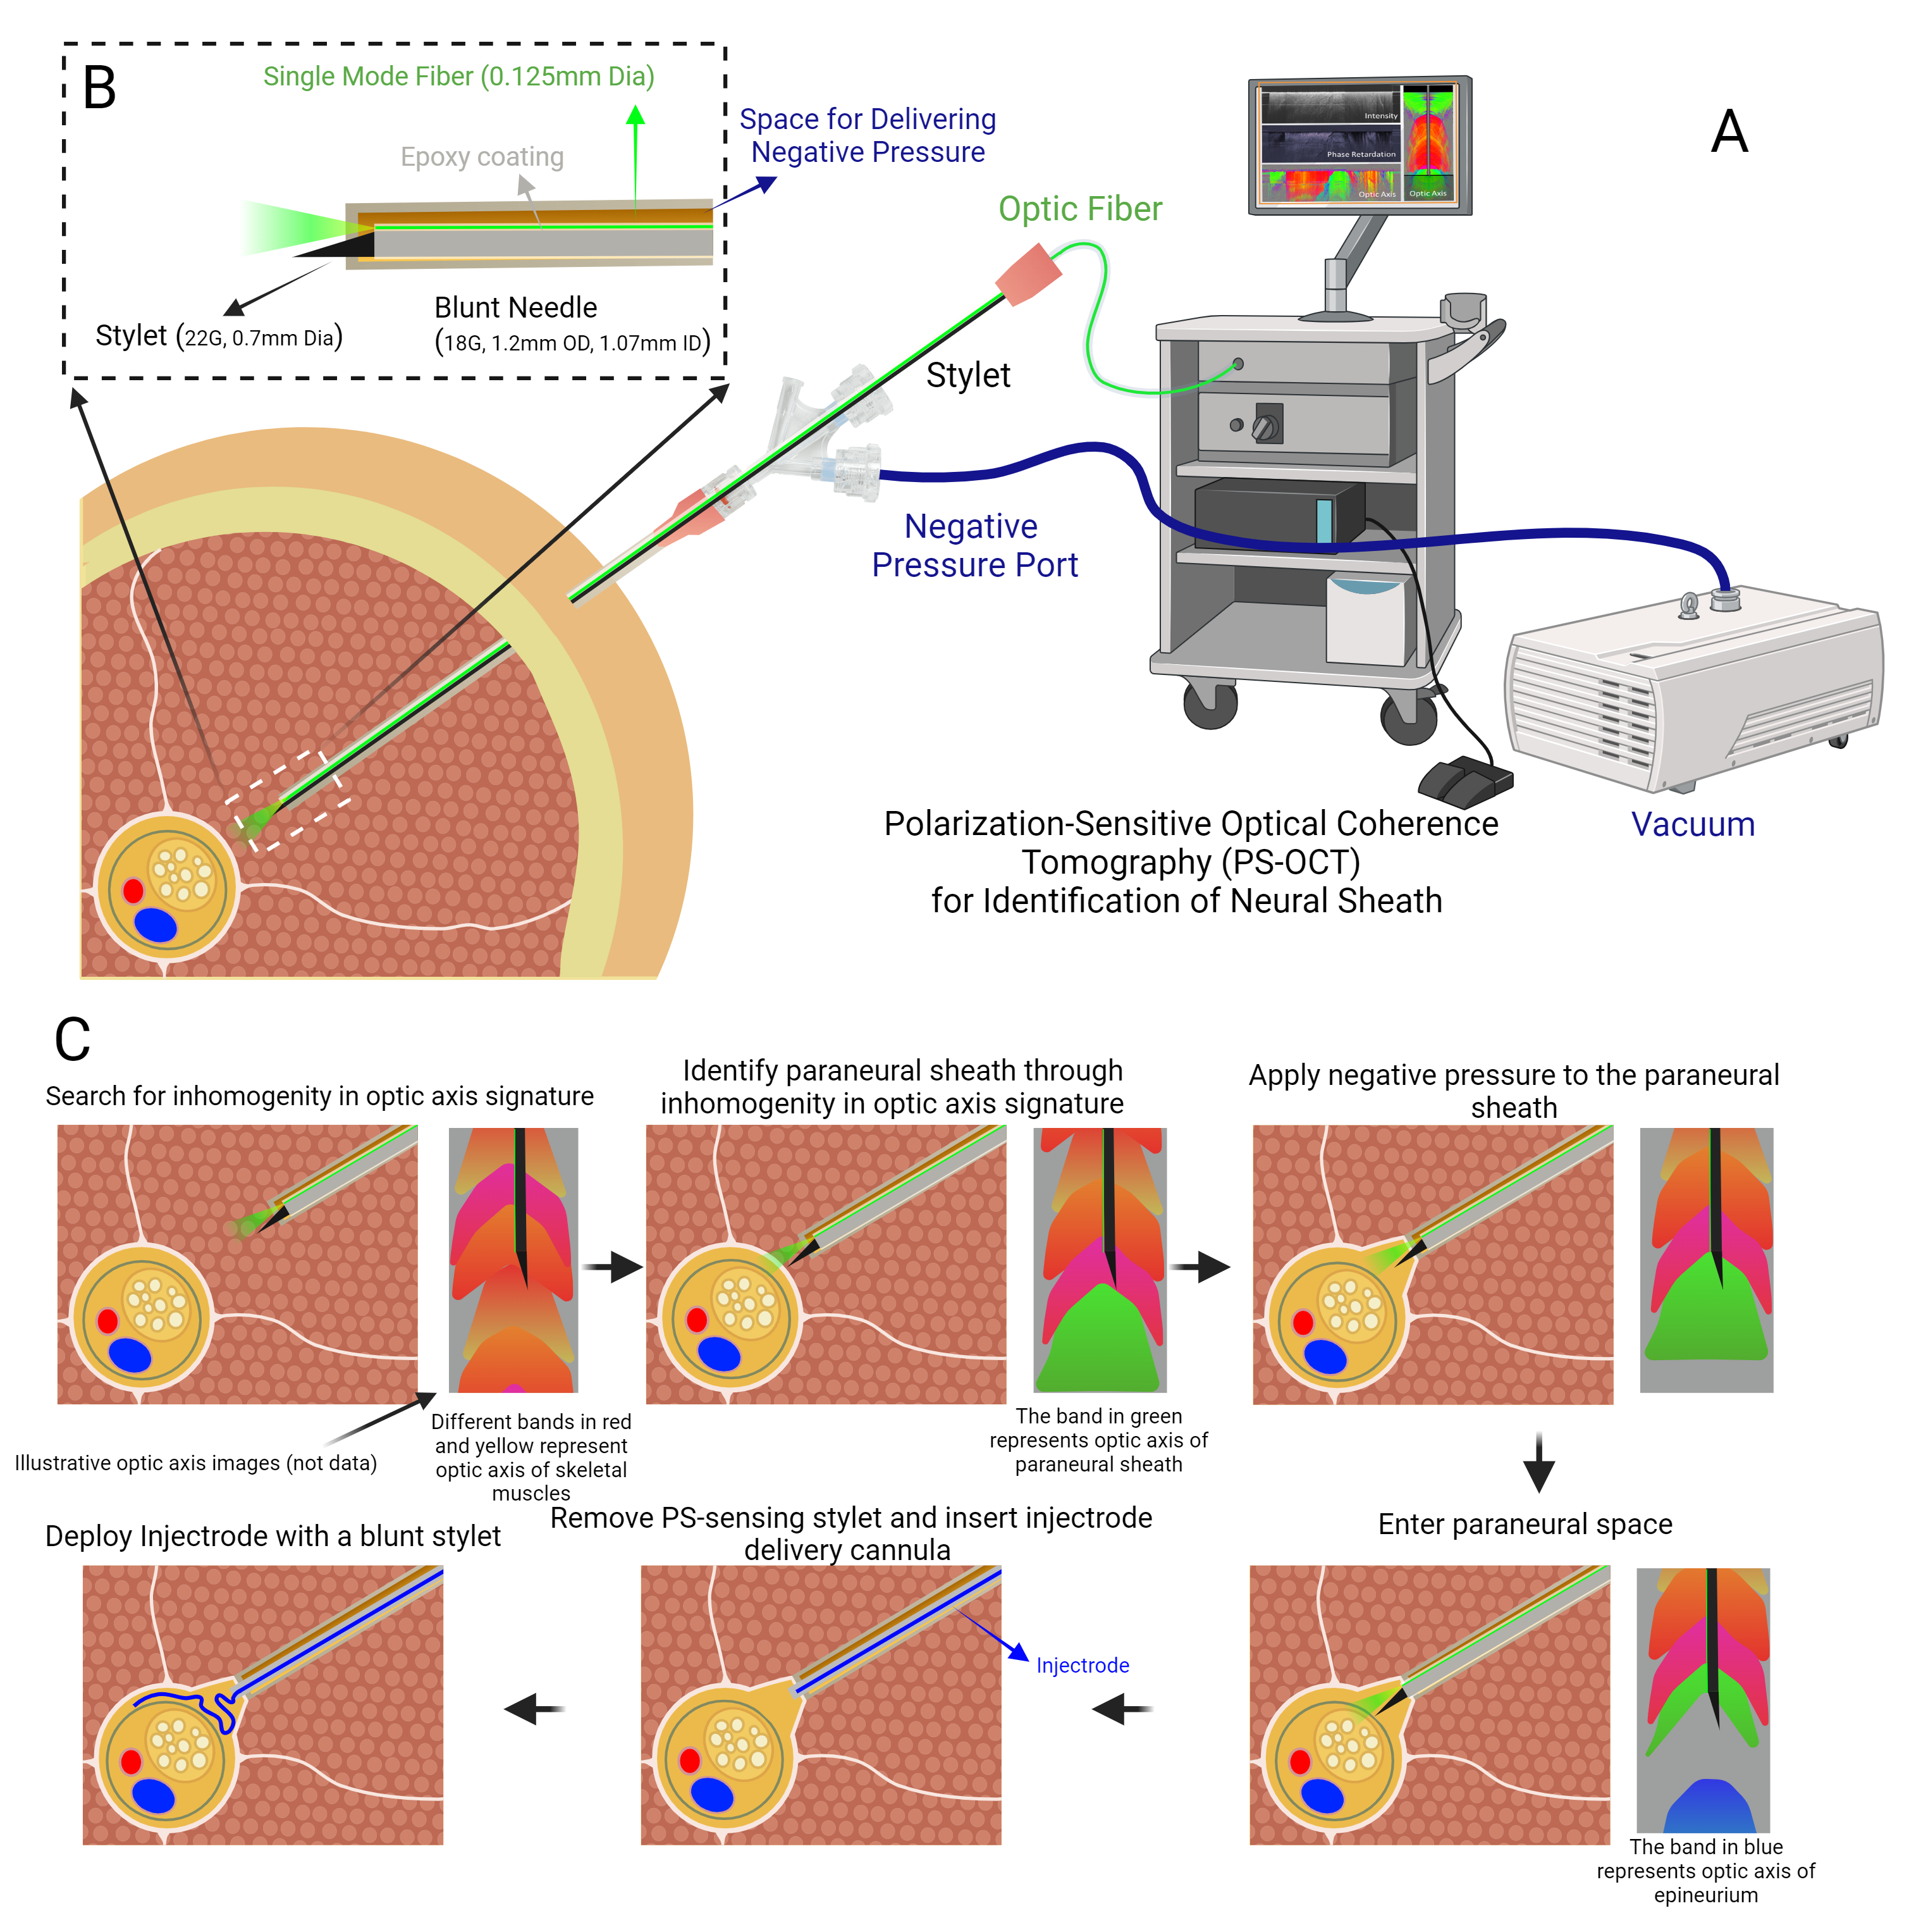
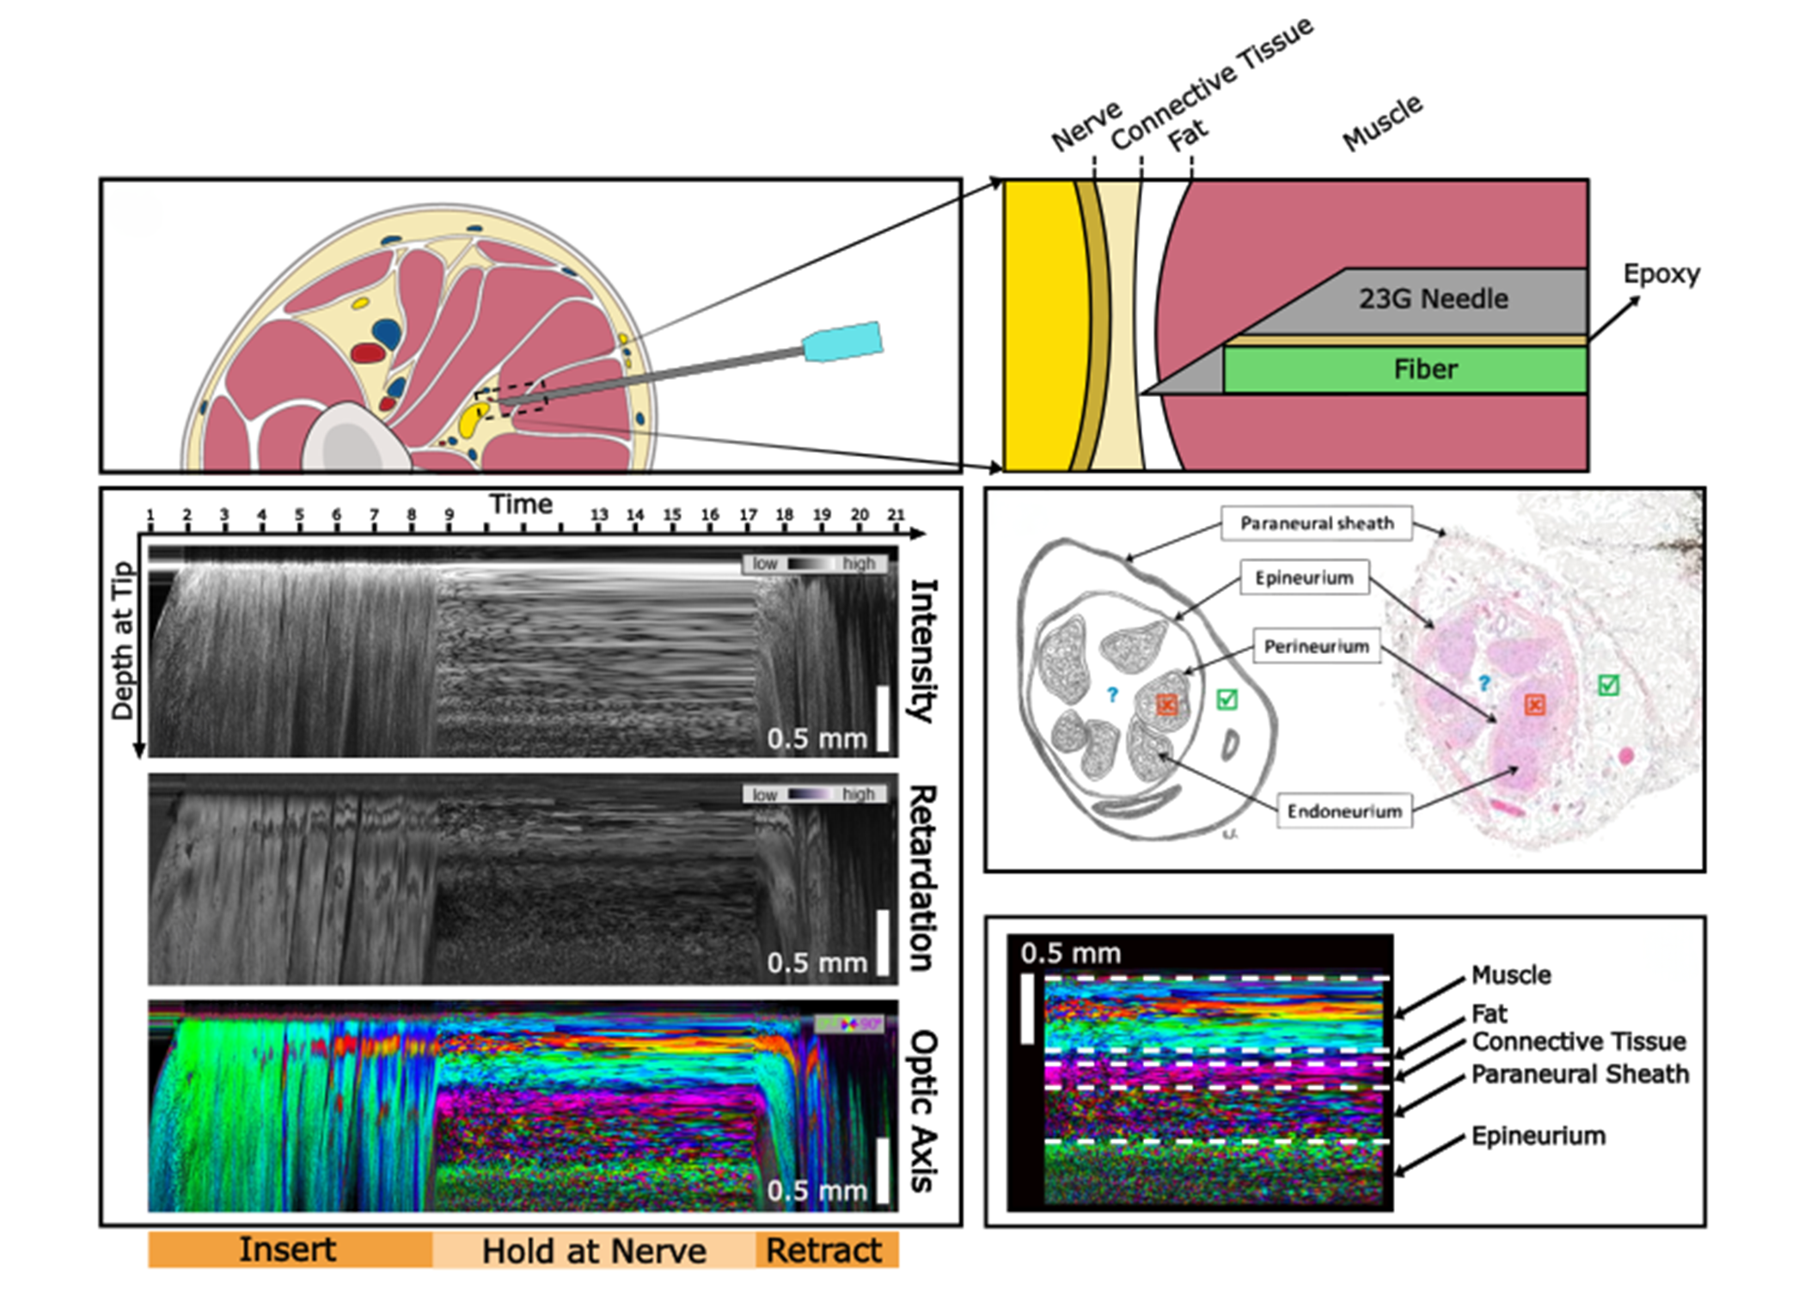
Minimally Invasive Nerve Layer Identification Using PSOCT for Optimized Electrode Placement in PTNS.
Ricardo Sanchez^{1,2}, Rex Chen^{1,2}, Kip Ludwig^{1,2,3}
[1] Wisconsin Institute for Translational Neuronginering (WITNe), University of Wisconsin, Madison, Wisconsin, [2] Dept. of Biomedical Engineering, University of Wisconsin, Madison, Wisconsin, [3] Dept. of Neurosurgery, University of Wisconsin, Madison, Wisconsin
Introduction
Methods
Conclusions
Peripheral tibial nerve stimulation (PTNS) is commonly used to treat conditions like overactive bladder (OAB), but both clinic-placed needles and implanted systems avoid direct contact with the posterior tibial nerve due to risks of nerve damage and compression, which can cause chronic pain or tarsal tunnel syndrome. Current methods place electrodes several millimeters from the nerve, limiting therapeutic effect. Optimal therapeutic results requires placing the electrode closer to the nerve, ideally on the epineurium, while avoiding damage to surrounding tissue layers.
Porcine models were selected for this study due to the similarities in neural-anatomical size to humans. A 1.5-inch, 23-gauge needle probe with an embedded optical fiber was mounted on a Siskiyou MX7600 Series micromanipulator. The probe was inserted through two layers of muscle and carefully positioned at the estimated surface of the sciatic nerve. It was held in place for 30 seconds to capture data before being withdrawn. After the procedure, the sciatic nerve and surrounding muscle tissue were dissected to identify and verify the tissue layers.
The initial results are promising in identifying tissue layers and are a meaningful contribution to further iterations of the needle probe. These improvements will serve to develop a probe to increase the safety of implantations while maximizing the therapeutic effects.
Future Plans
To address this issue, we developed a minimally invasive needle probe with polarization-sensitive optical coherence tomography (PSOCT) to accurately identify the surrounding tissue layers and improve electrode placement.
Future experiments will focus on iterative improvements to the needle probe, integrating the capability to inject tissue dye for validation of the recorded tissue layers. This will allow us to directly confirm the accuracy of the PSOCT system’s tissue identification. Additionally, we will assess the probe’s performance with injectable materials to further refine its precision and reliability in clinical applications. Furthermore, the probe will be changed with suction functionality, similar to that used in endoscopic surgical probes, to improve precision during procedures and ensure clearer access to key tissue layers for accurate identification and electrode placemen
Results
The PSOCT data showed clear changes in tissue layers as the needle probe neared the muscle-sciatic nerve interface, with polarization data aligning with shifts in fiber directionality. After post-examination, the polarization data putatively correlated with the identified tissue layers. This correlation supports the probe’s potential to distinguish between muscle, connective tissue, and nerve sheaths based on polarization characteristics.
Acknowledgments
Future Work
Funding: NIH (1R01NS138422-01), and The Grainger Institute for Engineering – University of Wisconsin Madison
Institutions: Thank you to the FDA (Ilyas Saytashev) and Harvard (Benjamin J. Vakoc and Danielle J. Harper) for their instrumental help with the SPARK PSOCT system.
Objective
Evaluate the probe’s ability to identify tissue layers around the sciatic nerve in a porcine model. To develop a probe that can safely guide electrode placement close to the nerve, improving stimulation precision and reducing the risk of adverse effects in OAB treatment.

