Slide 1



Slide 2

Group 35
Lobes of Confusion
Tharan
Jonathan
Ricardo
Nicholas
Aaron

Slide 3
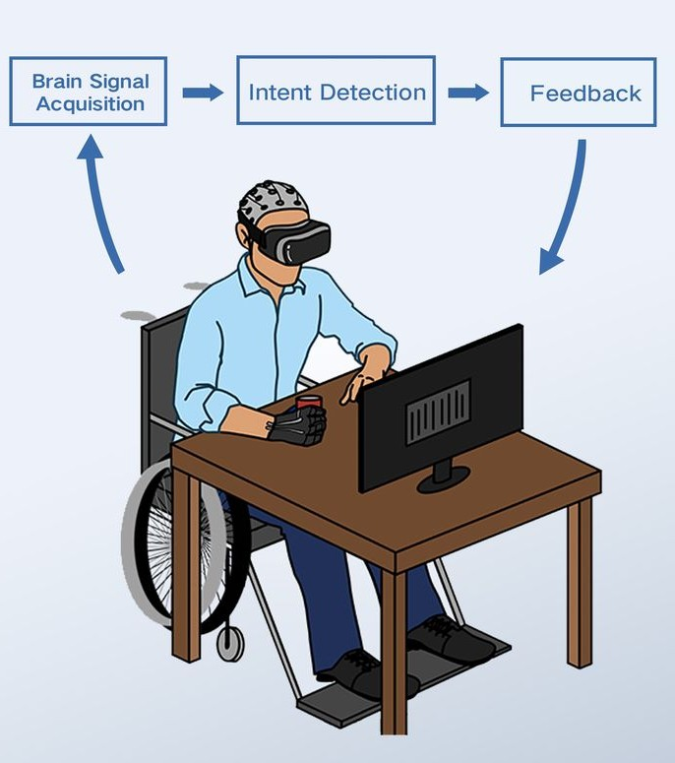
Introduction
Stroke survivors suffer from upper-limb motor impairment
Brain-Computer Interfaces (BCIs) and Functional Electrical Stimulation (FES) is a promising rehabilitation approach
Goal: Optimize a preprocessing, feature extraction, and classification algorithm to improve BCI decoding accuracy in motor imagery task.
Mane at al., 2022
Group 35

Slide 4
Introduction
Previous Pipelines:
CSP + LDA - established state-of-the-art baseline for motor imagery BCI classification
  simple, robust, widely used
PCA + TVLDA - more recent time-variant approach that explicitly models transient brain patterns during motor imagery tasks
  achieves higher accuracy than CSP+LDA
Group 35

Slide 5
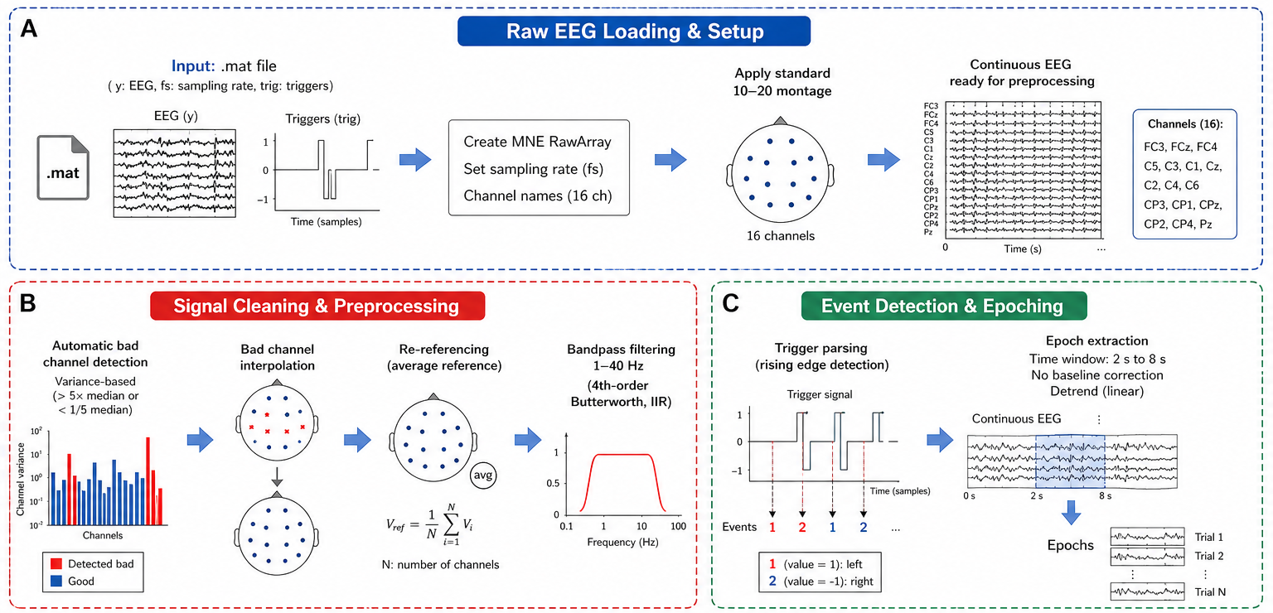
Approach
Group 35

Slide 6
RESULTS
OUTCOME
Subject | Stage | CSP + LDA (g.tec) | PCA + TVLDA (g.tec) | CSP + LDA* (This Work) | CSP + SVM* (This Work)
P1 | Pre | 77.1 % | 92.9 % | 85.9 % | 85.9 %
 | Post | 93.9 % | 97 % | 95.7 % | 97.1 %
P2 | Pre | 68.4 % | 72.4 % | 61 % | 62.3 %
 | Post | 96.1 % | 97.4 % | 100 % | 100 %
P3 | Pre | 74.4 % | 93.6 % | 92.4 % | 92.4 %
 | Post | 79.7 % | 100 % | 93.7 % | 100 %
*Window 2.5 - 7.75 sec*
Group 35

Slide 7
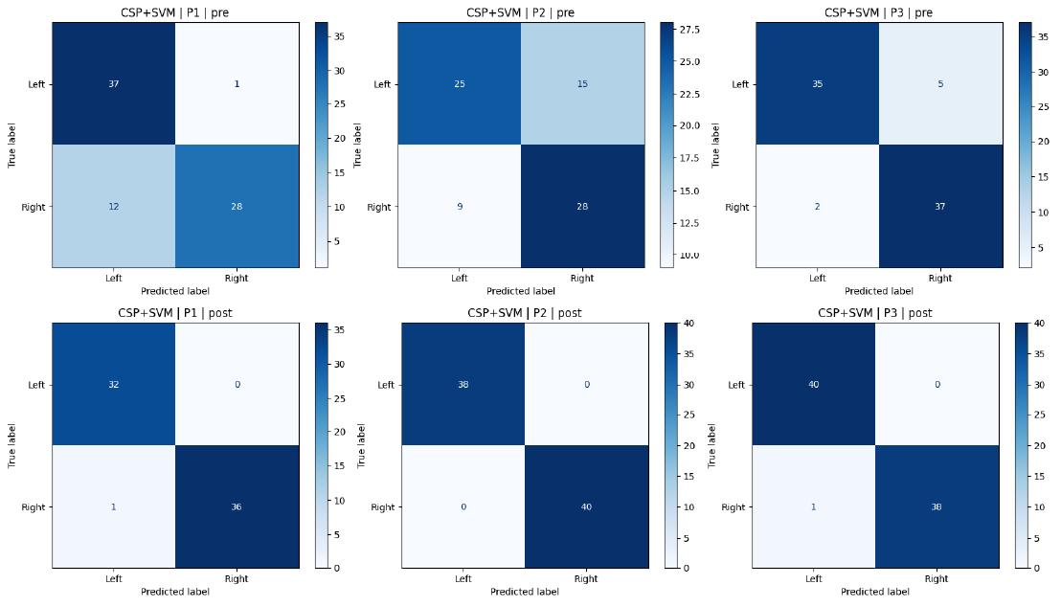
CSP + SVM Model Confusion Matrices (Window 2.5 - 7.75 sec)
Group 35

Slide 8
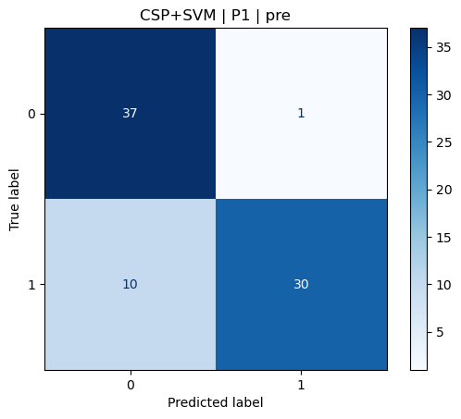
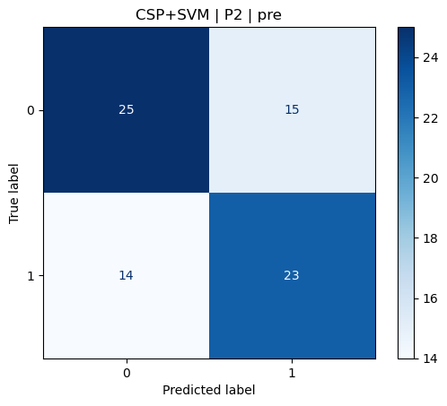
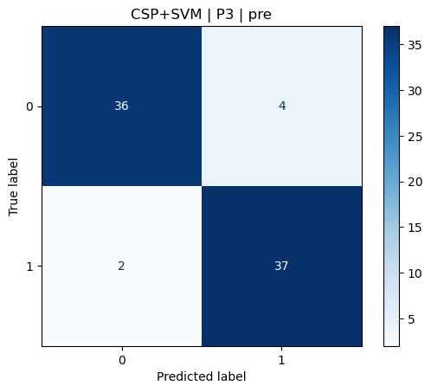
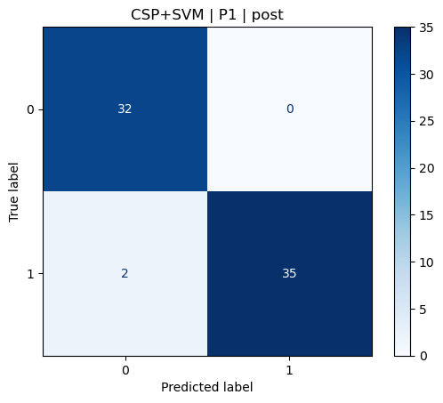
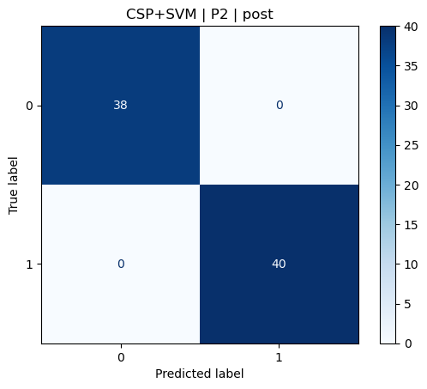
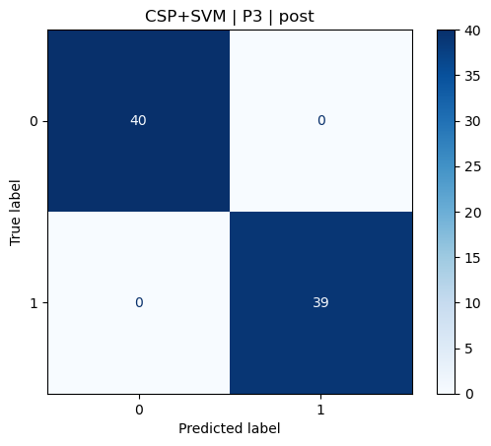
CSP + SVM Model Confusion Matrices (Window 2.5 - 7.75 sec)
Group 35

Slide 9
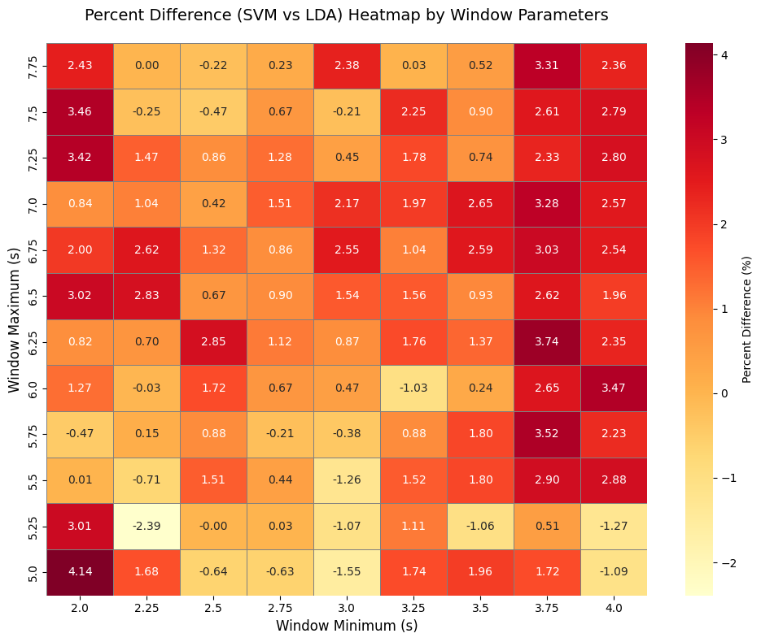
Percentage Differences of
(LDA - SVM) Mean % Accuracies
Group 35

Slide 10

CSP + SVM
CSP + LDA
Group 35

Slide 11
Conclusion
Our results show that different patients can have different optimal timing windows that maximize model accuracy.
Each patient’s lesion is different and emphasize the need for BCI algorithms that are personalized for clinical use.
Classification accuracy was the worst for P1 that contained the most artifacts - BCI algorithms should include adaptive artifact rejection algorithms.
Group 35

Slide 12
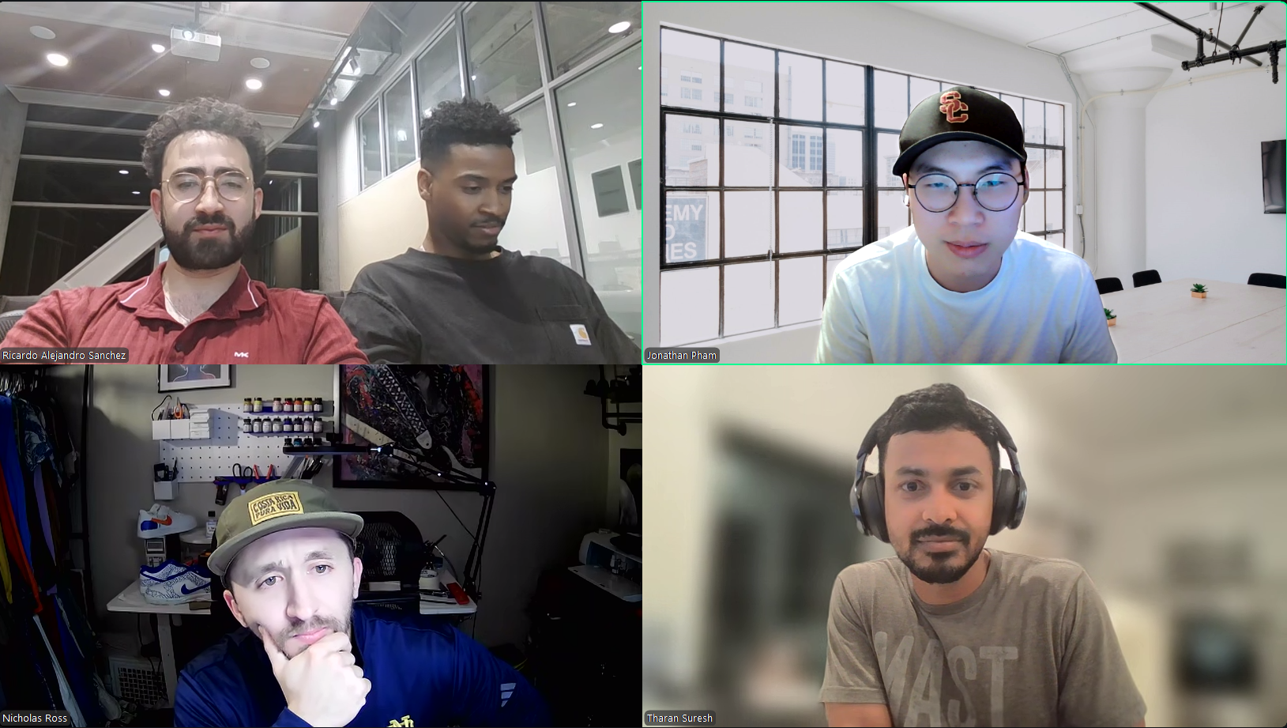
Group 35

