Slide 1

STAGE 3
DDPM-based Indoor
Trajectory Refinement
Keywords: DDPM · SDEdit · conditional residual model · paired trajectory recovery
01
Problem reset
02
Core finding
03
Claim boundary
biased gap filling -> full-trajectory refinement
conditioning beats prior-only editing
works only under error-structure alignment
Shang Shanchong
Politecnico di Torino
Notes:
Good morning. This presentation reports Stage 3 of my thesis on indoor trajectory refinement with diffusion models.
The story has three parts. First, I explain why my original Stage 3 task formulation had to be corrected. Second, I show what changes once the problem is reframed as full-trajectory refinement. Third, I define the claim boundary: where the current method works, where it fails, and what Stage 4 should focus on.
The key message I want to build toward is simple: for this task, observation conditioning matters more than making the unconditional prior stronger.

Slide 2
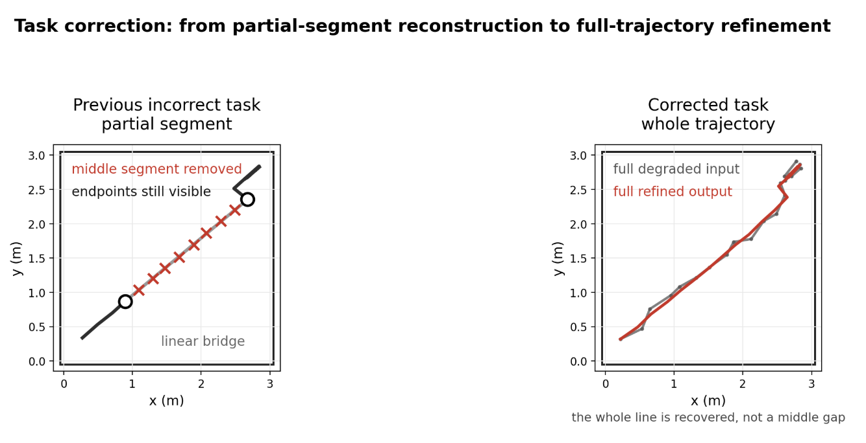
Task correction: what the old experiment really tested
2 / 13
Old local-gap task
Frames 8–11 were removed, but prefix, suffix, and both boundary points stayed visible.
Linear interpolation therefore solved a boundary-anchored bridge problem.
The unconditional DDPM had no mask, no endpoint constraint, and no observation channel.
Corrected task
Complete degraded trajectory → refined full trajectory; evaluated against the paired clean reference.
Diagnostic result from the old task
Method | ADE | RMSE | Masked ADE
Linear interpolation | 0.0026 ± 0.0026 | 0.0061 ± 0.0061 | 0.0129 ± 0.0130
Savitzky-Golay | 0.0046 ± 0.0039 | 0.0071 ± 0.0062 | 0.0126 ± 0.0127
Kalman CV | 0.0138 ± 0.0102 | 0.0230 ± 0.0189 | 0.0422 ± 0.0387
Uncond. DDPM inpainting | 0.1196 ± 0.1160 | 0.1626 ± 0.1579 | 0.1238 ± 0.1195
Working hypothesis
When the whole trajectory is corrupted, does observation-conditioned DDPM provide a better refinement interface than prior-only DDPM editing?
Stage 3 — DDPM-based Indoor Trajectory Refinement
Notes:
I start with the task correction because it changes how the old result should be read. In the old experiment, only the middle segment was missing. Both boundary points around that segment were still visible, so linear interpolation was structurally favoured. It was not a weak baseline; it was almost exactly matched to the task. The unconditional DDPM had the opposite interface: it could generate a plausible segment, but it had no mask, no endpoint constraint, and no explicit observed-context channel. The old gap therefore diagnoses a task-interface mismatch, not the uselessness of trajectory priors. The corrected Stage 3 task is full-trajectory refinement: every frame may contain error, and the model has to refine the whole sequence. That gives the working hypothesis shown here.

Slide 3
Evaluation framework: paired full-trajectory recovery
2 / 13
Evaluation object
One paired instance = degraded full trajectory → refined output → clean reference. Comparisons are within the same input–reference pair.
Metric | How to read it
ADE | primary full-trajectory accuracy; lower is better
RMSE | penalizes larger frame-wise errors
FDE | endpoint accuracy only
Smoothness | diagnostic; lower is not automatically better
Improved fraction | how often the method helps over noisy input
Δ vs noisy | relative gain or degradation
Paired p-value | systematic improvement under paired test
Protocol
Fixed evaluation set: N = 200 trajectories.
DDPM methods: five inference seeds {42, 43, 44, 45, 46}.
Seed averaging is applied first; metrics are then computed.
All ± std values reflect trajectory-level variation, not seed spread.
Smoothness warning
A smoother path can be worse if it moves away from the clean reference. Kalman CV later shows exactly this.
Metrics follow the report evaluation section; ADE remains the headline metric because the task is full-trajectory recovery.
Stage 3 — DDPM-based Indoor Trajectory Refinement
Notes:
This slide fixes the statistical reading. Each method receives the same degraded input and is scored against the same clean reference, so the comparison is paired. ADE is the main metric because the target is average full-trajectory recovery. RMSE, FDE, smoothness, improved fraction, delta, and paired tests are complementary diagnostics. A key warning is smoothness. A smoother trajectory is not automatically a better one. If the spatial error increases, smoothness is just over-smoothing. That is why I do not use smoothness as the main success criterion.

Slide 4
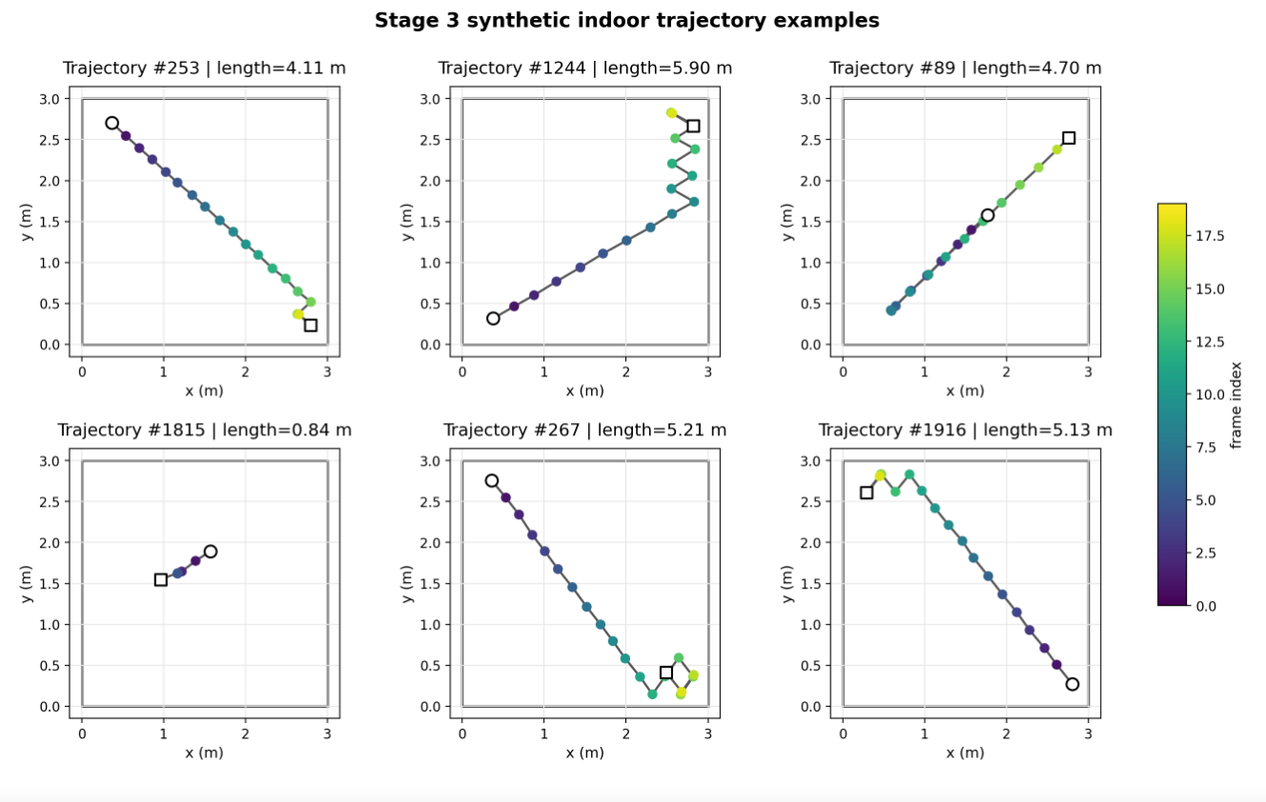
Synthetic indoor data: paired recovery instead of outdoor tracking reuse
3 / 13
Why not ETH/UCY for Stage 3?
ETH/UCY was useful for Stage 2 prior learning, but it mostly describes outdoor pedestrian motion. Stage 3 needs controlled indoor error injection and clean–degraded pairs.
Item | Value
Room | 3 m × 3 m
Trajectory | 20 frames @ 3 Hz
Motion patterns | goal-directed, multi-goal, pacing, near-stationary, boundary-walk
Clean set | 2,000 initial → 12,000 expanded
Train / validation | 10,000 / 2,000 trajectories
Prior training | 60,000 after geometric augmentation
Paired design
Every degraded input has a known clean reference; method comparisons are paired by construction.
Fig. 2 from the report; circle = start, square = end, colour = frame index.
Stage 3 — DDPM-based Indoor Trajectory Refinement
Notes:
For the corrected task, I move from ETH/UCY to synthetic indoor trajectories. This is not because ETH/UCY is bad; it answered the Stage 2 prior-learning question. Here the question is different. I need paired clean and degraded trajectories inside a controlled room. The synthetic generator gives a 3 by 3 metre environment, 20 frames at 3 Hz, and five simple indoor motion patterns, including pacing, near-stationary behaviour, and boundary walking. The key design feature is the pairing: each clean trajectory can be degraded in a controlled way, and all methods are evaluated against the same clean reference.

Slide 5
Indoor DDPM prior validation before refinement
5/ 13
Purpose
This check verifies whether the indoor trajectory-only DDPM can be trained stably and sampled without obvious artefacts before it is used in refinement experiments.
Check | Result | Interpretation
Training data | 60,000 augmented trajectories | indoor synthetic prior
Checkpoint | best_ema_model.pt | used downstream
Schedule | 100 timesteps | fixed train/sample setting
Best epoch / val loss | epoch 60 / 0.2611 | stable enough for diagnostics
Large-step ratio† | 0.0000 | no unrealistic jumps
Direction bias† | dx 0.0019, dy 0.0051 | below 0.01 threshold
Claim boundary
These checks show technical usability, not recovery ability.
Recovery is tested only in the paired refinement experiments: SDEdit first, then conditional residual DDPM.
† Custom internal diagnostics for this experiment; not standardized community metrics.
Stage 3 — DDPM-based Indoor Trajectory Refinement
Notes:
The indoor DDPM prior is not presented as a final generative model. This page only checks whether the prior is stable enough to use in downstream refinement diagnostics. The best EMA checkpoint is selected at epoch 60. The validation loss shows a clear decreasing trend, the large-step ratio is zero, and the directional bias is below the threshold. The boundary is important: passing the sanity check does not prove trajectory recovery. It only allows me to run the refinement experiments that actually test recovery.

Slide 6
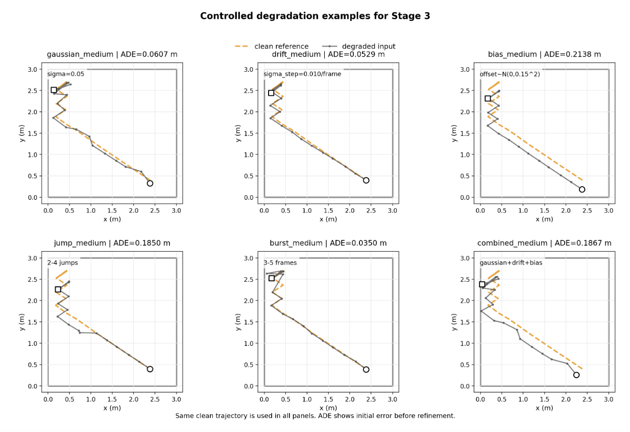
Controlled degradation: six error structures, one paired protocol
6/ 13
Degradation | ADE | RMSE | FDE
gaussian_medium | 0.0626 ± 0.0077 | 0.0698 ± 0.0081 | 0.0628 ± 0.0335
drift_medium | 0.0176 ± 0.0069 | 0.0199 ± 0.0076 | 0.0261 ± 0.0131
jump_medium | 0.2634 ± 0.0890 | 0.3040 ± 0.0700 | 0.3542 ± 0.0904
burst_medium | 0.0748 ± 0.0204 | 0.1574 ± 0.0431 | 0.0425 ± 0.1133
bias_medium | 0.1890 ± 0.0957 | 0.1890 ± 0.0957 | 0.1890 ± 0.0957
combined_medium | 0.1991 ± 0.0867 | 0.2053 ± 0.0848 | 0.2027 ± 0.1051
Figs. 3–4 from the report. The same clean trajectory is degraded under all six example panels.
Stage 3 — DDPM-based Indoor Trajectory Refinement
Notes:
The paired protocol is simple: clean trajectory, controlled degradation, refinement method, and then comparison to the clean reference. The six degradation types are not cosmetic variations. They probe different failure modes: gaussian frame noise, slow drift, sparse jumps, local bursts, constant bias, and mixed corruption. This matters because a model can look good under gaussian noise while failing under structured sensor-like errors. The figure gives a visual example, but the numbers printed inside the panels are only for that single example. The dataset-level comparison comes later.
这里 drift 的 ADE 比 gaussian 低，是因为这个表统计的是 refinement 之前的 degraded input error。当前 drift_medium 的参数设置比较轻，它是一个随时间平滑累积的小偏移；而 gaussian_medium 是每一帧都有随机扰动，所以平均帧误差更大。这个结果不代表 drift 更容易修，反而说明 drift 的初始误差已经很小，因此后面的模型如果按照 gaussian 噪声学到的修正幅度去修，很容易 over-correct，把本来接近 clean 的轨迹推远。

Slide 7
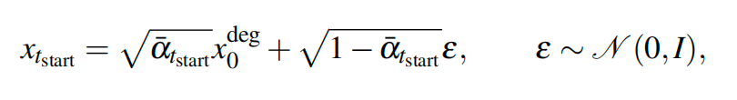
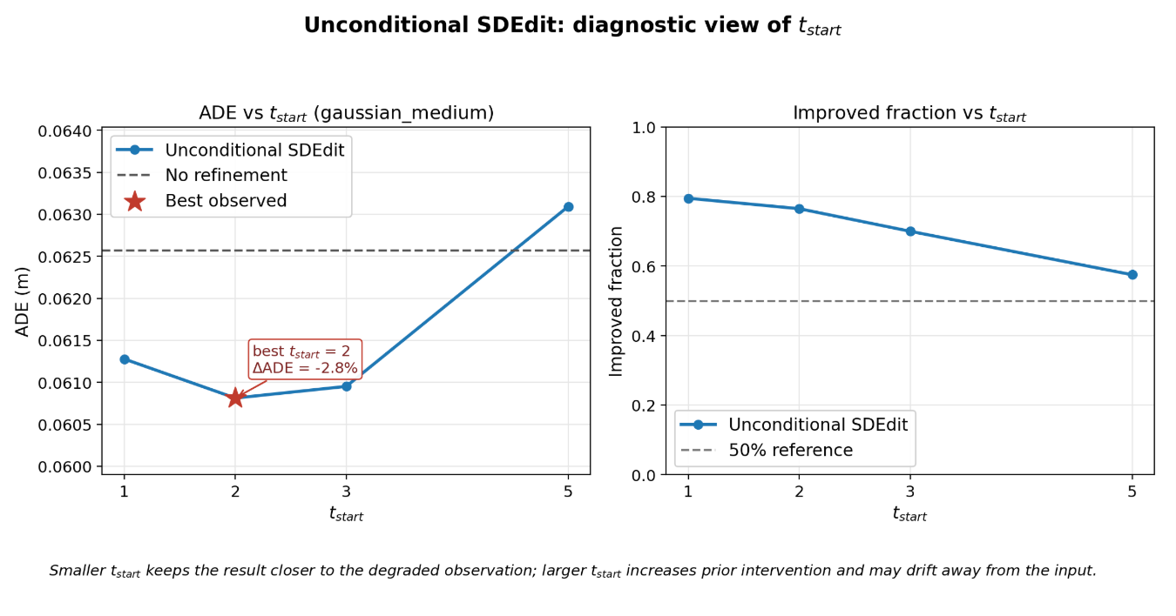
Unconditional SDEdit: method, reference, and sweep
7 / 13
SDEdit mechanism
Forward: inject gaussian noise into the degraded trajectory up to t_start.
Reverse: denoise with the pretrained DDPM prior back to t = 0.
t_start controls the identity-to-prior-drift trade-off.
Why gaussian_medium first?
It is the most favourable condition for SDEdit because DDPM forward perturbation is gaussian. If prior-only editing can help, it should help here first.
method | t_start | ADE mean ± std | improved_fraction_ADE
noisy_input | -1 | 0.0625666 ± 0.0077235 | 0.000
sdedit_t1 | 1 | 0.0612772 ± 0.0078860 | 0.795
sdedit_t2 | 2 | 0.0608118 ± 0.0083935 | 0.765
sdedit_t3 | 3 | 0.0609506 ± 0.0096328 | 0.700
sdedit_t5 | 5 | 0.0630930 ± 0.0135656 | 0.575
SDEdit reference: Meng et al., “SDEdit: Guided Image Synthesis and Editing with Stochastic Differential Equations,” ICLR 2022. DDPM reference: Ho et al., NeurIPS 2020.
Stage 3 — DDPM-based Indoor Trajectory Refinement
Notes:
This slide introduces unconditional SDEdit and gives the literature context. In this report SDEdit is not a new supervised model. It is an editing procedure that reuses the pretrained DDPM prior. The procedure is two-step: inject gaussian noise into the degraded input up to t_start, then denoise with the learned reverse process. Small t_start keeps the result close to the input. Large t_start gives the prior more freedom but increases drift risk. I start with gaussian_medium because it is the easiest condition for this method. The best point is t_start equals two, with a small ADE reduction from 0.0626 to 0.0608 metres.

Slide 8
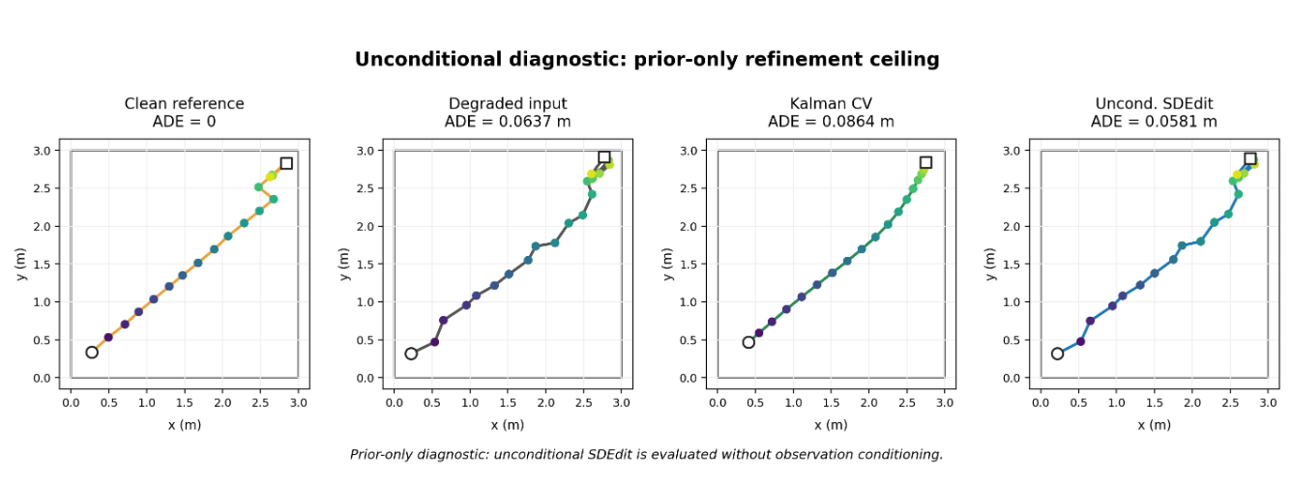
Prior-only ceiling under gaussian degradation
8 / 13
How to read this result
SDEdit improves systematically, but the effect size is small.
Kalman CV is a warning: it becomes smoother but ADE worsens by 35.9%.
This is the ceiling of prior-only refinement before adding observation conditioning.
Interpretation
The prior can nudge a trajectory toward plausibility, but it is still weakly tied to this observation.
Method | ADE (m) | Δ vs noisy | Improved
noisy_input | 0.0626 ± 0.0077 | — | —
Linear interpolation | 0.0626 ± 0.0077 | 0.0% | 0.000
Savitzky-Golay | 0.0656 ± 0.0328 | +4.9% | 0.720
Kalman CV | 0.0850 ± 0.0281 | +35.9% | 0.235
Uncond. SDEdit (t=2) | 0.0608 ± 0.0084 | −2.8% | 0.765
Report Table 5; N = 200; spread is across trajectories after seed averaging.
Stage 3 — DDPM-based Indoor Trajectory Refinement
Notes:
Here I compare no refinement, Kalman constant-velocity, and unconditional SDEdit on the same gaussian_medium evaluation set. The prior-only SDEdit effect is systematic but small. ADE drops by 2.8%, and the improved fraction is 0.765. Kalman CV is important because it shows why smoothness alone is not a success metric. It produces a smoother path, but ADE becomes much worse. So the right interpretation is spatial recovery first, smoothness as a diagnostic second. This slide sets the prior-only ceiling. The next question is whether conditioning the prior on the degraded observation can do better.

Slide 9

Conditional residual DDPM: the interface is changed, not just the model
9 / 13
Interface change
Prior-only SDEdit | Conditional residual DDPM
Edits with a learned prior, but no explicit observation-specific correction channel. | Receives the degraded trajectory as condition and predicts the correction residual.
Can become plausible without being correct for this input. | Asks: given this degraded trajectory, where is it off, and by how much?
Literature link
DDPM formulation: Ho et al. 2020.
SDEdit diagnostic: Meng et al. 2022.
Conditional time-series diffusion direction: SSSD-style imputation ideas.
Here, conditioning is the tested variable: the data, metric, and gaussian evaluation set stay matched.
Residual target
Why residual?
Predict the correction, not the whole clean trajectory from scratch. The condition is the degraded observation, not ground-truth leakage.
Ho et al., DDPM, NeurIPS 2020; Meng et al., SDEdit, ICLR 2022; Alcaraz & Strodthoff, SSSD, TMLR 2023.
Stage 3 — DDPM-based Indoor Trajectory Refinement
Notes:
This is the conceptual turning point. I am not simply trying a bigger network. I am changing the refinement interface. SDEdit edits through the prior, but it is not told what correction this particular observation needs. The conditional residual model receives the degraded trajectory and learns the residual between degraded and clean trajectories. The residual target is defined in normalized relative-displacement space. This keeps continuity with the Stage 2 trajectory-prior representation, while tying the correction to the actual degraded observation. The key experimental variable is conditioning. The evaluation set is the same gaussian_medium set used for the unconditional result.

Slide 10
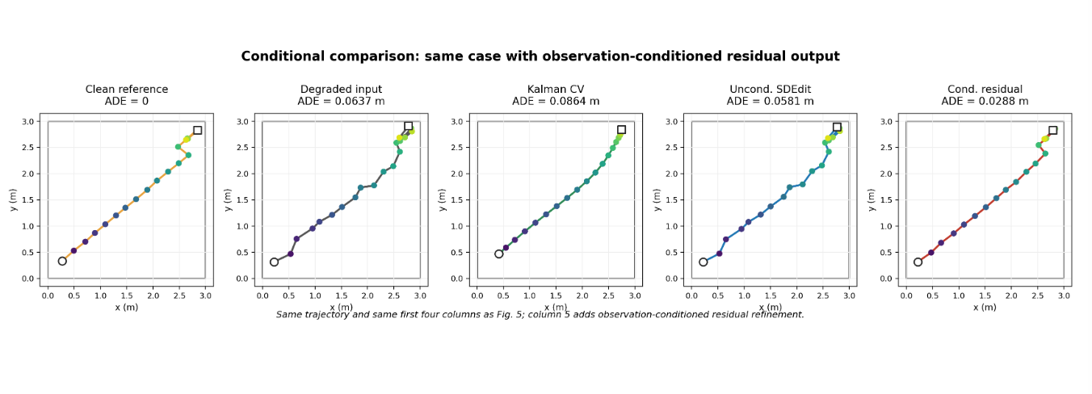
Matched gaussian evidence: conditioning gives the larger gain
10 / 13
Claim supported here
Under matched gaussian degradation, observation conditioning gives a clearly larger ADE reduction than prior-only editing. The result supports the interface-level part of the hypothesis.
Claim not supported yet
This does not prove broad sensor-error robustness. That needs cross-degradation testing.
Method | ADE | Δ vs noisy | Improved
No refinement | 0.0626 | — | —
Linear interpolation | 0.0626 ± 0.0077 | 0.0% | 0.000
Savitzky-Golay | 0.0656 ± 0.0328 | +4.9% | 0.720
Kalman CV | 0.0850 ± 0.0281 | +35.9% | 0.235
Unconditional SDEdit | 0.0608 | −2.80% | 0.765
Conditional residual DDPM | 0.0557 | −10.98% | 0.730
−10.98%
+8.41%
ADE vs no refinement
relative to SDEdit
Report Table 6 and Fig. 7; same N = 200 gaussian_medium degraded trajectories.
Stage 3 — DDPM-based Indoor Trajectory Refinement
Notes:
This slide gives the strongest positive result of Stage 3. On the matched gaussian_medium set, no refinement has ADE 0.0626, SDEdit has 0.0608, and conditional residual DDPM has 0.0557. That is a 10.98% reduction relative to the noisy input and an 8.41% improvement relative to unconditional SDEdit. The displayed trajectory shows the same comparison visually, using the same case as the prior-only diagnostic with the conditional output added as the fifth panel. The careful wording is important: this supports the interface-level hypothesis under matched gaussian corruption. It does not yet prove generalization to every sensor-like degradation.

Slide 11
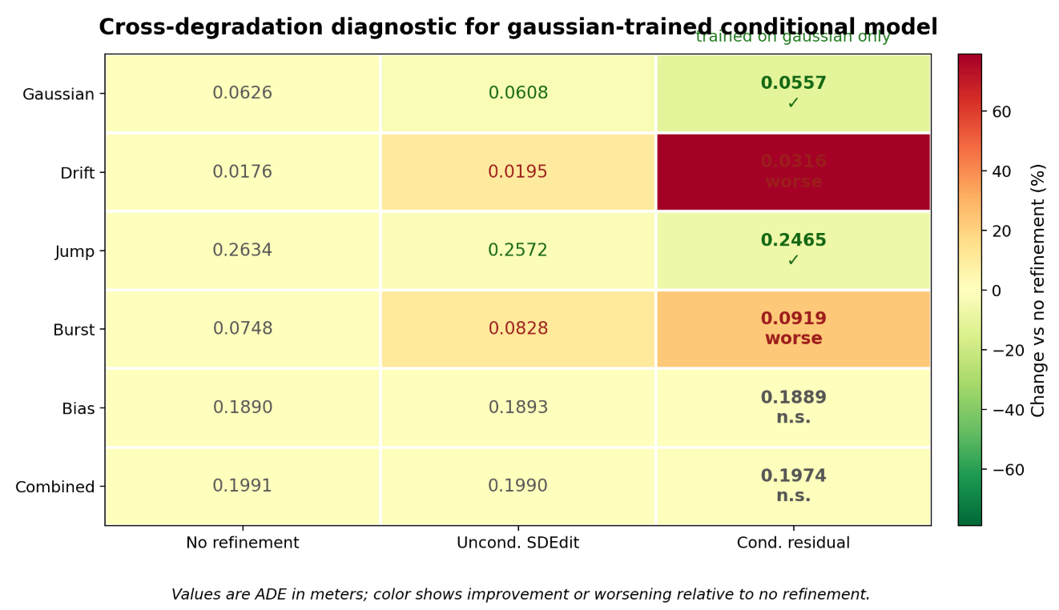
Cross-degradation test: the failures are structured
11 / 13
One gaussian-trained conditional model, six test conditions
Case | Observed result | Likely reason
Gaussian | improves | training and test corruption match
Jump | improves | sparse offsets resemble extreme residuals
Drift | worse | over-corrects an already mild error
Burst | worse | local high-noise frames ≠ uniform gaussian residual
Bias | near unchanged | constant offset cancels in relative displacement
Combined | weak | mixed error exceeds current interface
Interpretation
Conditioning helps only when the corruption model, representation, and test error structure are aligned.
Report Table 7 and Fig. 8; non-gaussian rows are diagnostic generalization tests, not matched-training results.
Stage 3 — DDPM-based Indoor Trajectory Refinement
Notes:
The conditional model was trained on gaussian_medium only. The other five degradation types test generalization, not matched training. The important point is that the failures are different. Gaussian improves because it matches the training corruption. Jump improves because sparse large offsets partially look like extreme residual noise. Drift worsens because the model applies a correction larger than needed. Burst worsens because the noise is local, but the model has no reliability mask. Bias is almost unchanged because a constant global offset cancels in relative-displacement space. So the conclusion is not simply that generalization is bad. The conclusion is that each failure identifies a design boundary: correction scale, frame reliability, and representation.

Slide 12
Backbone ablation: capacity is not the main bottleneck
12 / 13
Why test the backbone?
The model-family concern is valid: SSSD-S4 and Diffusion-TS are relevant time-series diffusion families. For T = 20, I test the most immediate capacity question first: temporal receptive-field coverage.
Backbone | Blocks | Effective RF | Coverage | Params
Current Conv1D | 2 | 13 frames | 65.0% | 212,354
Expanded Conv1D | 4 | 21 frames | full-window | 409,474
Result summary | Value
Median relative ADE gain | 0.73%
Improved over 2-block | 4 / 6 degradations
Still beats noisy_input | 1 / 6 degradations
Parameter increase | ≈ 1.93×
Conclusion
The expanded model shifts ADE slightly, but it does not change the failure regime.
Design implication
The next bottleneck is observation anchoring and confidence control, not simply a wider temporal receptive field.
SSSD: Alcaraz & Strodthoff, TMLR 2023. Diffusion-TS: Yuan & Qiao, ICLR 2024. Ablation values from report Tables 9–11.
Stage 3 — DDPM-based Indoor Trajectory Refinement
Notes:
This slide addresses the backbone concern. SSSD-S4 and Diffusion-TS are valid time-series diffusion families. SSSD-S4 is especially relevant to conditional imputation, while Diffusion-TS is a general time-series diffusion model. However, the current task uses short T equals 20 indoor windows. The most immediate question is not long-range modelling, but whether the current Conv1D receptive field is too small. So I tested a 2-block versus 4-block Conv1D backbone inside the verified pipeline. The expanded model nearly doubles parameters and covers the full window, but the median relative ADE gain is only 0.73%. More importantly, it still beats the noisy input in only one of six degradation types. This means the bottleneck is not primarily temporal capacity; it is observation anchoring and confidence-aware correction.

Slide 13
Stage 3 claim boundary and next-step implication
13 / 13
What Stage 3 establishes
Evidence | Bounded claim
Task correction | old local gap-filling was biased toward linear interpolation
Uncond. SDEdit | prior-only editing gives a small but systematic gaussian gain (−2.8%)
Cond. residual DDPM | observation conditioning gives the larger matched-gaussian gain (−10.98%)
Cross-degradation | failures are explainable: drift scale, burst reliability, bias representation
Backbone ablation | full-window Conv1D does not remove the failure regime
Main conclusion
Conditioning is the operative variable, but only when corruption, representation and test error structure are aligned.
Next-step implication
Move toward sensor-anchored, confidence-aware posterior refinement.
References and role
Reference | Used for
Ho et al. 2020 | DDPM formulation
Meng et al. 2022 | SDEdit prior-only editing diagnostic
Tariq et al. 2020 / 2021 | indoor human tracking and trajectory metrics context
Alcaraz & Strodthoff 2023 | SSSD / conditional time-series diffusion family
Yuan & Qiao 2024 | Diffusion-TS / alternative time-series diffusion family
Final claim deliberately remains bounded: Stage 3 maps the interface lever and failure boundaries; it does not claim universal sensor-error recovery.
Stage 3 — DDPM-based Indoor Trajectory Refinement
Notes:
I close with a bounded conclusion rather than an over-claim. Stage 3 establishes five things: the old task was biased, prior-only SDEdit has a small but real ceiling, observation conditioning gives the larger matched-gaussian gain, cross-degradation failures are structured, and backbone expansion does not solve the failure regime. The main conclusion is therefore precise: conditioning is the operative variable, but it only helps when the corruption model, representation, and test error structure are aligned. The next-step implication is not to add more unconditional prior machinery. The next design should anchor refinement to sensor evidence and explicitly model confidence or reliability, so the correction scale depends on how trustworthy each observation is.

