Slide 1

STAGE 3
DDPM-based Indoor
Trajectory Refinement
Keywords: DDPM · SDEdit · conditional residual model · paired full-trajectory recovery
01
Problem reset
02
Core finding
03
Claim boundary
biased gap filling -> paired full-trajectory refinement
conditioning beats prior-only editing
works only under error-structure alignment
Shang Shanchong
Politecnico di Torino
Notes:
Good morning. This talk reports Stage 3 of my thesis: DDPM-based refinement for indoor trajectories.
The story is intentionally bounded. I first correct the original task, then test prior-only editing, and finally test whether observation conditioning changes the recovery interface.
The main message is that the model needs to see the degraded observation. A stronger unconditional prior alone is not enough for this paired recovery task.

Slide 2
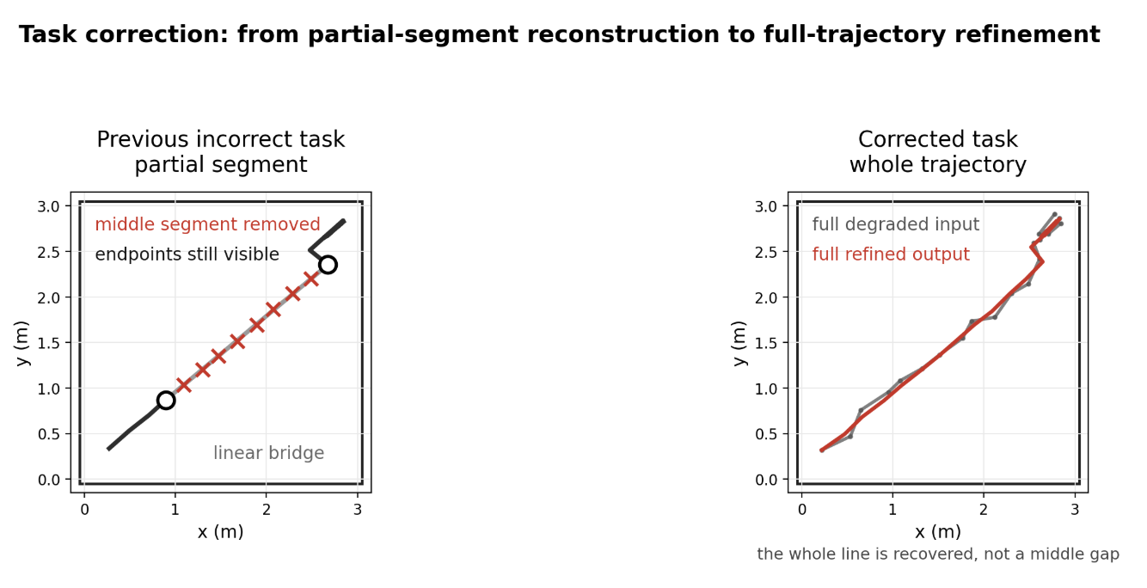
Task reset: why the old gap-filling result was biased
2 / 13
Old local-gap task
Frames 8–11 were removed, but prefix, suffix, and both boundary points stayed visible.
Linear interpolation therefore solved a boundary-anchored bridge problem.
The unconditional DDPM had no mask, no endpoint constraint, and no observation channel.
Corrected task
Complete degraded trajectory → refined full trajectory; evaluated against the paired clean reference.
Diagnostic result from the old task
Method | ADE | RMSE | Masked ADE
Linear interpolation | 0.0026 ± 0.0026 | 0.0061 ± 0.0061 | 0.0129 ± 0.0130
Savitzky-Golay | 0.0046 ± 0.0039 | 0.0071 ± 0.0062 | 0.0126 ± 0.0127
Kalman CV | 0.0138 ± 0.0102 | 0.0230 ± 0.0189 | 0.0422 ± 0.0387
Uncond. DDPM inpainting | 0.1196 ± 0.1160 | 0.1626 ± 0.1579 | 0.1238 ± 0.1195
Working hypothesis
When the whole trajectory is corrupted, does observation-conditioned DDPM provide a better refinement interface than prior-only DDPM editing?
Stage 3 — DDPM-based Indoor Trajectory Refinement
Notes:
I start with the old result because it explains why the task had to change.
The original setup removed frames 8 to 11, while the prefix, suffix, and both boundary points remained visible. That made the task almost a boundary-anchored bridge problem, so linear interpolation was structurally favoured.
The table now includes the classical baselines as well. Linear and Savitzky-Golay are strong in the missing-span setting, while the unconditional DDPM inpainting output is not tied tightly enough to the observed path.
So I read this slide as a task-interface diagnosis, not as evidence that trajectory priors are useless.

Slide 3
Evaluation framework: paired recovery, not visual plausibility
3 / 13
Evaluation object
One paired instance = degraded full trajectory → refined output → clean reference. Comparisons are within the same input–reference pair.
Metric | How to read it
ADE | primary full-trajectory accuracy; lower is better
RMSE | penalizes larger frame-wise errors
FDE | endpoint accuracy only
Smoothness | diagnostic; lower is not automatically better
Improved fraction | how often the method helps over noisy input
Δ vs noisy | relative gain or degradation
Paired p-value | systematic improvement under paired test
Protocol
Fixed evaluation set: N = 200 trajectories.
DDPM methods: five inference seeds {42, 43, 44, 45, 46}.
Seed averaging is applied first; metrics are then computed.
All ± std values reflect trajectory-level variation, not seed spread.
Smoothness warning
A smoother path can be worse if it moves away from the clean reference. Kalman CV later shows exactly this.
Metrics follow the report evaluation section; ADE remains the headline metric because the task is full-trajectory recovery.
Stage 3 — DDPM-based Indoor Trajectory Refinement
Notes:
This slide fixes the evaluation language for the rest of the deck.
Every row is a paired comparison: the same degraded trajectory, the same clean reference, and then one candidate output.
ADE is the headline metric because the corrected task is full-trajectory recovery. RMSE, FDE, improved fraction and p-values are supporting diagnostics.
The smoothness warning matters. A path can look smoother and still be farther from the clean trajectory; Kalman CV later shows exactly that.

Slide 4
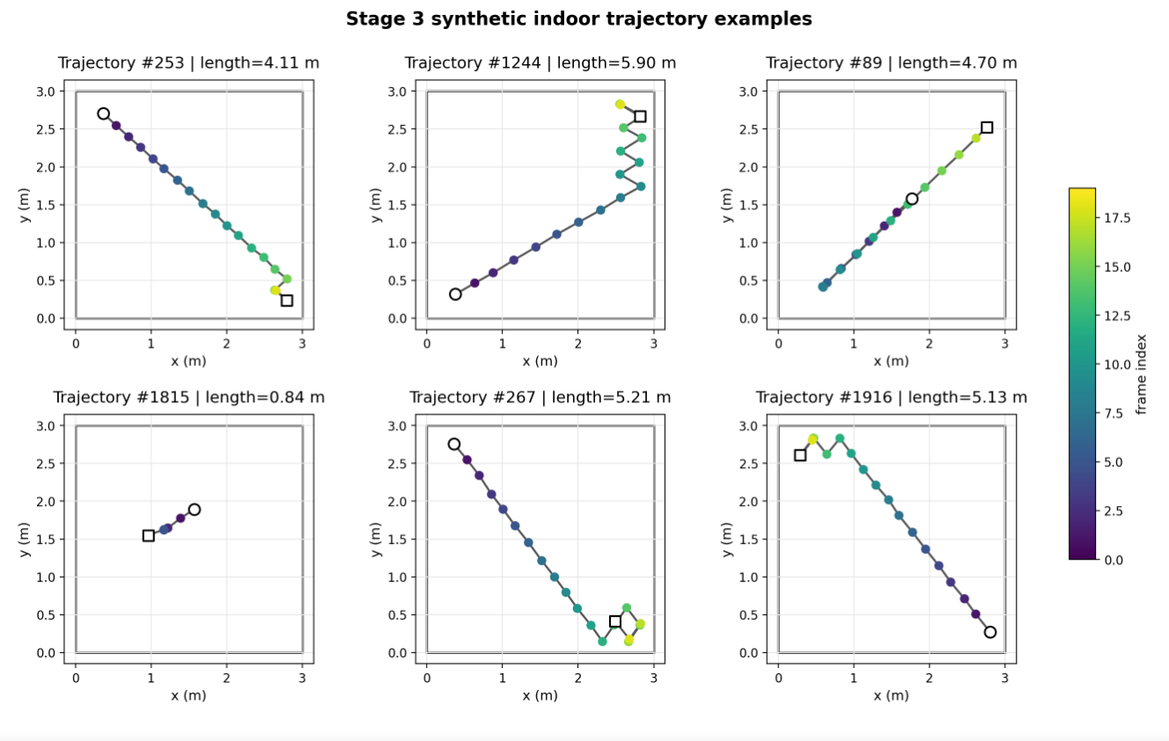
Synthetic indoor data: paired recovery instead of outdoor tracking reuse
4 / 13
Why not ETH/UCY for Stage 3?
ETH/UCY was useful for Stage 2 prior learning, but it mostly describes outdoor pedestrian motion. Stage 3 needs controlled indoor error injection and clean–degraded pairs.
Item | Value
Room | 3 m × 3 m
Trajectory | 20 frames @ 3 Hz
Motion patterns | goal-directed, multi-goal, pacing, near-stationary, boundary-walk
Clean set | 2,000 initial → 12,000 expanded
Train / validation | 10,000 / 2,000 trajectories
Prior training | 60,000 after geometric augmentation
Paired design
Every degraded input has a known clean reference; method comparisons are paired by construction.
Fig. 2 from the report; circle = start, square = end, colour = frame index.
Stage 3 — DDPM-based Indoor Trajectory Refinement
Notes:
For the corrected task, I use synthetic indoor trajectories because I need clean and degraded pairs under controlled error injection.
ETH and UCY were useful for earlier prior learning, but they mostly reflect outdoor pedestrian tracks. Here the question is indoor sensor-like refinement.
The pairing is the key design feature. Each clean trajectory can be degraded in known ways, and all methods are scored against the same clean reference.

Slide 5
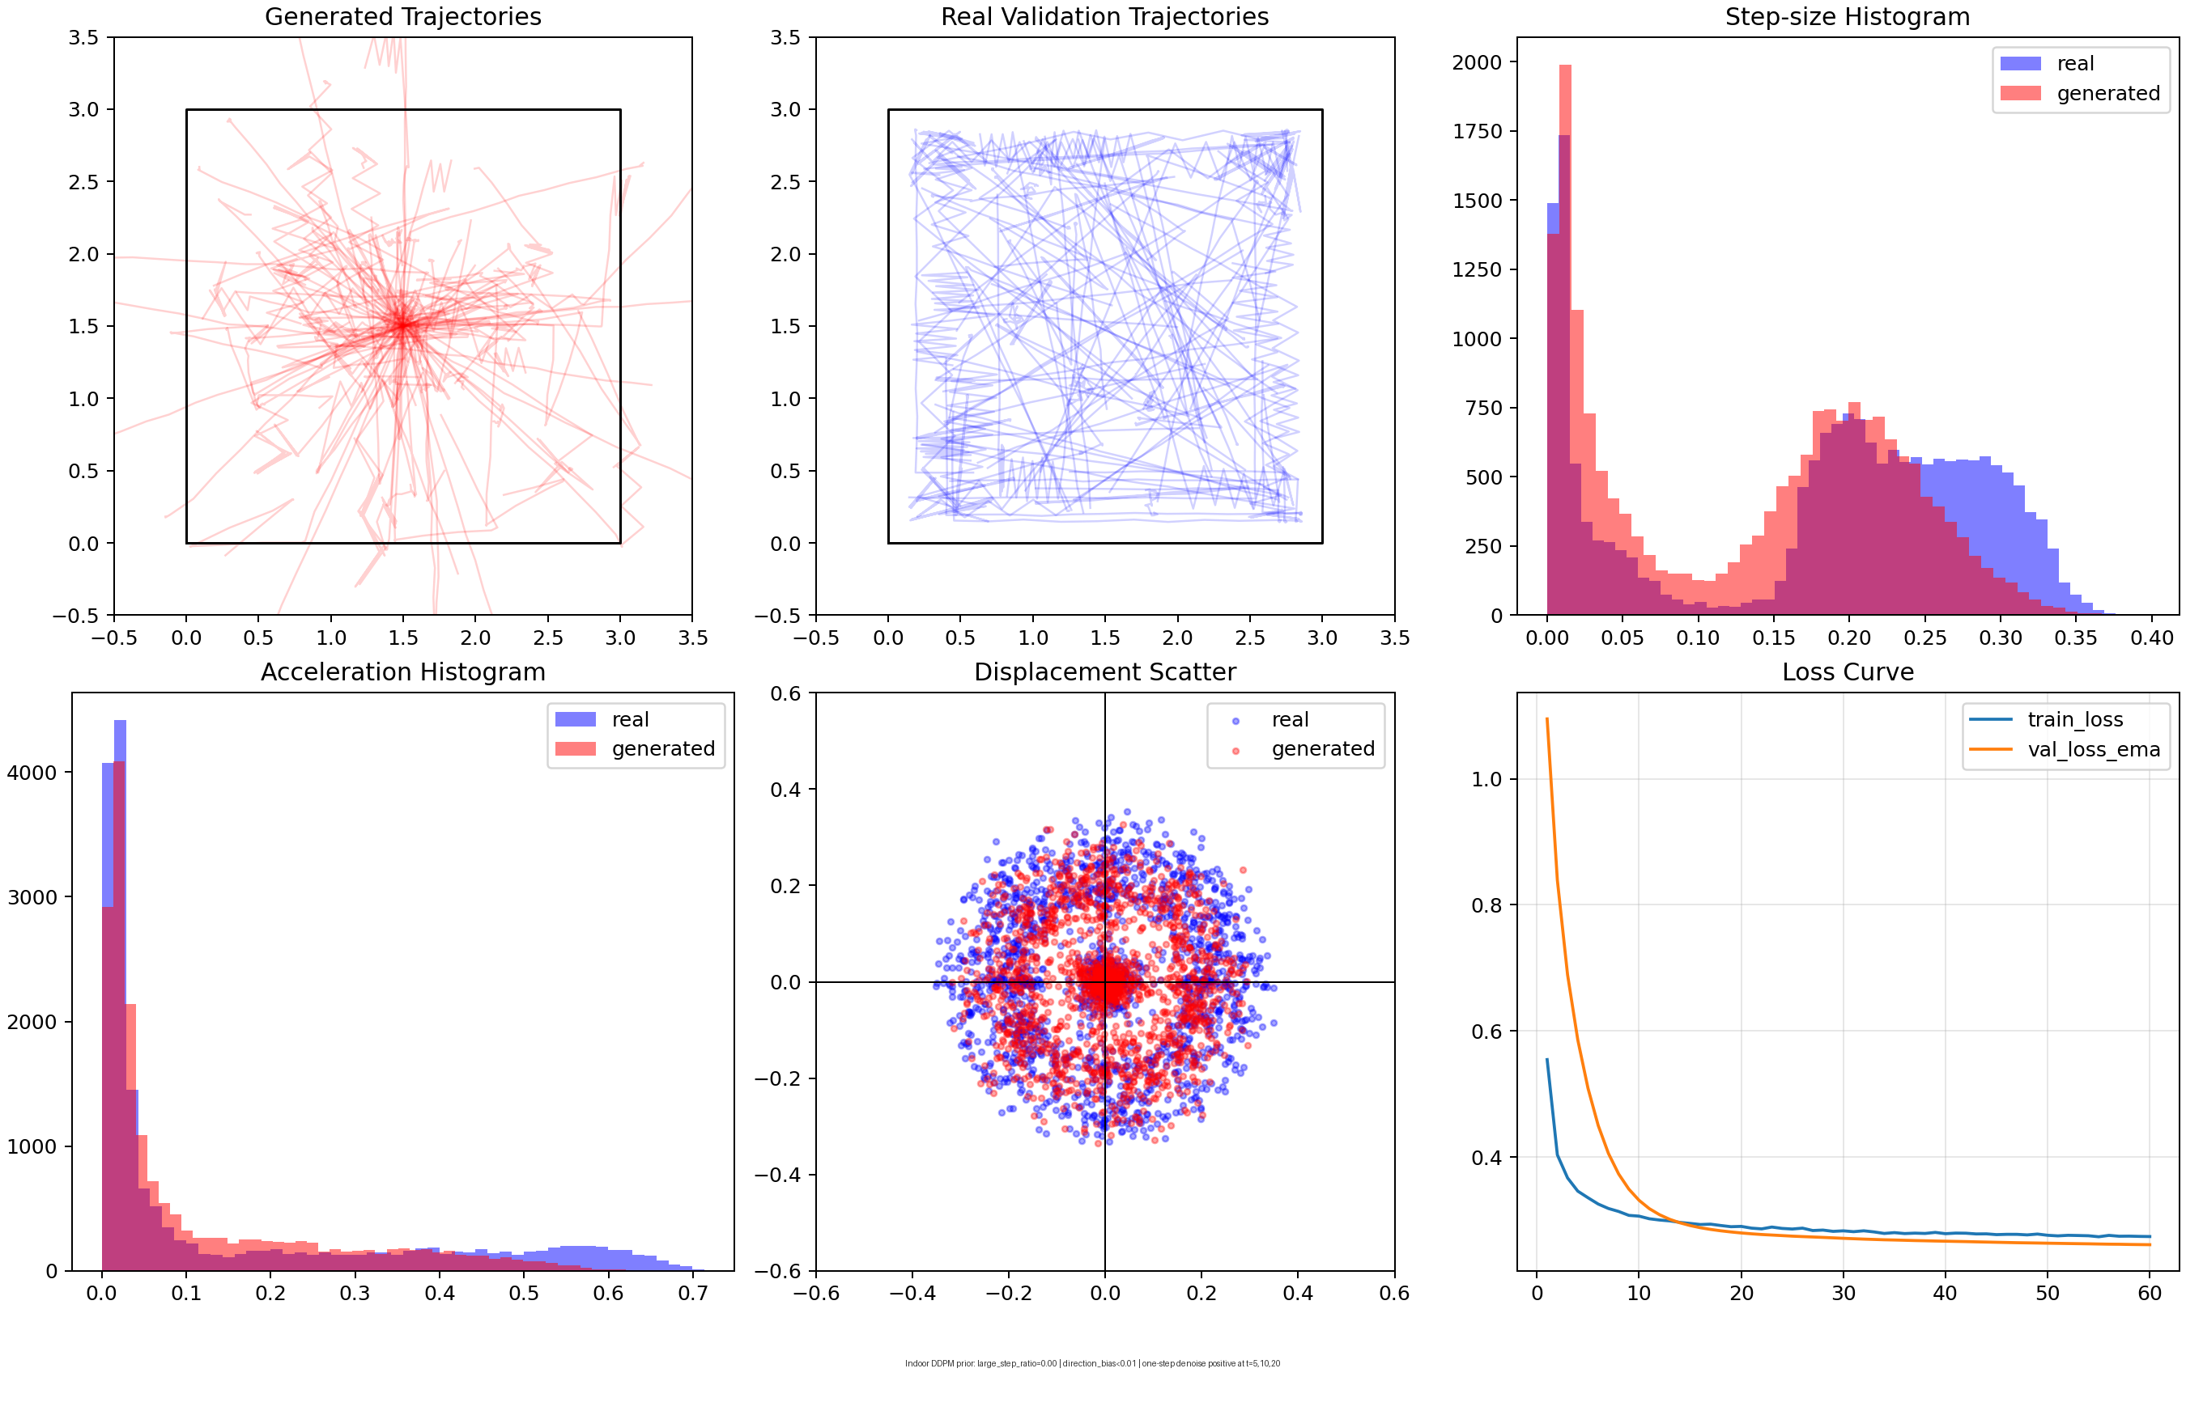
Unconditional prior sanity check before refinement
5 / 13
Purpose
This check verifies whether the indoor trajectory-only DDPM can be trained stably and sampled without obvious artefacts before it is used in refinement experiments.
Check | Result | Interpretation
Training data | 60,000 augmented trajectories | indoor synthetic prior
Checkpoint | best_ema_model.pt | used downstream
Schedule | 100 timesteps | fixed train/sample setting
Best epoch / val loss | epoch 60 / 0.2611 | stable enough for diagnostics
Large-step ratio† | 0.0000 | no unrealistic jumps
Direction bias† | dx 0.0019, dy 0.0051 | below 0.01 threshold
Claim boundary
Usable prior check only; paired recovery is evaluated later.
† Custom internal diagnostics for this experiment; not standardized community metrics.
Stage 3 — DDPM-based Indoor Trajectory Refinement
Notes:
This is still not a recovery result. It is only a sanity check for the unconditional indoor DDPM prior.
The selected EMA checkpoint reaches its best validation loss at epoch 60. The generated samples do not show unrealistic large jumps, and the direction bias is below the internal threshold.
The figure is useful as a quality-control view, but the claim stays narrow: the prior is technically usable enough to support downstream diagnostics.
Actual recovery is tested only on paired clean-degraded examples, first with SDEdit and then with the conditional residual model.

Slide 6
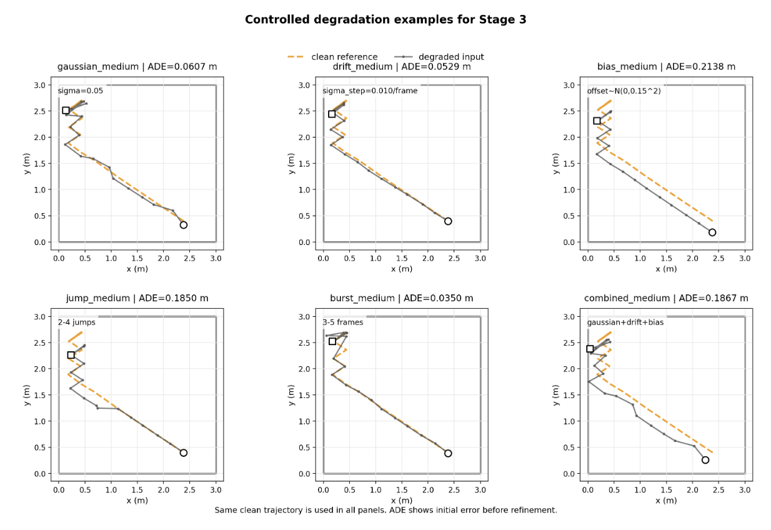
Degradation baseline: six error structures before refinement
6 / 13
Degradation | ADE | RMSE | FDE
gaussian_medium | 0.0626 ± 0.0077 | 0.0698 ± 0.0081 | 0.0628 ± 0.0335
drift_medium | 0.0176 ± 0.0069 | 0.0199 ± 0.0076 | 0.0261 ± 0.0131
jump_medium | 0.2634 ± 0.0890 | 0.3040 ± 0.0700 | 0.3542 ± 0.0904
burst_medium | 0.0748 ± 0.0204 | 0.1574 ± 0.0431 | 0.0425 ± 0.1133
bias_medium | 0.1890 ± 0.0957 | 0.1890 ± 0.0957 | 0.1890 ± 0.0957
combined_medium | 0.1991 ± 0.0867 | 0.2053 ± 0.0848 | 0.2027 ± 0.1051
Dataset-level baseline; values are clean vs degraded before any refinement.
Stage 3 — DDPM-based Indoor Trajectory Refinement
Notes:
This slide defines the baseline before any model tries to refine the trajectory.
The six degradations probe different error structures: independent gaussian noise, smooth drift, sparse jumps, local bursts, constant bias, and a combined setting.
The table is dataset-level clean-versus-degraded error for N equals 200. It is not a refinement result yet.
One subtle point is drift. Its initial ADE is smaller than gaussian here, so a gaussian-trained correction can easily over-correct it later.

Slide 7
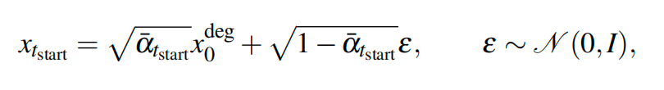
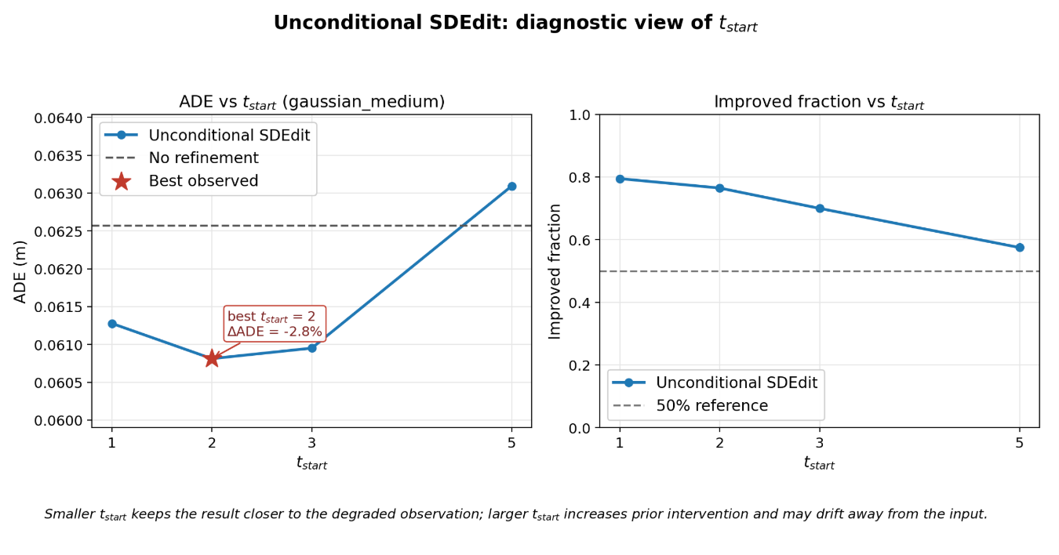
Unconditional SDEdit: prior-only editing with t_start
7 / 13
SDEdit mechanism
Forward: inject gaussian noise into the degraded trajectory up to t_start.
Reverse: denoise with the pretrained DDPM prior back to t = 0.
t_start controls the identity-to-prior-drift trade-off.
Why gaussian_medium first?
It is the most favourable condition for SDEdit because DDPM forward perturbation is gaussian. If prior-only editing can help, it should help here first.
method | t_start | ADE mean ± std | improved_fraction_ADE
noisy_input | -1 | 0.0625666 ± 0.0077235 | 0.000
sdedit_t1 | 1 | 0.0612772 ± 0.0078860 | 0.795
sdedit_t2 | 2 | 0.0608118 ± 0.0083935 | 0.765
sdedit_t3 | 3 | 0.0609506 ± 0.0096328 | 0.700
sdedit_t5 | 5 | 0.0630930 ± 0.0135656 | 0.575
SDEdit reference: Meng et al., “SDEdit: Guided Image Synthesis and Editing with Stochastic Differential Equations,” ICLR 2022. DDPM reference: Ho et al., NeurIPS 2020.
Stage 3 — DDPM-based Indoor Trajectory Refinement
Notes:
Now I move from prior checking to prior-only editing.
SDEdit starts from the degraded trajectory, adds gaussian noise up to t_start, and denoises with the unconditional prior.
Small t_start mostly preserves the input; large t_start gives the prior more freedom but also more chance to drift away from this particular observation.
The best point in the sweep is t_start equals 2, with ADE moving from 0.0626 to 0.0608 metres.

Slide 8
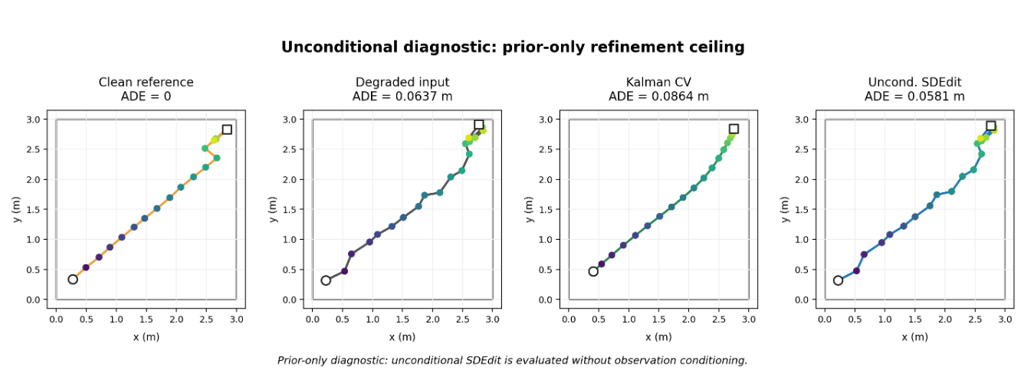
Prior-only ceiling: small gaussian gain, smoothing is not recovery
8 / 13
How to read this result
SDEdit improves systematically, but the effect size is small.
Kalman CV is a warning: it becomes smoother but ADE worsens by 35.9%.
This is the ceiling of prior-only refinement before adding observation conditioning.
Interpretation
The prior can nudge a trajectory toward plausibility, but it is still weakly tied to this observation.
Method | ADE (m) | Δ vs noisy | Improved
noisy_input | 0.0626 ± 0.0077 | — | —
Linear interpolation | 0.0626 ± 0.0077 | 0.0% | 0.000
Savitzky-Golay | 0.0656 ± 0.0328 | +4.9% | 0.720
Kalman CV | 0.0850 ± 0.0281 | +35.9% | 0.235
Uncond. SDEdit (t=2) | 0.0608 ± 0.0084 | −2.8% | 0.765
Report Table 5; N = 200; Linear is identity in full-trajectory setting.
Stage 3 — DDPM-based Indoor Trajectory Refinement
Notes:
This is the prior-only ceiling under matched gaussian degradation.
Linear interpolation is included here for traceability, but in a full-trajectory setting with no missing mask it is effectively the identity baseline.
Savitzky-Golay and Kalman show the danger of treating smoothness as recovery. Both can smooth the path, but their mean ADE worsens under this protocol.
Unconditional SDEdit gives a systematic but small gain: about 2.8 percent. That motivates changing the interface rather than only polishing the prior.

Slide 9

Conditional residual DDPM: condition on the observation, predict correction
9 / 13
Interface change
Prior-only SDEdit | Conditional residual DDPM
Edits with a learned prior, but no explicit observation-specific correction channel. | Receives the degraded trajectory as condition and predicts the correction residual.
Can become plausible without being correct for this input. | Asks: given this degraded trajectory, where is it off, and by how much?
Literature link
DDPM formulation: Ho et al. 2020.
SDEdit diagnostic: Meng et al. 2022.
Conditional time-series diffusion direction: SSSD-style imputation ideas.
Here, conditioning is the tested variable: the data, metric, and gaussian evaluation set stay matched.
Residual target
Why residual?
Predict the correction, not the whole clean trajectory from scratch. The condition is the degraded observation, not ground-truth leakage.
Ho et al., DDPM, NeurIPS 2020; Meng et al., SDEdit, ICLR 2022; Alcaraz & Strodthoff, SSSD, TMLR 2023.
Stage 3 — DDPM-based Indoor Trajectory Refinement
Notes:
This is the conceptual turn in Stage 3.
SDEdit asks the prior to edit the degraded trajectory, but it does not explicitly learn what correction this observation needs.
The conditional residual model receives the degraded trajectory as condition and predicts the correction residual.
So the tested variable is the interface: prior-only editing versus observation-conditioned correction, under the same gaussian evaluation set.

Slide 10
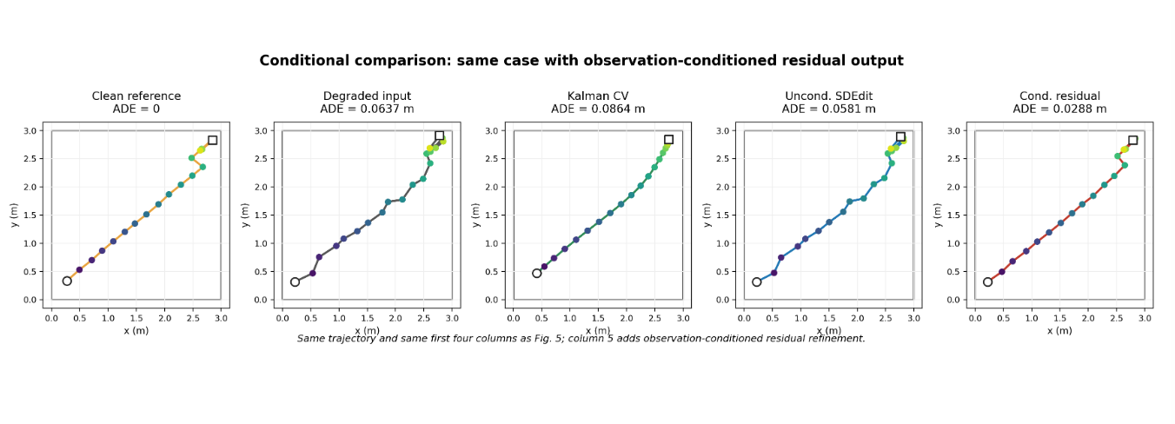
Matched gaussian result: conditioning gives the larger gain
10 / 13
Claim supported here
Under matched gaussian degradation, observation conditioning gives a clearly larger ADE reduction than prior-only editing. The result supports the interface-level part of the hypothesis.
Claim not supported yet
This does not prove broad sensor-error robustness. That needs cross-degradation testing.
Method | ADE | Δ vs noisy | Improved
No refinement | 0.0626 | — | —
Linear interpolation | 0.0626 ± 0.0077 | 0.0% | 0.000
Savitzky-Golay | 0.0656 ± 0.0328 | +4.9% | 0.720
Kalman CV | 0.0850 ± 0.0281 | +35.9% | 0.235
Unconditional SDEdit | 0.0608 | −2.80% | 0.765
Conditional residual DDPM | 0.0557 | −10.98% | 0.730
−10.98%
+8.41%
ADE vs no refinement
relative to SDEdit
Report Table 6 and Fig. 7; same N = 200 gaussian_medium degraded trajectories.
Stage 3 — DDPM-based Indoor Trajectory Refinement
Notes:
This slide contains the strongest positive Stage 3 result.
On the matched gaussian set, no refinement is 0.0626 metres ADE, unconditional SDEdit is 0.0608, and conditional residual DDPM reaches 0.0557.
That is a 10.98 percent reduction versus noisy input, and an 8.41 percent relative gain over SDEdit.
The wording is deliberately bounded. This supports conditioning under matched gaussian corruption; it does not prove broad sensor-error robustness.

Slide 11
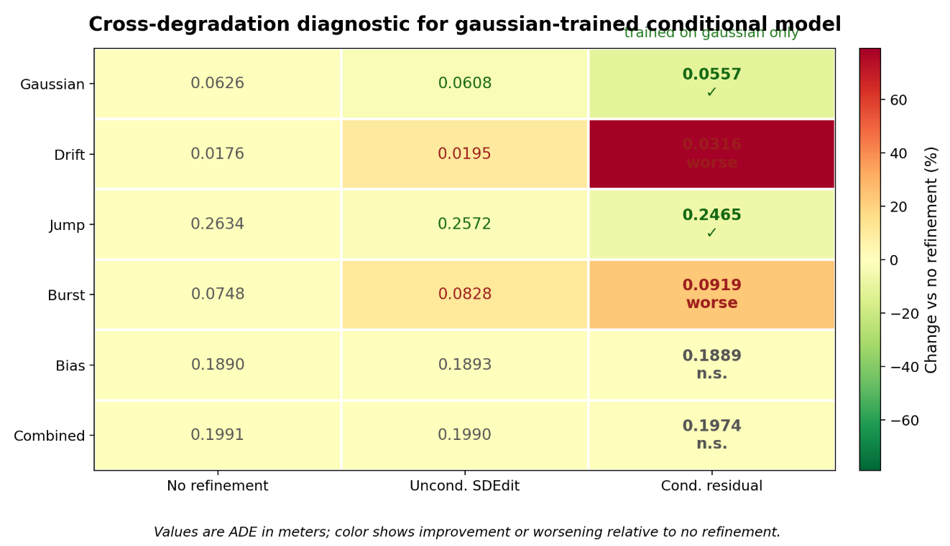
Cross-degradation result: failures are structured, not random
11 / 13
One gaussian-trained conditional model, six test conditions
Case | Observed result | Likely reason
Gaussian | improves | training and test corruption match
Jump | improves | sparse offsets resemble extreme residuals
Drift | worse | over-corrects an already mild error
Burst | worse | local high-noise frames ≠ uniform gaussian residual
Bias | near unchanged | constant offset cancels in relative displacement
Combined | weak | mixed error exceeds current interface
Interpretation
Conditioning helps only when the corruption model, representation, and test error structure are aligned.
Report Table 7 and Fig. 8; non-gaussian rows are diagnostic generalization tests, not matched-training results.
Stage 3 — DDPM-based Indoor Trajectory Refinement
Notes:
The same gaussian-trained conditional model is then tested across other degradation types.
The failures are structured. Drift worsens because the model applies too much correction to a mild smooth error. Burst worsens because the corruption is local but the model has no reliability mask.
Bias is almost unchanged because a constant global offset cancels in the relative-displacement representation.
So the result is not just poor generalization. It tells us what the next interface has to model: correction scale, frame reliability, and representation limits.

Slide 12
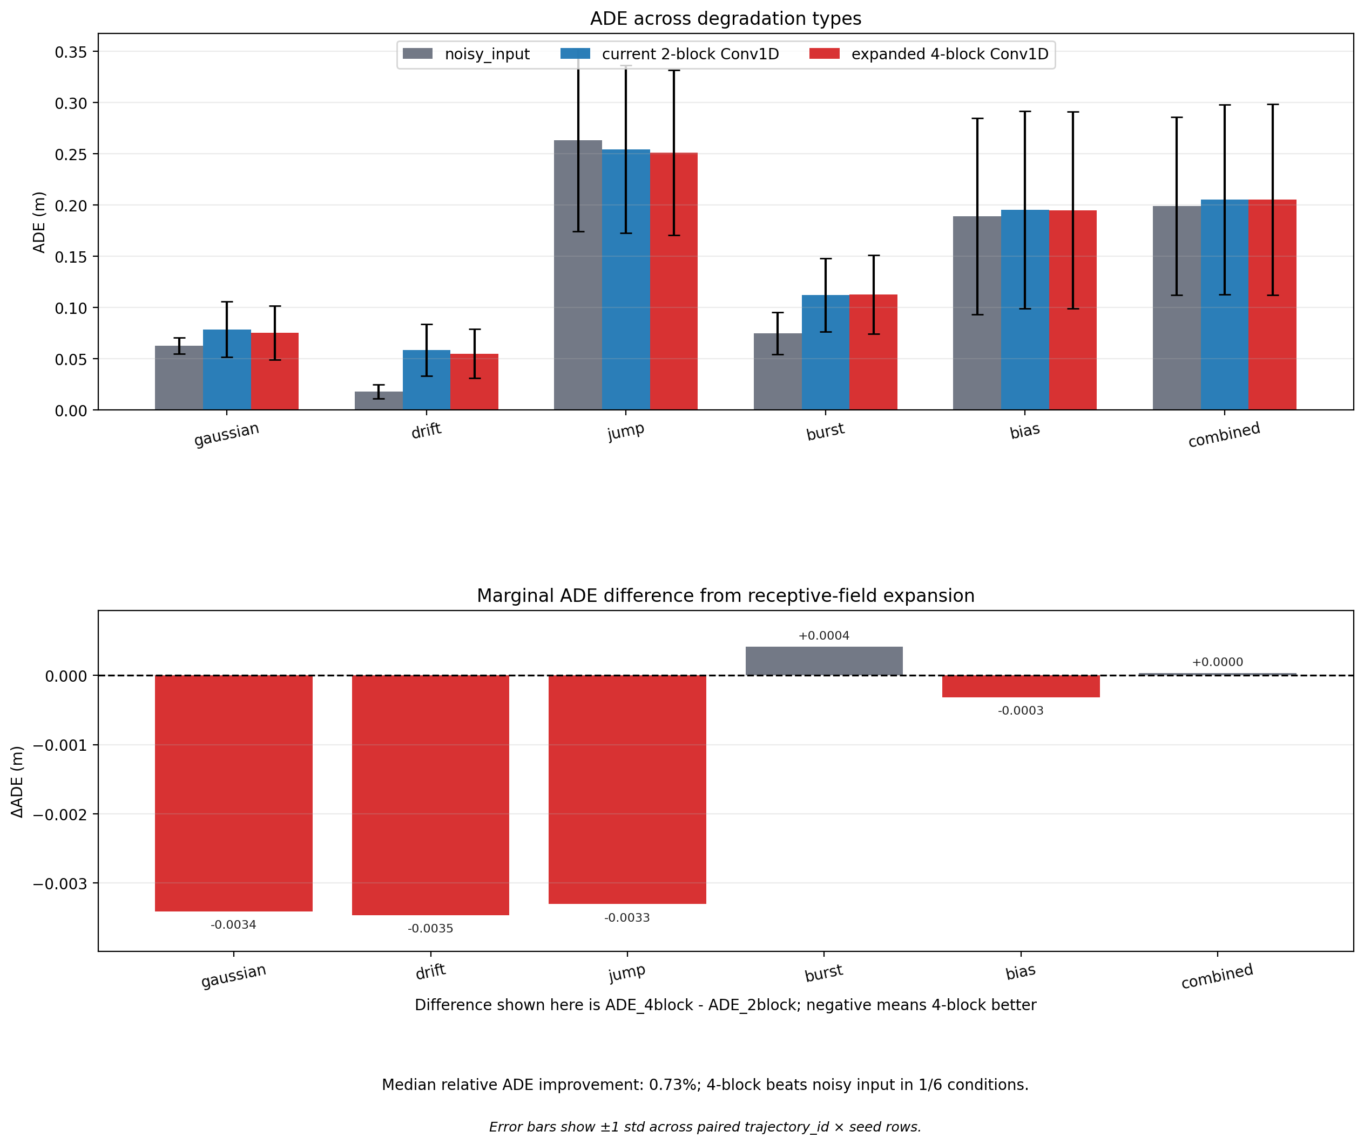
Backbone ablation: more receptive field does not fix the interface
12 / 13
Why test the backbone?
The model-family concern is valid: SSSD-S4 and Diffusion-TS are relevant time-series diffusion families. For T = 20, I test the most immediate capacity question first: temporal receptive-field coverage.
Backbone | Blocks | Effective RF | Coverage | Params
Current Conv1D | 2 | 13 frames | 65.0% | 212,354
Expanded Conv1D | 4 | 21 frames | full-window | 409,474
Result summary | Value
Median relative ADE gain | 0.73%
Improved over 2-block | 4 / 6 degradations
Still beats noisy_input | 1 / 6 degradations
Parameter increase | ≈ 1.93×
Design implication
The failure regime survives full-window coverage; Stage 4 should model observation confidence and anchoring.
SSSD: Alcaraz & Strodthoff, TMLR 2023. Diffusion-TS: Yuan & Qiao, ICLR 2024. Ablation values from report Tables 9–11.
Stage 3 — DDPM-based Indoor Trajectory Refinement
Notes:
This slide addresses the concern that the problem may simply be model capacity.
I compare the current two-block Conv1D with a four-block version whose receptive field covers the full 20-frame window.
The larger backbone nearly doubles the parameter count and gives a small median relative ADE gain, but it still beats the noisy input in only one of six degradations.
That points away from receptive field as the main bottleneck. The next bottleneck is observation anchoring and confidence-aware correction.

Slide 13
Bounded Stage 3 claim and Stage 4 implication
13 / 13
What Stage 3 establishes
Evidence | Bounded claim
Task correction | old local gap-filling was biased toward linear interpolation
Uncond. SDEdit | prior-only editing gives a small but systematic gaussian gain (−2.8%)
Cond. residual DDPM | observation conditioning gives the larger matched-gaussian gain (−10.98%)
Cross-degradation | failures are explainable: drift scale, burst reliability, bias representation
Backbone ablation | full-window Conv1D does not remove the failure regime
Main conclusion
Conditioning is the operative variable, but only when corruption, representation and test error structure are aligned.
Next-step implication
Move toward sensor-anchored, confidence-aware posterior refinement.
References and role
Reference | Used for
Ho et al. 2020 | DDPM formulation
Meng et al. 2022 | SDEdit prior-only editing diagnostic
Tariq et al. 2020 / 2021 | indoor human tracking and trajectory metrics context
Alcaraz & Strodthoff 2023 | SSSD / conditional time-series diffusion family
Yuan & Qiao 2024 | Diffusion-TS / alternative time-series diffusion family
Final claim deliberately remains bounded: Stage 3 maps the interface lever and failure boundaries; it does not claim universal sensor-error recovery.
Stage 3 — DDPM-based Indoor Trajectory Refinement
Notes:
I close with a bounded claim rather than an over-claim.
Stage 3 establishes five things: the old local gap task was biased, prior-only SDEdit has a small ceiling, conditioning gives the larger matched-gaussian gain, cross-degradation failures are explainable, and a wider backbone does not remove the failure regime.
The main conclusion is precise: conditioning is the operative variable, but only when the corruption model, representation and test error structure are aligned.
The next step is therefore sensor-anchored, confidence-aware posterior refinement, not simply a stronger unconditional prior.

