Slide 1
Bus 139 Final Project
Ricky Santos

Slide 2
Outline
Problem
Data Analysis
EDA
Cross Validation
Decision Tree
Logistic Regression
ROC
Results
What I found, importance of what I found
Questions

Slide 3
Problem
What were the characteristics that would have most likely saved a person aboard the Titanic?

Slide 4
Data Analysis

Slide 5
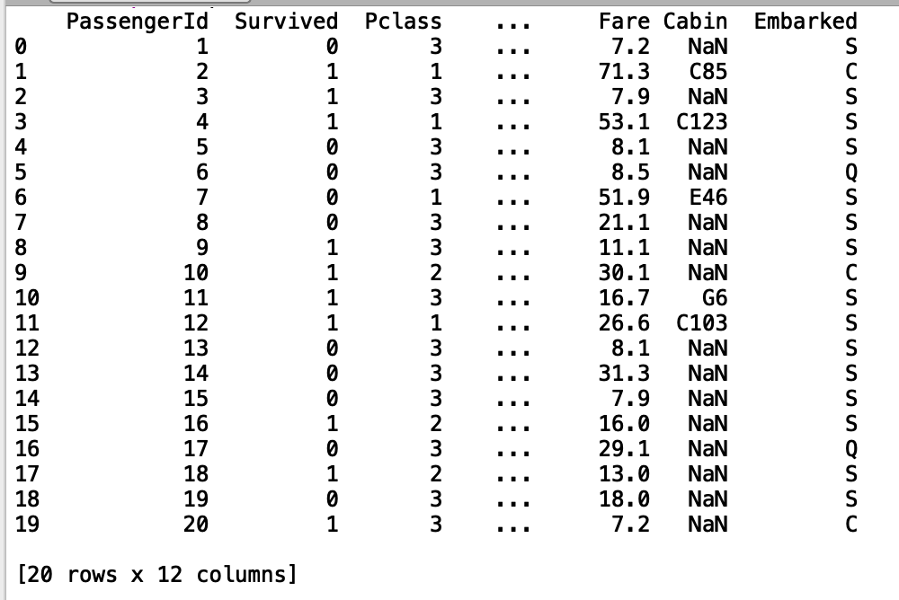
Why should we apply EDA to dataset?
The code must be cleaned up
due to the NaNs seen to the right:

Slide 6
EDA - Training Set
Changes Made to Data:
Changed
Male and Female categories were turned into boolean variables so that data can be used.
Male = 0 Female = 1
Dropped due to being a categorical variable
Name, Ticket number, Cabin, Embarked, and Passenger ID were deleted.
Inputs Used | Output
P Class | Survived
Sex
Age
SibSp
Parch
Fare

Slide 7
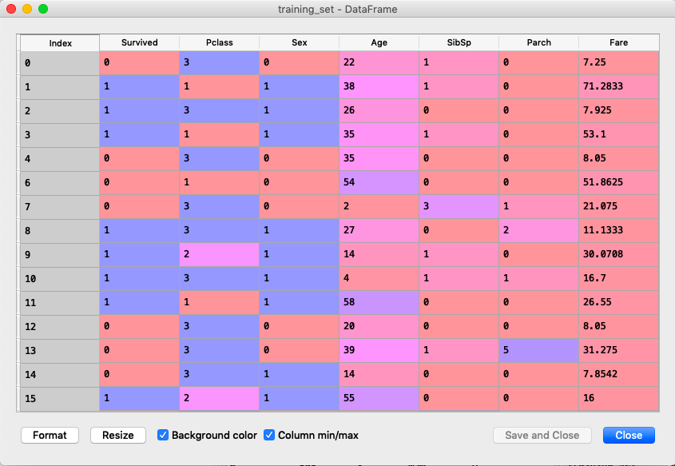
EDA - Training Set
To check for correlation of inputs to outputs:
Imported train set
Checked for descriptive statistics
Chose to not normalize data as normalization of x would have made booleans to normal distribution.

Slide 8
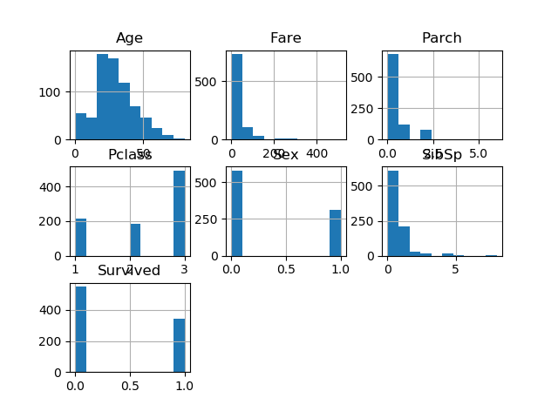
EDA - Training Set

Slide 9
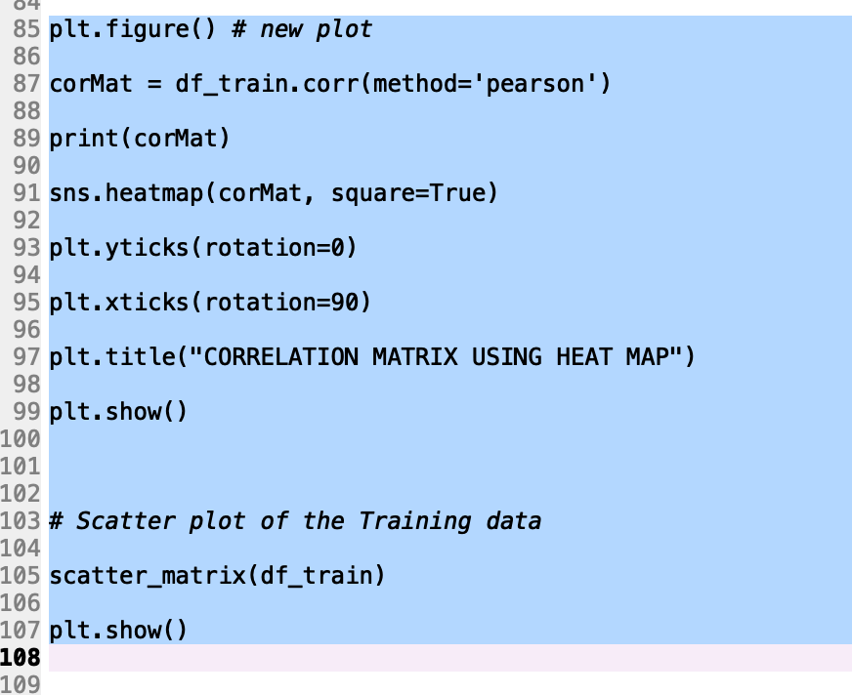
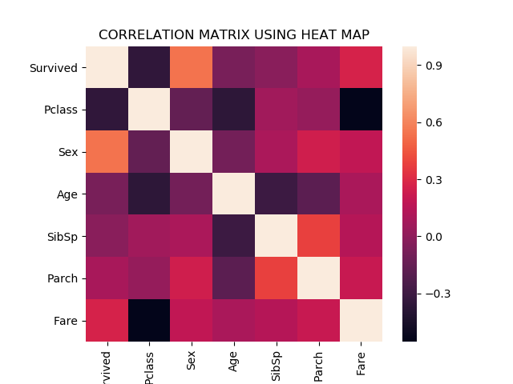
EDA - Training Set
Highest correlation of inputs to output (Survived) by rank (highest correlation 1st):
Sex
PClass
Fare
Parch
SibSp
Age

Slide 10
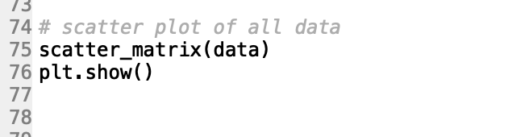
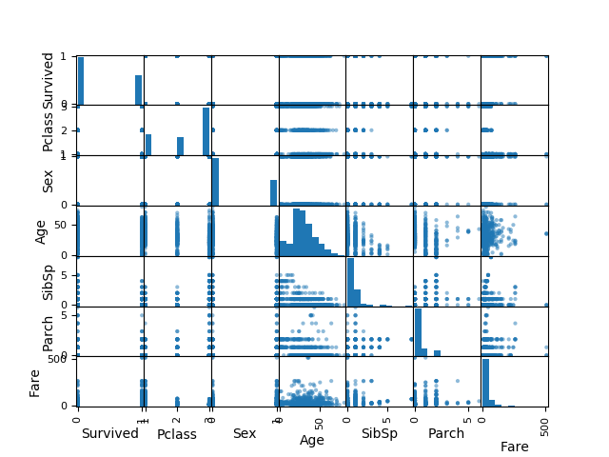
EDA - Training Set
To see the relationship from one input to the other we utilized a scatter plot to see if there were any linear relationships.

Slide 11
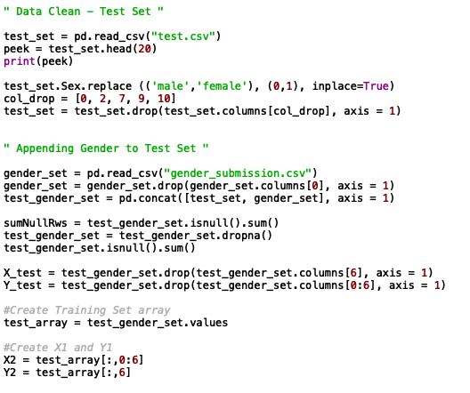
Data Prep - Test Set
Dropped categorical variables and converted Sex to a boolean set.
Concatenated the gender submission data to the test set.

Slide 12
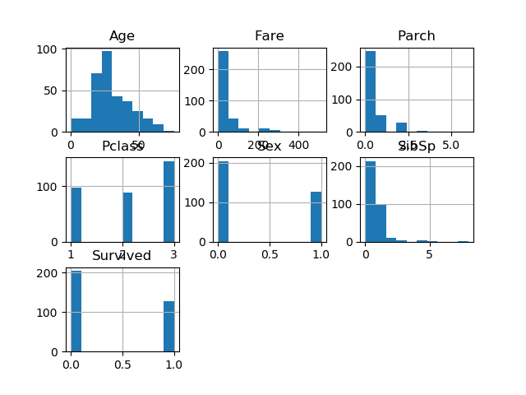
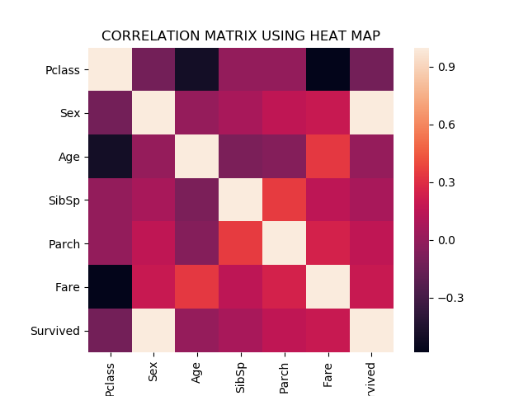
EDA - Test Set
Ran a histogram model, correlation heat map, and scatter plot.

Slide 13
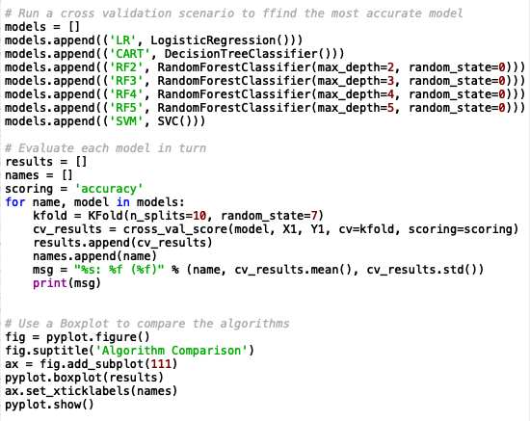
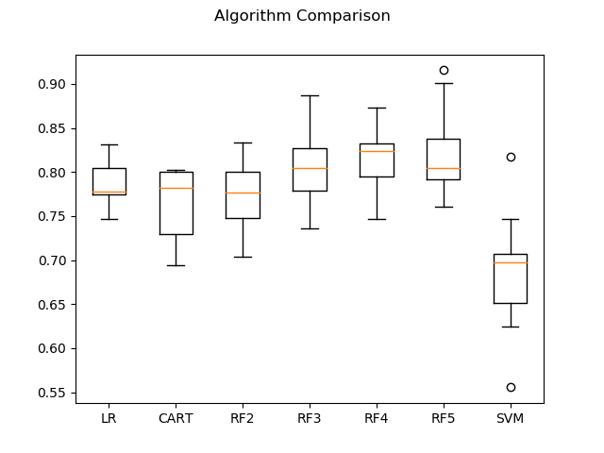
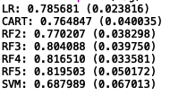
Cross Validation - Training Set
Training array is created and Cross Validation is done to see which algorithm is most accurate for predicting outcomes.
I found that the Random Forest Classifier with a depth of 4 and 5 to be the most accurate model on an average and standard deviation basis. They had similar means (and were highest) and similar standard deviation (and were smallest). However, I chose to stick with the Random Forest Classifier with a depth of 5.

Slide 14
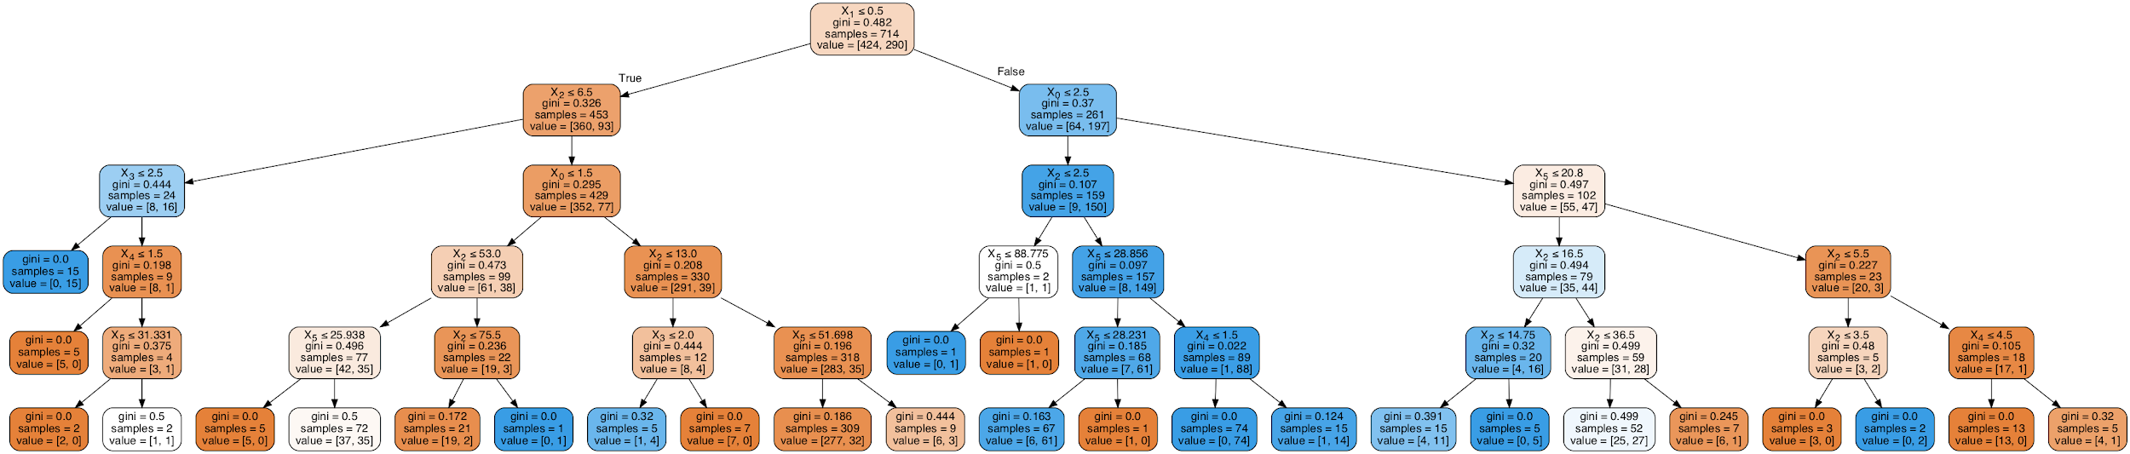
Decision Tree - Test and Training Set
(max depth = 5)

Slide 15
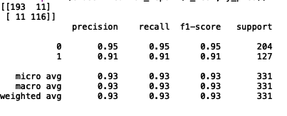
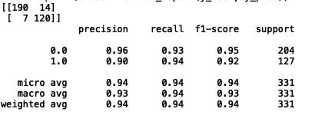
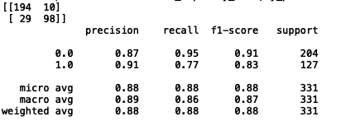
Confusion and Classification Matrices
Decision Tree ________________________
Logistic Regression __________________
Random Forest Classifier ____________
(max depth = 5)
Notes:
Precision is the ratio of correctly predicted positive observations to the total predicted positive observations. High precision = low false positive rate
Recall is the ratio of correctly predicted positive observations to the all observations in actual class - yes.
F1 Score is the weighted average of Precision and Recall. Therefore, this score takes both false positives and false negatives into account.
The support is the number of samples of the true response that lie in that class.

Slide 16
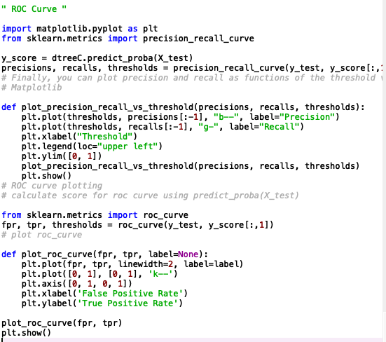
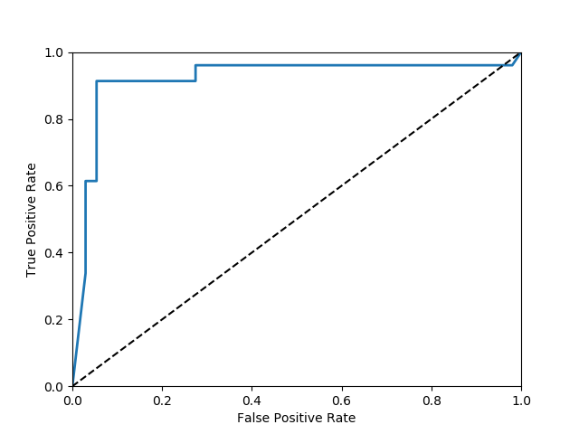
ROC Curve
Results

Slide 17
What is the ROC Curve?
In a Receiver Operating Characteristic (ROC) curve, the True Positive Rate (tpr), or Sensitivity, is plotted in the function of the False Positive Rate (fpr), or 100-Specificity
It is important to note that a perfect ROC Curve with 100% Sensitivity and 100% Specificity is one that passes through the upper left corner
How can we interpret our results after running the ROC Curve?
Based on results, we see that the ROC Curve has a higher Sensitivity level while the Specificity level is lower
We also can claim that the result we got could have a little bit to do with overfitting in the model

Slide 18
Results

Slide 19
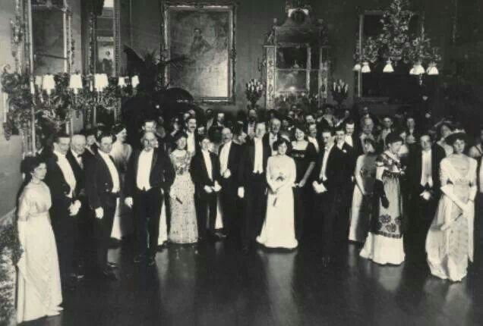
What are the results and what can be concluded?
Based on research, we can conclude the following characteristics made you more likely to survive the Titanic disaster:
Woman
Higher Fare Passengers
Younger Age

Slide 20
Questions?

