Slide 1
Influence of resource inequality in cooperation
Department of Computer Science and Engineering, Instituto Superior Técnico
Daniel Ramos
Miguel Tavares
Ricardo Brancas
- 81620
- 83528
- 83557

Slide 2
Cooperation exists in nature.
Why?

Slide 3
Prisioner’s dilemma
 | Cooperator | Defector
Cooperator | R | S
Defector | T | P
$$T<R<P<S$$

Slide 4
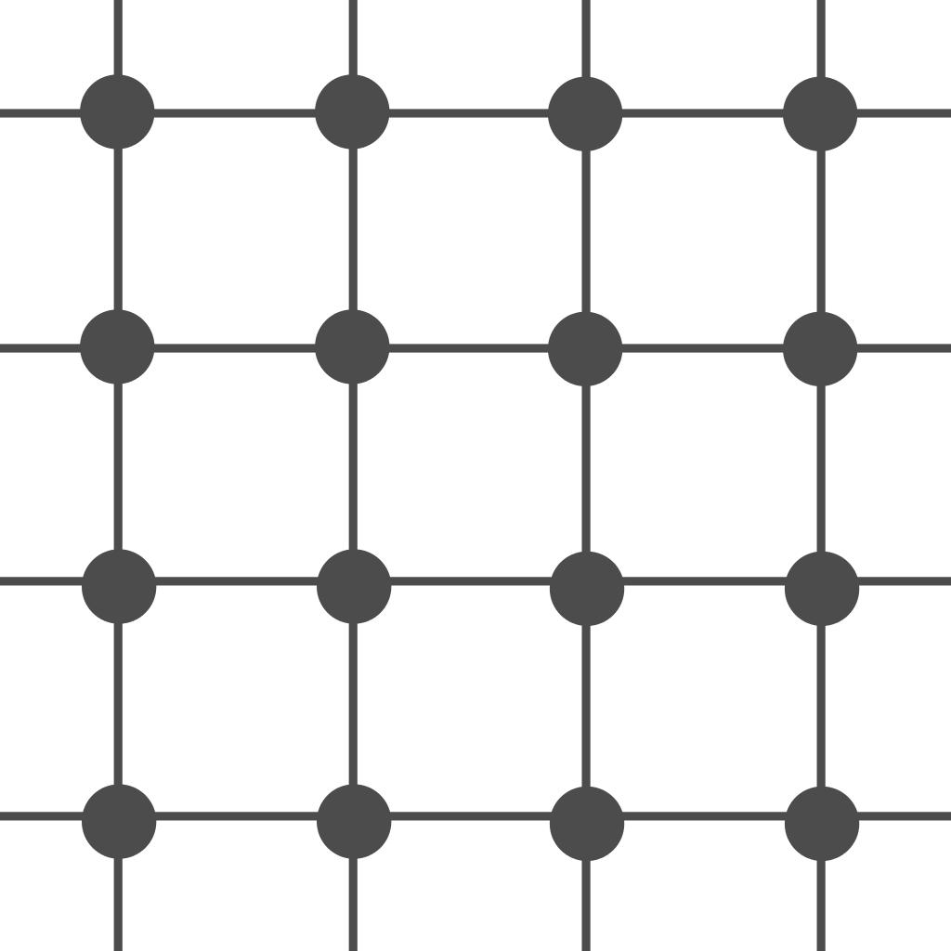
Lattice

Slide 5
Original approach
$$P_{t+1}[x=C]=\frac{\underset{y∈neigh(x)∪\{x\}}{∑}A(y)^{m}s(y)}{\underset{y∈neigh(x)∪\{x\}}{∑}A(y)^{m}}$$
Notes:
A(y) : payoff do player y
s(y) : 1 se y é cooperador, 0 cc.
m : parâmetro livre do modelo

Slide 6
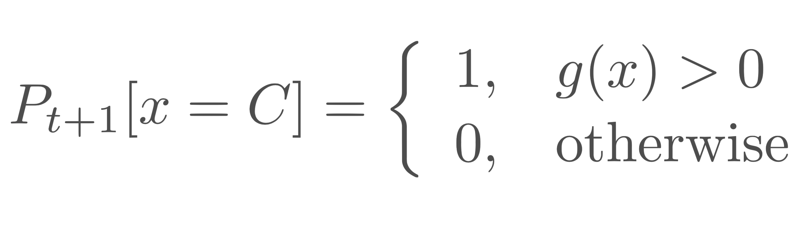
Replicator equation approach
$$\begin{matrix}g(k) & =T_{k}^{+}-T_{k}^{-} \\ & =\frac{k}{Z}\frac{Z-k}{Z}tanh\left(\frac{β}{2}(f_{C}(k)-f_{D}(k))\right)\end{matrix}$$

Slide 7
softmax approach
$$P_{t+1}[x=C]=σ(x)_{C}=\frac{e^{-ηf_{C}(x)}}{e^{-η(f_{C}(x)+f_{D}(x))}}$$

