Slide 1
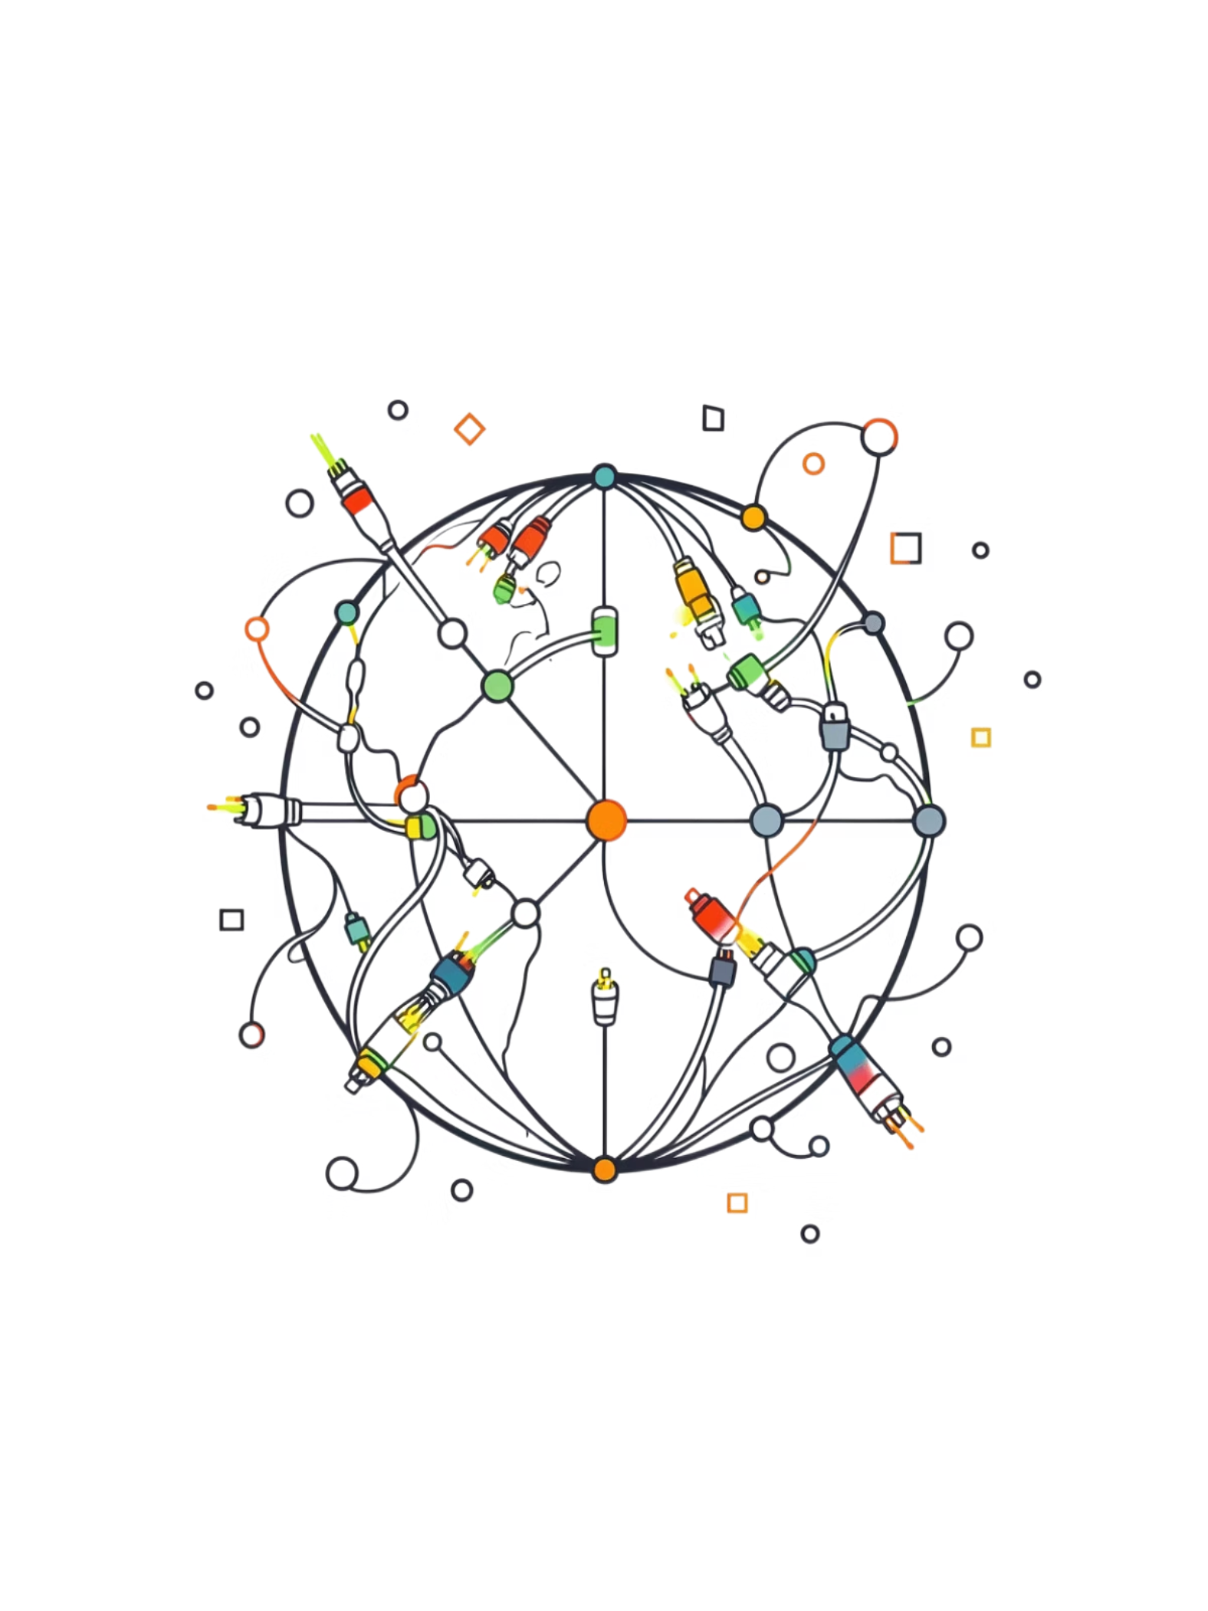
How the Internet Works
A visual guide to physical links, IP addressing, protocols, and the journey from URL to webpage.

Slide 2
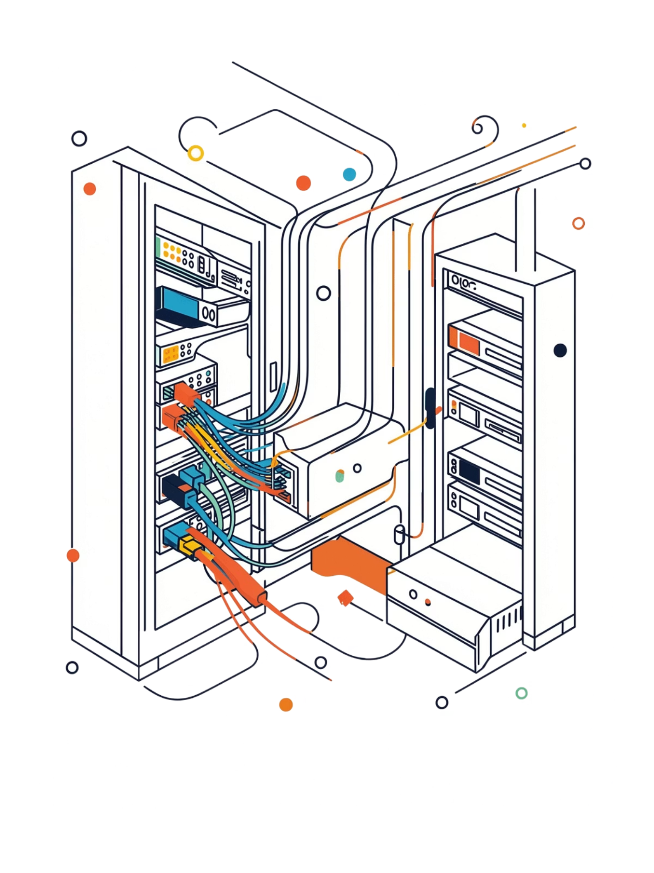
The Physical Web & IP Addressing
Physical Links
IP Addresses
Computers connect via fiber optic cables, copper wires, and wireless signals — forming a global mesh of routers and switches that pass data along the fastest available path.
Every device gets a unique numeric address (e.g. 192.168.1.1). ISPs assign them dynamically via DHCP or statically; routers use these addresses to forward packets toward their destination.

Slide 3
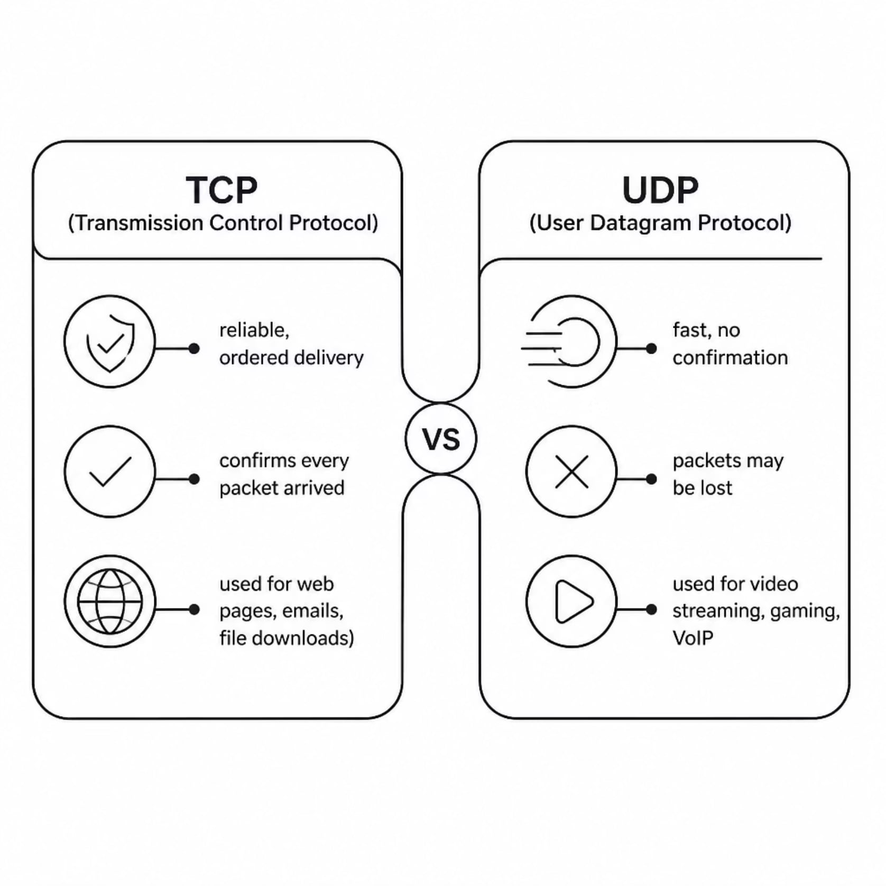
TCP vs. UDP: Choosing How Data Travels
When to Use Each
The choice between TCP and UDP comes down to one question: does accuracy or speed matter more?
TCP — web pages, emails, file downloads where every byte must arrive correctly
UDP — live video, online gaming, and VoIP where a dropped packet is better than a delay

Slide 4

From URL to Webpage: The Full Journey
Internet Suite (TCP/IP)
OSI Model
4 practical layers — the model the internet actually runs on. Designed for real-world implementation.
7 theoretical layers — a reference standard used for teaching and diagnosing how data is packaged, transmitted, and received.

