Slide 1
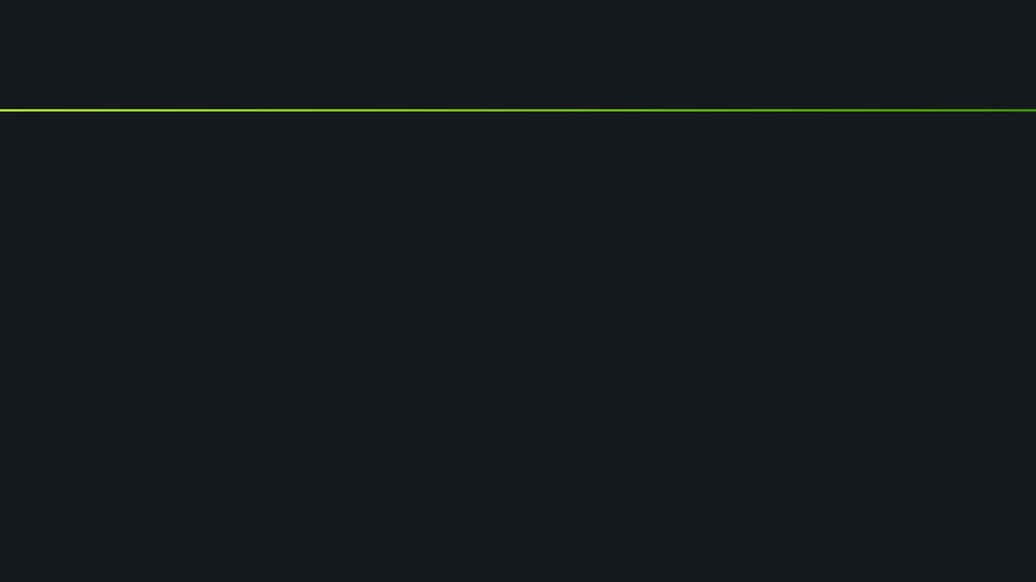
SISTEMAS OPERATIVOS MOVILES Y EMBEBIDOS
DEFENSA HITO 3
Nombre Completo: Univ. Ricardo David La Madrid Alarcón
Asignatura: SISTEMAS OPERATIVOS MOVILES Y EMBEBIDOS
Carrera: INGENIERÍA DE SISTEMAS
Paralelo: SOME (1)
Docente: Lic. William R. Barra Paredes

Slide 2
Activity Main
public class MainActivity extends AppCompatActivity {
private ViewPager viewPagerContainer;
@Override
protected void onCreate(Bundle savedInstanceState) {
super.onCreate(savedInstanceState);
setContentView(R.layout.activity_main);
_initializeComponents();
_initializeFragmentAdapter();}
public void _initializeComponents() {
viewPagerContainer = findViewById(R.id.viewPagerContainer);}
public void _initializeFragmentAdapter() {
OnboardingAdapter adapter = new OnboardingAdapter(getSupportFragmentManager());
viewPagerContainer.setAdapter(adapter);
}
}

Slide 3
Fragment 1 y 2 son similares, asi que pongo solo el fragment 1 porque solo varia el nombre del fragment
public class FragmentUno extends Fragment {
private TextView textPrev, textNext;
private TextView textDoneIns, textPrevIns;
private ViewPager viewPager;
private View view;
public FragmentUno() {}
@Override
public View onCreateView(LayoutInflater inflater, ViewGroup container,
Bundle savedInstanceState) {
_initializeInflater(inflater, container);
_initialize();
_addClickDoneAndPrev();
return view; }
private void _addClickDoneAndPrev() {
textPrev.setOnClickListener(new View.OnClickListener() {
@Override
public void onClick(View v) {
viewPager.setCurrentItem(3); }
});
textNext.setOnClickListener(new View.OnClickListener(){
@Override
public void onClick(View v) {
viewPager.setCurrentItem(1);}});}
private void _initialize() {
viewPager = getActivity().findViewById(R.id.viewPagerContainer);
textNext = view.findViewById(R.id.textNext);
textPrev = view.findViewById(R.id.Skip);
}
private void _initializeInflater(LayoutInflater inflater, ViewGroup container) {
view = inflater.inflate(R.layout.fragment_uno, container, false);
}
}

Slide 4
Fragment 3
public class FragmentTres extends Fragment {
private EditText etSelectapp,etUsername;
private Button descbas,descient,desccustom,selectbas,selectcient,selectcustom,btLogin;
private ViewPager viewPager;
private View view;
public FragmentTres()
{
// Required empty public constructor
}
@Override
public View onCreateView(LayoutInflater inflater, ViewGroup container, Bundle savedInstanceState)
{
initializeInflater(inflater, container);
initializeComponents();
eventClickAction();
return view;
}
public void initializeInflater(LayoutInflater inflater, ViewGroup container)
{
view = inflater.inflate(R.layout.fragment_tres, container, false);
}
public void initializeComponents()
{
viewPager = getActivity().findViewById(R.id.viewPagerContainer);
etSelectapp = view.findViewById(R.id.etSelectapp);
etUsername = view.findViewById(R.id.etUsername);
btLogin = view.findViewById(R.id.btLogin);
descbas = view.findViewById(R.id.descbas);
descient = view.findViewById(R.id.descient);
desccustom = view.findViewById(R.id.desccustom);
selectbas = view.findViewById(R.id.selectbas);
selectcient = view.findViewById(R.id.selectcient);
selectcustom = view.findViewById(R.id.selectcustom);
}
public void eventClickAction()
{

Slide 5
Fragment 3
selectbas.setOnClickListener(new View.OnClickListener() {
@Override
public void onClick(View v) {
etSelectapp.setText("Basica");
}
});
selectcient.setOnClickListener(new View.OnClickListener() {
@Override
public void onClick(View v) {
etSelectapp.setText("Cientifica");
}
});
selectcustom.setOnClickListener(new View.OnClickListener() {
@Override
public void onClick(View v) {
etSelectapp.setText("Custom");
}
});
descbas.setOnClickListener(new View.OnClickListener() {
@Override
public void onClick(View v) {
Toast.makeText(getActivity(), "Calculadora con operaciones simples básica", Toast.LENGTH_SHORT).show();
}
});
descient.setOnClickListener(new View.OnClickListener() {
@Override
public void onClick(View v) {
Toast.makeText(getActivity(), "Calculadora con operaciones avanzadas", Toast.LENGTH_SHORT).show();
}
});
desccustom.setOnClickListener(new View.OnClickListener() {
@Override
public void onClick(View v) {
Toast.makeText(getActivity(), "Calculadora con operaciones para programadores", Toast.LENGTH_SHORT).show();
}

Slide 6
Fragment 3
});
btLogin.setOnClickListener(new View.OnClickListener()
{
@Override
public void onClick(View v)
{
String selectapp = etSelectapp.getText().toString().trim();
String username = etUsername.getText().toString().trim();
if(username.equals("") || selectapp .equals(""))
{
Toast.makeText(getActivity(), "Debe llenar todos los campos", Toast.LENGTH_SHORT).show();
}
else if(selectapp.equals("Custom"))
{
Intent intent = new Intent(getActivity(), Custom.class);
intent.putExtra("selectapp", selectapp);
intent.putExtra("username", username);
startActivity(intent);}
else if(selectapp.equals("Basica"))
{
Intent intent = new Intent(getActivity(), Basica.class);
intent.putExtra("selectapp", selectapp);
intent.putExtra("username", username);
startActivity(intent);
}
else if(selectapp.equals("Cientifica")) {
Intent intent = new Intent(getActivity(), Cientifica.class);
intent.putExtra("selectapp", selectapp);
intent.putExtra("username", username);
startActivity(intent);
}
else{
Toast.makeText(getActivity(), "Seleccione Calculadora", Toast.LENGTH_SHORT).show();}
}
});
}
}

Slide 7
Clase OnboardingAdapter
public class OnboardingAdapter extends FragmentPagerAdapter {
public OnboardingAdapter(FragmentManager fm) {
super(fm);}
@NonNull
@Override
public Fragment getItem(int position) {
switch (position) {
case 0:
return new FragmentUno();
case 1:
return new FragmentDos();
case 2:
return new FragmentTres();
default:
return null;
}
}
@Override
public int getCount()
{
return 3;
}
}

Slide 8
Activity Basica y Cientifica son similares, asi que solo pondré el de básica solo cambia el nombre del activity
public class Basica extends AppCompatActivity {
private TextView tvShowUsername;
@Override
protected void onCreate(Bundle savedInstanceState) {
super.onCreate(savedInstanceState);
setContentView(R.layout.activity_basica);
initializeComponents();
}
private void initializeComponents()
{
tvShowUsername = findViewById(R.id.tvShowUsername);
String username = getIntent().getStringExtra("username");
String msg = "App: Basica \n Bienvenido: " + username;
tvShowUsername.setText(msg);
}
}

Slide 9
Activity Custom (el código es muy extenso asi que pondré lo mas importante como es declaración de variables y funciones de los botones principales
public class Custom extends AppCompatActivity implements View.OnClickListener{
TextView tvdisplay;
private Button bt1,bt0,bt2,bt3,bt4,btsum,btres,btdiv,btmul,btshift,btigual,bts1,bts2,bts3,bts4,btclean;
private TextView tvShowUsername;
int i = 0;
public double op1 = 0.0,ope;
public double op2;
String operador;
double n1,n2,resu;
@Override
protected void onCreate(Bundle savedInstanceState) {
super.onCreate(savedInstanceState);
setContentView(R.layout.activity_custom);
initializeComponents();
initializerVariables();
}private void initializerVariables() {
bt0 = findViewById(R.id.bt0);
bt0.setOnClickListener(this);
bt1 = findViewById(R.id.bt1);
bt1.setOnClickListener(this);
bt2 = findViewById(R.id.bt2);
bt2.setOnClickListener(this);
bt3 = findViewById(R.id.bt3);
bt3.setOnClickListener(this);
bt4 = findViewById(R.id.bt4);
bt4.setOnClickListener(this);
btsum = findViewById(R.id.btsum);
btsum.setOnClickListener(this);
btres = findViewById(R.id.btres);
btres.setOnClickListener(this);

Slide 10
Activity Custom
btmul = findViewById(R.id.btmul);
btmul.setOnClickListener(this);
btdiv = findViewById(R.id.btdiv);
btdiv.setOnClickListener(this);
btigual = findViewById(R.id.btigual);
btigual.setOnClickListener(this);
btshift = findViewById(R.id.btshift);
btshift.setOnClickListener(this);
bts1 = findViewById(R.id.bts1);
bts1.setOnClickListener(this);
bts2 = findViewById(R.id.bts2);
bts2.setOnClickListener(this);
bts3 = findViewById(R.id.bts3);
bts3.setOnClickListener(this);
bts4 = findViewById(R.id.bts4);
bts4.setOnClickListener(this);
btclean = findViewById(R.id.btclean);
btclean.setOnClickListener(this);
}
private void initializeComponents()
{
tvShowUsername = findViewById(R.id.tvShowUsername);
String username = getIntent().getStringExtra("username");
String msg = "App: Custom \n Bienvenido: " + username;
tvShowUsername.setText(msg);
}

Slide 11
Boton Factorial
try {
double fact=1;
String auxi = tvdisplay.getText().toString();
Double op11 = Double.parseDouble(auxi);
for(Double i = op11;i>0;i--)
{
fact = fact*i;
}
tvdisplay.setText(""+fact);
}
catch (Exception a)
{
Toast.makeText(getApplicationContext(),"Ingrese datos validos",Toast.LENGTH_LONG).show();
}

Slide 12
Boton X2
try {
String auxi = tvdisplay.getText().toString();
double op11 = Double.parseDouble(auxi);
double res = Math.pow(op11,2);
tvdisplay.setText(""+res);
}
catch (Exception a)
{
Toast.makeText(getApplicationContext(),"Ingrese datos validos",Toast.LENGTH_LONG).show();
}

Slide 13
Boton X3
try {
String auxi = tvdisplay.getText().toString();
double op11 = Double.parseDouble(auxi);
double res = Math.pow(op11,3);
tvdisplay.setText(""+res);
}
catch (Exception a)
{
Toast.makeText(getApplicationContext(),"Ingrese datos validos",Toast.LENGTH_LONG).show();
}

Slide 14
Boton Fibo
try { String auxi = tvdisplay.getText().toString();
op1 = Double.parseDouble(auxi);
int f =0;
int t1 =1;
int t2;
int sum =0;
for(double i = 1;i<=op1;i++){
t2 = f;
f = t1 +f;
t1 = t2;
sum = sum + t1;}
tvdisplay.setText(""+sum);
op1=0;}
catch (Exception E) { }

Slide 15
Boton XY
try {
String auxi = tvdisplay.getText().toString();
op1 = Double.parseDouble(auxi);
tvdisplay.setText("");
ope=6;
}
catch (Exception a)
{
Toast.makeText(getApplicationContext(),"Ingrese datos validos",Toast.LENGTH_LONG).show();
}
}

Slide 16
Boton NXY
try {
String auxi = tvdisplay.getText().toString();
op1 = Double.parseDouble(auxi);
}
catch (NumberFormatException e){
Toast.makeText(getApplicationContext(),"Ingrese datos validos",Toast.LENGTH_LONG).show();
}
tvdisplay.setText("");
ope = 5;

Slide 17
Boton shift
{i++;
if (i % 2 == 0) {
bts1.setText("X2");
bts2.setText("X3");
bts3.setText("N!");
bts4.setText("Σn");
bts1.setOnClickListener(new View.OnClickListener() {
@Override
public void onClick(View v) {
tvdisplay=(TextView)findViewById(R.id.tvplay);
try{
n1=Double.parseDouble(tvdisplay.getText().toString());
resu=Math.pow(n1,n2);
tvdisplay.setText(String.valueOf(resu));
}catch (NumberFormatException nfe){}}
});
bts2.setOnClickListener(new View.OnClickListener() {
@Override
public void onClick(View v) {}});
bts3.setOnClickListener(new View.OnClickListener() {
@Override
public void onClick(View v) {}});
bts4.setOnClickListener(new View.OnClickListener() {
@Override
public void onClick(View v) {}});
} else {
bts1.setText("X3");
bts2.setText("XY");
bts3.setText("fibo");
bts4.setText("Σnxy");
bts1.setOnClickListener(new View.OnClickListener() {
@Override
public void onClick(View v) {}});
bts2.setOnClickListener(new View.OnClickListener() {
@Override
public void onClick(View v) {}});
bts3.setOnClickListener(new View.OnClickListener() {
@Override
public void onClick(View v) {}});
bts4.setOnClickListener(new View.OnClickListener() {
@Override
public void onClick(View v) {}});}

Slide 18
Boton igual donde se encuentran los funciones matemáticas básicas + - * /
tvdisplay=(TextView)findViewById(R.id.tvplay);
n2=Double.parseDouble(tvdisplay.getText().toString());
if(operador.equals("+")) {
resu=n1+n2;}
else if(operador.equals("-")){
resu=n1-n2;}
else if(operador.equals("*")){
resu=n1*n2;}
else if(operador.equals("/")){
resu=n1/n2;}
else if(operador.equals("xy")){
tvdisplay=(TextView)findViewById(R.id.tvplay);
n2=Double.parseDouble(tvdisplay.getText().toString());
tvdisplay.setText(" ");
}
tvdisplay.setText(" "+resu);

