Slide 1
Classical Neurons in a Quantum Circuit
Evaluating different approaches to recreate ML-Neurons in Quantum Circuits

Slide 2
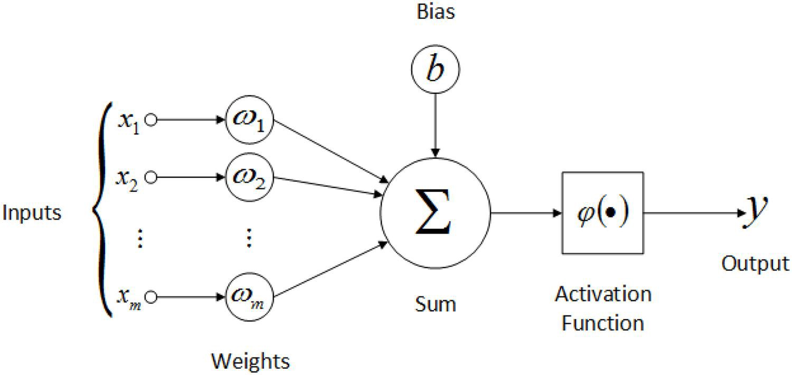
The Classical Neuron

Slide 3
Recreating the arithmetic operations
Binary addition and binary multiplication

Slide 4
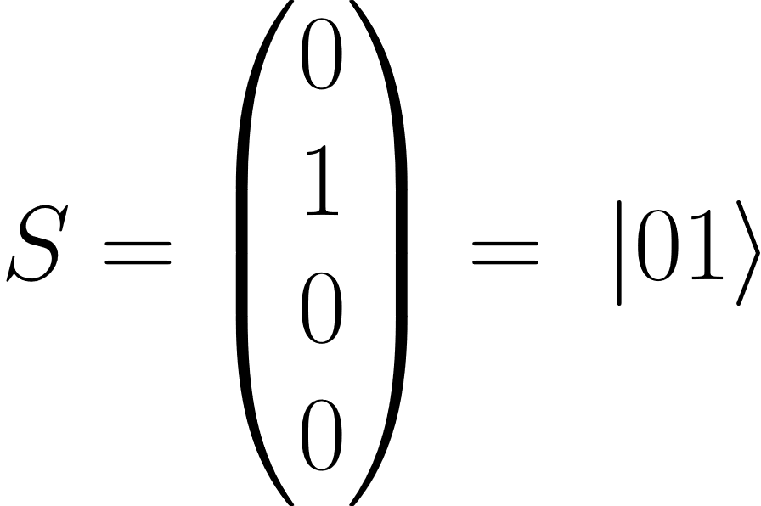
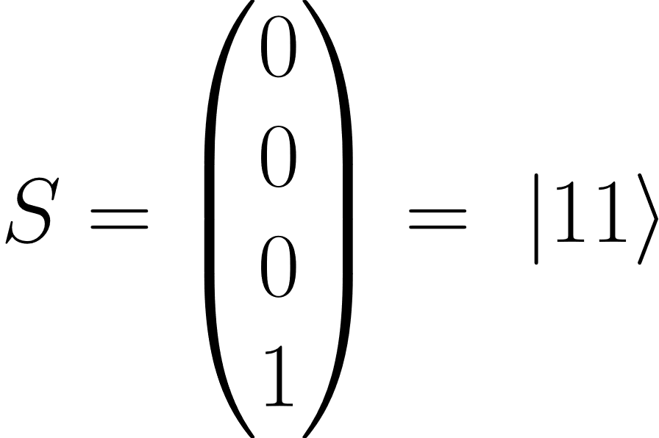
Binary Addition

Slide 5
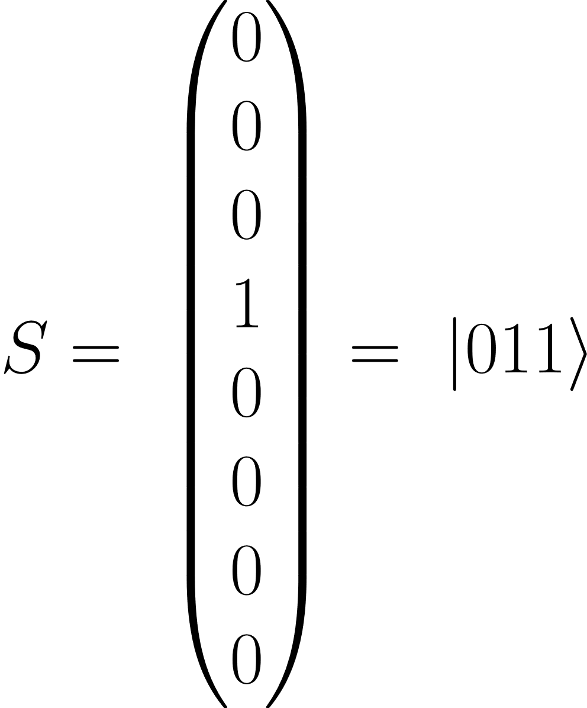
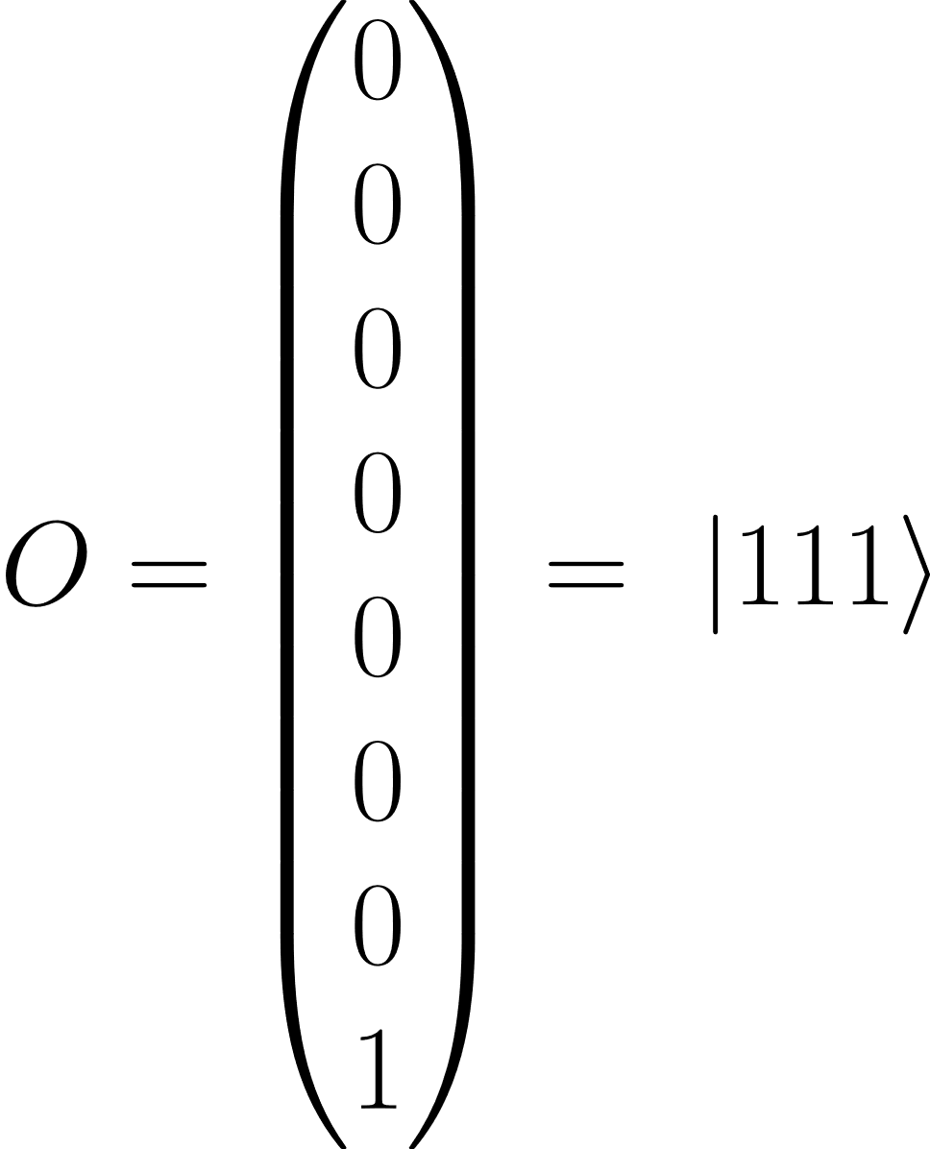
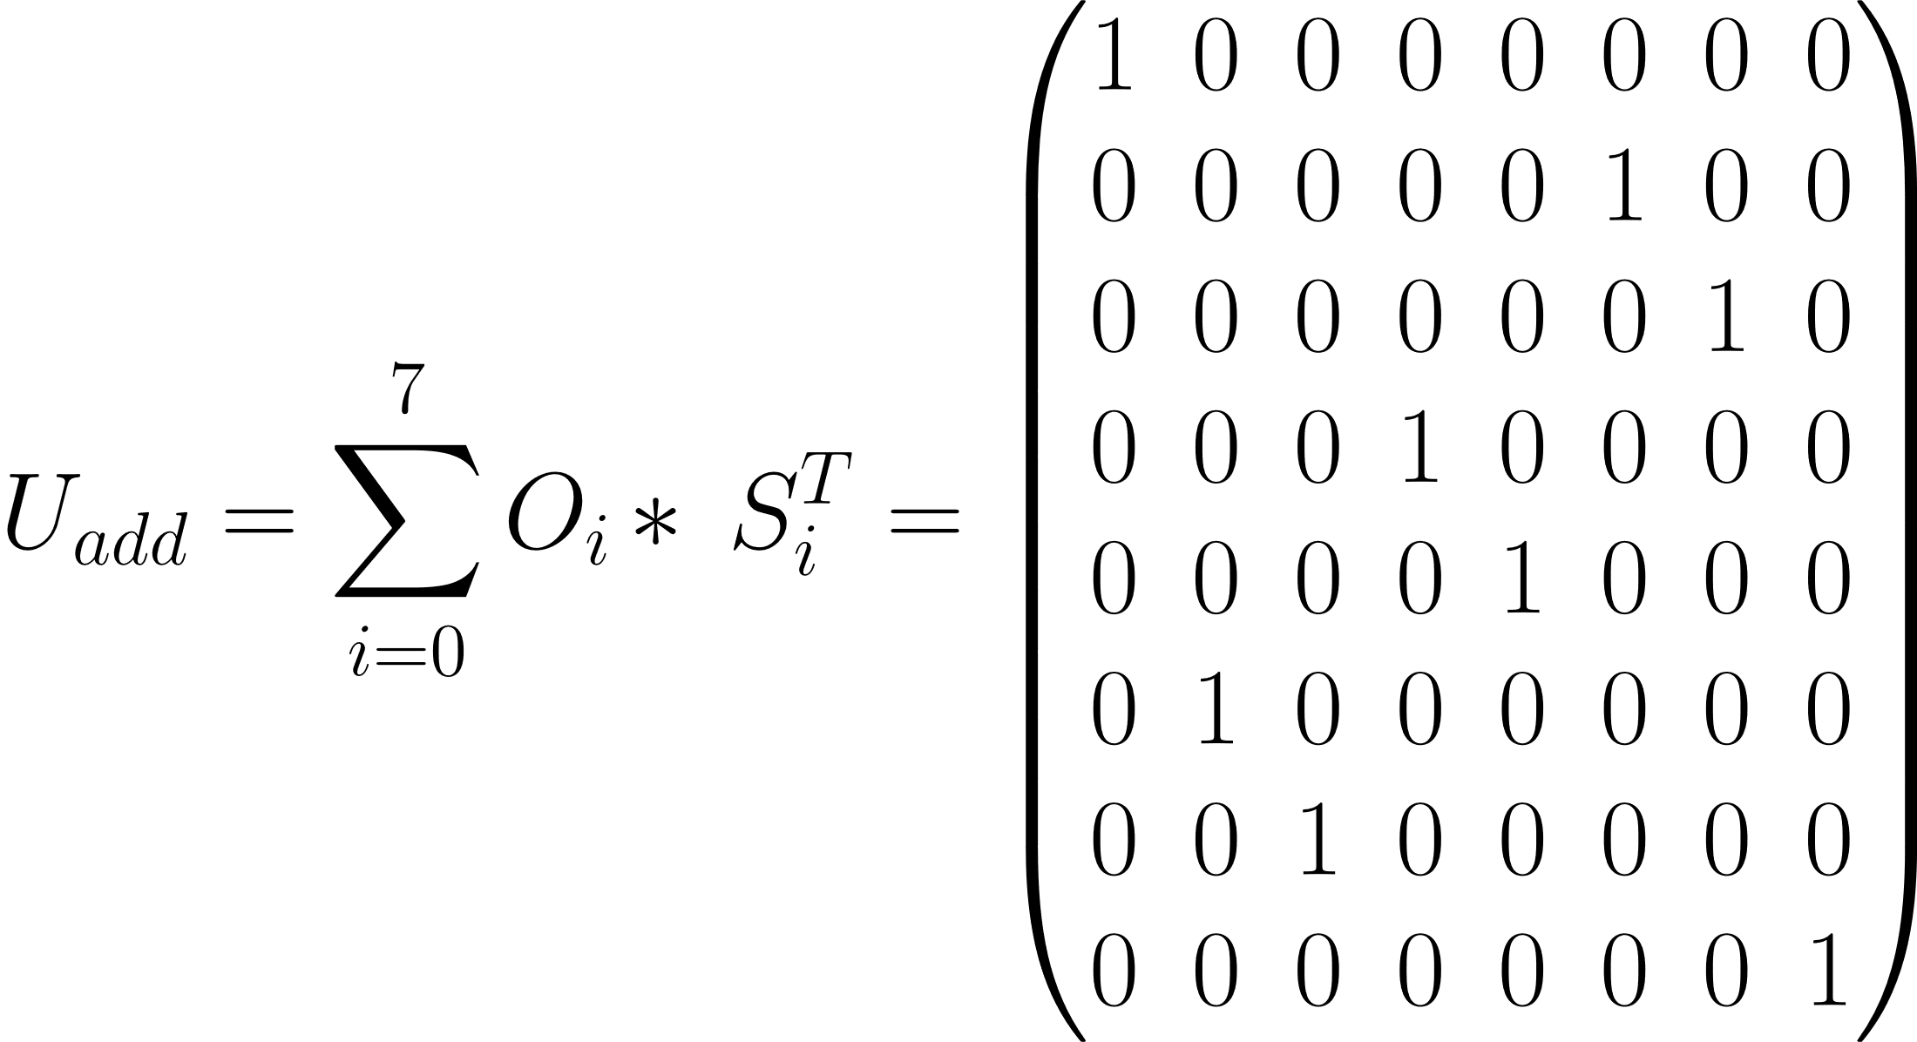
Binary Addition

Slide 6
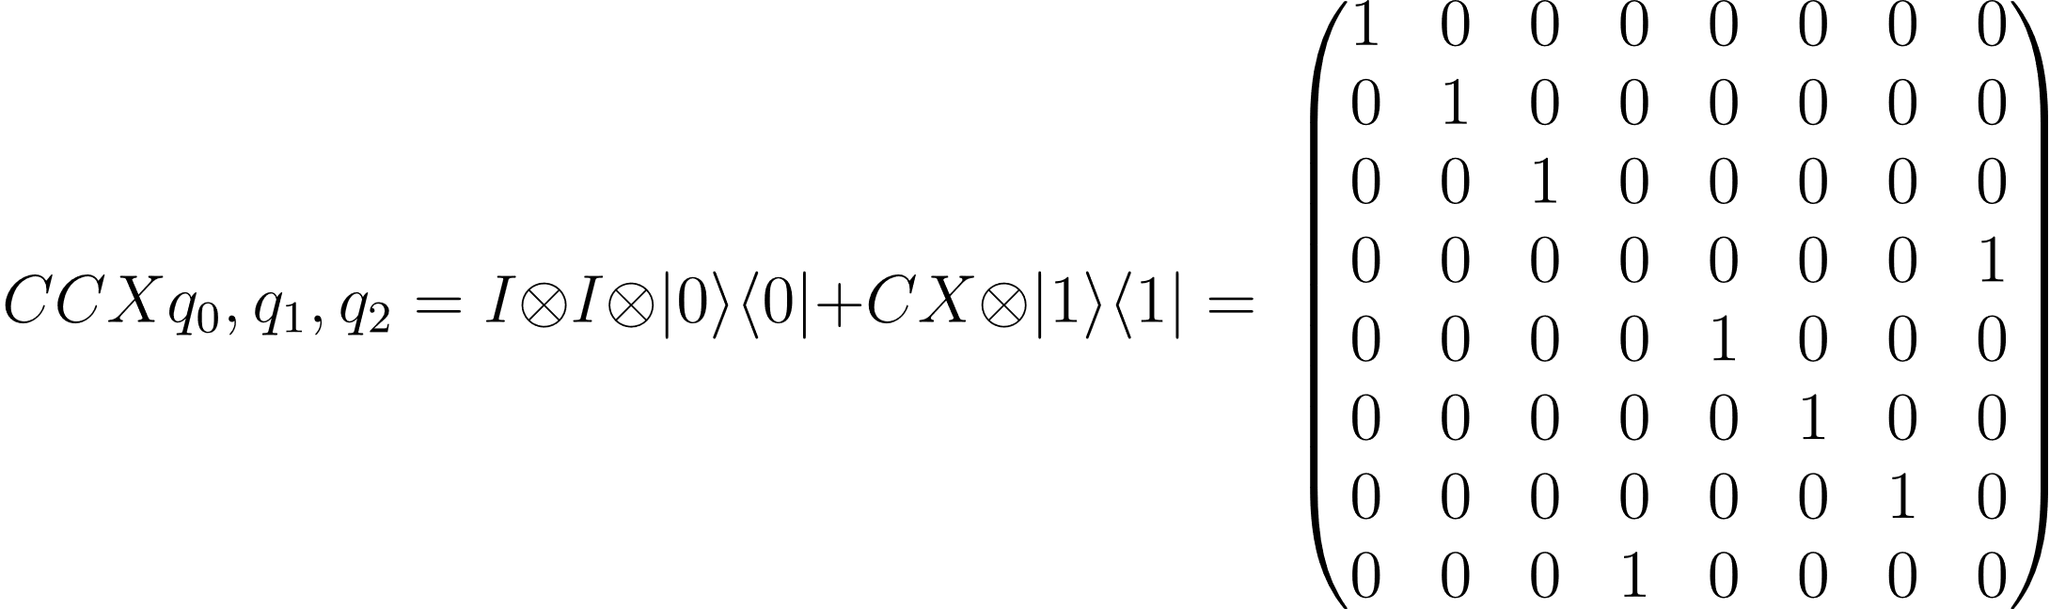
Binary Addition

Slide 7
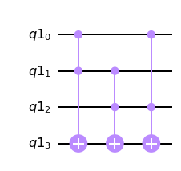
Binary Addition

Slide 8
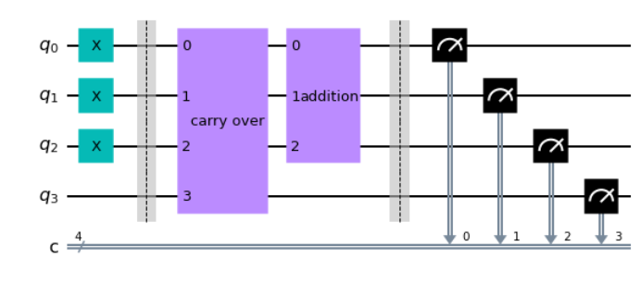
Binary Addition

Slide 9
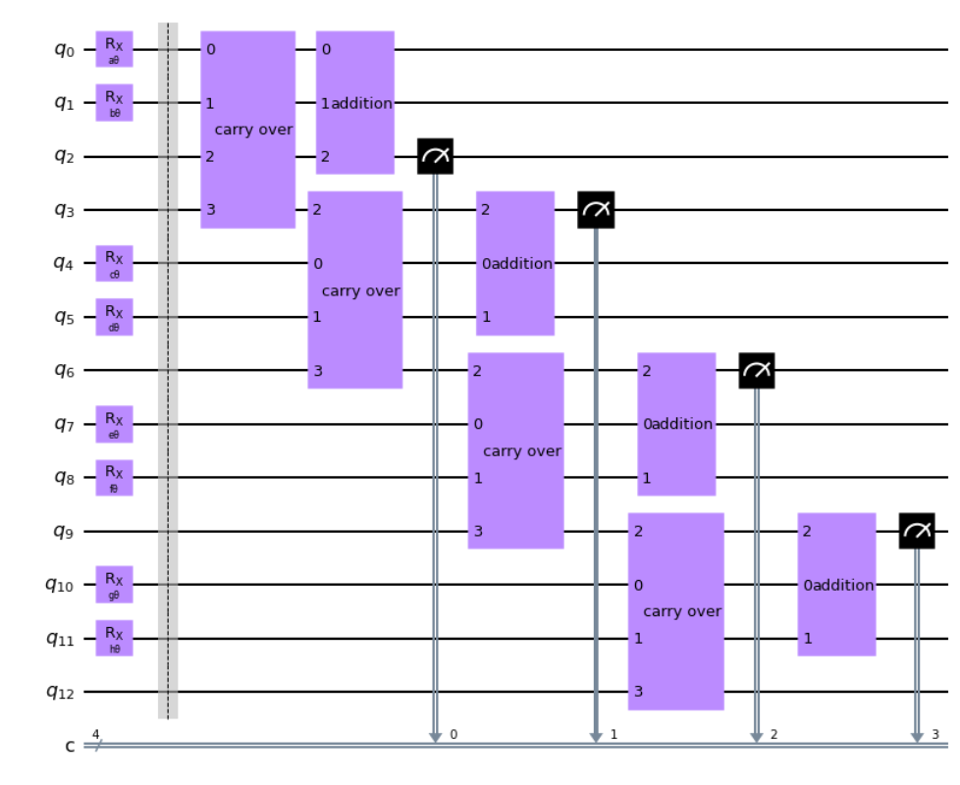

Slide 10
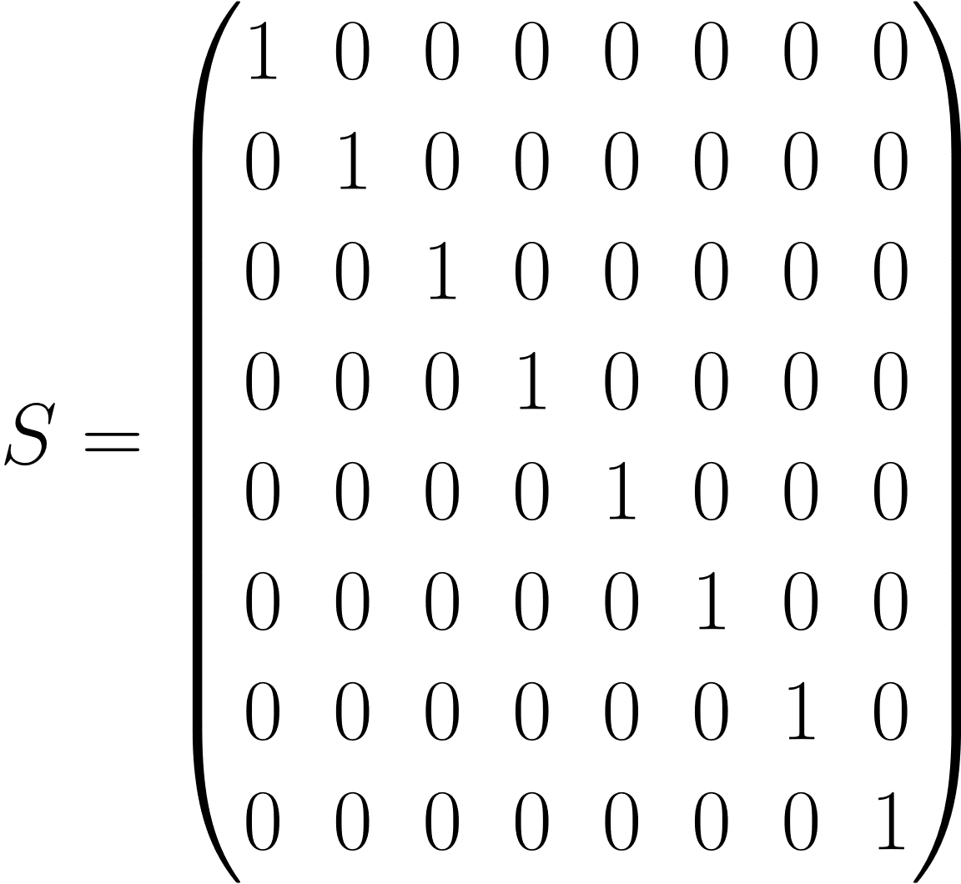
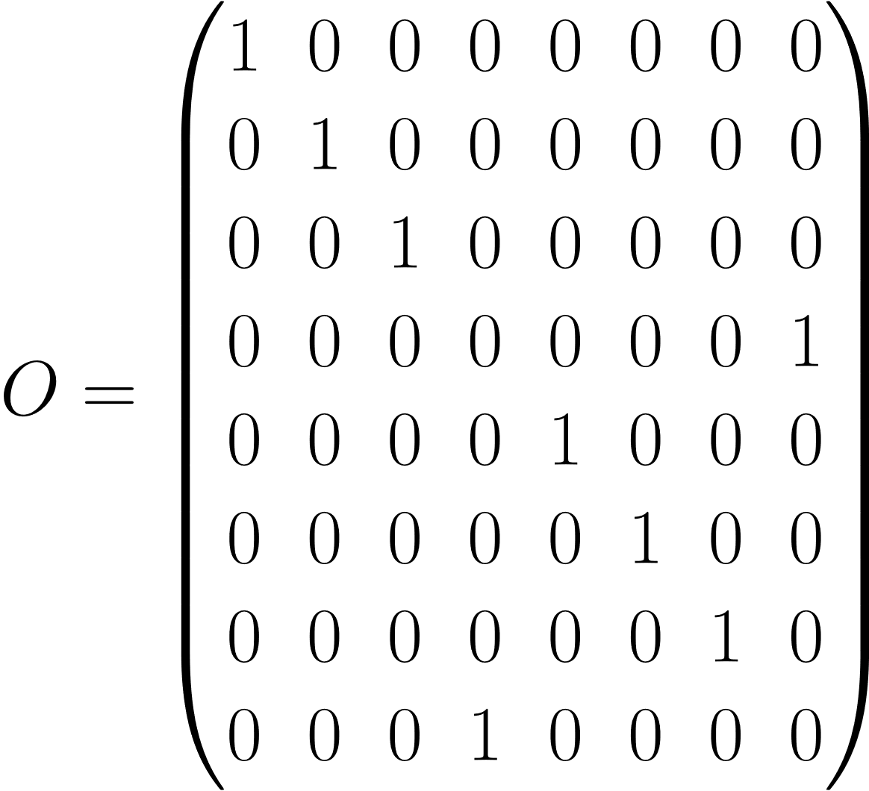
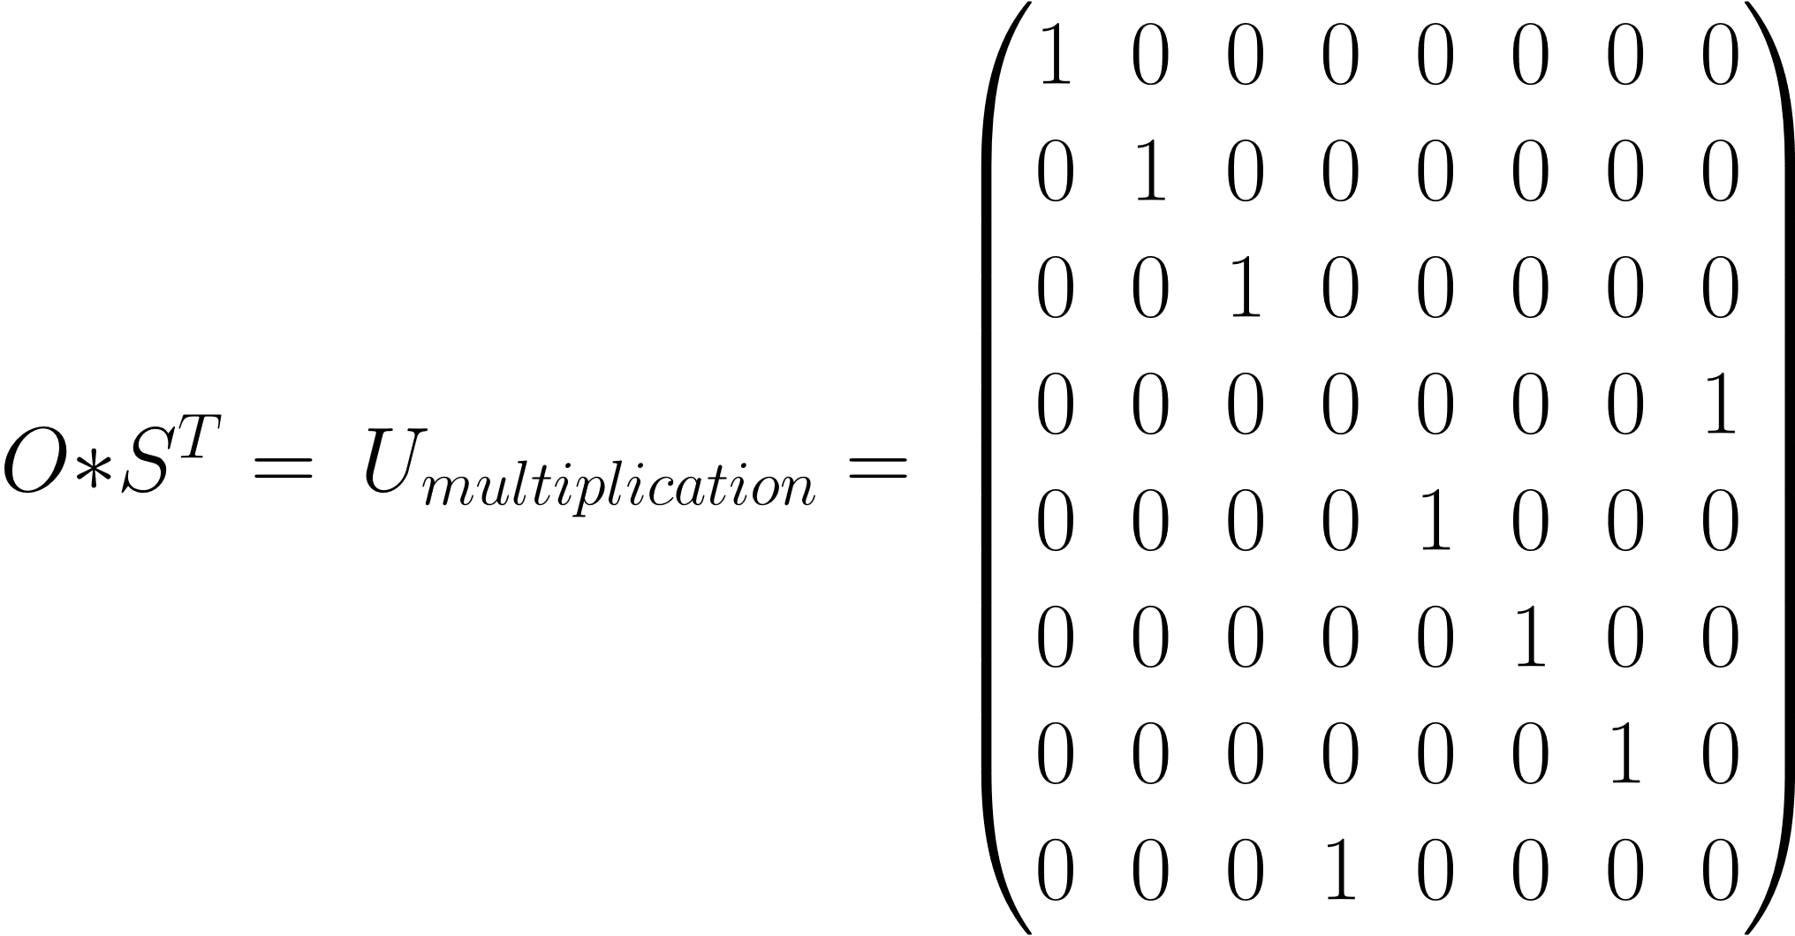
Binary Multiplication

Slide 11
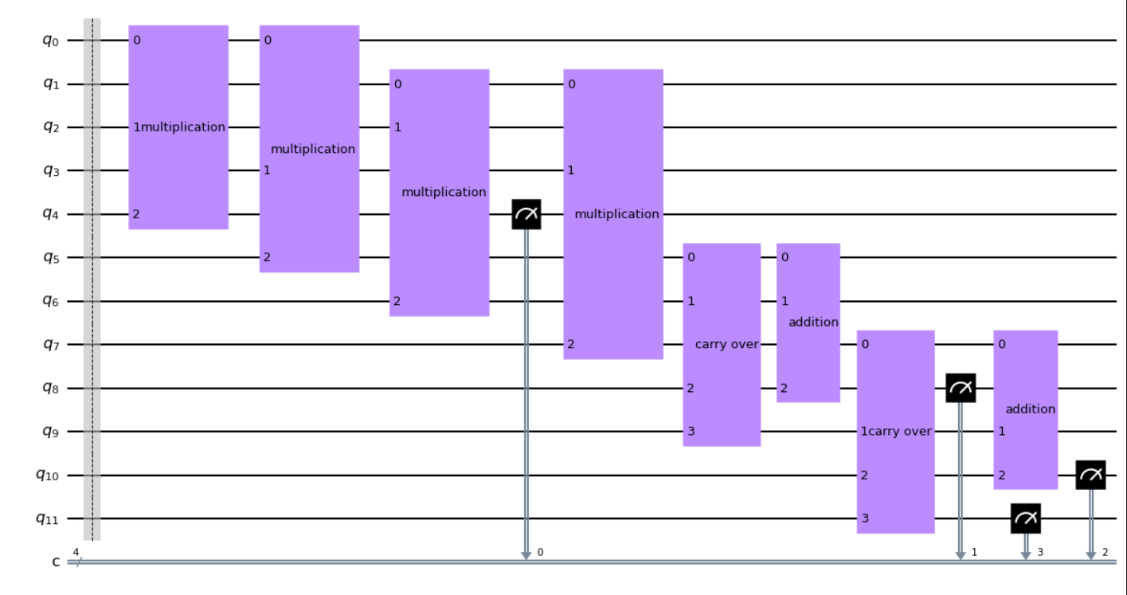

Slide 12
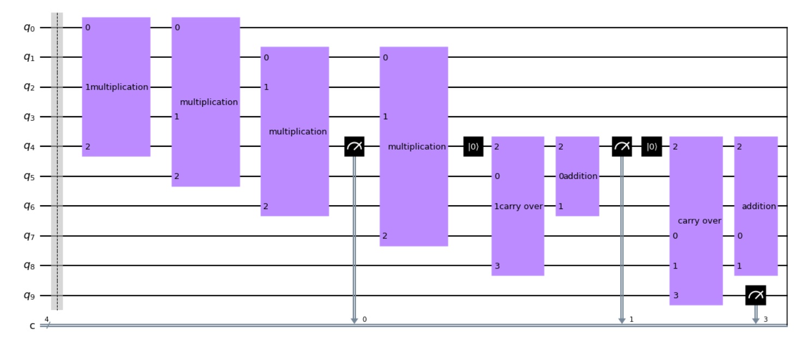


Slide 13
Conclusion
Whilst the results fulfill all the required rules,they lack the usage of all the features that make quantum computing so interesting – those being probabilities and entanglement.
Whilst the effort might not have been in vain (computers with only qpuS might use this in the future for basic arithmetic calculations), it appears to be a terribly inefficient way of recreating the classical neuron in a quantum envoirement.

