Slide 1
Classical Neurons in a Quantum Circuit
Evaluating different approaches to recreate ML-Neurons in Quantum Circuits

Slide 2
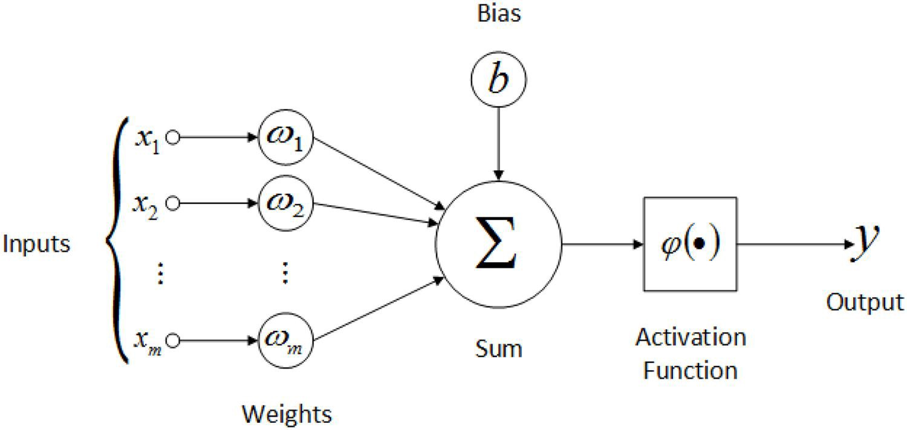
The Classical Neuron

Slide 3
Recreating the arithmetic operations
Binary addition and binary multiplication

Slide 4
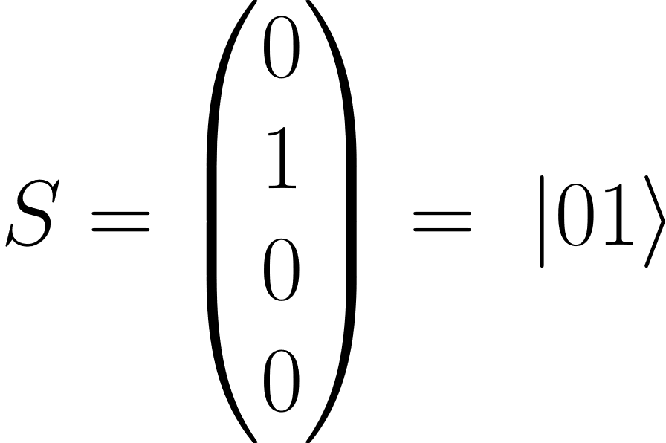
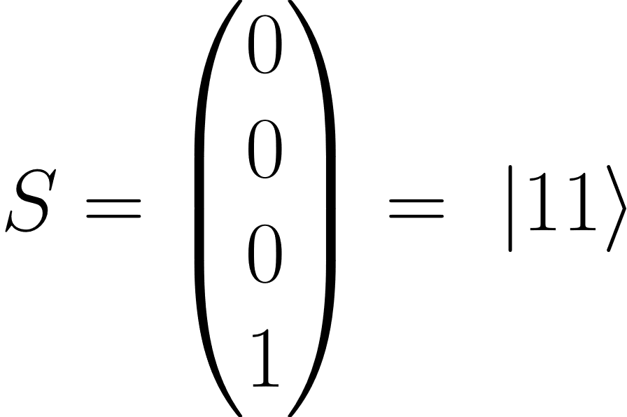
Binary Addition

Slide 5
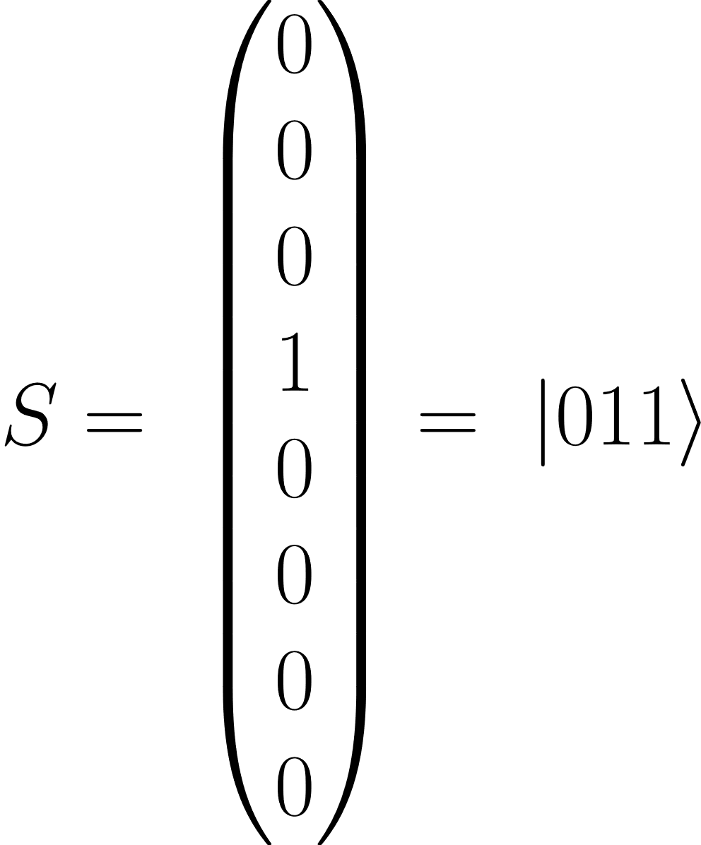
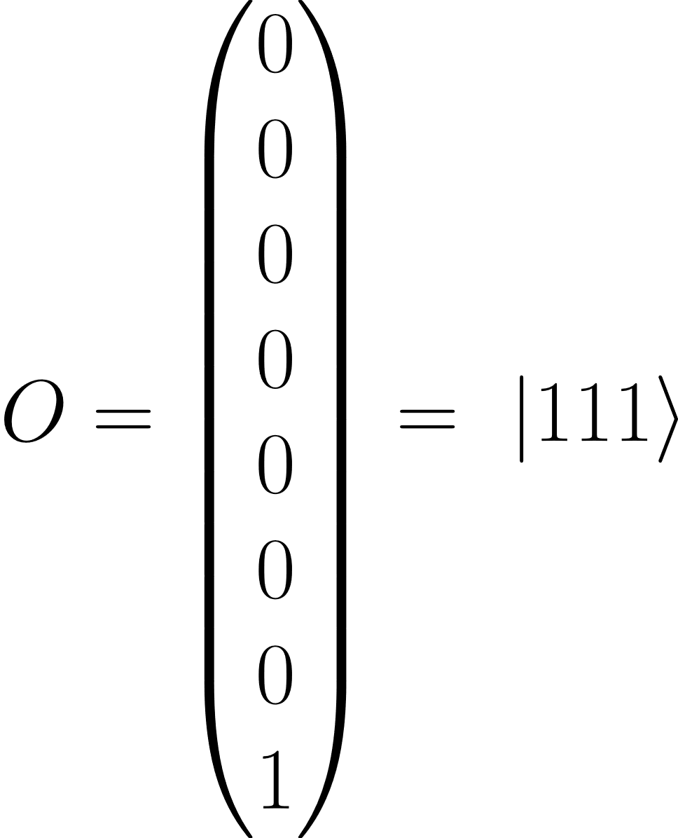
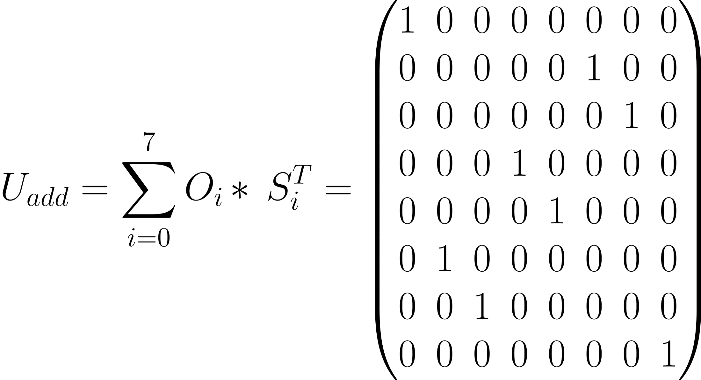
Binary Addition

Slide 6
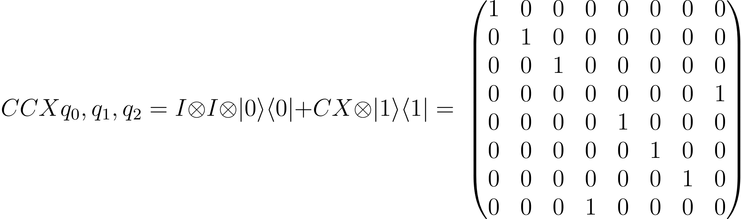
Binary Addition

Slide 7
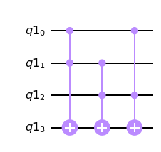
Binary Addition

Slide 8
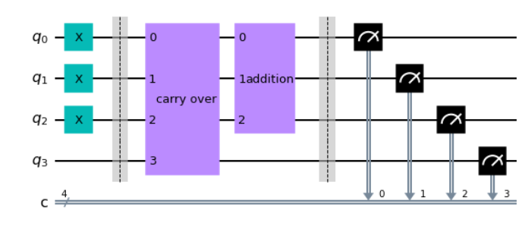
Binary Addition

Slide 9
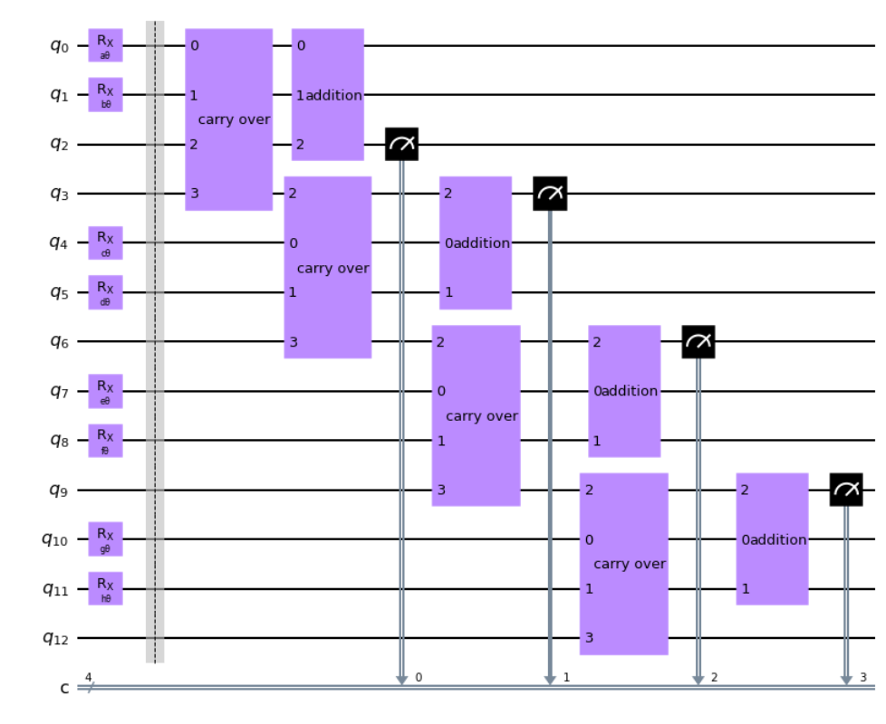

Slide 10
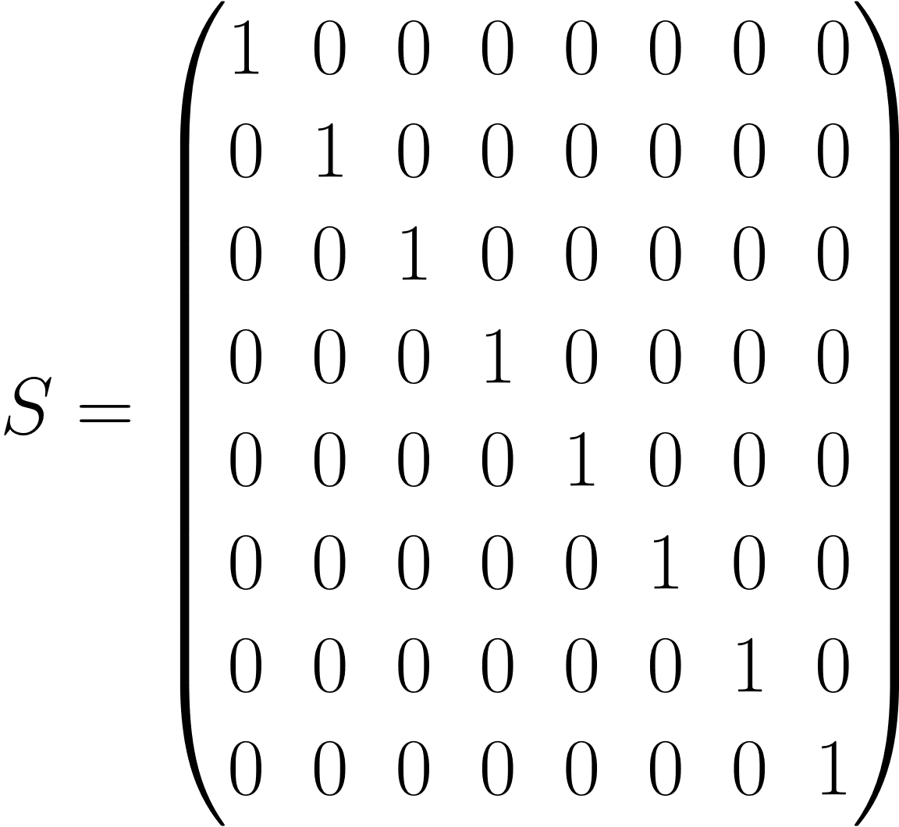
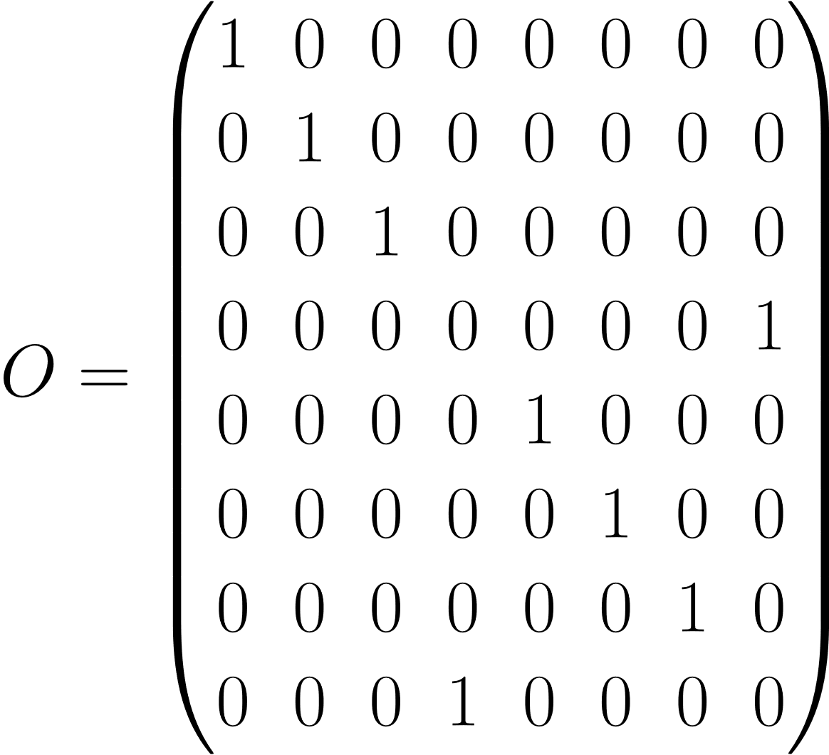
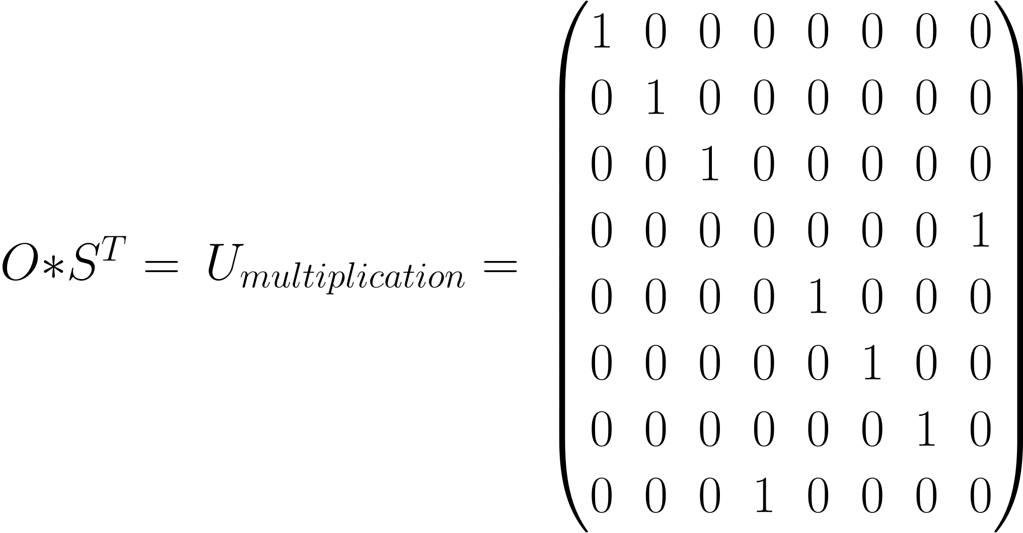
Binary Multiplication

Slide 11
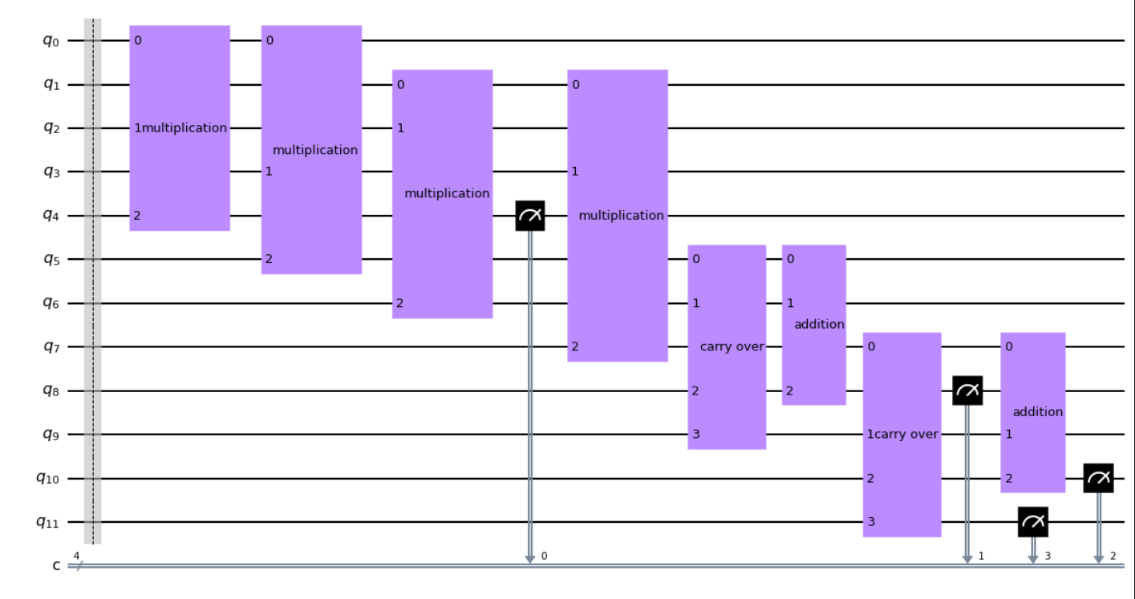

Slide 12
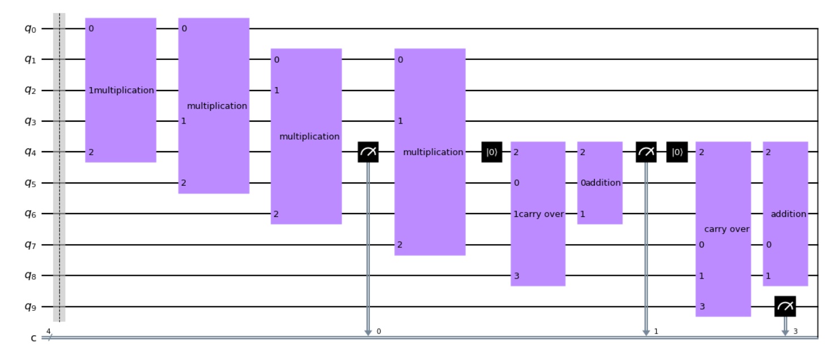


Slide 13
Conclusion
Whilst the results fulfill all the required rules,they lack the usage of all the features that make quantum computing so interesting – those being probabilities and entanglement.
Whilst the effort might not have been in vain (computers with only qpuS might use this in the future for basic arithmetic calculations), it appears to be a terribly inefficient way of recreating the classical neuron in a quantum envoirement.

Slide 14
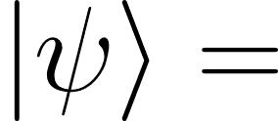

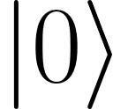


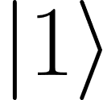
The basic idea
Measuring a qubit collapses the current state onto the z pane with a given probability
X
Z
Y

Slide 15
The basic idea
Measuring a qubit collapses the current state onto the z axis with a given probability
X
Z
Y

Slide 16

Basic application

Slide 17



Input features + relevance weights

Slide 18
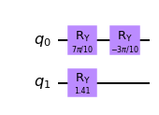
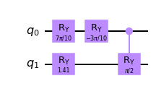
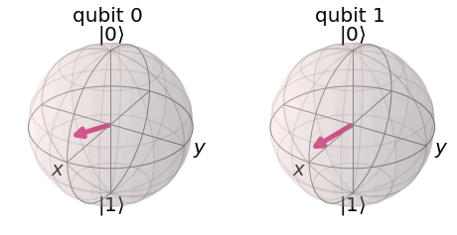
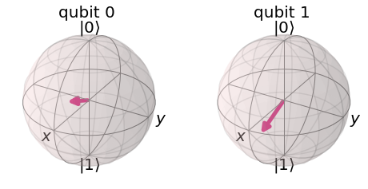
Input features + relevance weights

Slide 19
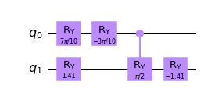
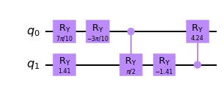
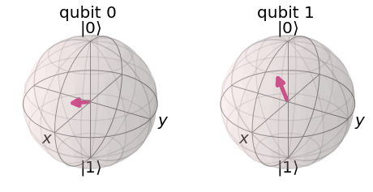
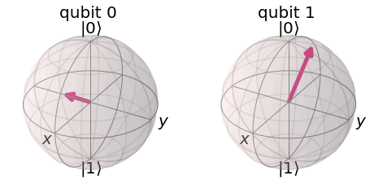
Input features + relevancy weights

Slide 20
Input features + relevancy weights

Slide 21

Evaluated models using IRIS (4f, 3c)
Accuracy: 0.5466666666666666

Slide 22
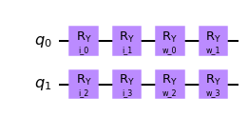
Evaluated models using IRIS (4f, 3c)
Accuracy: 0.6933333333333334

Slide 23
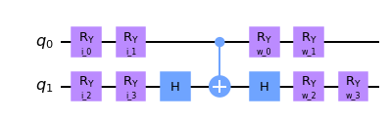
Evaluated models using IRIS (4f, 3c)
Accuracy: 0.66

Slide 24
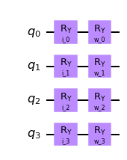
Evaluated models using IRIS (4f, 3c)
Accuracy: 0.7733333333333333

Slide 25
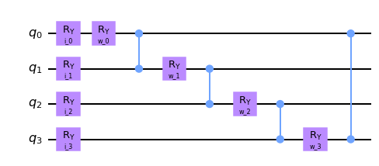
Evaluated models using IRIS (4f, 3c)
Accuracy: 0.8466666666666667

Slide 26
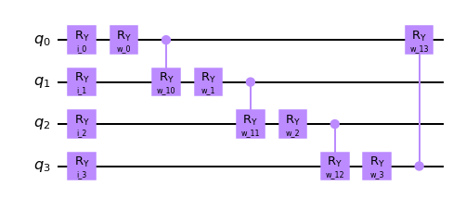
Evaluated models using IRIS (4f, 3c)
Accuracy: 0.8933333333333333

Slide 27
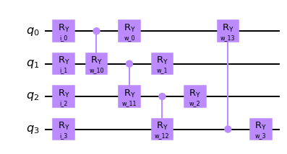
Evaluated models using IRIS (4f, 3c)
Accuracy: 0.44666666666666666

Slide 28
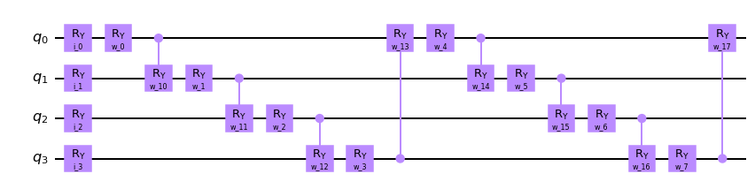
Evaluated models using IRIS (4f, 3c)
Accuracy: 0.96

Slide 29
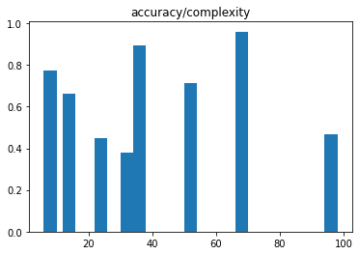
Statistics

Slide 30
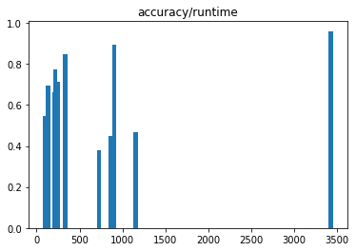
Statistics

Slide 31
Also works separately!
Accuracy: 0.8933333333333333
Accuracy: 0.7333333333333333
Accuracy: 0.8733333333333333

Slide 32
Comparable results when using t/t split
1. Training
Mean Accuracy training: 0.8482142857142857
Mean Accuracy testing: 0.9736842105263158
Mean Accuracy overall: 0.8866666666666667
2. Training
Mean Accuracy training: 0.9017857142857143
Mean Accuracy testing: 0.7631578947368421
Mean Accuracy overall: 0.8666666666666667

Slide 33
Results are often not directly reproducable!
Same train/test split, same random seed!
1. Training on a Monday
Mean Accuracy training: 0.6696428571428571
Mean Accuracy testing: 0.6578947368421053
Mean Accuracy overall: 0.6666666666666666
1. Training on a Sunday
Mean Accuracy training: 0.8482142857142857
Mean Accuracy testing: 0.9736842105263158
Mean Accuracy overall: 0.8866666666666667

Slide 34
Comparison to other ML Algos, Kaggle Hearth Disease dataset, 3/12 f
CatBoost Classifier(gradient boosting on decision trees), 1000 iterations, ~2s
Accuracy of Gradient Boosting is : 91.67%
77 iterations
Quantum Neuron
45 iterations
Non-normalized data
Mean Accuracy training: 0.5983263598326359
Mean Accuracy testing: 0.6
Mean Accuracy overall: 0.5852842809364549
Normalized data
Mean Accuracy training: 0.6778242677824268
Mean Accuracy testing: 0.7
Mean Accuracy overall: 0.68561872909699
Maybe better with all features?

