Slide 1

Exploratory Data Analysis Challenge
Ricardo Muchacho

Slide 2
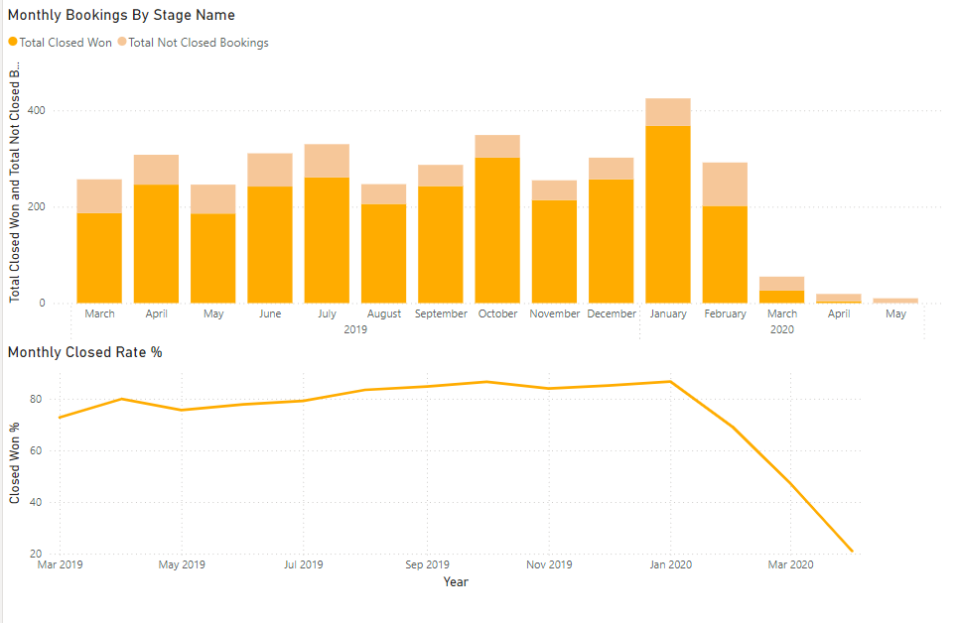
Close Rate Monthly Performance
Close Rate Decreased to 0% during 2020
Amount of bookings significantly decreased in March 2020
January 2020 was the best performing month with 86.5% Close Rate

Slide 3
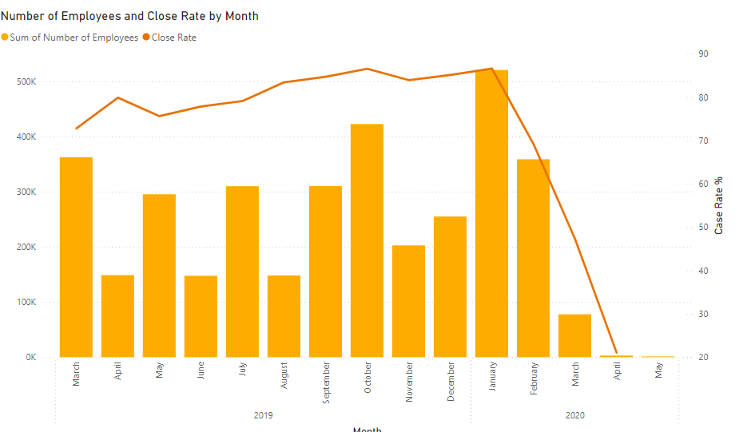
Employees and Close Rate
Significant staff downsizing in March 2020 caused decline in Close Rate
Rehire or hire employees with similar backgrounds from January 2020
Improve Employee Relations and work environment
Feedback mechanisms, Activities, Rewards, Team Building Exercices…

Slide 4
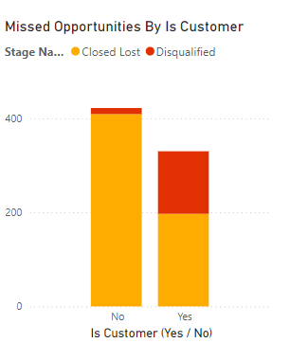
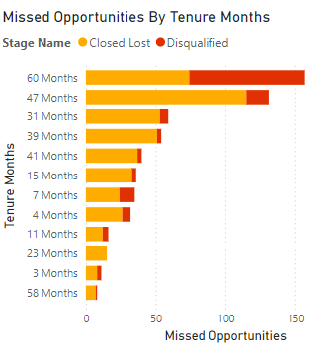
Missed Opportunities Improvements
Highest Disqualified Bookings for 60 months Tenures
60 month Tenures is the most common and has the highest disqualified rate
Review and enhance the processes associated with 60-month tenures
Closed Lost bookings represent the most frequent missed opportunity
Implement a training program to reduce the customer loss rate

Slide 5
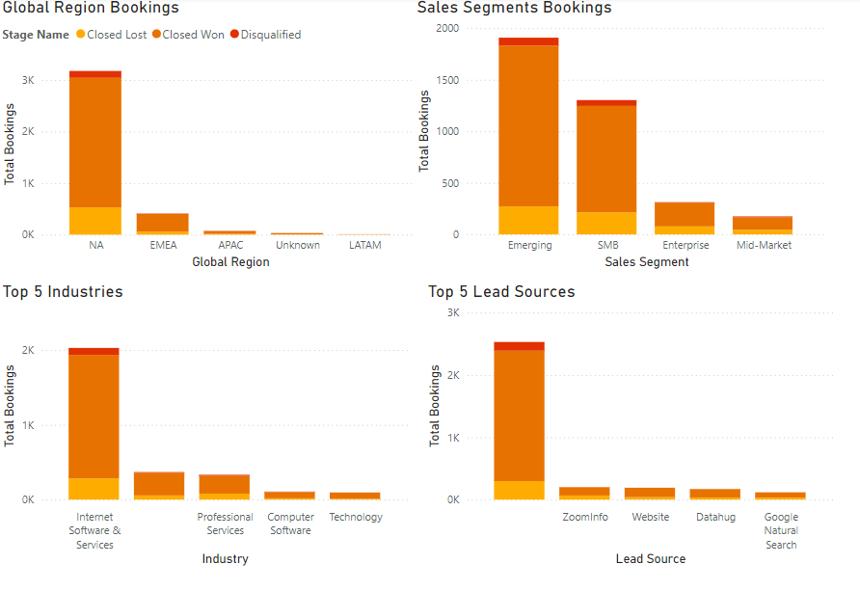
Market Demographics
Growth opportunity in EMEA
EMEA as the second-largest market, presents growth potential compared to NA
Focus on Emerging and SMB Segments within Internet Software & Services Industries
Leverage NA proven track record to attract and secure new customers

