Slide 1

Assignment 2 - Data Analytics
Project - CSIS-4260-002
Student Ricardo Ramirez M
StudentID: 300381941

Slide 2




What is the Assignment2?
Project Summary:
PDF Scraping: Scraped mining concession data (names, companies, CVE numbers, regions, provinces, and concession types) from the Chilean Official Mining Bulletin PDFs.
Sentiment Analysis: Applied sentiment analysis to evaluate the public sentiment on concession names and regions using Hugging Face's multilingual model.
Web Scraping: Gathered historical editions of the mining bulletin using Selenium and BeautifulSoup to track past publications.
Data Visualization: The extracted data is displayed in an interactive web app using Streamlit for users to explore mining concession information.
Python parts
Scraping
dataSet

Slide 3
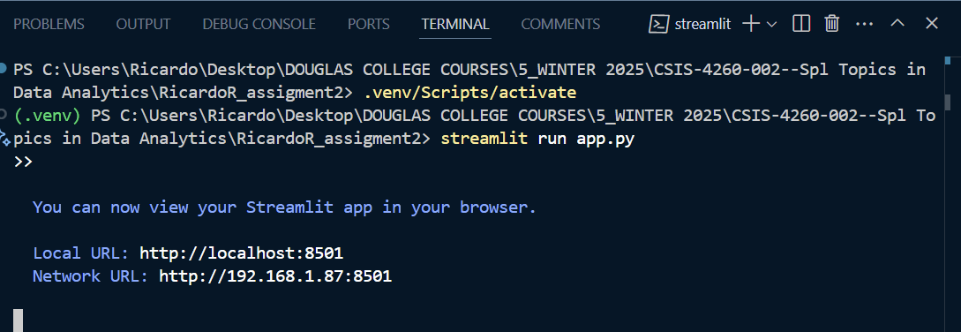
Connection to the DashBoard

Slide 4
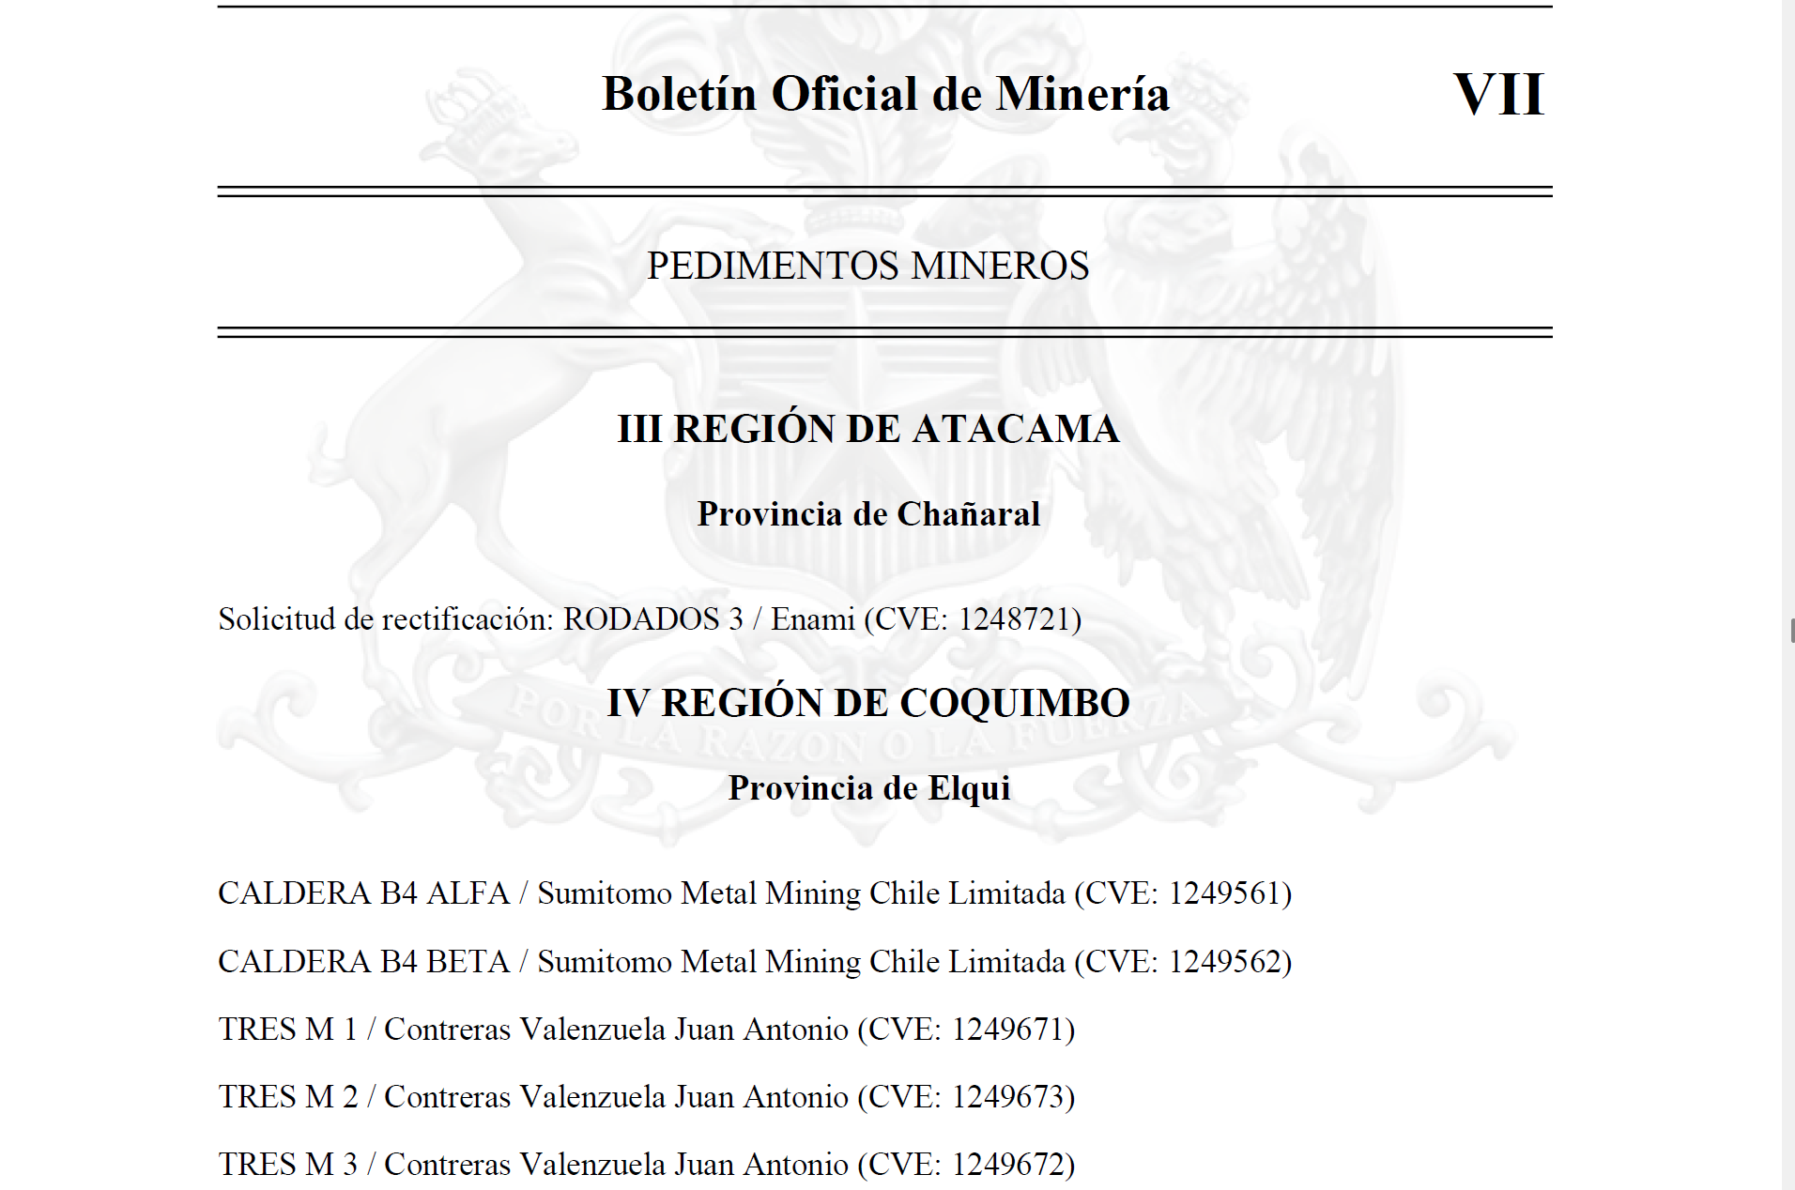
What did I Scrap??

Slide 5
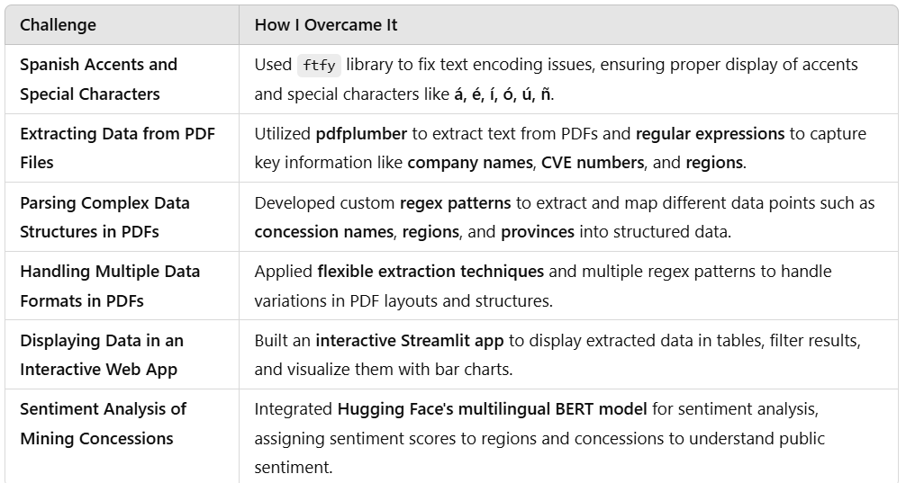
Challenges!!

Slide 6
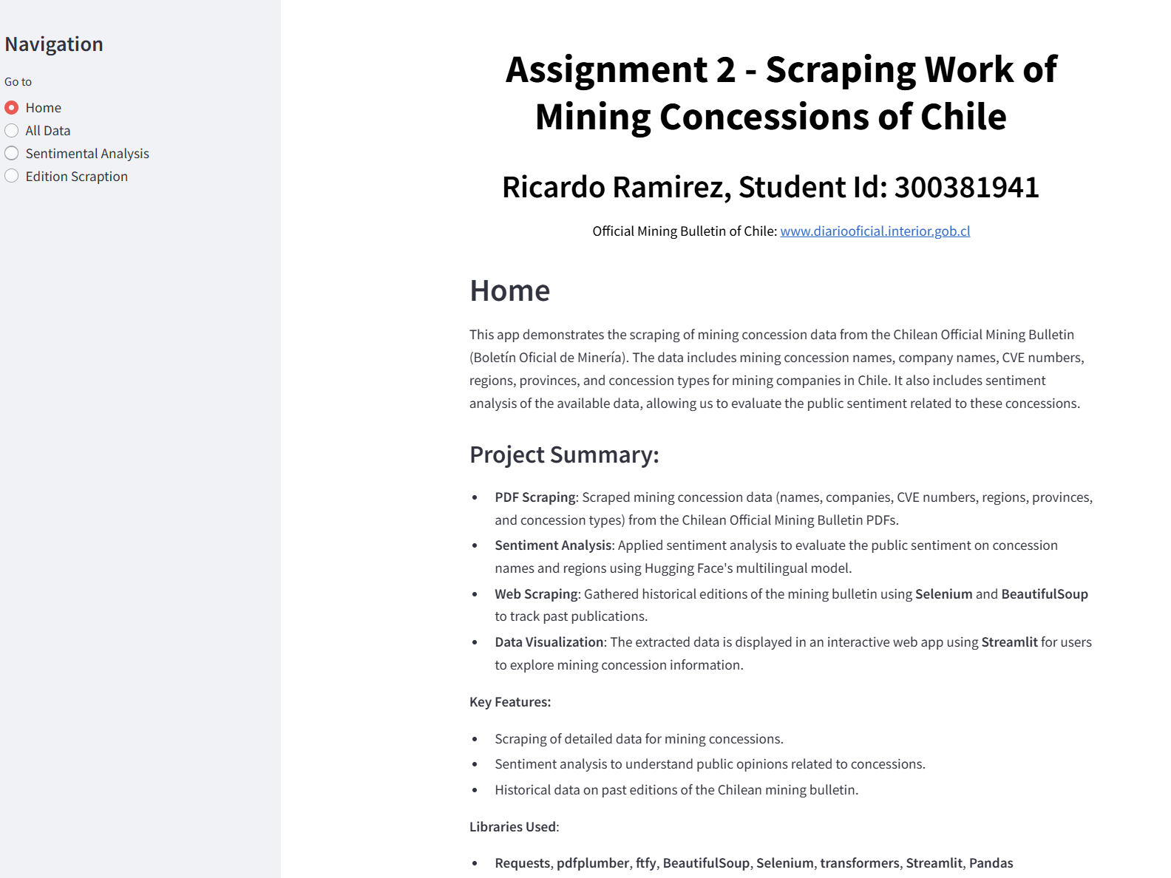
Main Page

Slide 7
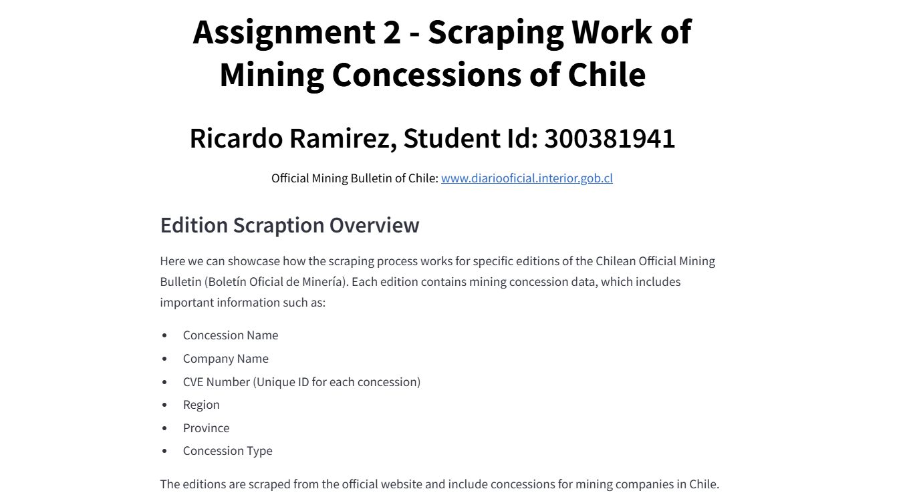
Part 1

Slide 8
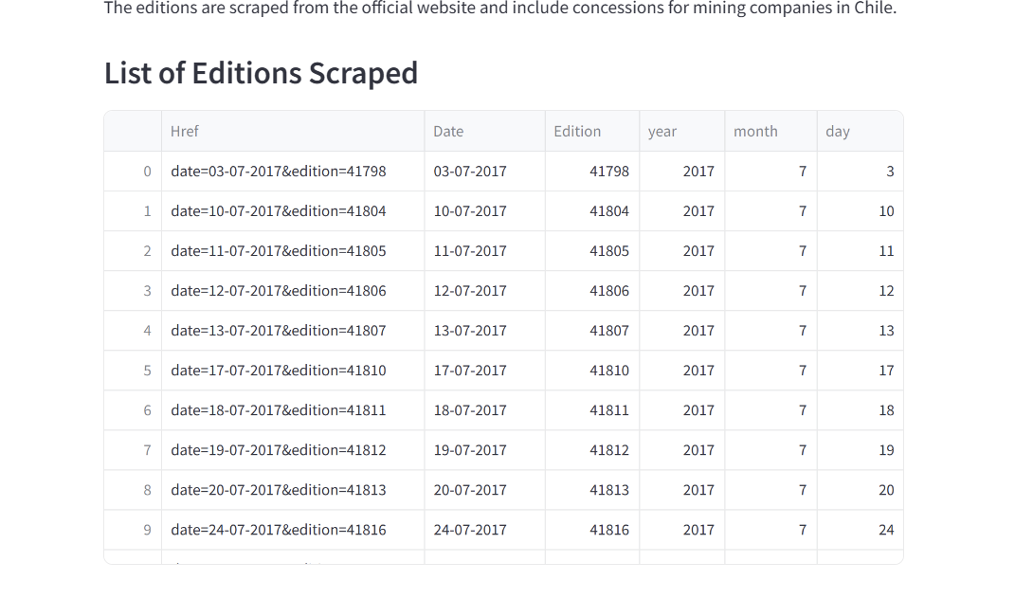
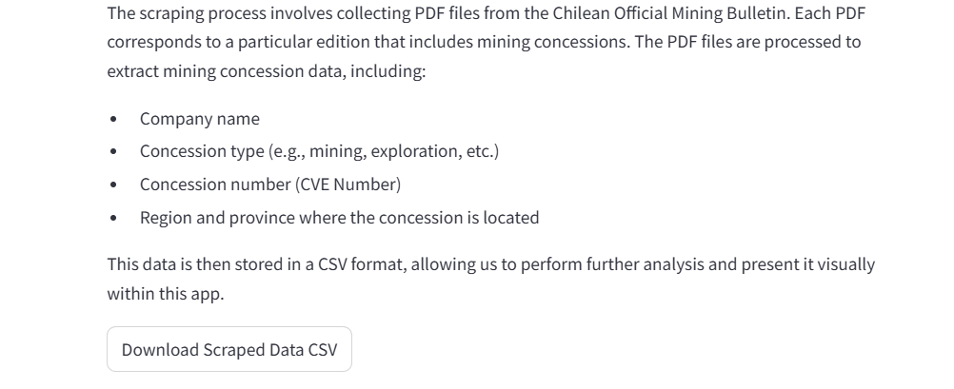
Part 2

Slide 9

Thank You

