Slide 1
VR Classroom
Teacher Evaluation System
Capstone Demo Presentation · Ricardo Salloum
Unity 6 · Python 3.11+ · Whisper · Markov Attention · LLM-based Qwen2.5 0.5B

Slide 2
Agenda
01
Project Overview & Motivation
02
System Architecture
03
Attention & Retention Model
04
Voice & TTS Pipeline
05
Exam System & Statistics
06
Simulation Results
07
Requirements & Limitations
08
Conclusion & Demo

Slide 3
01
Project Overview

Slide 4
What Is This Project?
A VR classroom simulation where virtual students listen to a real lecture through a microphone, then take an exam.
Each student has a different attention level, so they don't all hear the same thing.
Goal: Model how attention affects exam scores in a measurable, reproducible way, and give the teacher actionable feedback.
🎤 Live Whisper transcription
🧠 Markov-chain attention model
🤖 LLM answers exam questions
🔊 Kokoro TTS student questions
📊 MCQ exam + tier statistics

Slide 5
02
System Architecture

Slide 6
Two-Side Architecture: Unity ↔ Python
🎮 Unity Frontend
🐍 Python Backend
ClassroomManager.cs for scene orchestration
StudentAgent.cs for spawning & exam flow
VoiceController.cs for mic capture
QuestioningManager.cs for TTS questions
ExamStats.cs for mean / median / StdDev
SimpleSlideshow.cs for in-game PDF viewer
Agent.py
Student AI: /send_lecture,
/ask_question, /answer_mcq
HTTP
POST
Agent_Voice.py
Port 5005 · Whisper STT
/transcribe
Agent_TTS.py
Port 5003 · Kokoro TTS
/synthesize

Slide 7
03
Attention & Retention Model

Slide 8
Markov Chain Attention Model
Each student switches between ATTENTIVE and ZONED_OUT states word-by-word, producing realistic burst-style gaps rather than random scatter.
ATTENTIVE
pdropout
ZONED_OUT
precover
Steady-state P(attentive) = p_{recover} / (p_{dropout} + p_{recover})
Tier | Profile | pdropout | precover | P(attentive) | Avg Zone (words)
A | Perfect | 0.000 | 1.000 | 100% | 0
A | High | 0.035 | 0.700 | ~92% | 2.9
B | Medium | 0.100 | 0.340 | ~69% | 5.6
C | Low | 0.190 | 0.220 | ~35% | 12.5

Slide 9
Context Pipeline Per Student
Raw Lecture
apply_blanking()
apply_markov_mask()
self.context
LLM Answer
Professor speech
Drop sentences → [BLANKED]
Markov chain → [ZONED]
Fed to LLM only
MCQ response
Key insight: Repetition helps lower tiers more, each re-mention is a fresh Markov episode. Tier C with 5× repetition can beat Tier B baseline.
Zones are bursts, not random scatter → realistic behavior
Tiers don't overlap → clean score separation without hard caps
Unrelated content → all agents score 0/25 (pure guessing)

Slide 10
04
Voice & TTS Pipeline

Slide 11
Voice Pipeline: Transcription & Student Questions
🎤 ASR : Automatic Speech Recognition
🔊 Student Questions via TTS
VoiceController.cs records mic continuously (1800 s buffer)
30-second chunks → Agent_Voice.py /transcribe (port 5005)
Whisper base (74M params), English forced, fp16 disabled
Filler-word cleanup regex: 'uh', 'um', 'like', 'you know'…
Final full-recording pass when lecture ends
QuestioningManager on cooldown (180 s first)
Asks every 150 s and picks random student
Keyword-overlap match from lecture snippet
POST to Agent_TTS.py → Kokoro synthesis
WAV decoded → AudioSource in Unity
Configuration & Details
ASR chunk interval
Whisper model
Default TTS voice
Voice diversity
30 seconds
base (74M params)
af_bella (Kokoro)
American / British, M / F

Slide 12
05
Exam System & Statistics

Slide 13
End-of-Lecture MCQ Exam Flow
1
Lecture ends
📋 SubmitMCQ Response
Which option student picks
Confidence score
no_context flag (empty context → guess)
All questions processed per student
2
SendLecture (parallel coroutines)
3
All students process context
4
SubmitMCQ per question per student
5
LLM: best match → answer + confidence
6
ExamStats.cs: mean, median, StdDev per tier
7
Live console + in-engine UI

Slide 14
06
Simulation Results

Slide 15
Tier Performance Across Test Variants

Slide 16
Key Findings from Simulations
Tier Alignment
Repetition Effect
Tier A scores 21-24/25
Tier B lands 13.7-17.0
Tier C occasional recovery via Markov
Tier C (5×) = 16.7 → beats Tier B baseline (17.0)
Tier A plateaus ~23 (analytical ceiling)
Reviewing content genuinely helps lower tiers
Context Isolation
In-Engine Validation
Unrelated content → 0/25 across all tiers
Removed end section → Q15,16,17,19 all 0%
Agents cannot pull knowledge they didn't hear
MCQ pipeline confirmed end-to-end in VR
Live console score streaming works
Contextual Q&A keyword matching verified

Slide 17
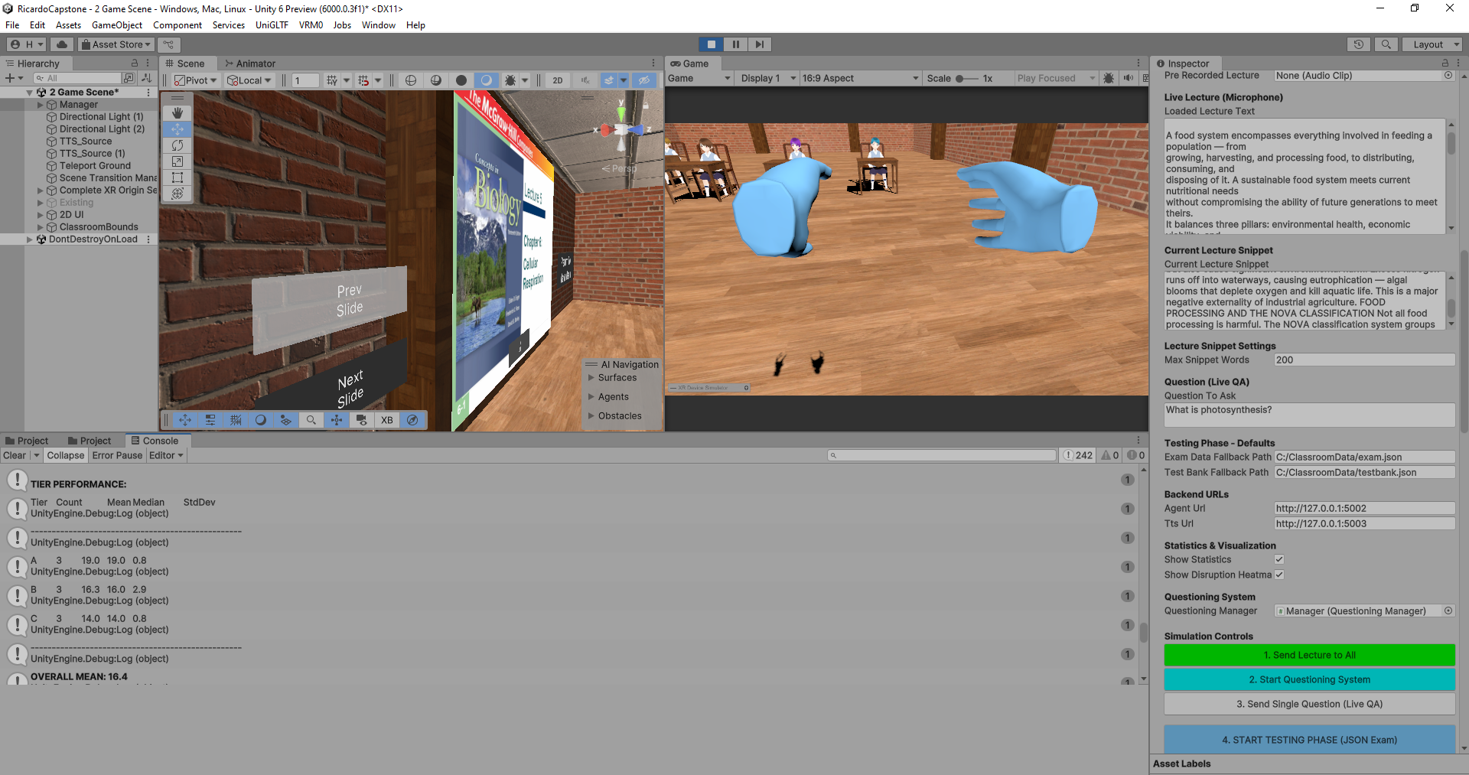

Slide 18
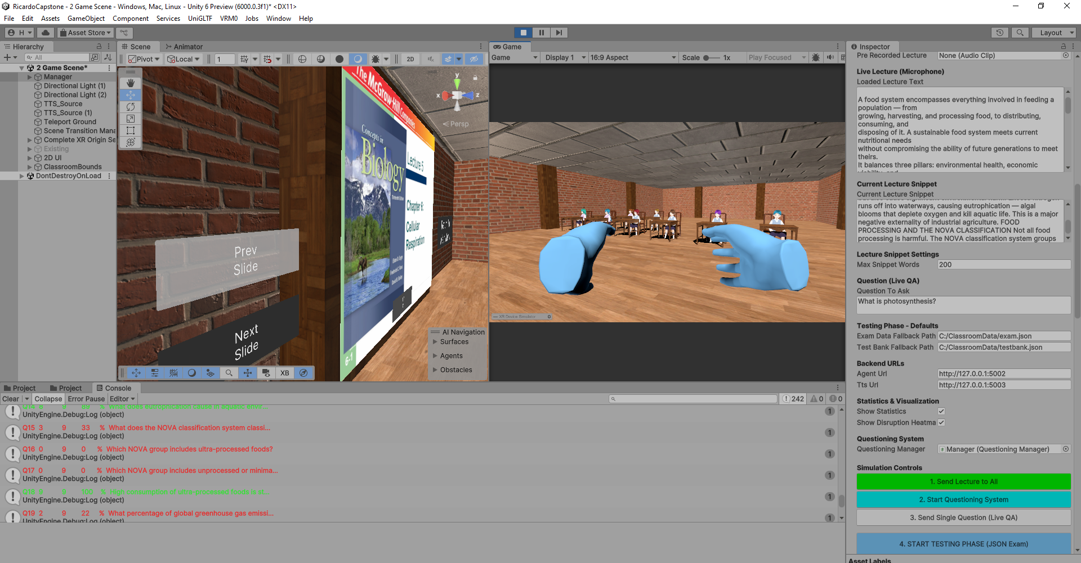

Slide 19
07
Requirements

Slide 20
System Requirements
🖥️ Hardware
⚙️ Software
VR headset
GPU: GTX 1050 min, RTX 3060+ recommended
High VRAM GPU (ASR + Embeddings + LLM in memory)
16 GB RAM (dev hardware), 32 GB recommended
Unity 6 (free personal license)
Python 3.11+
HuggingFace Transformers, FAISS
FastAPI (3 independent local servers)
Kokoro TTS (PyTorch, fully offline)
AI Models
ASR
Embeddings
Re-ranker
LLM
TTS
Whisper base
(74M params)
Sentence-BERT
all-MiniLM-L6-v2
ms-marco-
MiniLM-L-6-v2
Qwen2.5-0.5B
Instruct (local)
Kokoro
(PyTorch)
Automatic Speech
Recognition
384-dim semantic
similarity (22M)
Cross-encoder
chunk re-ranking
MCQ answering
& question gen
Offline neural
TTS 12 voices

Slide 21
08
Limitations

Slide 22
Where It Works, and Where It Doesn't
✅ Works Well
❌ Fails For
Lecture-heavy subjects
K-12 and liberal arts
Non-math high school
History
Biology & nursing programs
System knows: "ice floats because of density"
System knows: "derivative = rate of change"
Problem-solving courses
Advanced math & STEM
Computer science & engineering
Can NOT compute derivative of x³
Can NOT compute density from M/V
Core limitation: The attention model is simplified, no external knowledge. Agents are purely context-driven. This is intentional design, not a bug.

Slide 23
Conclusion
1
Markov model works
Clear tier separation, predictable steady-state attention probabilities
2
Context isolation confirmed
Agents cannot answer what they didn't hear, 0% on removed content
3
Repetition helps
Mimics real pedagogy, reviewing material improves all tiers
4
Full pipeline in VR
End-to-end tested: transcription → exam → live stats in-engine
Ricardo Salloum · VR Classroom Teacher Evaluation System · Capstone Demo

