Slide 1
LIVE EARTH-OBSERVATION SESSION · 60 MINUTES
Watch a lagoon
collapse, from space.
In one hour you download real satellite and pollution data with your own hands — and see the 2021 Mar Menor crisis appear on screen. No install, mostly no account.
10 m
5
7
0
SENTINEL-2 DETAIL
LIVE DATA SOURCES
HANDS-ON STEPS
SOFTWARE TO INSTALL
00
MAR MENOR · LIVE EARTH-OBSERVATION SESSION

Slide 2
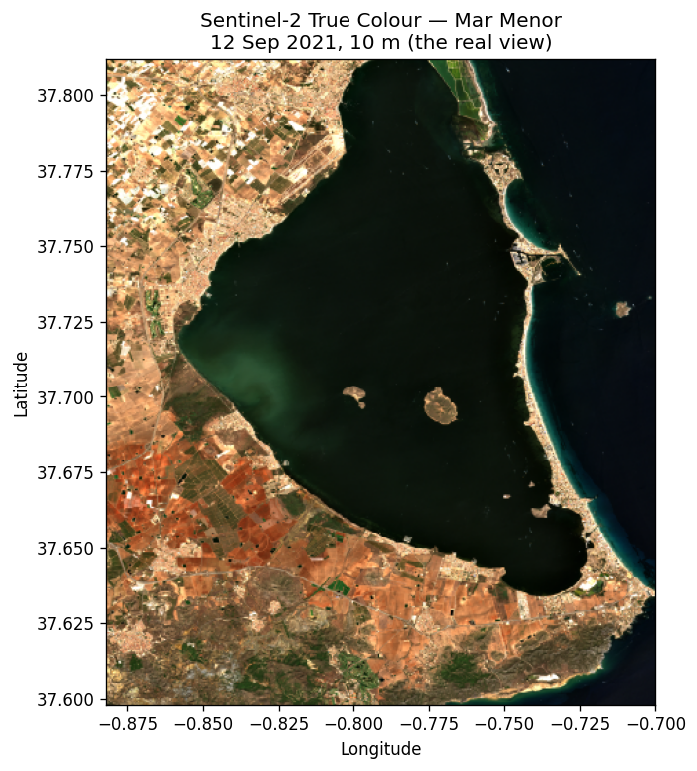
THE PLACE · THE CRISIS
A small sea that broke, on camera.
The Mar Menor is Europe's largest coastal lagoon — shallow, closed, ringed by farmland.
In August 2021 it turned green and three tonnes of fish died: an algal bloom, fed by farm runoff and a marine heatwave, stripped the water of oxygen.
Every stage of it was recorded from orbit — free, open, and the subject of today's session.
01
MAR MENOR · LIVE EARTH-OBSERVATION SESSION

Slide 3
WHAT WE'LL DO TOGETHER
Seven steps, one hour.
1
Browse any date from orbit — NASA GIBS
2
Download real Sentinel-2 (10 m) — only our window
3
Measure the bloom — the NDCI chlorophyll index
4
Add live pollution data — air quality
5
Unlock server products with a free Copernicus key
6
Detect the crises with machine learning
7
Store & query it all in a database
02
MAR MENOR · LIVE EARTH-OBSERVATION SESSION

Slide 4
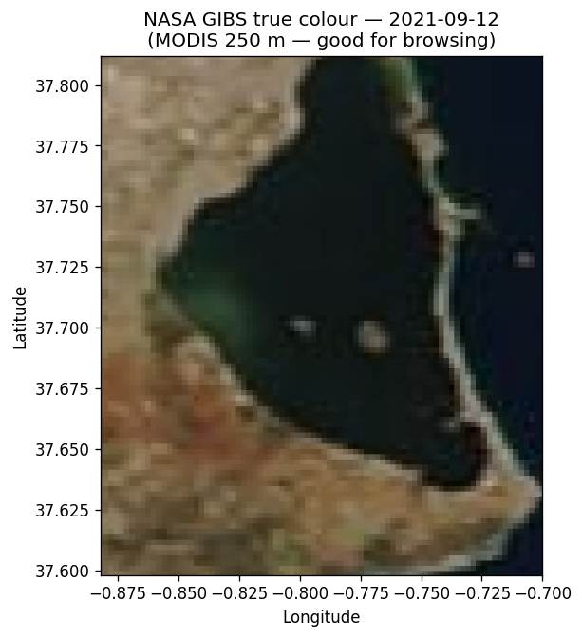
STEP 1 · BROWSE
Find a clear day from orbit.
LIVE · NO LOGIN NASA GIBS returns a true-colour picture of any day since 2000. We scout for cloud-free dates before downloading the heavy data.
— One URL, one image — change the date and re-run.
03
MAR MENOR · LIVE EARTH-OBSERVATION SESSION

Slide 5
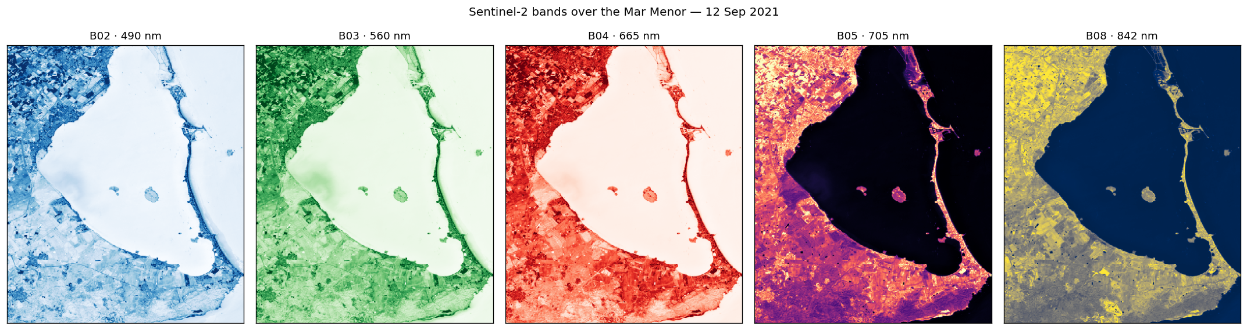
STEP 2 · DOWNLOAD
What each wavelength sees.
LIVE · NO LOGIN Sentinel-2 records separate bands. We read only our window (~16 MB, not 800). Watch the bloom flip from dark in red to bright in red-edge.
04
MAR MENOR · LIVE EARTH-OBSERVATION SESSION

Slide 6
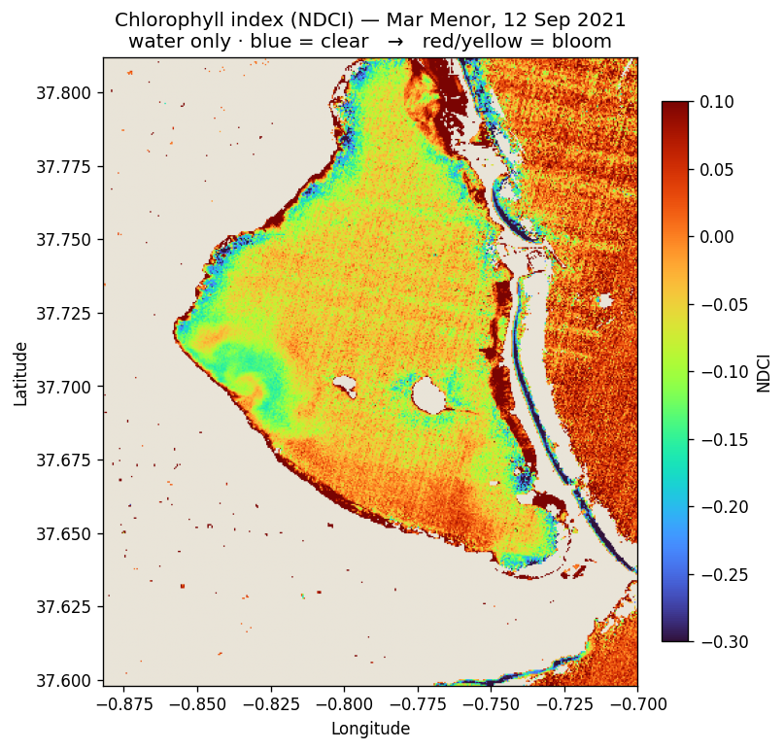
STEP 3 · MEASURE
The bloom, as a number.
LIVE The NDCI turns two bands into chlorophyll at every pixel. Land is greyed out; the bloom is strongest in the north-west, by the farmland.
NDCI = (B05 − B04) / (B05 + B04)
05
MAR MENOR · LIVE EARTH-OBSERVATION SESSION

Slide 7
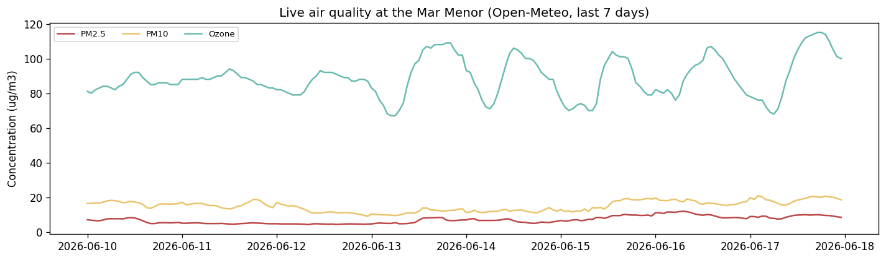
STEP 4 · POLLUTION
More than water colour.
LIVE · NO LOGIN A keyless API returns hourly PM2.5, PM10 and ozone — the dust over the same farmland that feeds the lagoon. Same pattern: ask, receive, plot.
06
MAR MENOR · LIVE EARTH-OBSERVATION SESSION

Slide 8
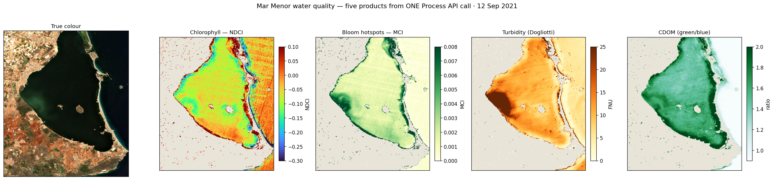
STEP 5 · GO PRO
Five products, one request.
FREE ACCOUNT With a free Copernicus key the server computes products for you. One call returns the three optical components of the water — plus the bloom peak.
— True colour · chlorophyll · bloom hotspots · turbidity · CDOM.
07
MAR MENOR · LIVE EARTH-OBSERVATION SESSION

Slide 9
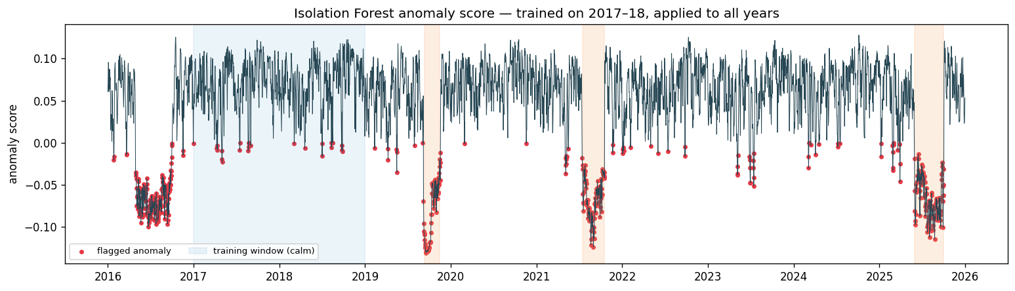
STEP 6 · MACHINE LEARNING
It finds the crises itself.
LIVE An Isolation Forest, trained only on the calm years, flags every later day that looks abnormal — and rediscovers the 2019 and 2021 crises it never saw.
— 100% of the documented crisis days, caught out-of-sample.
08
MAR MENOR · LIVE EARTH-OBSERVATION SESSION

Slide 10
WHAT YOU TAKE AWAY
The barrier was never access.
1
Free & open. the data that recorded a disaster is one request away — no paywall.
2
Move few pixels. search a catalogue, read only your window, let the server compute.
3
One pattern. discover → take a subset → analyse → store. It works for any coast.
4
You did it live. browse, download, measure, detect and store — in one hour, no install.
Go further → notebooks 01 · 02 · 03 in the repo
fin
MAR MENOR · LIVE EARTH-OBSERVATION SESSION

