Slide 1
Automated Web Testing
With Selenium

Slide 2
What We Are
Going
to
Cover
▪ Selenium
□ IDE
□ Web Driver
□ Server
▪ Automation Framework Basics

Slide 3

What
is
Selenium?
Tool / framework for automating web browsers

Slide 4





Think of Selenium as: an API for
web browsers

Slide 5
What Else Can It Do?

Slide 6
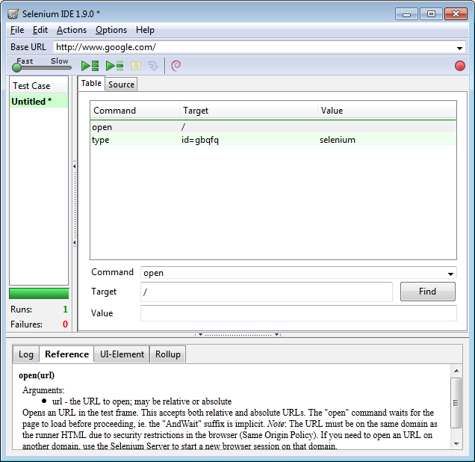
Recording
Selenium IDE

Slide 7
Why Automated Testing?

Slide 8
Regression
Don’t fall backwards!

Slide 9
High
Level
Testing
Testing like the
real user

Slide 10
Exact
Requirements
Automated tests are exact and not open
for interpretation

Slide 11
Brief
History of Selenium
Started out
around 2004 from Thoughtworks
Webdriver
merged with
Selenium
Selenium 1
used Javascript to drive browsers
Selenium 2 was
released

Slide 12

Selenium Architecture

Slide 13











Selenium WebDriver
Bindings
C#
Java
Python
Ruby
…
WebDriver API
IE
FireFox
Chrome
HtmlUnit
…
Drivers

Slide 14






Zooming
In
Binding
Code
WebDriver Wire
Protocol
IE Driver
Server

Slide 15
Selenium IDE

Slide 16
Understanding
Selenium
IDE
Generate
Commands
(Selenese)
Record
Play

Slide 17
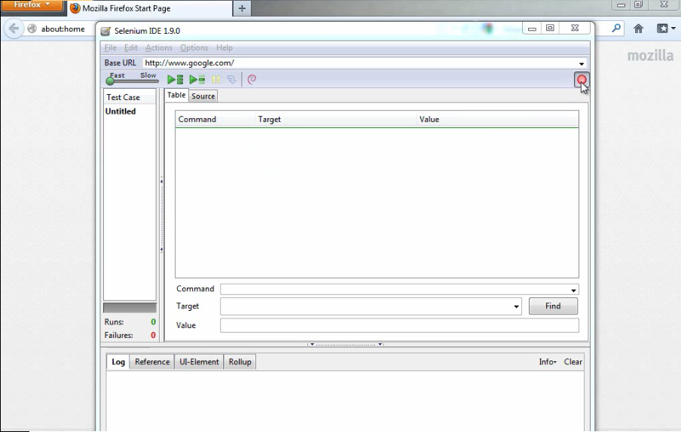

Slide 18
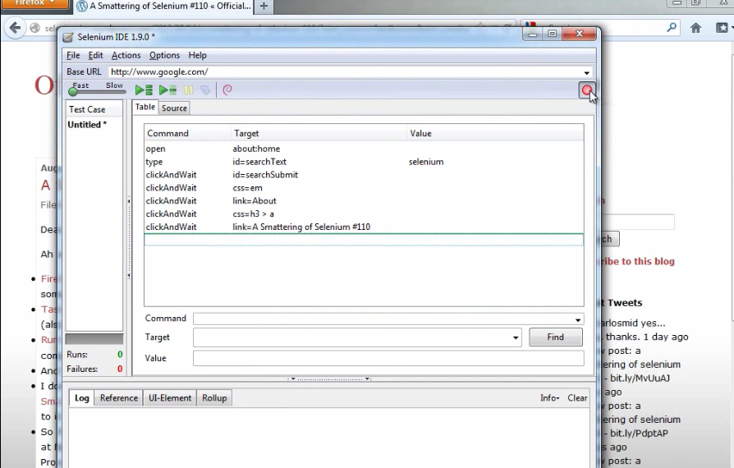

Slide 19
Selenese
▪ Command
▪ Target
▪ Value

Slide 20







What
is
WebDriver?
Chrome
WebDriver
Test
Script
Firefox
IE

Slide 21
Finding Elements
ClassName
CssSelector
Id
LinkText
Name
PartialLinkText
TagName
XPath

Slide 22
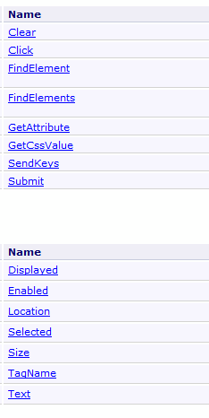



Page
Elements
IWebElement
All you need (mostly)

Slide 23
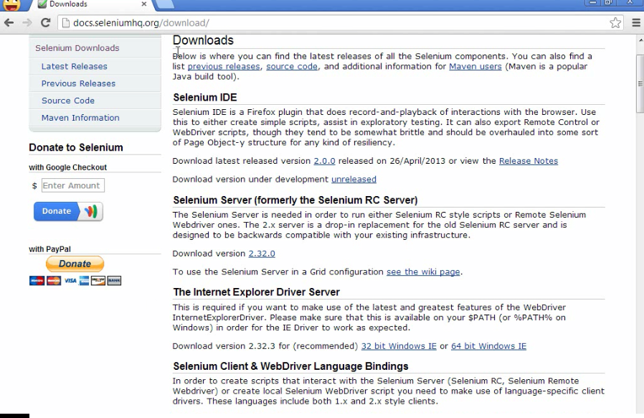
Test using Selenium and JUnit

Slide 24
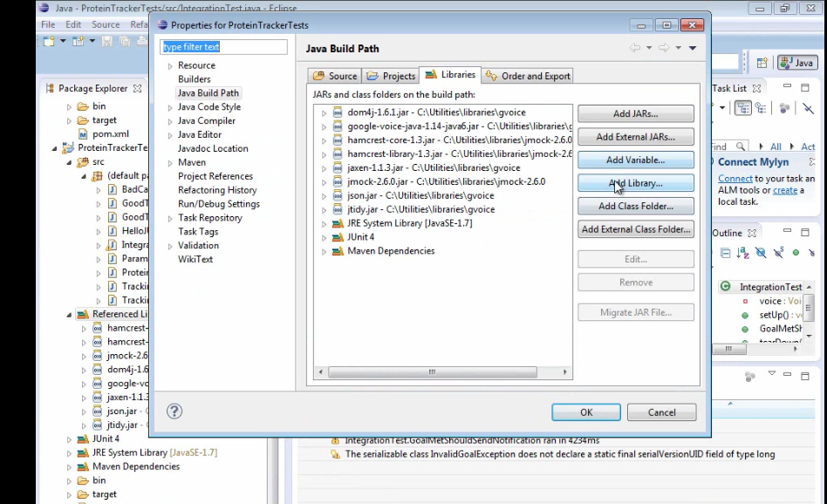

Slide 25
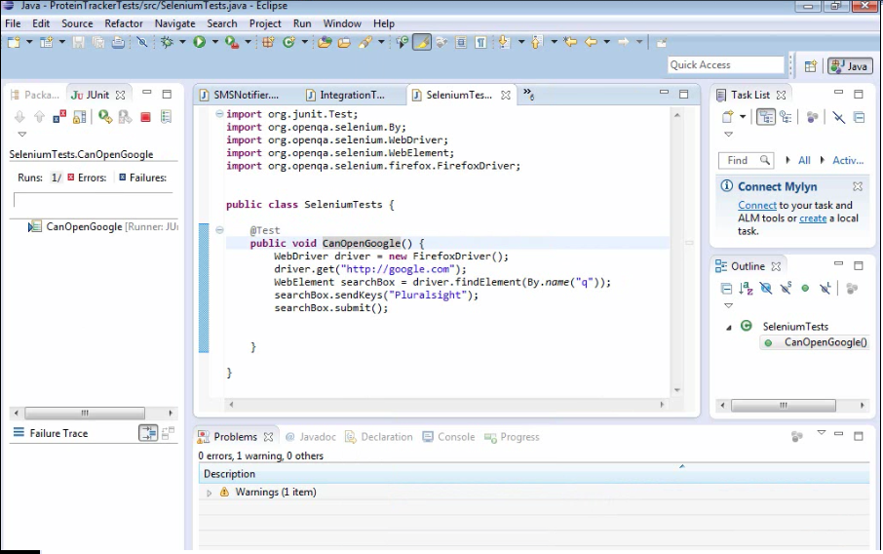

Slide 26
THE END
Thanks for you attention…

