Slide 1
DEEP LEARNING · FINAL PROJECT
Qubit Evolution: Predicting
Quantum Dynamics with Deep Learning
Recurrent and Transformer Sequence Surrogates for the 10-Qubit PXP Rydberg Chain
AUTHORS
INSTITUTION & COURSE
Ernesto Gligora · Riccardo Lavorato
Artificial Intelligence and Computer Science
University of Calabria — A.Y. 2025/2026
Notes:
Slide 1 — Introduction:
Welcome everyone. In this presentation we introduce our Deep Learning project on predicting the multi-step time evolution of a 10-qubit PXP Rydberg quantum chain using Recurrent and Transformer sequence architectures.

Slide 2
01 · MOTIVATION & SCOPE
Problem Statement & Forecasting Challenges
2 / 13
The Classical Simulation Bottleneck
Unified Forecasting Pipeline
▸ Exponential Hilbert Space (2^N): exact numerical integration becomes intractable as qubit count and horizon grow.
▸ Data-Driven Surrogate: learn the dynamical evolution of N = 10 interacting Rydberg qubits directly from observable trajectories.
▸ 55 Physical Observables: forecast T_out = 40 future steps (0.80 s) of 10 magnetizations and 45 pairwise correlations.
▸ Two Model Families: systematic 24-model benchmark comparing Recurrent (M1, M2) and Transformer (M3, M4) architectures.
CHALLENGE 01 · CONTEXT LENGTH
CHALLENGE 02 · TEMPORAL RESOLUTION
CHALLENGE 03 · EXPLAINABILITY
Minimize Input Window
2× Super-Resolution
Attention Interpretability
Find the shortest history T_in ∈ {5, 10, 20, 40} that preserves multi-step forecast accuracy on strictly aligned future targets.
Reconstruct dense future trajectories (Δt = 0.02 s, 40 steps) starting from a 2× coarser input window (Δt = 0.04 s, 20 steps).
Extract decoder cross-attention and causal self-attention maps to explain how the network tracks quantum many-body scars.
Ernesto Gligora & Riccardo Lavorato | Qubit Evolution: Predicting Quantum Dynamics with Deep Learning
University of Calabria · A.Y. 2025/2026
Notes:
Slide 2 — Problem Statement & Challenges:
At the top we outline the physical motivation: the Hilbert space scales as 2^N, so we train a data-driven neural surrogate that forecasts 40 future steps across 55 observables, comparing Recurrent (M1, M2) and Transformer (M3, M4) families. At the bottom we summarize the three scientific challenges: 1) minimizing input window length T_in, 2) 2x temporal super-resolution, and 3) opening the black box via attention maps.

Slide 3
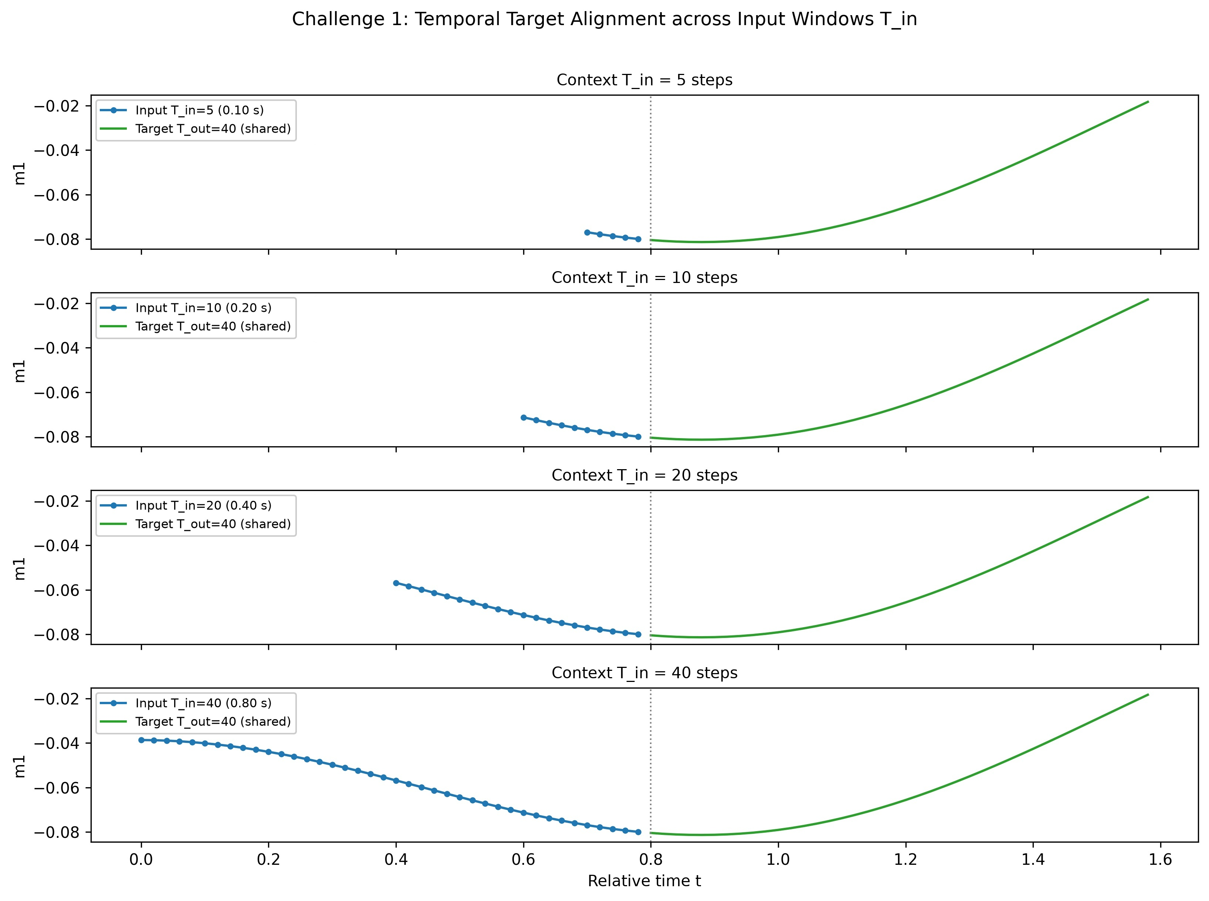
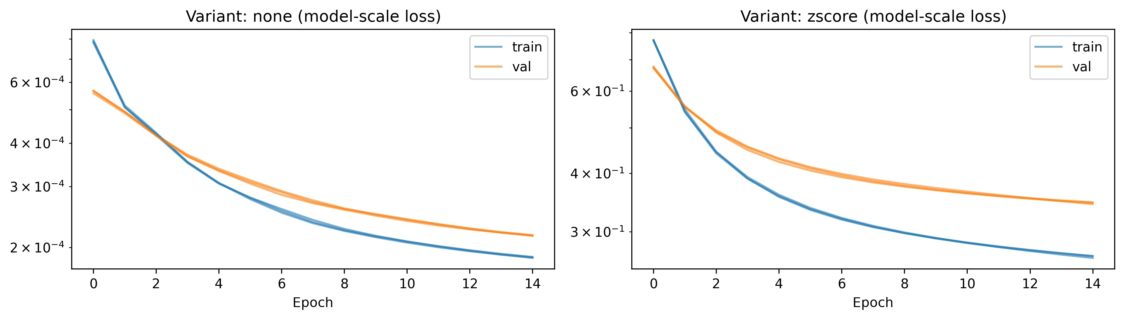
02 · DATA & PHYSICS VERIFICATION
Dataset, Normalization & Windowing
3 / 13
400 Trajectories
D = 55 Features
280 / 60 / 60
0.0% Violations
1,001 steps each (Δt = 0.02 s)
10 Mag ⟨σ_z^i⟩ + 45 Corr ⟨σ_z^i σ_z^j⟩
Leak-free trajectory-level split
Quantum positivity P(s_i, s_j) ≥ 0.155
Why Raw Physical Scale Beats Z-Score
▸ Bounded Observables [−1, 1]: Pauli expectation values are naturally bounded, matching a tanh output head.
▸ 3-Seed Ablation Winner: raw data + tanh achieves Val MSE = 2.17e-4 vs. 2.32e-4 with Z-score (−6.7% error), because Z-score amplifies noise in low-variance long-range correlations.
Aligned sliding-window extraction across input histories T_in ∈ {5, 10, 20, 40}
Sliding Window Protocols (Stride s = 10)
▸ Canonical Benchmark: short window (T_in = 10 → 26,880 train windows) and long window (T_in = 20 → 26,600 train windows) predicting T_out = 40 steps.
▸ Aligned Challenge 1 Grid: all target windows anchored at t_0 ≥ 40 (5,580 test windows) for bias-free comparison.
3-seed validation loss ablation: raw physical scale (tanh) vs. Z-score
Ernesto Gligora & Riccardo Lavorato | Qubit Evolution: Predicting Quantum Dynamics with Deep Learning
University of Calabria · A.Y. 2025/2026
Notes:
Slide 3 — Dataset & Preprocessing:
At the top are the 4 key dataset metrics: 400 trajectories, 55 physical observables, leak-free 280/60/60 trajectory split, and 0% quantum positivity violations. On the right we explain why we avoid Z-score standardization: preserving the native [-1, 1] physical scale with a tanh output head reduces validation MSE by 6.7% (2.17e-4 vs 2.32e-4).

Slide 4
03 · ARCHITECTURAL PROGRESSION
Model Roadmap: From Latent Pilot to Transformers
4 / 13
STEP 1 · PILOT
STEP 2 · RNN DIRECT
STEP 3 · RNN SEQ2SEQ
STEP 4 · WINNER ★
STEP 5 · EXPLAIN & SR
16-D Autoencoder
M1 One-Shot RNN
M2 Autoregressive
M3 Direct TRN
M4 Seq2Seq & SR
55 → 16 → 55 AE +
Latent Transformer
Stacked LSTM / GRU +
Dense(40 × 55, tanh)
Encoder–Decoder RNN
with (h, c) Transfer
Global Self-Attention +
One-Shot tanh Head
Causal Decoder + Cross-Attn
& 2× Super-Resolution
Cuts parameters by 60.5%, but the AE reconstruction floor (3.62e-4) limits accuracy.
→ Native 55-D space kept.
Predicts all 40 future steps in one shot with zero recursive drift.
→ Limit: compresses past into one vector h_Tin.
Generates step-by-step closed-loop predictions.
→ Limit: fixed-vector bottleneck + exposure bias.
Best overall accuracy (Test MSE = 1.21e-4, −25% vs. M1). Combines full past attention with drift-free projection.
Unlocks 40 × 10 cross-attention heatmaps (Challenge 3) and reconstructs dense Δt = 0.02 s trajectories.
Ernesto Gligora & Riccardo Lavorato | Qubit Evolution: Predicting Quantum Dynamics with Deep Learning
University of Calabria · A.Y. 2025/2026
Notes:
Slide 4 — Architectural Roadmap:
Here is our 5-stage architectural progression from left to right: 1) The 16-D Autoencoder introduces a reconstruction floor (3.62e-4), so we retain the native 55-D space. 2) M1 (One-Shot RNN) predicts all 40 steps at once without recursive drift, but compresses history into a single vector. 3) M2 (Seq2Seq RNN) decodes step-by-step but suffers from exposure bias. 4) M3 (Direct Transformer, highlighted in teal) is the overall winner (Test MSE = 1.21e-4). 5) M4 & SR add causal cross-attention for interpretability and 2x super-resolution.

Slide 5
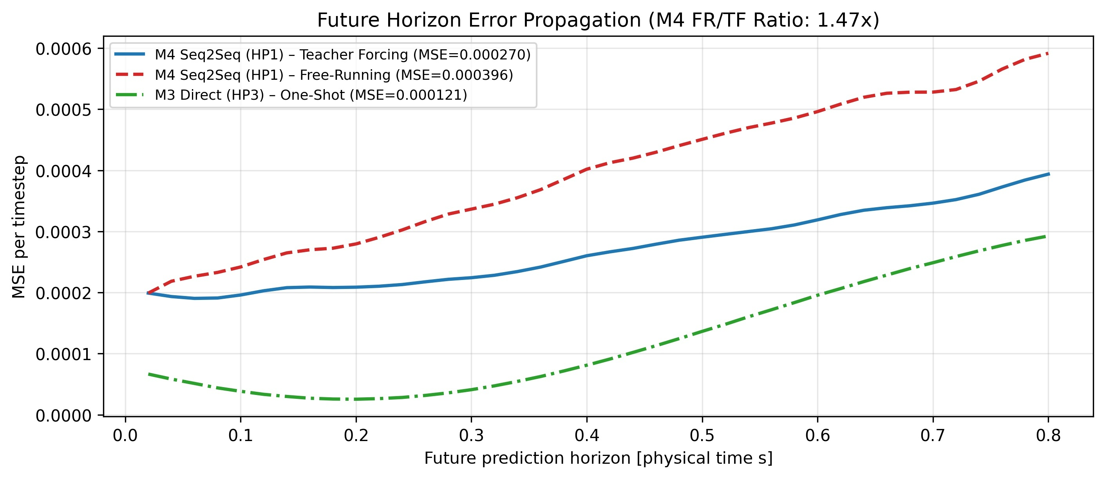
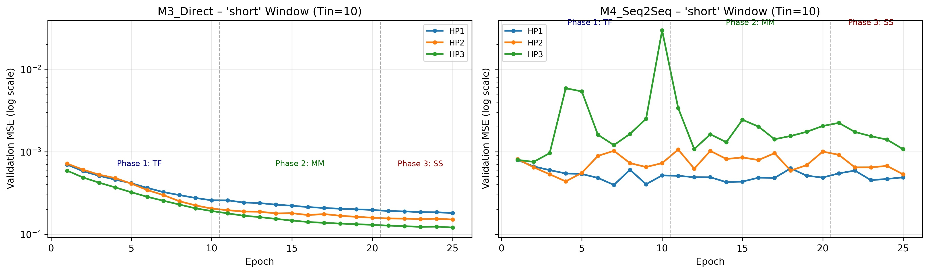
04 · OPTIMIZATION STRATEGY
Three-Phase Hybrid Training Curriculum (25 Epochs)
5 / 13
PHASE 1 · EPOCHS 1–10 (10 EP)
PHASE 2 · EPOCHS 11–20 (10 EP)
PHASE 3 · EPOCHS 21–25 (5 EP)
Teacher Forcing (p_ss = 0.0)
Masked Modeling (p_mask = 0.15)
Scheduled Sampling (p_ss: 0 → 0.5)
Unmasked encoder input; Seq2Seq decoders receive ground-truth shifted targets.
Randomly zeroes 15% of input steps (preserving anchor t_0) to enforce non-local temporal interpolation.
Two-pass parallel sampling mixes self-generated predictions into Seq2Seq decoders to mitigate open-loop drift.
Validation MSE across the 3-phase curriculum (M3 Direct vs. M4 Seq2Seq)
Horizon error accumulation: Teacher Forcing vs. Free-Running M4 vs. One-Shot M3
Ernesto Gligora & Riccardo Lavorato | Qubit Evolution: Predicting Quantum Dynamics with Deep Learning
University of Calabria · A.Y. 2025/2026
Notes:
Slide 5 — Three-Phase Hybrid Training Curriculum:
At the top are the 3 phases across 25 total epochs: Teacher Forcing (10 epochs), 15% Masked Modeling (10 epochs), and Scheduled Sampling (5 epochs). Bottom left shows the validation loss convergence; bottom right illustrates error accumulation across the 40 future steps, where one-shot M3 remains flat and bounded compared to the autoregressive rollout of M4.

Slide 6
05 · EXPERIMENTAL DESIGN
Factorial Hyperparameter Grid & Validation Protocol
6 / 13
24-Model Full Factorial Grid
RECURRENT FAMILY WINNERS (M1: HP1 | M2: HP2)
4 architectures (M1–M4) × 3 capacity configurations (HP1, HP2, HP3) × 2 input windows (short, long) = 24 full trainings.
Recurrent Cell Type
LSTM (outperforms GRU)
Hidden Units (d_rnn)
64 units
Stacked Layers (L)
1 layer (M1) / 2 layers (M2)
Dropout Rate
0.0 (M1) / 0.10 (M2)
True Free-Running Model Selection
Optimizer & LR
Adam (lr = 1e-3, batch = 64)
Validation MSE is evaluated at every epoch in unassisted inference mode, restoring the best free-running checkpoint.
TRANSFORMER FAMILY WINNERS (M3: HP3 ★ | M4: HP1)
Embedding Dim (d_model)
64 (all winning configs)
Attention Heads (H)
2 heads (M3) / 4 heads (M4)
3-Seed & 5-Fold Cross-Validation
Top models verified across seeds 42/43/44 and 5 trajectory-level folds (340 dev trajectories: 272 train / 68 val per fold).
Encoder/Decoder Blocks
1 block (M3, 196k params) / 2 (M4)
Feed-Forward Dim (d_ff)
128 (2 × d_model)
Optimizer & LR
Adam (lr = 1e-3, batch = 64)
Ernesto Gligora & Riccardo Lavorato | Qubit Evolution: Predicting Quantum Dynamics with Deep Learning
University of Calabria · A.Y. 2025/2026
Notes:
Slide 6 — Hyperparameter Tuning & Validation Protocol:
On the left is our validation protocol: 24 full factorial trainings, true free-running checkpoint selection at every epoch, plus 3-seed stability and 5-Fold trajectory-level Cross-Validation. On the right are the winning hyperparameters: 64-unit LSTMs for the recurrent models, and the compact 1-layer Transformer (HP3, 196k params) for M3.

Slide 7
06 · BENCHMARK RESULTS
Test Set Performance & Exposure Bias Analysis
7 / 13
1.21 × 10⁻⁴
−24.9% Error
0.36 × 10⁻⁴
Best Blind Test MSE — M3 (HP3)
M3 Transformer vs. Best RNN (M1)
Single-Qubit Mag MSE (−52% vs. M1)
ARCHITECTURE | VAL MSE (SHORT, 3 SEEDS) | VAL MSE (LONG) | 5-FOLD CV MSE | BLIND TEST MSE | INFERENCE REGIME
Persistence baseline | 6.21e-4 | - | - | - | Constant last-step copy
M1 (LSTM direct, HP1) | 1.61e-4 ± 0.00e-4 | 1.47e-4 | 1.60e-4 ± 0.02e-4 | 1.61e-4 | One-shot (no recursive drift)
M2 (LSTM seq2seq, HP2) | 2.66e-4 | 2.42e-4 | — | — | Autoregressive closed-loop
M3 (Transformer direct, HP3) ★ | 1.21e-4 ± 0.01e-4 | 1.21e-4 | 1.20e-4 ± 0.02e-4 | 1.21e-4 | One-shot (−25% error vs. M1)
M4 (Transformer seq2seq, HP1) | 3.96e-4 | 3.38e-4 | — | — | TF 2.70e-4 → Free-Run 3.96e-4
Key Takeaway — Eliminating Exposure Bias: In Seq2Seq M4, Free-Running errors (3.96e-4) exceed Teacher Forcing (2.70e-4) by 1.47× and M3 (1.21e-4) by 3.3×. One-shot M3 projects all 40 steps simultaneously from globally attended tokens and wins on every split.
Ernesto Gligora & Riccardo Lavorato | Qubit Evolution: Predicting Quantum Dynamics with Deep Learning
University of Calabria · A.Y. 2025/2026
Notes:
Slide 7 — Test Set Benchmark Results:
The top 3 KPIs highlight M3 (HP3): Blind Test MSE = 1.21e-4, a 25% error reduction over the best RNN M1 (1.61e-4), and a 52% error reduction on single-qubit magnetizations (0.36e-4 vs 0.75e-4). The table clearly exposes the Seq2Seq exposure bias gap (from 2.70e-4 under Teacher Forcing to 3.96e-4 in Free-Running, vs 1.21e-4 for M3).

Slide 8
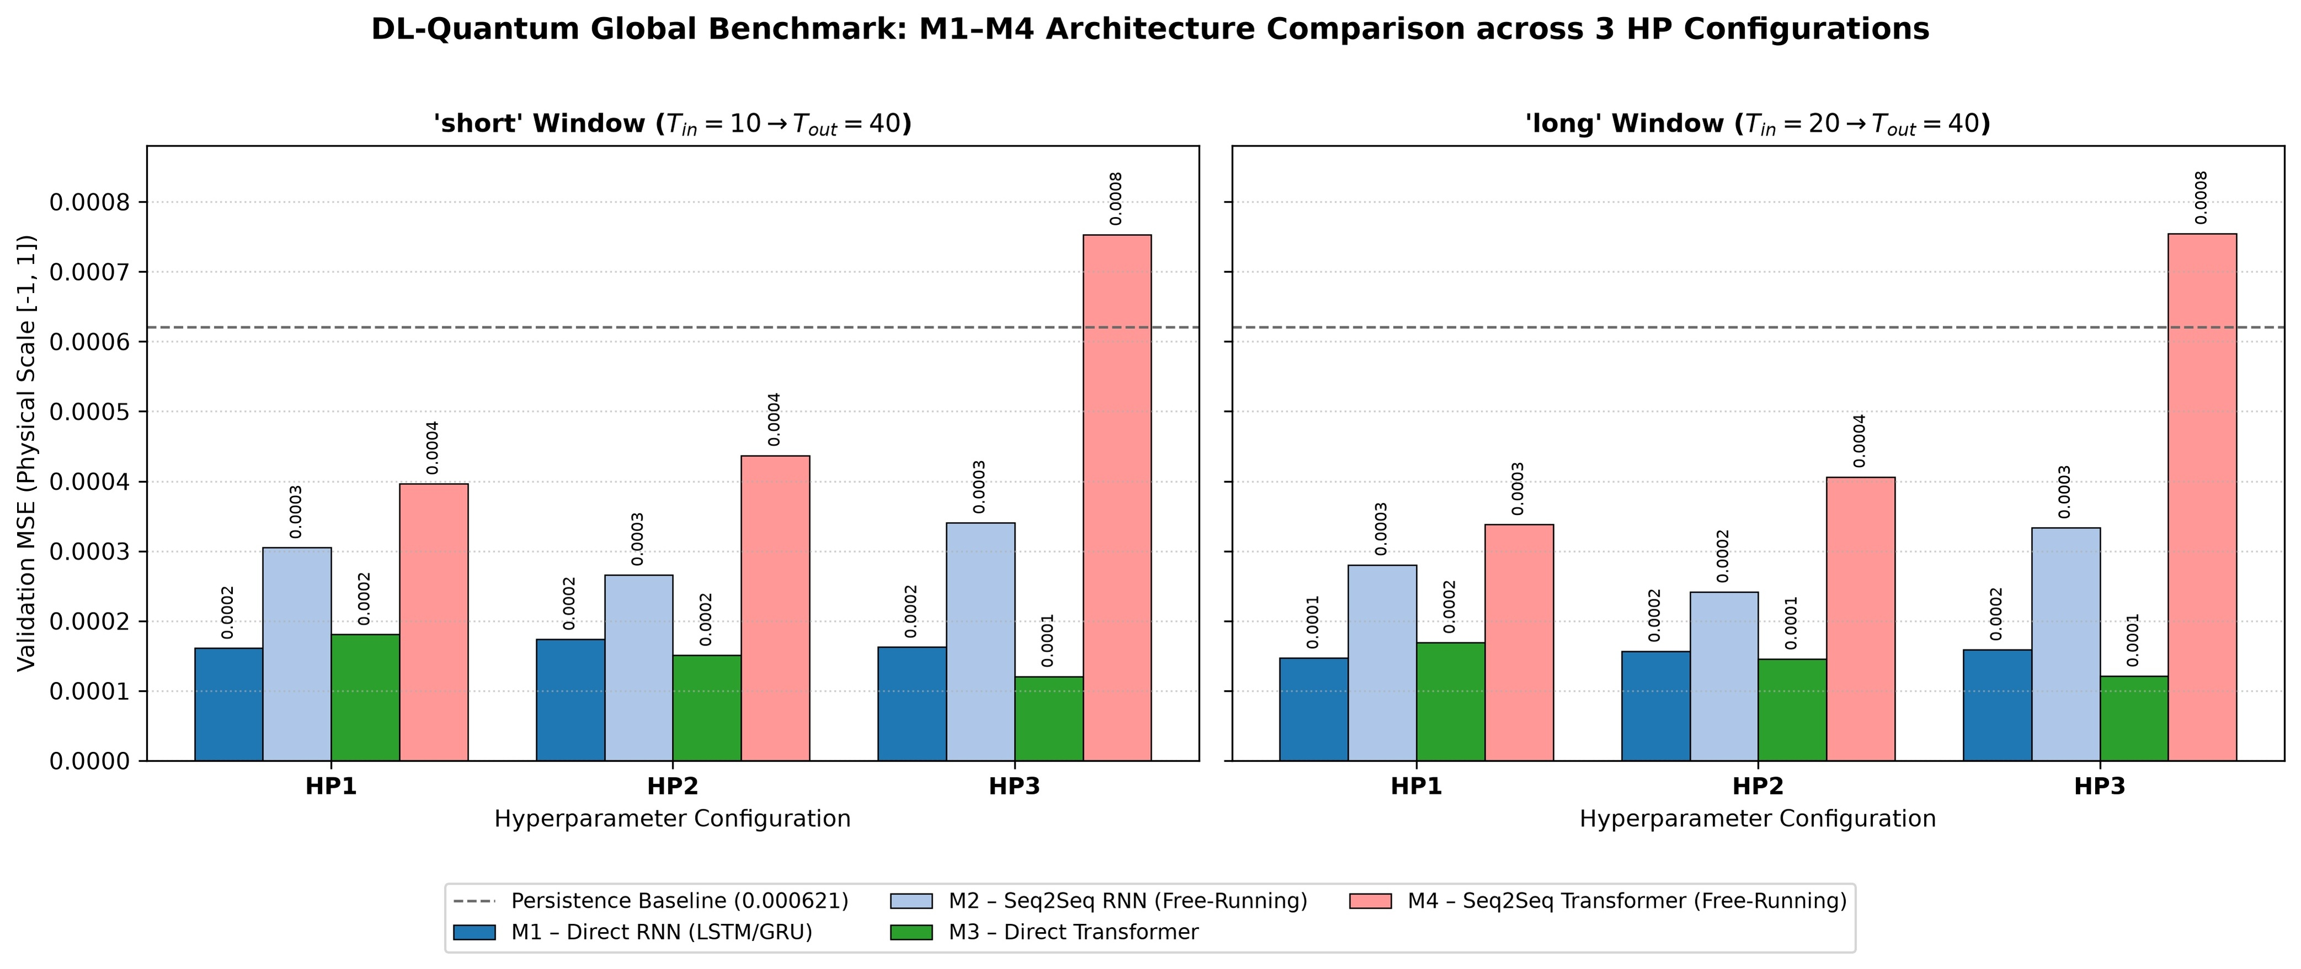
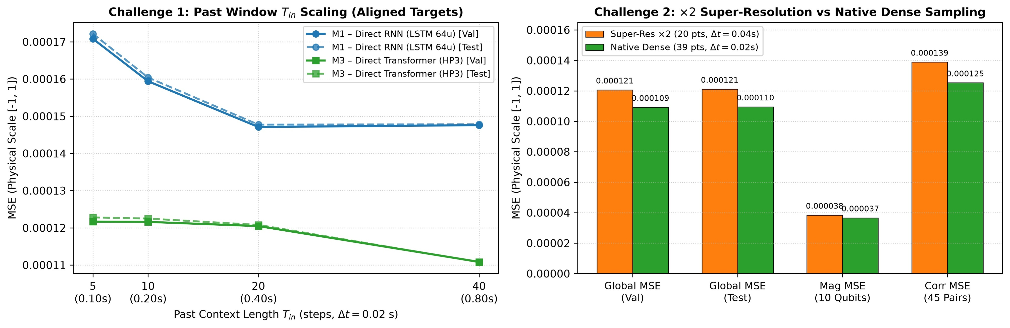
07 · CHALLENGE 1
Minimizing the Historical Observation Window (T_in)
8 / 13
Strictly Aligned Targets
LSTM Saturation at T_in = 20
Optimal Knee: T_in = 10 (0.20 s)
All target windows anchored at t_0 ≥ 40 (5,580 test segments) so every T_in ∈ {5, 10, 20, 40} predicts identical future intervals.
M1 improves from T_in = 5 (1.72e-4) to T_in = 20 (1.48e-4), then saturates completely at T_in = 40 due to fixed-vector compression.
M3 beats the best RNN already at T_in = 5 (1.23e-4) and scales to 1.11e-4 at T_in = 40. T_in = 10 cuts readout latency by 75%.
Aligned-target MSE scaling across T_in ∈ {5, 10, 20, 40} (left) and Challenge 2 summary (right)
24-model factorial benchmark across all four families (short T_in = 10 vs. long T_in = 20)
Ernesto Gligora & Riccardo Lavorato | Qubit Evolution: Predicting Quantum Dynamics with Deep Learning
University of Calabria · A.Y. 2025/2026
Notes:
Slide 8 — Challenge 1 (Minimal Input Window):
Comparing T_in = 5, 10, 20, 40 on strictly aligned future targets (t_0 >= 40), the LSTM saturates beyond T_in = 20 (1.48e-4). The M3 Transformer outperforms the best RNN already at T_in = 5 (1.23e-4) and scales down to 1.11e-4 at T_in = 40. Selecting T_in = 10 (0.20 s) offers the optimal Pareto knee, cutting observation window length by 75%.

Slide 9
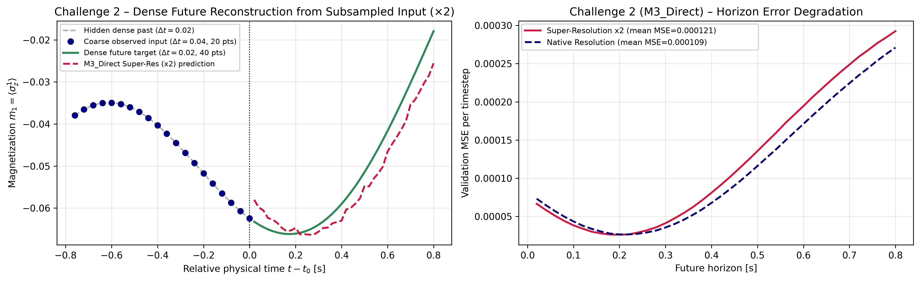
08 · CHALLENGE 2
Temporal Super-Resolution (×2: Δt = 0.04 s → 0.02 s)
9 / 13
Coarse-to-Fine Task Setup
▸ Input: 20 coarse steps at Δt_sub = 0.04 s (2× subsampled).
▸ Output: 40 dense future steps at native Δt = 0.02 s.
Near-Lossless Reconstruction (1.21e-4)
Matches the dense T_in = 10 baseline (1.22e-4) and sits within ΔMSE = 1.1e-5 of the 39-step native upper bound (1.10e-4).
M3-SR dense reconstruction from 2× subsampled input (left) and horizon error curve (right)
OBSERVATION REGIME | Δt_in | TEST MSE | TEST MAE
M3-SR (×2 subsampled, 20 pts) ★ | 0.04 s | 1.21 × 10⁻⁴ | 0.00788
M3 Native Upper Bound (39 pts) | 0.02 s | 1.10 × 10⁻⁴ | 0.00754
M3 Standard short (10 pts) | 0.02 s | 1.22 × 10⁻⁴ | 0.00789
Why 2× Subsampling Works Physically
Covering a wider physical span (0.76 s vs. 0.18 s for the dense T_in = 10 baseline) provides richer phase context, with zero architectural change.
Ernesto Gligora & Riccardo Lavorato | Qubit Evolution: Predicting Quantum Dynamics with Deep Learning
University of Calabria · A.Y. 2025/2026
Notes:
Slide 9 — Challenge 2 (2x Temporal Super-Resolution):
On the left are the reconstruction plot and comparison table; on the right are the 3 key insights. Starting from 20 points sampled at dt = 0.04 s, M3-SR reconstructs all 40 dense future steps at dt = 0.02 s with Test MSE = 1.21e-4, even edging out the dense short window baseline (1.22e-4) thanks to its wider 0.76 s physical span.

Slide 10
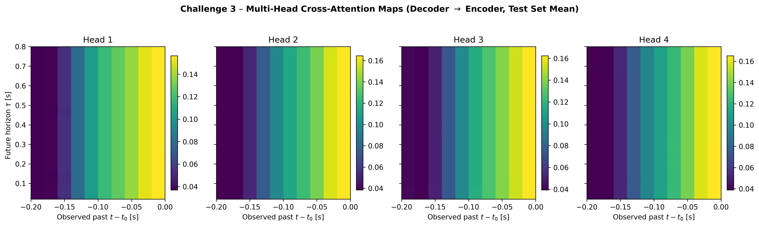
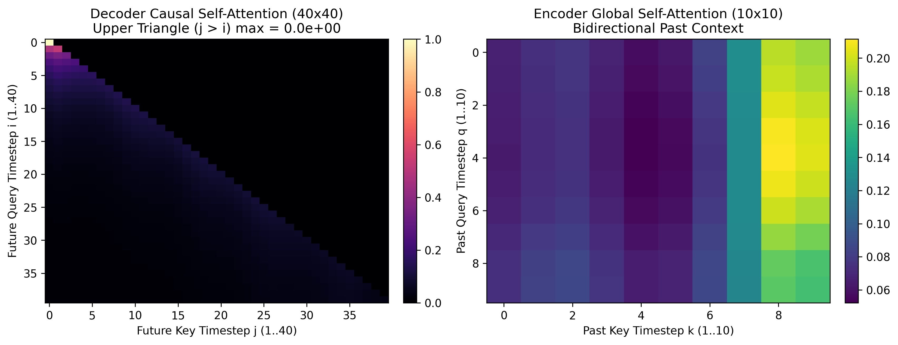
09 · CHALLENGE 3
Opening the Black Box: Multi-Head Attention Maps
10 / 13
Boundary Phase-Locking (t ∈ [−0.04, 0.00] s)
All 4 heads exhibit a strong recency gradient peaking at the final steps (ᾱ_k ≈ 0.16, sharpest in Heads 1 & 4) to lock x(t_0) and velocity.
Multi-Lag Curvature & Scar Tracking
M4 decoder cross-attention heatmaps across Heads 1–4 (40 future steps × 10 past steps)
Retain non-vanishing weights (ᾱ_k ≈ 0.04–0.12, broader in Heads 2 & 3) across t ∈ [−0.18, −0.06] s to capture PXP revival curvature.
Strict Causal Mask Verification
Upper triangle of the 40 × 40 decoder self-attention matrix is exact zero (max_{j>i} |α_ij| = 0.00), guaranteeing zero future leakage.
Decoder lower-triangular causal mask (40 × 40) and bidirectional encoder self-attention
Ernesto Gligora & Riccardo Lavorato | Qubit Evolution: Predicting Quantum Dynamics with Deep Learning
University of Calabria · A.Y. 2025/2026
Notes:
Slide 10 — Challenge 3 (Attention Maps):
On the left are the attention maps extracted from M4 on the test set; on the right is their physical interpretation. All 4 heads exhibit a strong recency gradient peaking (~0.16) on the latest observed steps to anchor state and velocity, while retaining non-vanishing weights (0.04–0.12) across earlier lags to estimate quantum-scar revival curvature. The 40x40 causal mask shows exact zero above the main diagonal.

Slide 11
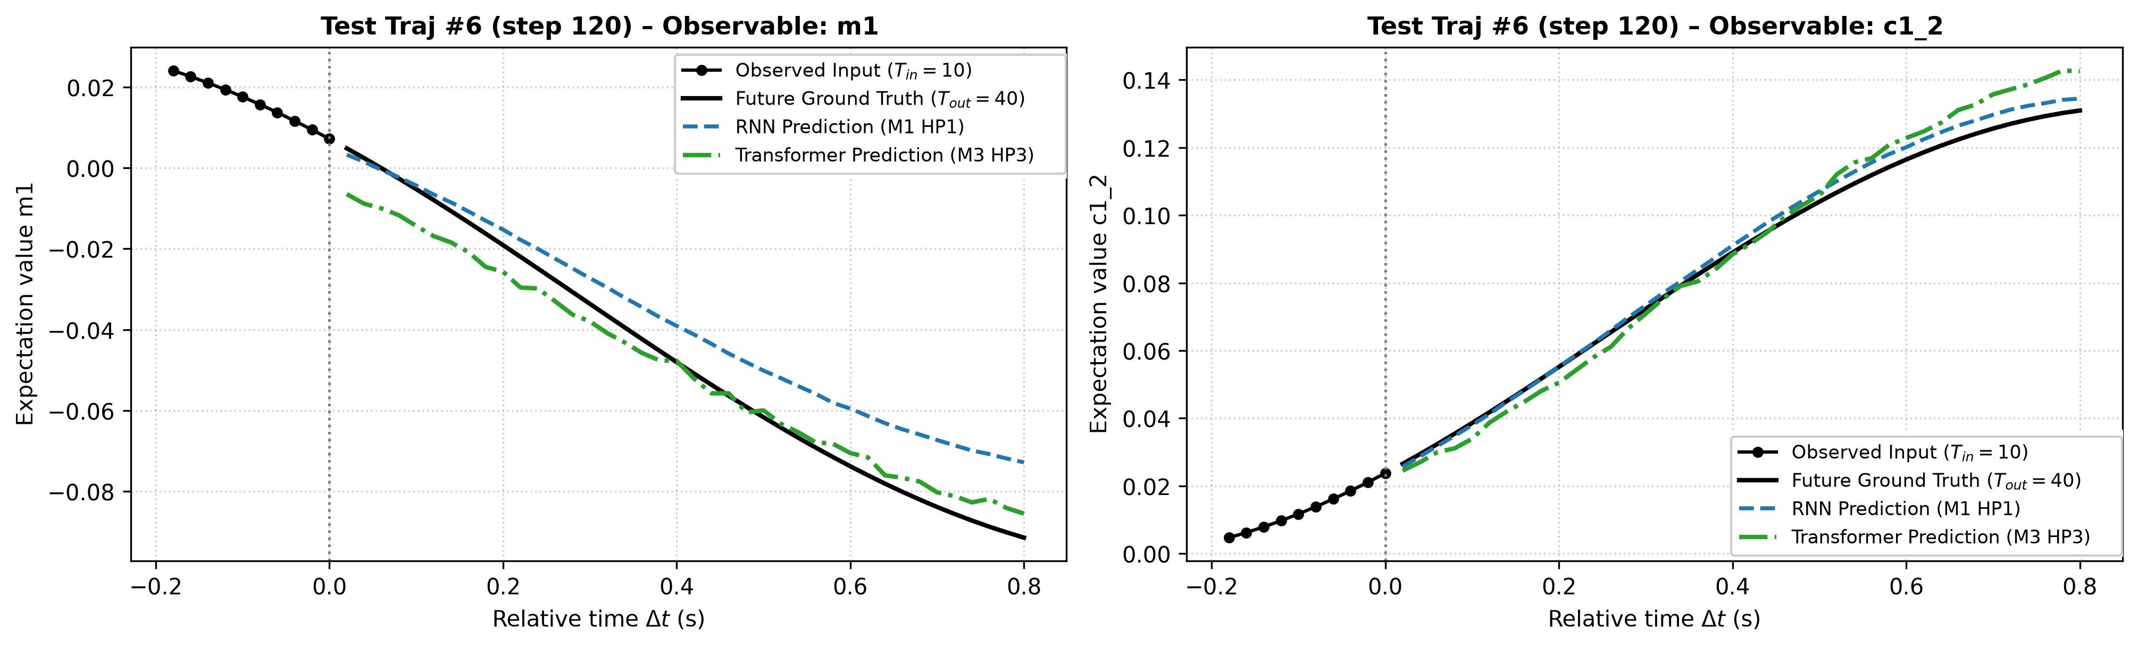
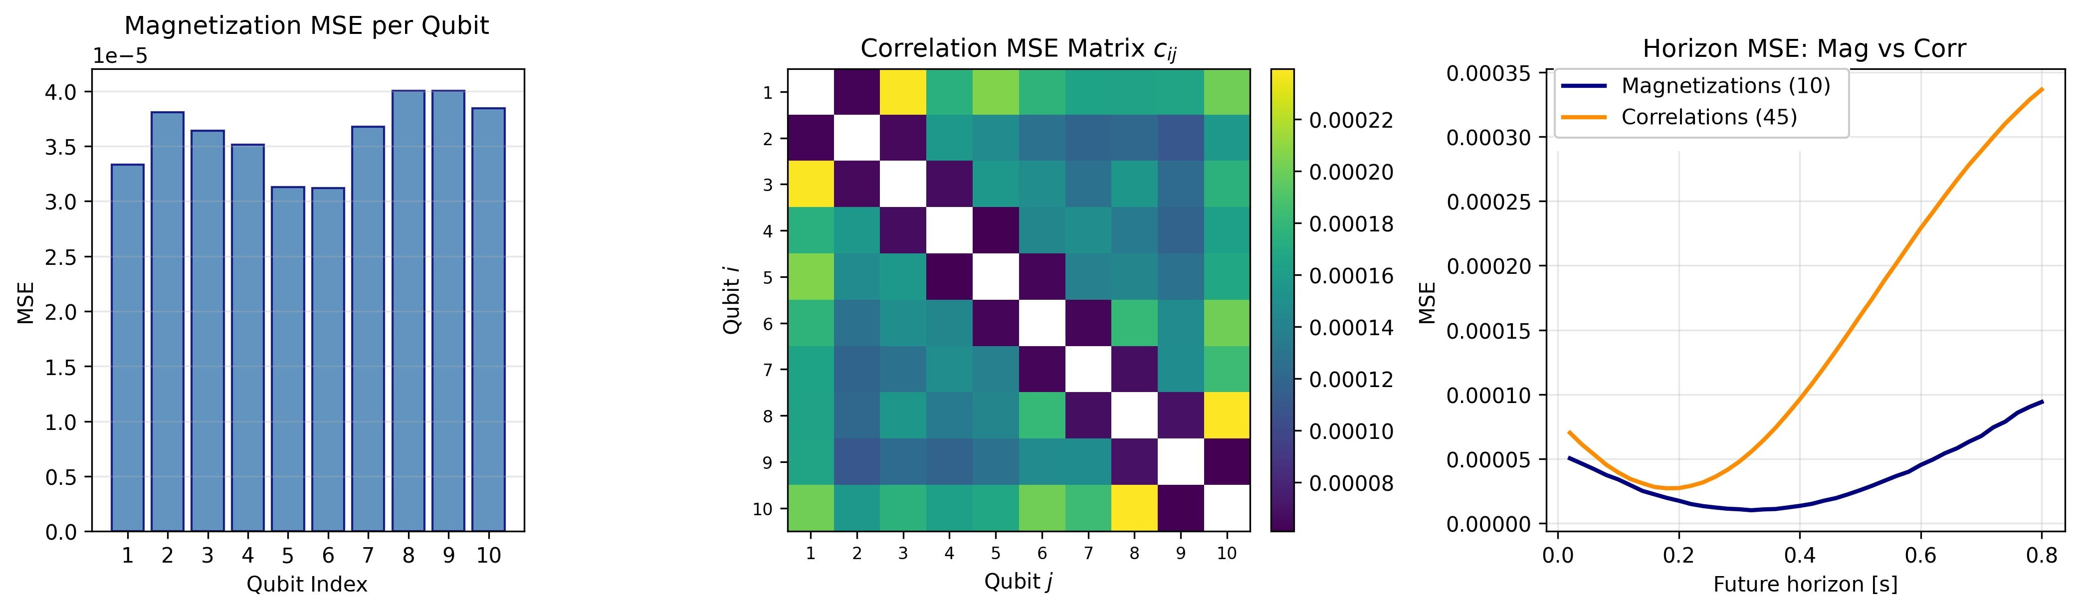
10 · PHYSICAL ERROR ANALYSIS
Blind Test Rollouts & Spatial Error Disaggregation
11 / 13
High-Fidelity Phase Tracking
Uniform Spatial Error
100% Quantum Positivity
Across 5,760 blind test windows (< 1 s inference), M3 tracks both magnetization revivals and two-body correlations with high phase fidelity.
Single-qubit magnetization MSE is uniformly low (~3-4e-5) across the chain, smallest at the central qubits q_5, q_6; correlation error peaks at intermediate distances.
Every test prediction satisfies two-body density-matrix positivity P(s_i, s_j) ≥ 0, with minimum probability P_min = 0.1632 > 0.
Blind test rollouts (m_1 and c_{1,2}): Ground Truth vs. M1 RNN and M3 Transformer
Disaggregated error: per-qubit magnetization MSE, pairwise c_ij matrix, and horizon drift
Ernesto Gligora & Riccardo Lavorato | Qubit Evolution: Predicting Quantum Dynamics with Deep Learning
University of Calabria · A.Y. 2025/2026
Notes:
Slide 11 — Blind Test Set & Disaggregated Error Analysis:
At the top are the 3 key physical insights, and at the bottom are the blind test figures. Notice how M3 accurately tracks the oscillation turning points, how single-qubit magnetization MSE is uniformly low across the chain (smallest at central qubits), and how pairwise correlations are 3.9x harder to predict than local magnetizations.

Slide 12
11 · OUTLOOK & EXTENSIONS
Future Research Directions
12 / 13
DIRECTION 01
DIRECTION 02
DIRECTION 03
3D Pareto Front (T_in, T_out, MSE)
Closing the Seq2Seq Exposure Gap
Scaling to N > 10 Qubit Arrays
▸ Multi-Objective Optimization: jointly minimize prediction MSE and input readout length T_in while maximizing the forecasting horizon T_out ∈ [20, 100].
▸ Hardware Latency Constraints: select operating points under realistic measurement-time budgets.
▸ Soft Sampling & Rollout Losses: combine Gumbel-like soft sampling or multi-step rollout losses with the causal Transformer decoder (M4).
▸ Goal: retain explicit cross-attention interpretability while matching one-shot accuracy over long horizons.
▸ Quadratic Correlation Scaling: pairwise observables grow as D = N + N(N−1)/2.
▸ Graph-Attention (GNN): couple spatial GNNs on the Rydberg interaction graph with temporal self-attention to scale to N = 50–100 atom simulators.
Ernesto Gligora & Riccardo Lavorato | Qubit Evolution: Predicting Quantum Dynamics with Deep Learning
University of Calabria · A.Y. 2025/2026
Notes:
Slide 12 — Future Research Directions:
We conclude with three future research extensions aligned with the report: 1) 3D Pareto Front (T_in, T_out, MSE) spanning horizons T_out in [20, 100]. 2) Closing the Seq2Seq exposure bias gap via soft sampling or multi-step rollout losses on M4 while preserving cross-attention interpretability. 3) Spatial Graph Neural Networks coupled with temporal self-attention to scale to 50–100 atom simulators.

Slide 13
Thank You
Ernesto Gligora · Riccardo Lavorato
Artificial Intelligence and Computer Science — University of Calabria (A.Y. 2025/2026)
Notes:
Thank you for your attention! We are happy to take any questions.

