Slide 1
PowerEnJoy

Slide 2
GOAL:
G1. A person who has the right requirements must be able to
register himself to the system.
G2. A registered person must be able to authenticate himself to
the system.
G3. A user must be able to localize the positions of the available
vehicles.
G4. A user must be able to reserve an available vehicle, for a
limited time.
G5. A user who has reserved a vehicle, must be able to use it.
G6. The system must properly charge for the user the cost of
used services.
G7. The system must properly manage the availability of
vehicles.
G8. The system must simplify the organization of the
technicians in their work.

Slide 3
DOMAIN ASSUMPTION
• GPS always indicates the right position.
• The GPS of all the vehicles is always working.
• The vehicles usable by the clients are always working,
especially during the whole ride.
• The battery level of a vehicle is always enough high to
complete the ride of the user.
• The user who reserved the vehicle is the same who will
use it.
• When a free technician notices a low battery vehicle, he
takes care of it.
• A technician that has plugged a vehicle into a power grid
changes the vehicle state from “In processing” to
“available”
• A user parks always in a safe area

Slide 4
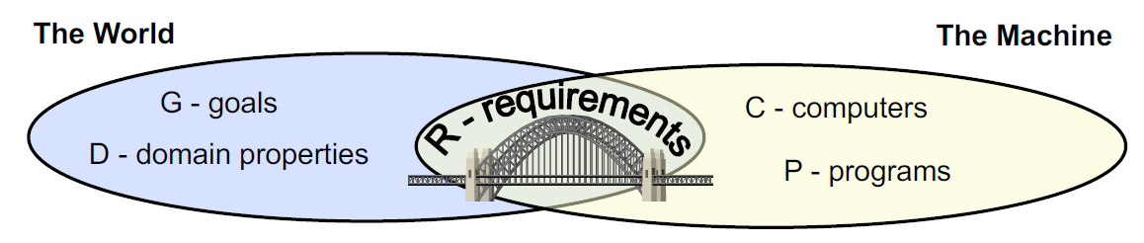
R and D |= G

Slide 5
G1. A person who has the right requirements must be able to
register himself to the system:
• The system must be able to verify the completeness and
correctness of the data provided by the person who
wants to register
• The system must provide a sign up functionality that
gives a password to the user to access the system
• The system must allow the sign up only if the data
provided by the person are correct.
G2. A registered person must be able to authenticate himself to the system:
• The system must be able to check the correctness of the
user’s login credentials
• The system permits the access to the user only if the
login credentials are correct
G4. A user must be able to reserve an available vehicle:
• The system must provide a functionality that permits to
the user to reserve a vehicle
• Only the vehicles shown to the user can be reserved
• The system must know if the user has a vehicle’s
reservation
• The system doesn’t allow to reserve a car if the user is in
the black list
• The system permits to reserve a vehicle only if the user
hasn’t already reserved another vehicle
G3. A user must be able to localize the position of the available
vehicles:
• The system must know the position of the vehicles
• The system must know the state of the vehicles
• The system must be able to receive the position
communicated by the user
• The system must provide a functionality that shows the
available vehicles to the user
G5. A user who has reserved a vehicle, must be able to use it:
• The system must provide a functionality to unlock or lock
the vehicle’s doors

Slide 6
G6. The system must properly charge customers the cost of used
services:
• The system must know the number of passengers
• The system must know the level of charge of the vehicles
• The system must know if the car is ignited or not
• The system must know if the vehicle is in charge or not
• The system must provide a functionality that shows to
the user, during the ride, the current charge
• The system must provide a functionality that calculates
the amount that the user has to pay according to the
discounts and rates established
• The system must be able to charging the amount
calculated to the user
• The system inserts the user in the black list if it is not able
to pay
G7. The system must properly manage the availability of
vehicles:
• The system must know the state of the vehicles
• The system must know the level of charge of the vehicles
• The system must know if the car is ignited or not
• The system must know if the vehicle is in charge or not
• The system must be able to change the state of the
vehicles
• The system must provide a functionality that manage the
availability of the vehicles in the correct way
G8. The system must simplify the organization of the technicians
in their work
• The system must know the state of the vehicles
• The system must know if the vehicle is in charge or not
• The system must provide a functionality that shows to
the technicians all the vehicles with their state and if the
car is in charge or not.
• The system must be able to change the state of the
vehicles based on what the technicians want

Slide 7
ARCHITECTURE

Slide 8
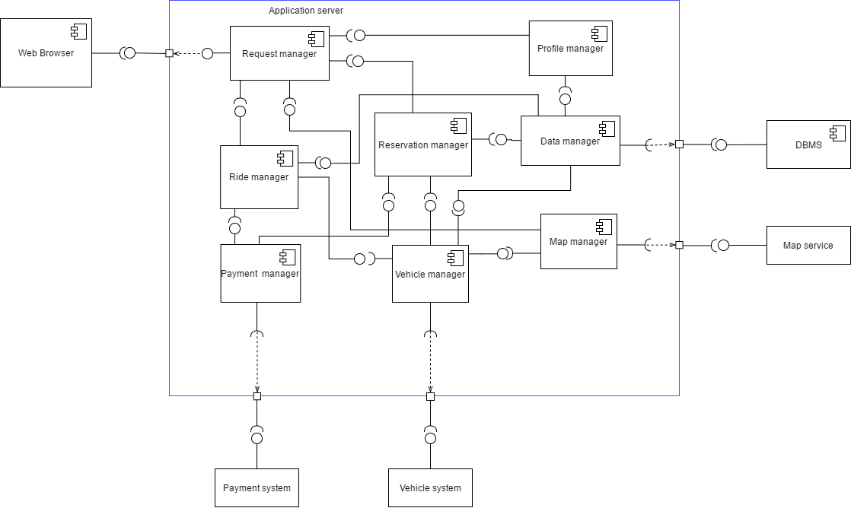
COMPONENT VIEW

Slide 9
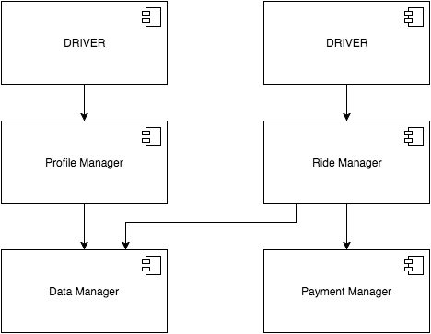
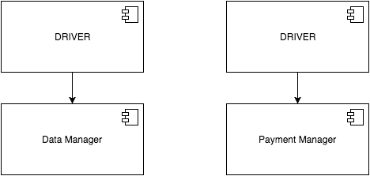
INTEGRATION TEST
Bottom-up method
1)
2)

Slide 10
4)
3)

Slide 11
5)

Slide 12
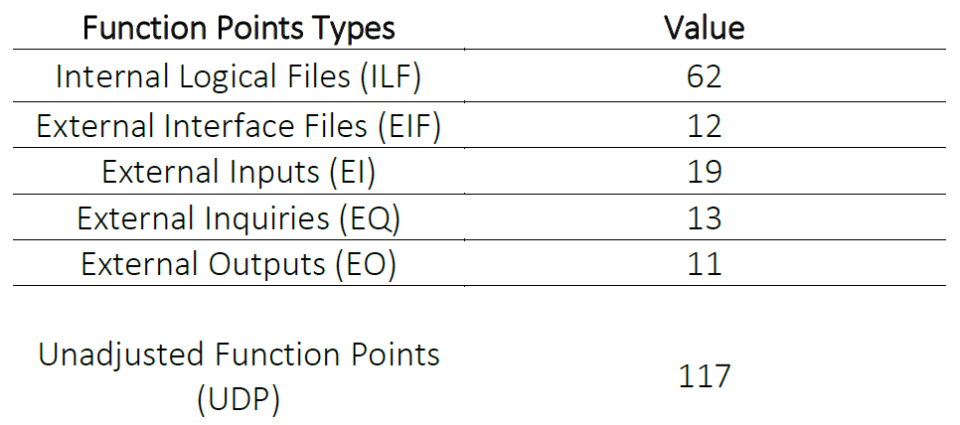
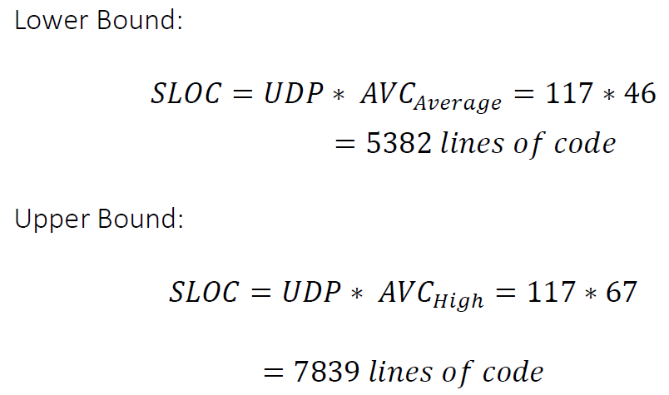
SIZE AND EFFORT ESTIMATION

Slide 13

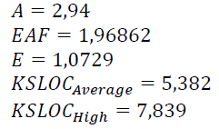
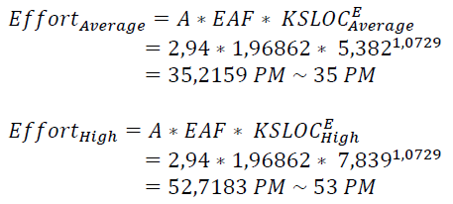

Slide 14
RESOURCE ALLOCATION

