Slide 1
Elk River
Group 8

Slide 2
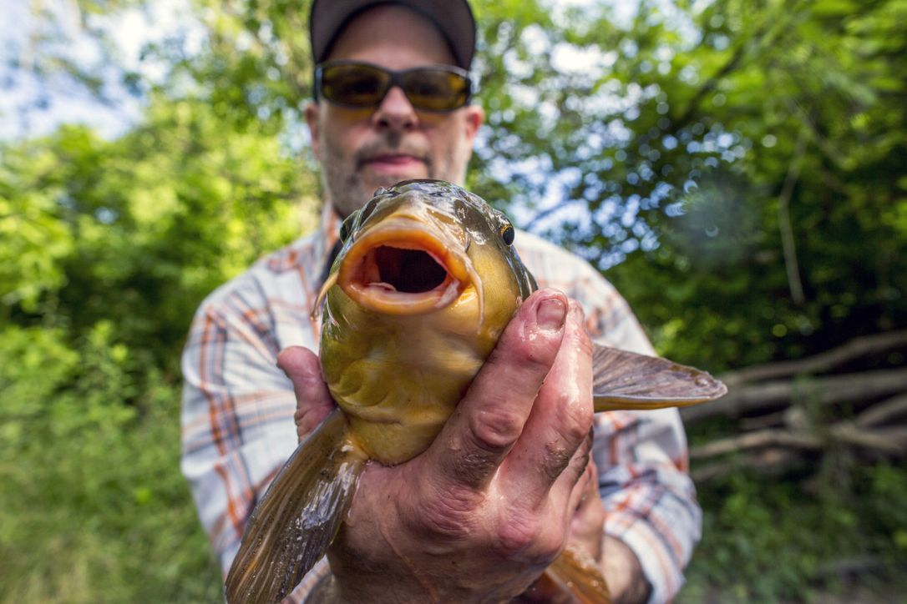
Target Group Fishing enthusiasts
Needs:
LOCALS: they need a new income system, possibly based on a clean use of the natural resources and environment.
OTHERS: they want a new and different place where to practice their passion and try different fishing tequniques.
Our offering: A service to facilitate organization of fishing trips and the creation of an infrastructure that will bring new people to fish in the area, creating therefore a need for services and accomodations that are not currently available.

Slide 3
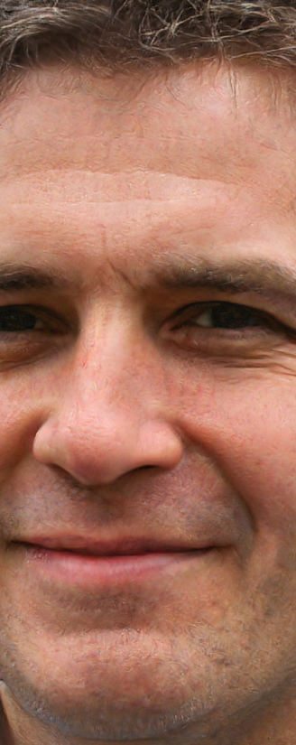
Persona Bob the local fishing enthusiast
Bob (40) father of 2 young children, has lived is entire life in the small town (700 people) of Webster Springs WV, when Freedom Industries closed after the chemical spill of 2014 he lost his job there and has since worked in his wife bakery, hoping for a new job.
Passions and skills: fishing, camping, hiking, restoring classic cars and classical music.
Why he would engage with us:
He is looking for a new job
He knows the territory and loves fishing
Daily routine: Wakes up early with his wife and helps her in the shop, then head out for the deliveries while she takes the kids to school, he then takes them back home for lunch and helps them with their homework until dinner. When the kids are in bed he enjoys some classical music while dreaming of his next fishing trip during the weekend.

Slide 4
Persona Bob the local fishing enthusiast
Personality: Bob is a kind man always with a smile on his face, truly an optimist at hearth that always sees the glass half full.
Social environment: Active member of his small community he is both well known and respected for his contributions whenever needed.
Dreams:
Having his own independent job
Spending more time with his kids
Provide more for his family

Slide 5
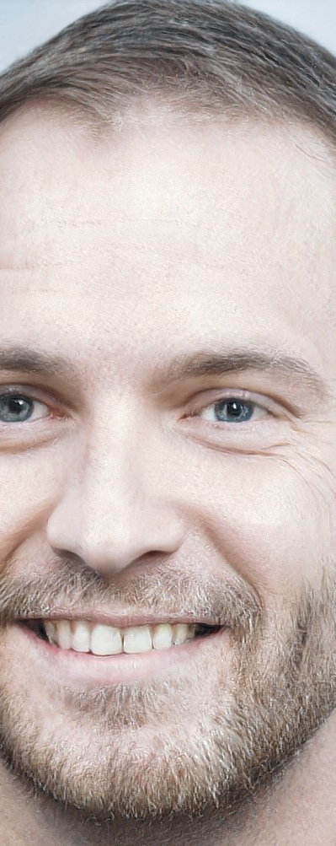
Persona Jack the tourist fisherman
Jack (36) father of a little girl (6 yo) lives with her and his wife in Columbus Ohio, he's an IT technician in a medium size company where he's been working since 2007. He never got a degree but studied IT in high school and has always been tech savvy. Jack's father always brought him to do outdoors activities, from rafting to camping and his true passion has always been fishing, which he still does.
Passions and skills: fishing, camping, driving, football, rafting.
Why he would engage with us:
He is looking for a new fishing area
Outdoors lover
Daily routine: Wakes up with his wife and daughter, takes her to preschool before going to work, they then meet again at launch and after he goes back for the afternoon shift. When he gets back in the evening they all eat together and spend the evening watching TV until the little one’s bet time comes, at which point Jack usually catches up with the latest football news.

Slide 6
Persona Jack the tourist fisherman
Personality: Loving father, great friend and teacher, always enjoys learning something new.
Social environment: Known and respected member of the company, has been working there almost since the beginning. Never misses a social occasion
Dreams:
Becoming one of the company managers
Teaching his daughter how to fish

Slide 7



Thinking hats
- Area is scarcely populated - Zone has been polluted in 2014 - People lost their job after the spill - Area rich of natural places - Elk River isn’t very deep - Only Charleston is growing - There are already fishing enthusiasts visiting | - It’s sad to think about people that are struggling in the area, but it doesn’t feel like a place I would visit right now - I would work on the place by taking advantage of the extensive natural resources in the area | - Unemployment can help in convincing people to try a new work system - People that already come here to fish could help spreading the word to others - Since the river is quite long, there is no risk of running out of space

Slide 8



Thinking hats
- Health care institutions advise against eating fishes from the river - If it’s too hot or too cold, outdors activities won’t be appealing - The area is not easily reachable due to the lack of public transportation - Since the river is not very deep in some spots ferries for transport are out of the question | - A natural area is ideal for camping or building cabins where people could spend their summer vacations or a weekend in spring - Other than fishing, hunting is already practiced in some form - A small niche of music enthusiasts search for music festivals in natural areas/woods | - Many ideas can be put in place, but the safer ones are probably those that take advantage of what’s already there, like fishing, hunting and camping - Although hunting is already practiced in the area at the moment, bringing too many people in the same zone would end up in safety hazards when guns are involved, even considering the large area we are dealing with dealing with

Slide 9
Customer Journey Map – Jack The Tourist
LIFECYCLE STAGE
AWARENESS
CONSIDERATION
ONBOARDING
CONVERT & RETAIN
USER EXPERIENCE
TOUCH POINTS & SCORECARD
Serach Tab
Payment Process
Radio / Social Ads
Booking Options
Elk River WebSite
App Store Reviews
Application Usability
In-App Bundle
App Website (optional)
App Design
Locals Responsiveness
Actual quality of service (on field)
Registration (optional)
Email Promotion
CHALLENGES
Bad Reputation (spill)
Online Awareness
GDPR for data management
Color / Design to attract customer
Nearby (better?) Fishing Spot
Locals Responsiveness
UI Responsiveness
Not intuitive Design
App reputation relies on every single local behaviour (working with the service)
Not attractive offers
Spam
RECOMMENDATION
METRICS
Bounce Rate
CTR (click through rate)
Conversion Rate
N. Download
Registration (optional)
N. working clients
N. prenotations
Improvement Opportunities
Campaign
Review Management
Usability test
Info Update
Locals service check

Slide 10
Data Analysis

Slide 11
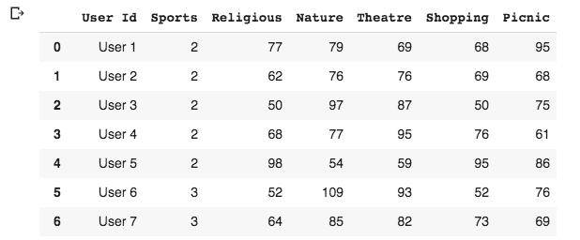
Clustering
The dataset is a 249 x 7 .csv file describing the number of reviews each user did. Every row has a specific user ID (249 users), every column reflects a different field of review

Slide 12
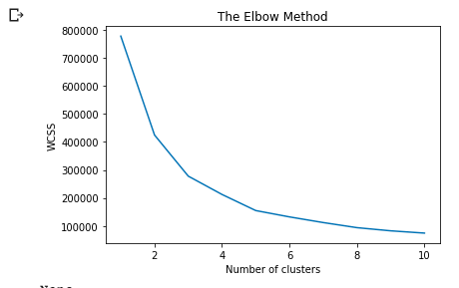
Clustering

Slide 13
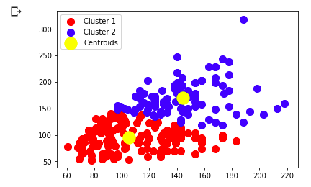
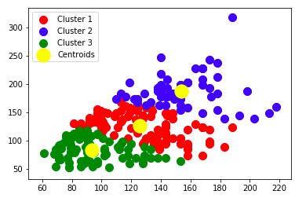
KMean
NATURE
PICNIC
PICNIC

Slide 14
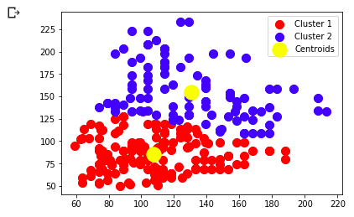
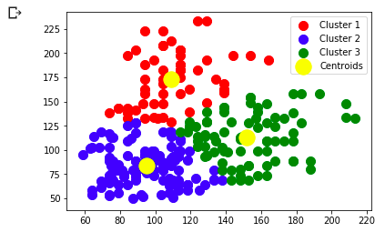
KMean
SPORTS
PICNIC
PICNIC

Slide 15
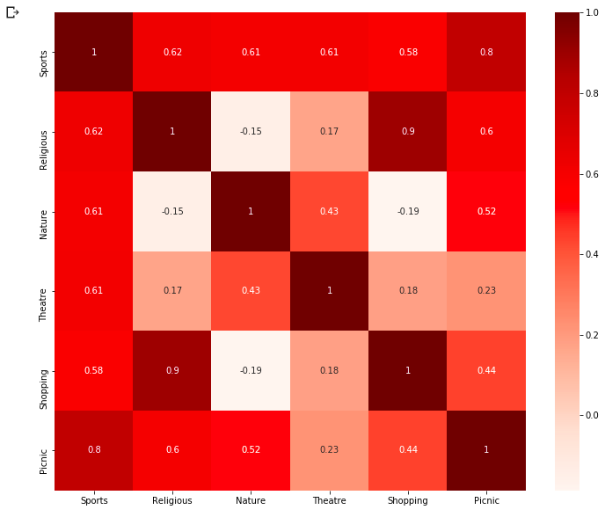
Confusion Matrix

Slide 16
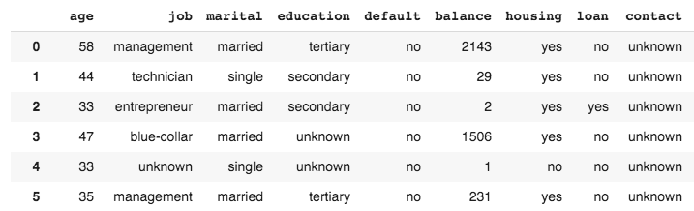
Classification
The data is related with direct marketing campaigns of a Portuguese banking institution, based on phone calls. Often, more than one contact to the same client was required, in order to access if the product (service) would be (or not) subscribed.
45211 rows × 9 columns

Slide 17
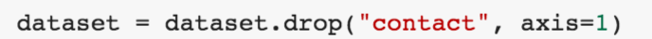
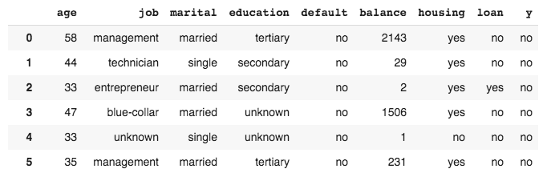
Feature Engineering
BINARY
CATEGORICAL
BINARY
BINARY
BINARY

Slide 18
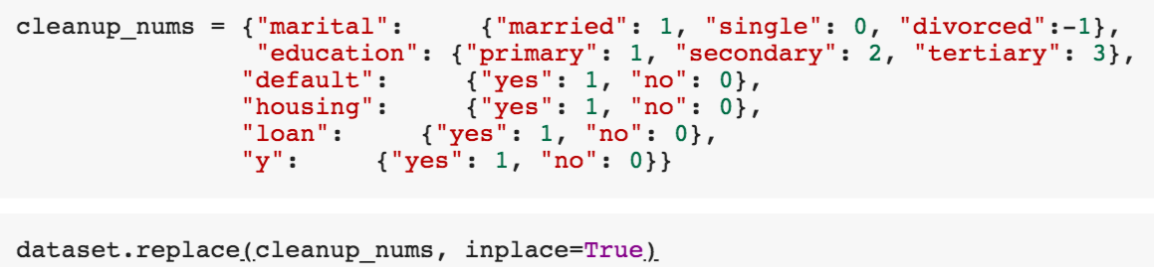

Feature Engineering

Slide 19
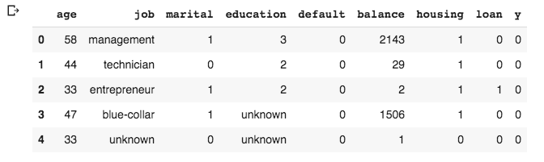
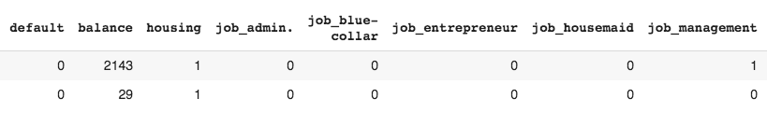
Feature Engineering
TARGET
DUMMY

Slide 20
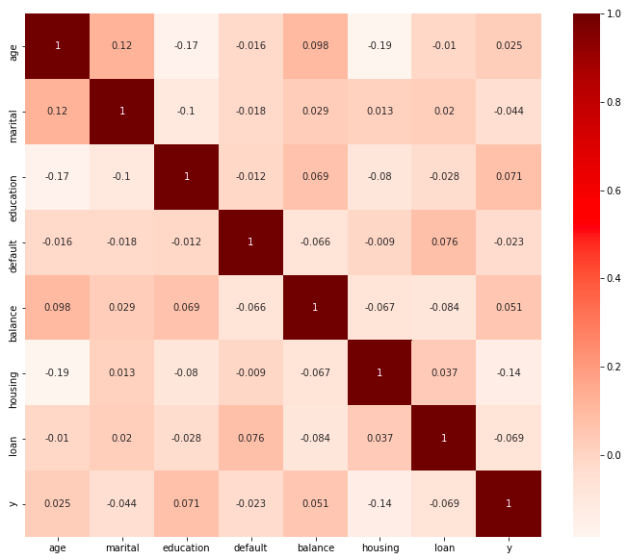
Confusion Matrix

Slide 21
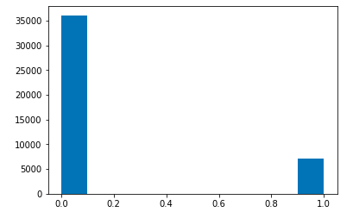
Metrics
PRECISION ?
Low precision indicates a
high number of false positives.
It is a measure of a
classifier's exactness.
IMBALANCED
RECALL ?
It is a measure of a classifier’s
completeness. Low recall
indicates a high number of
false negatives.
F1-SCORE ?
Since our main objective with the dataset is to prioritize accuraltely classifying subscription cases, the recall score can be considered our main metric

Slide 22
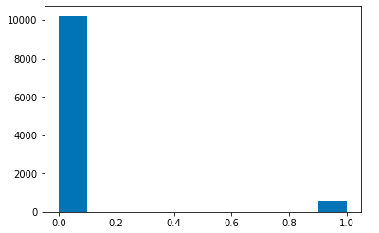


K-NN
y_predicted
CONFUSION MATRIX:

Slide 23
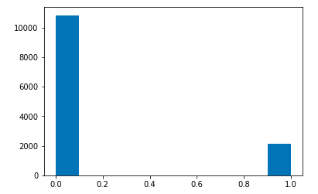


Decision Tree Classifier
y_predicted
CONFUSION MATRIX:

Slide 24
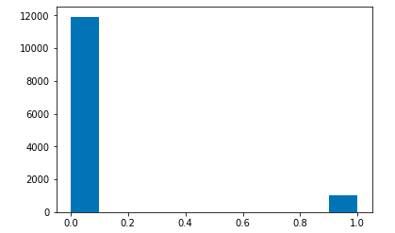


Random Forest Classifier
y_predicted
CONFUSION MATRIX:

Slide 25



Under-Sampling Majority Class
Decision Tree Classifier
Random Forest Classifier
UnderSampling produces higher recall score.
Only concern here is the small number of total samples we used to train the model.

Slide 26


SMOTE
Decision Tree Classifier
Random Forest Classifier

Slide 27
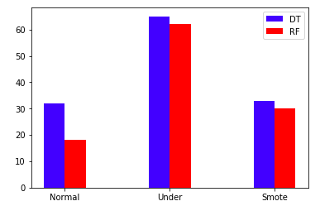
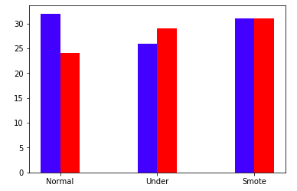
Recap
RECALL
F1
Synthetic Minority Oversampling Technique brings averall best results.
Only in reall, undersampling is outperforming, but it’s not trustworthy actually because we used only a small number of samples.
Remarkable also the fact that DT is not influenced by SMOTE.

Slide 28
Prototype – Mobile app

Slide 29


Technologies used
Android (OS):
Free to use and develop.
Over 75% market share.
Previous experience.
Firebase (DB & more):
Free for small scale projects.
Easy to integrate.
Many functionalities (database, notifications, storage, authentication, cloud functions)

Slide 30
Goal of the application
A platform for the local fishing experts to:
Offer fishing lessons.
Equipment rental.
Add fishing spots on the map.
A place where tourists can:
Make reservations for a service.
Leave reviews.
Users customers should be able to communicate with employees and vice-versa.

Slide 31
Live demo

