Slide 1
Reservation
Design and Implementation of Mobile Applications
2018-2019
Professor Luciano Baresi
RICCARDO FACCHINI
899190
riccardo.facchini@mail.polimi.it

Slide 2
Goals
G.1: Allow anyone that owns a smartphone to become a registered user of the service.
G.2: Allow the customers to search shops and establishments to book a reservation.
G.3: Allow the shop owners to have their shop found by customers whishing to book a reservation.
G.4: Show only the available times to book a reservation.
G.5: Show in the home screen of both kinds of users the next reservations.

Slide 3
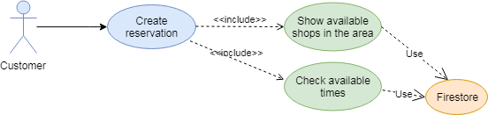
Use Case - Create Reservation
Allow the customer to create and register a reservation to a shop.
The system searches for the closest shops in the area and shows them to the customer.
Only available time slots are displayed as a choice.

Slide 4
Platform choice

Slide 5
Android
Minimum sdk version: 23 (Android 6.0 Marshmallow)
Target sdk version: 28 (Android 9.0 Pie)
Coverage of approximately 62.5%
Why Android:
Free and widespread.
Previous knowledge with Java and Android programming.
Personal Android device to test outside simulated environment.
Plenty of material and guides available.

Slide 6
Firebase
Pros:
Free for personal small scale use.
Constantly updated and supported.
Easy to use standard authentication method.
Easy to use Firestore non-relational DB system.
Cons:
Constant internet access required.
Queries less powerful than standard relational database.

Slide 7
Application design

Slide 8
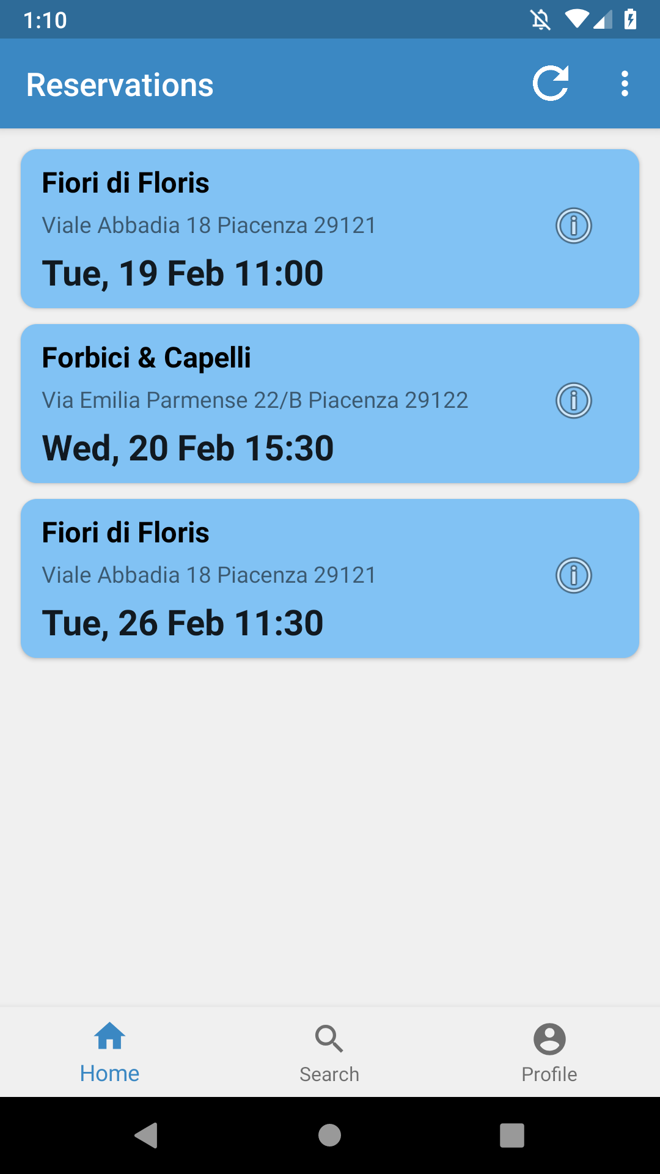
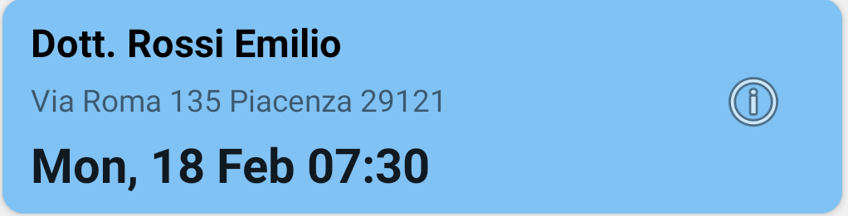
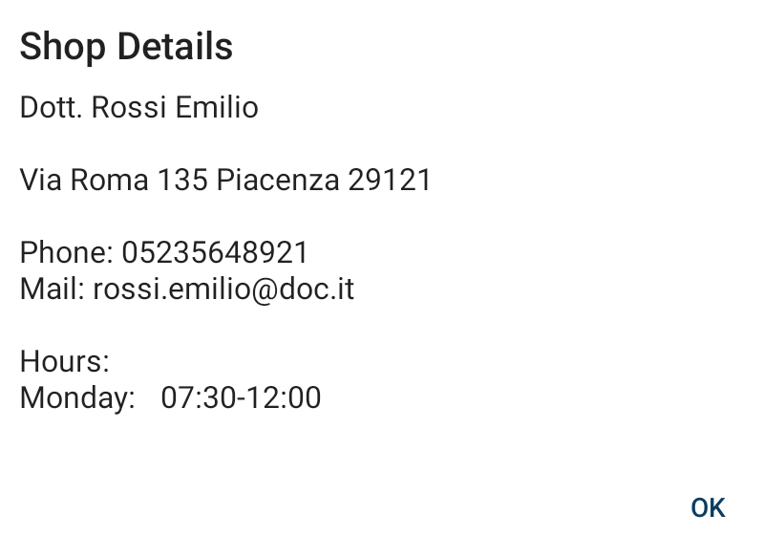
Home screen (5.2 inch phone)
Refresh and
Sign Out
Info button
Recyclerview with custom Cards
Bottom navigation bar

Slide 9
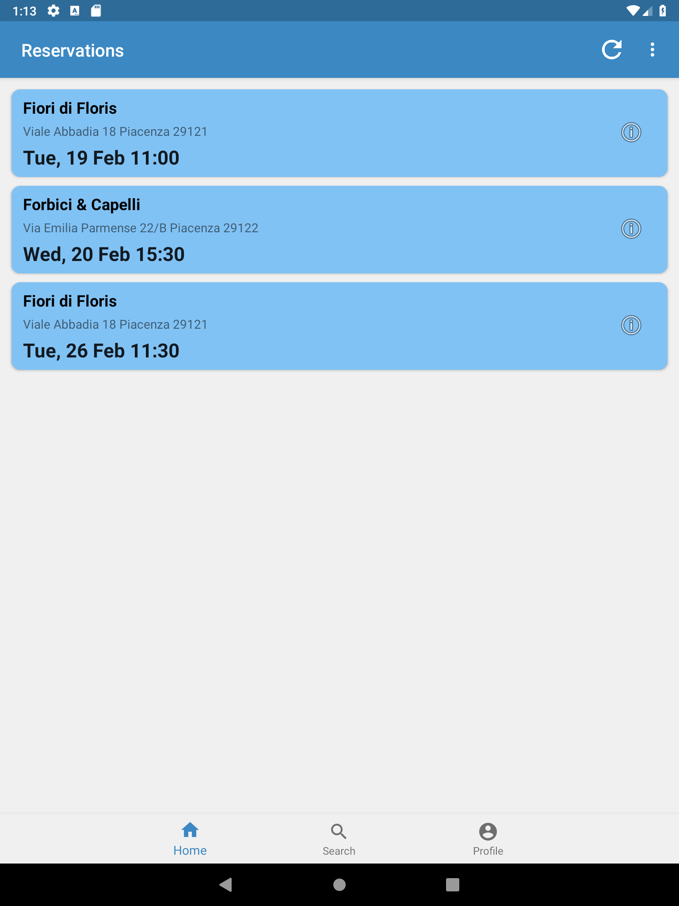
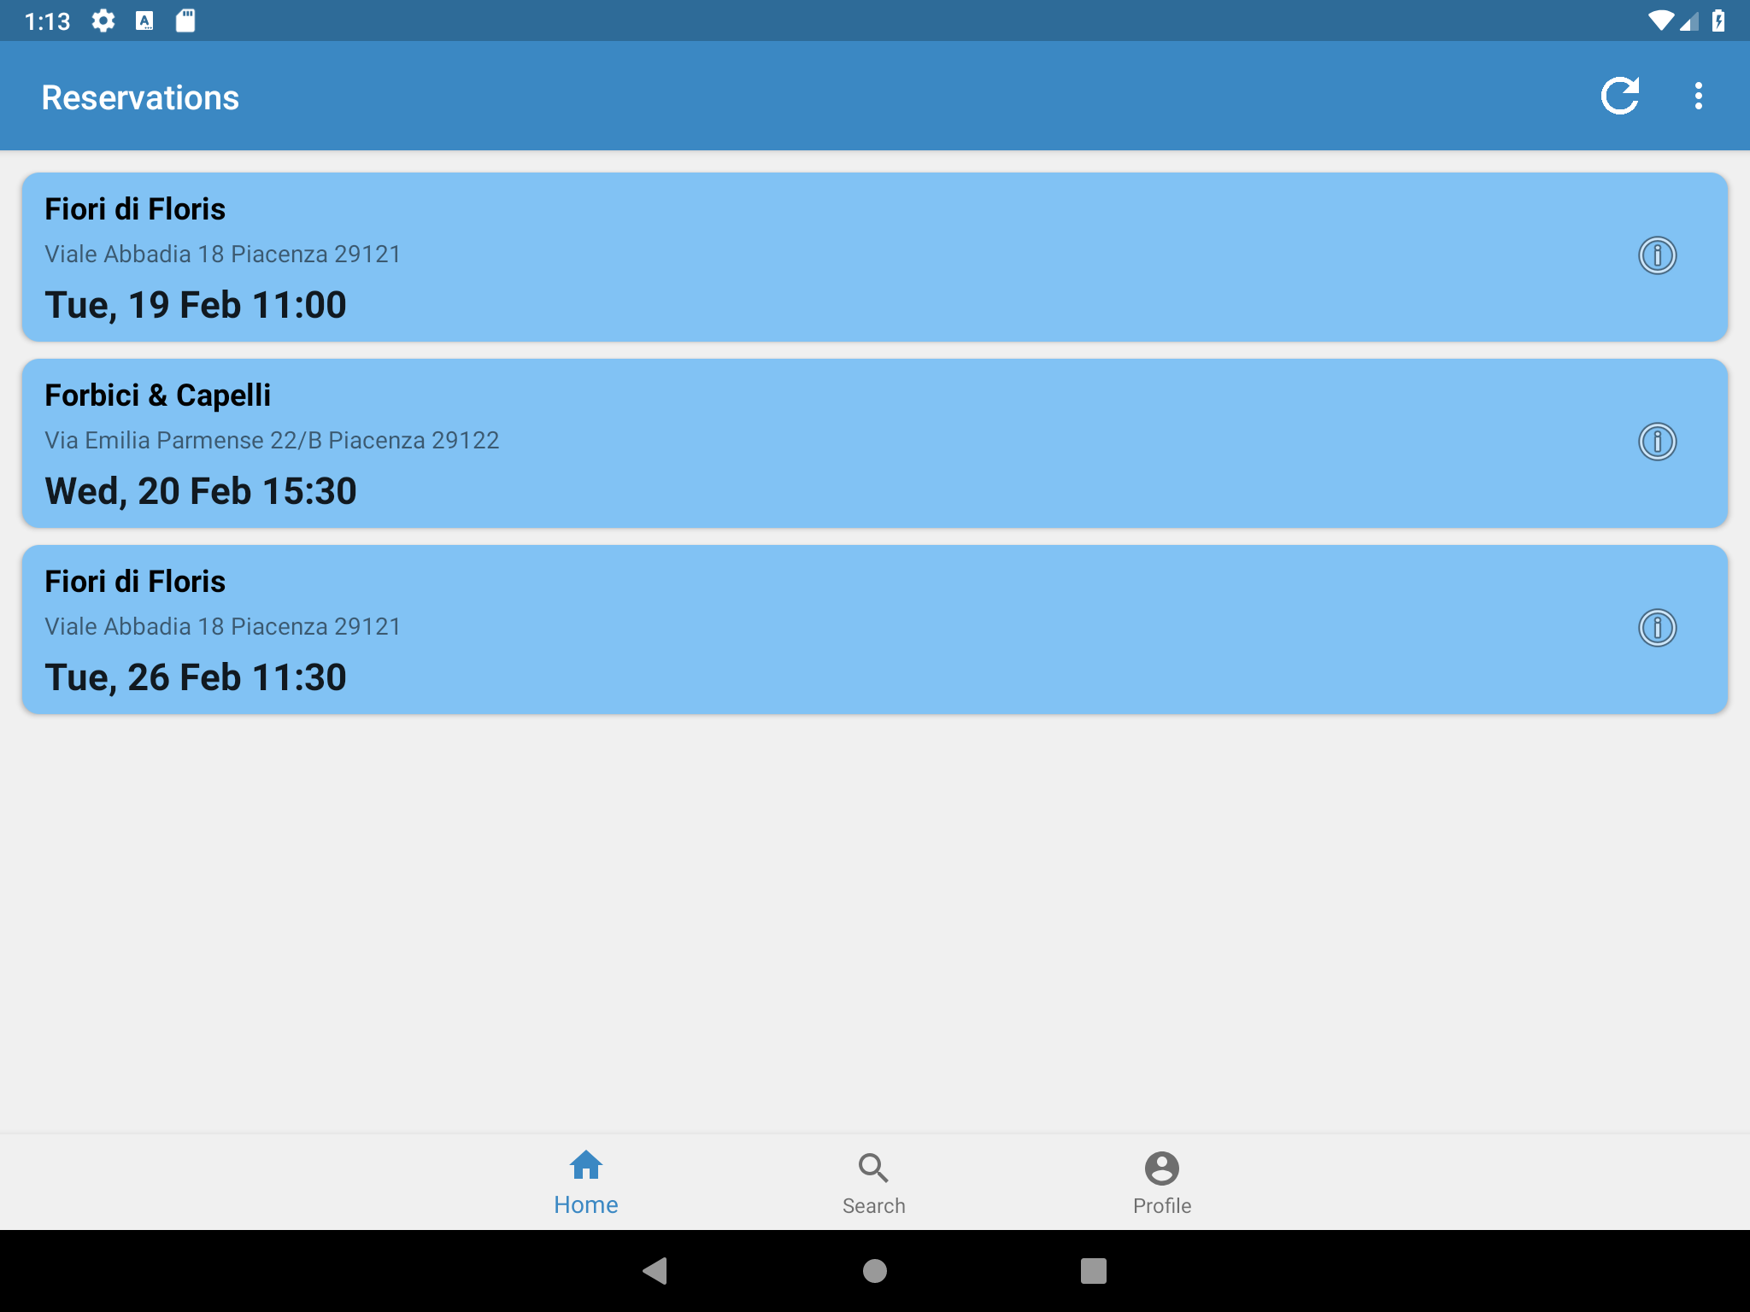
Home screen (8.86 inch tablet)
Portrait
Landscape

Slide 10
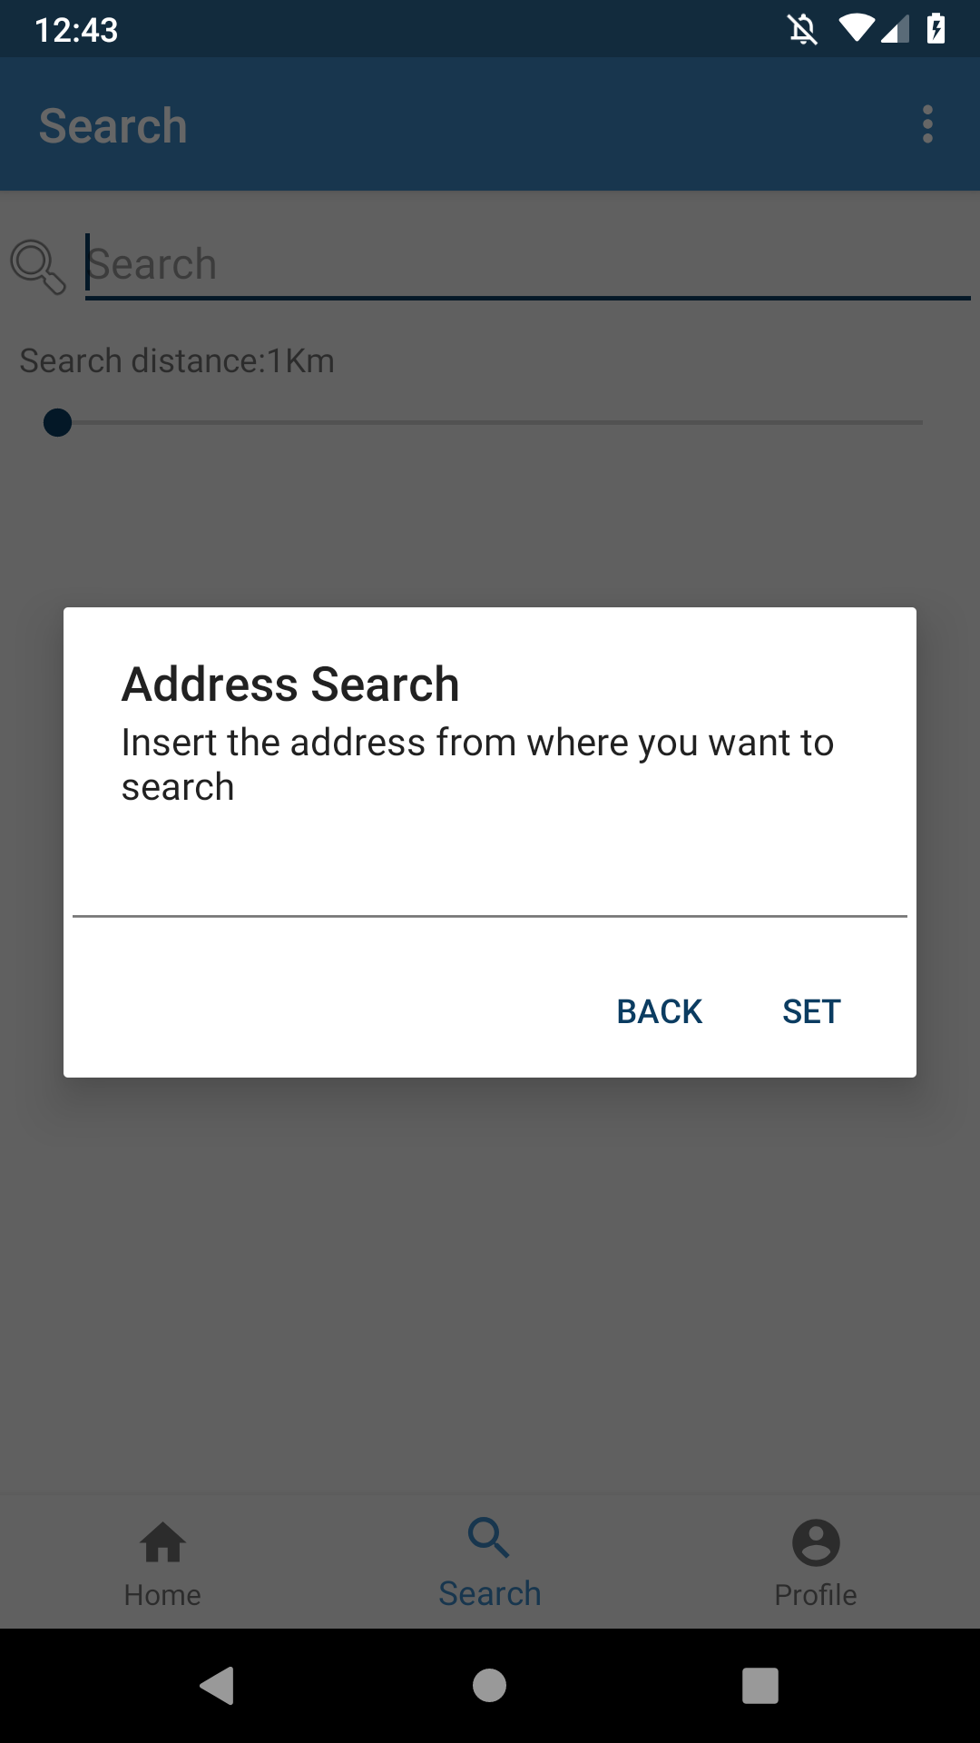
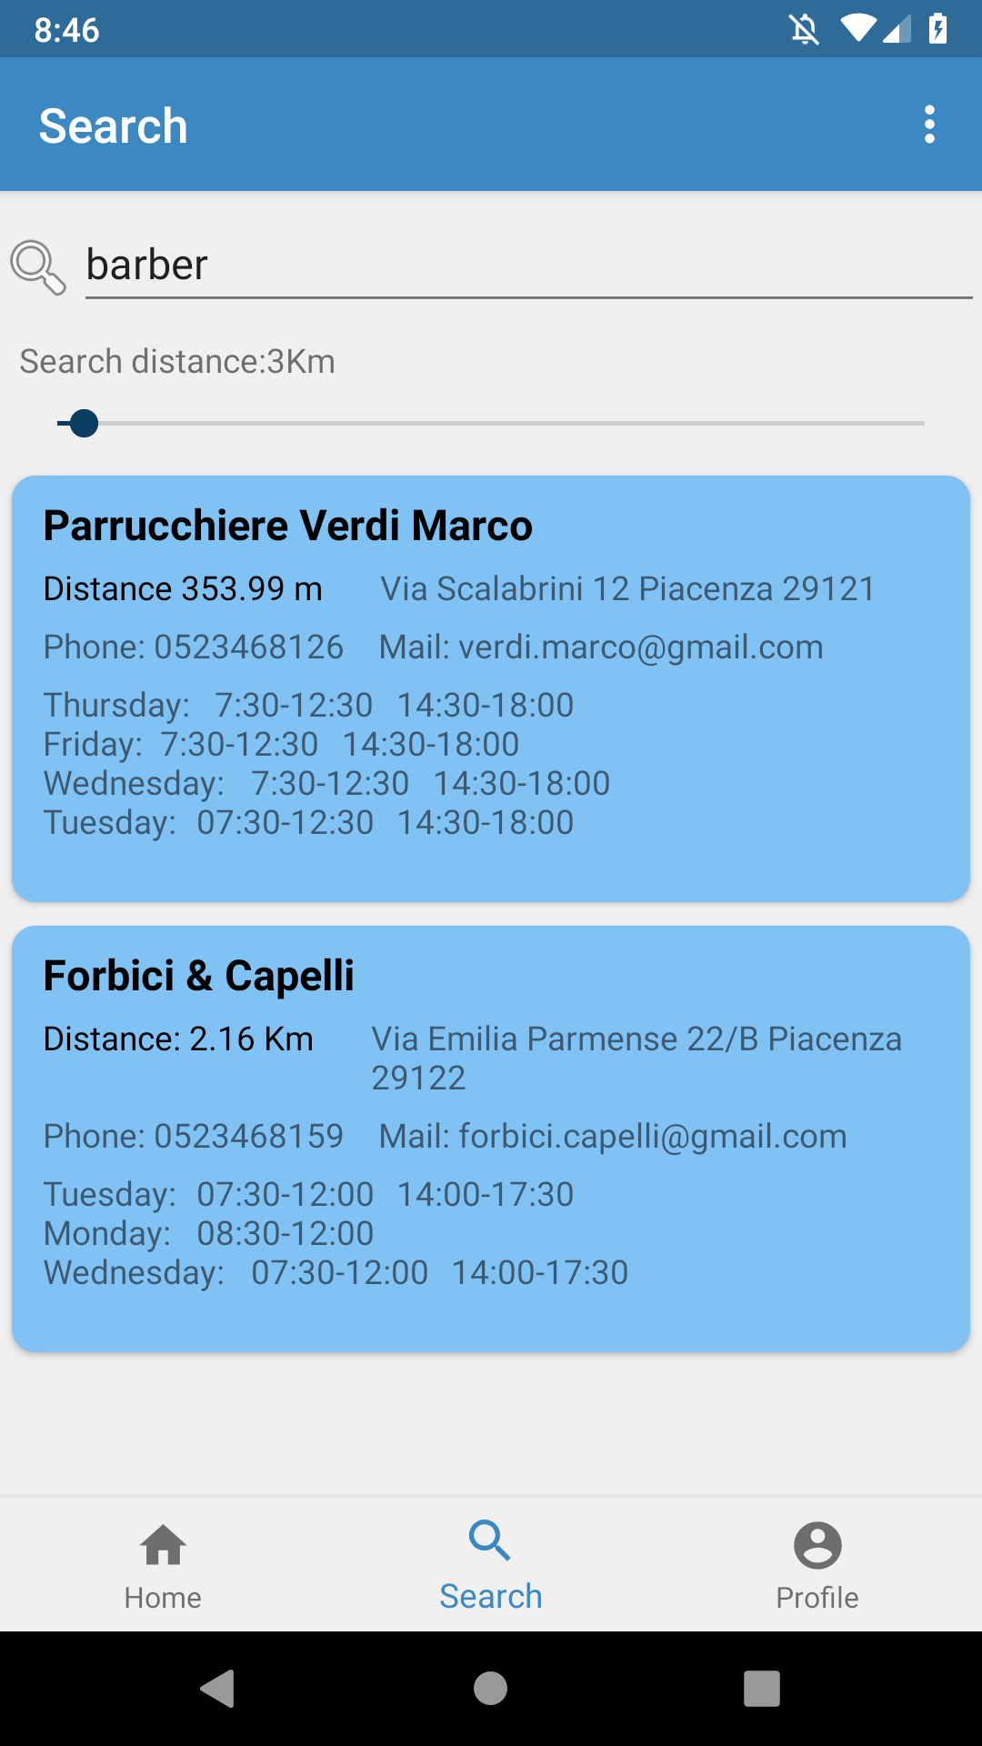
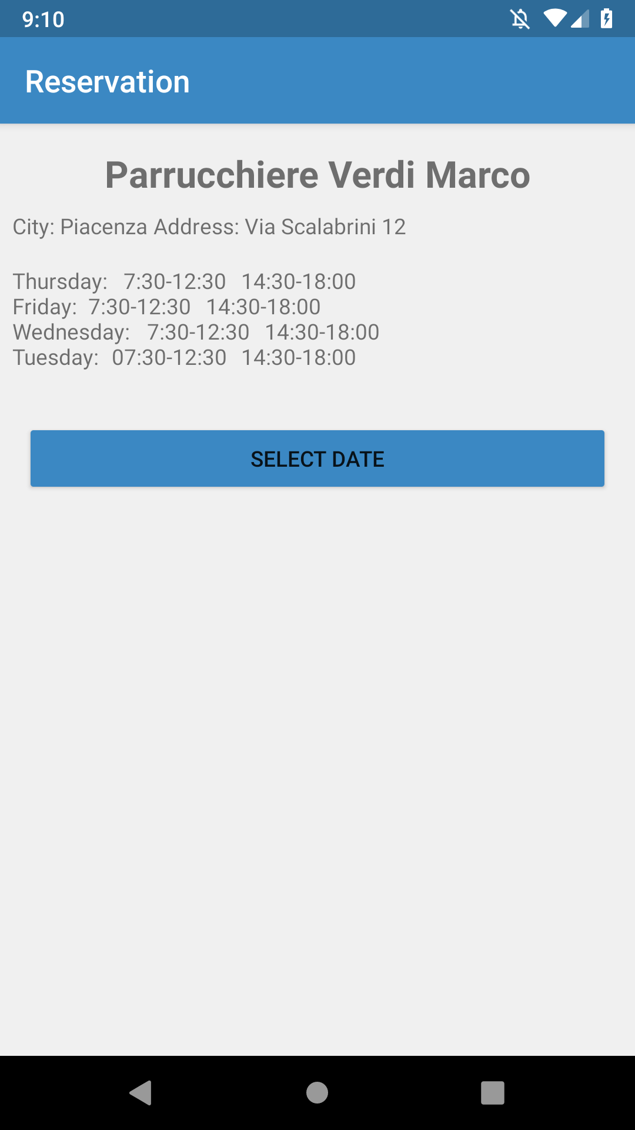
Reservation process (5.2 inch phone)

Slide 11
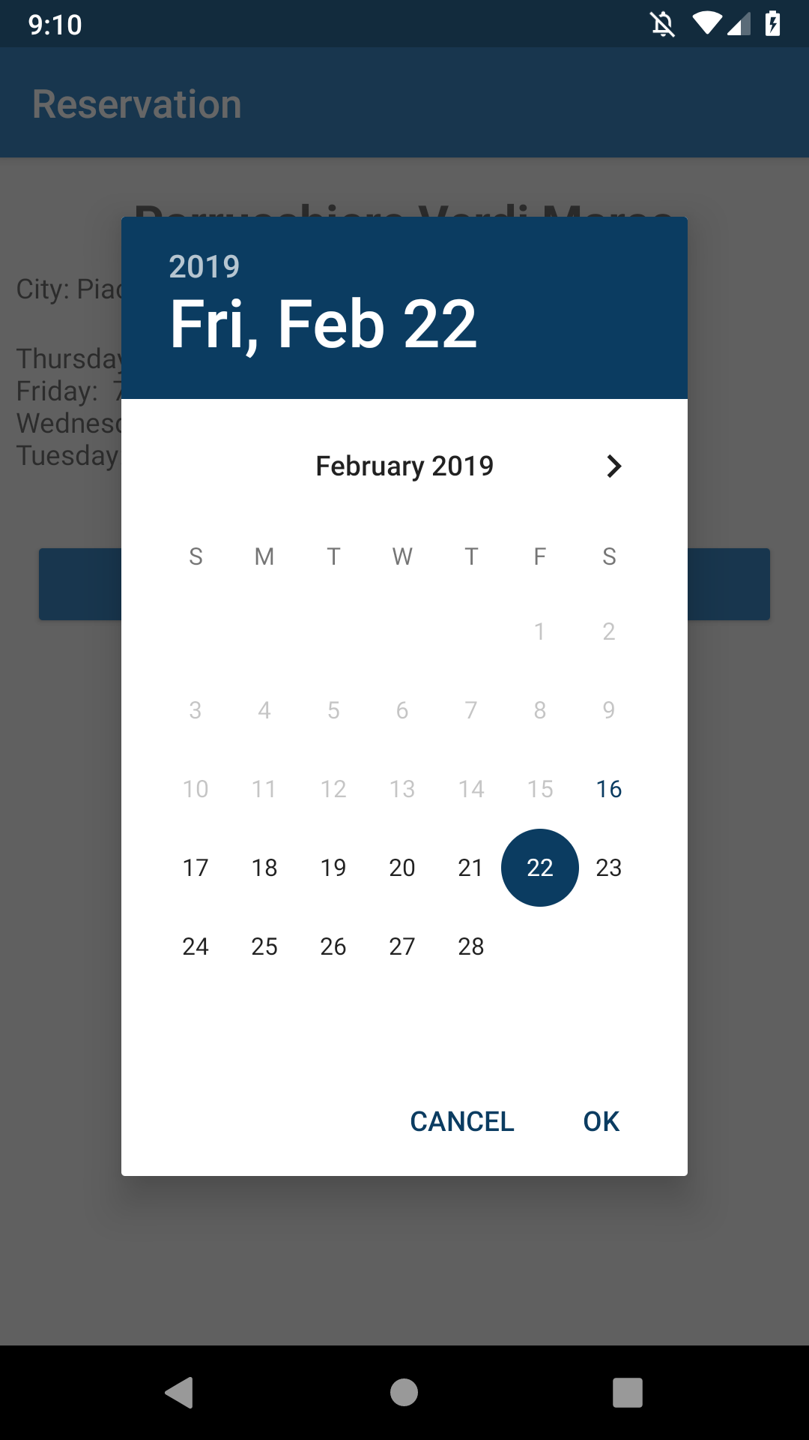
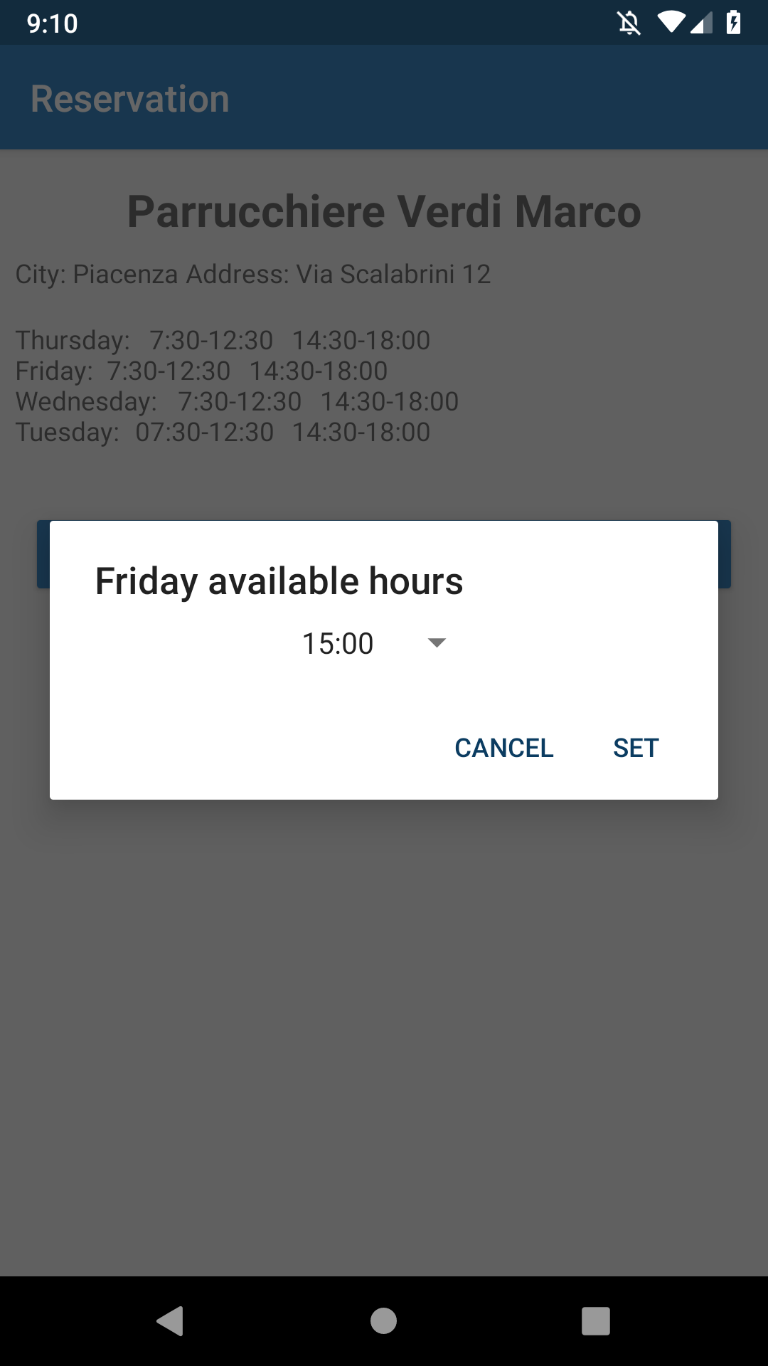
Reservation process (5.2 inch phone)

