Slide 1
Reservation
Design and Implementation of Mobile Applications
2018-2019
Professor Luciano Baresi
RICCARDO FACCHINI
899190
riccardo.facchini@mail.polimi.it

Slide 2
Goals
G.1: Allow anyone that owns a smartphone to become a registered user of the service.
G.2: Allow the customers to search shops and establishments to book a reservation.
G.3: Allow the shop owners to have their shop found by customers whishing to book a reservation.
G.4: Show only the available times to book a reservation.
G.5: Show in the home screen of both kinds of users the next reservations.

Slide 3
Goals (cont.)
G.6: Show in the history screen of both kinds of users the past reservations.
G.7: Allow users to edit their account.
G.8: Allow users to communicate with each other using a chat system.
G.9: Display map views when the customer is looking at a shop.

Slide 4

Platform choice

Slide 5
Android
Minimum sdk version: 23 (Android 6.0 Marshmallow)
Target sdk version: 28 (Android 9.0 Pie)
Coverage of approximately 62.6%
Free and widespread.
Previous knowledge with Java and Android programming.
Personal Android device to test outside simulated environment.
Plenty of material and guides available.

Slide 6

Firebase
Pros:
Free for personal small scale use.
Constantly updated and supported.
Easy to use standard authentication method.
Easy to use Firestore non-relational DB system.
Cons:
Internet access required.
Queries less powerful than standard relational database.

Slide 7
Application design

Slide 8
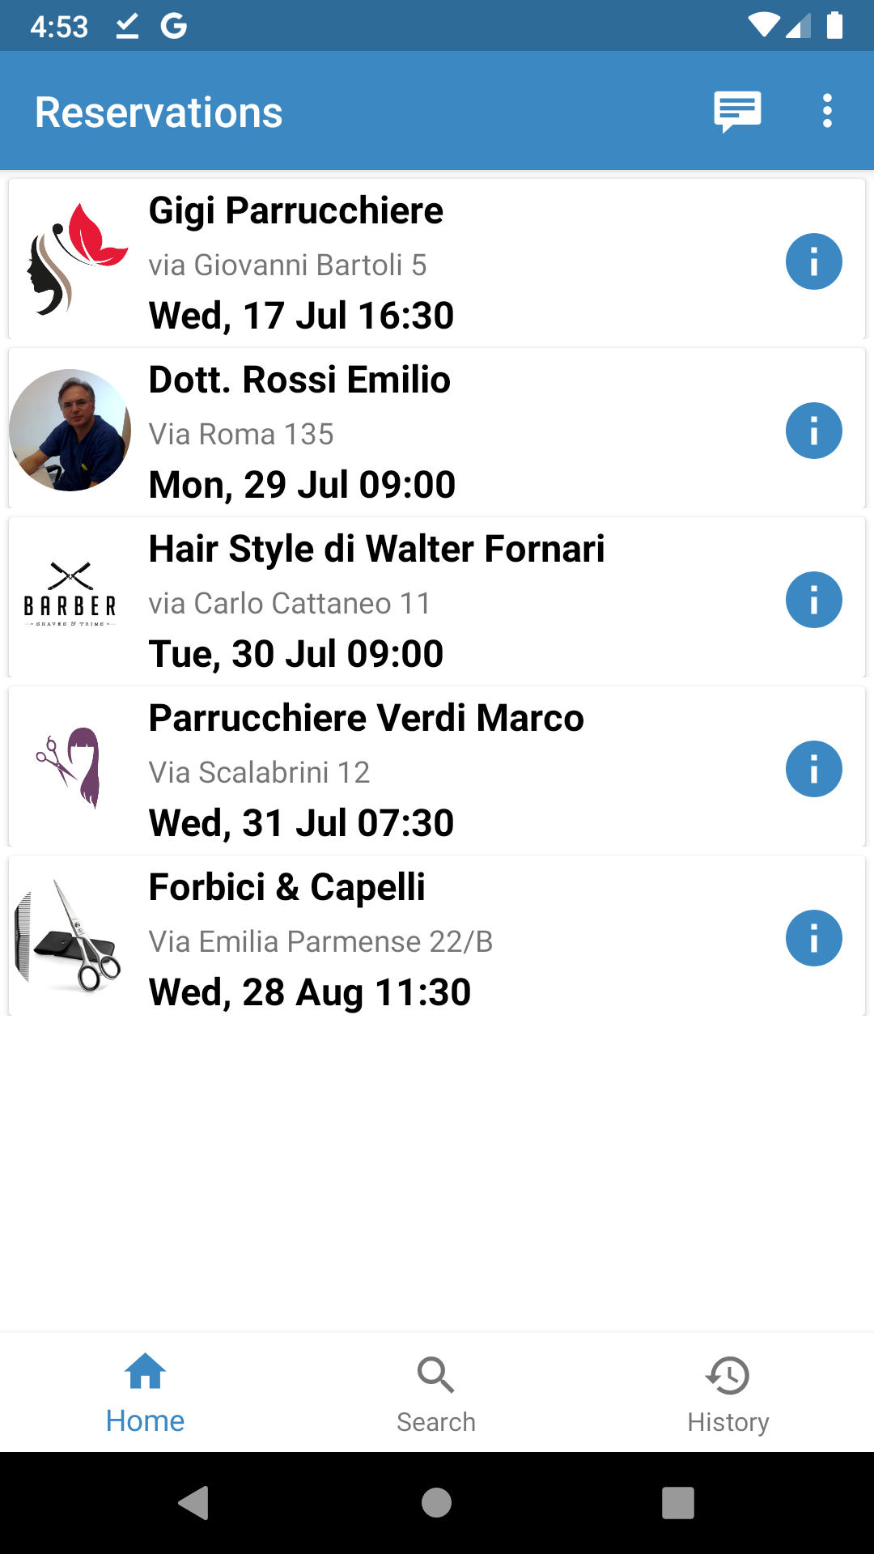

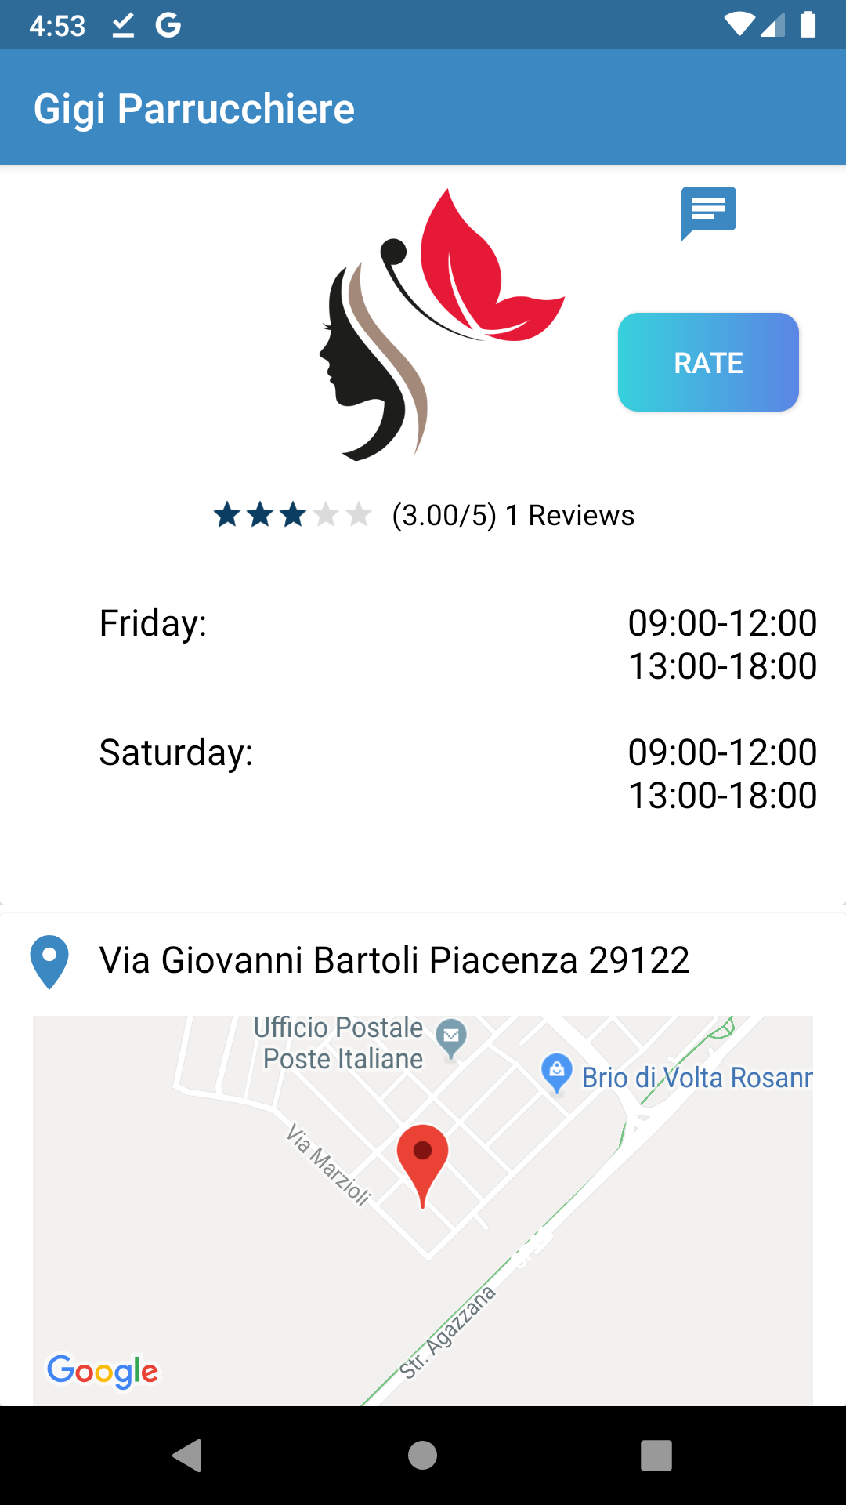
Home screen (5.2 inch phone)
Chat and
Sign Out
Info button
Recyclerview with custom Cards
Bottom navigation bar

Slide 9
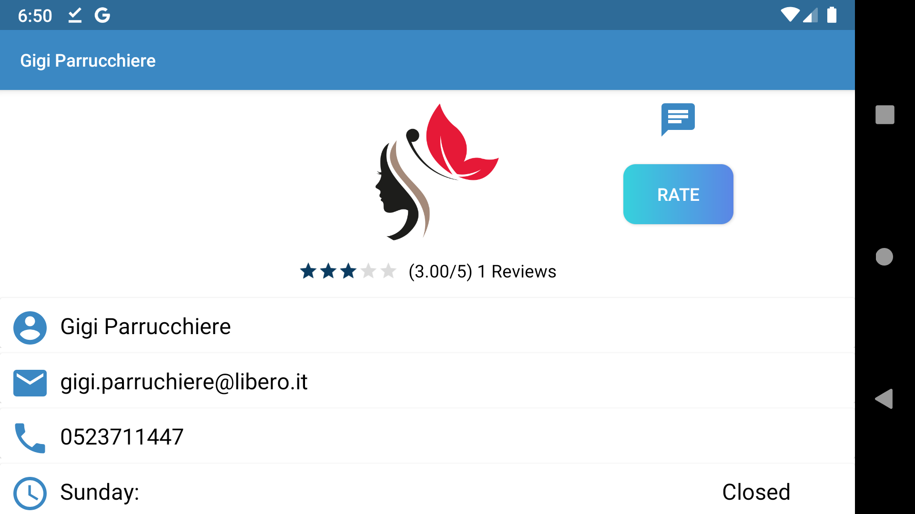
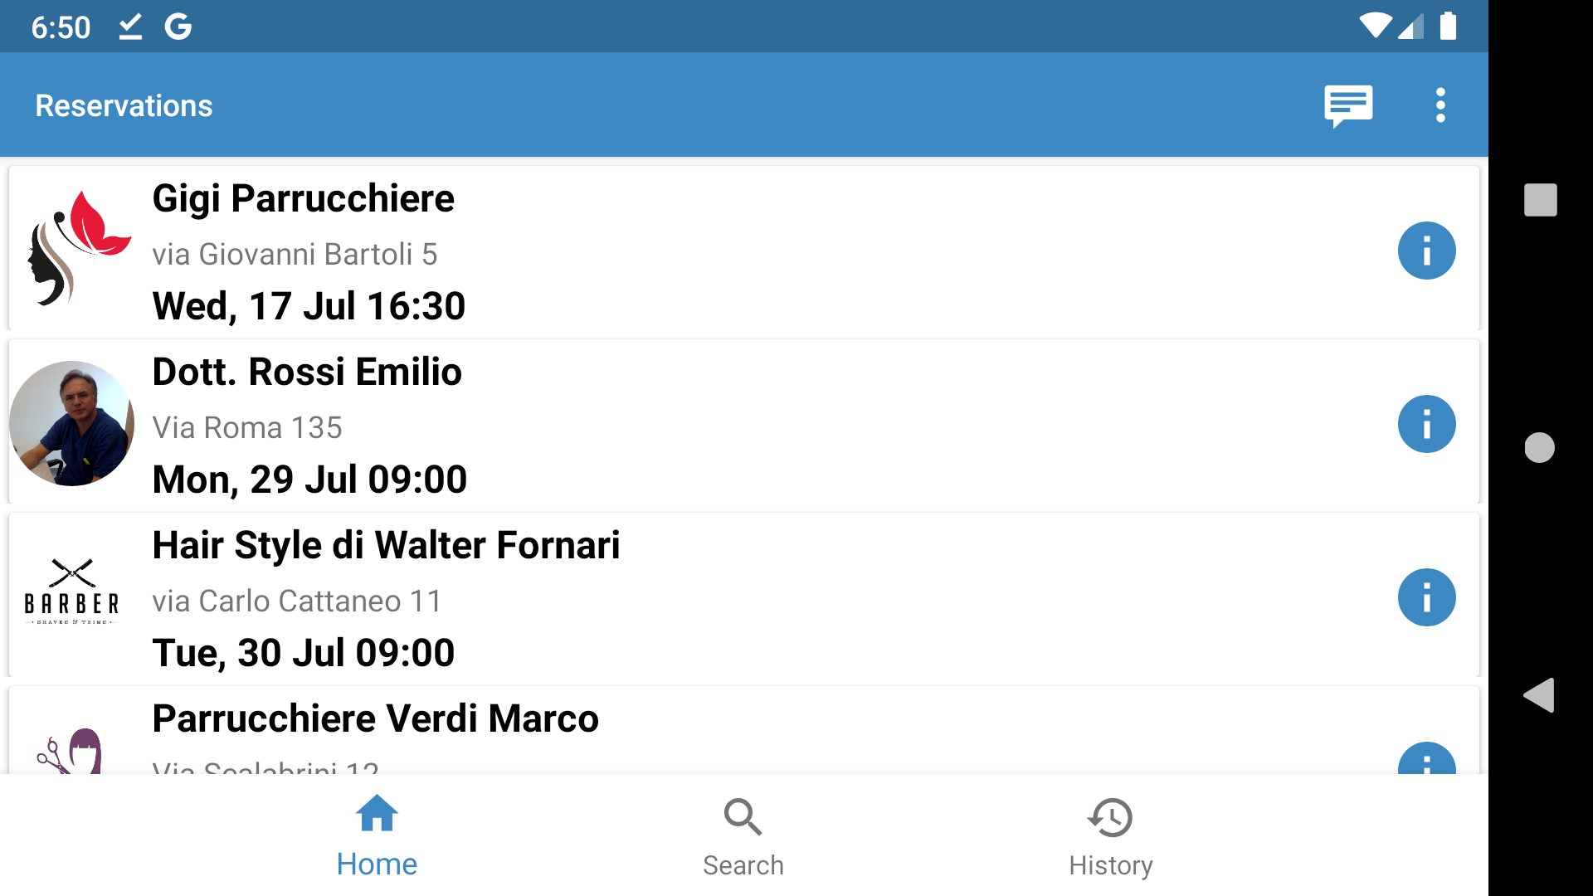
Landscape support

Slide 10
What’s new?

Slide 11
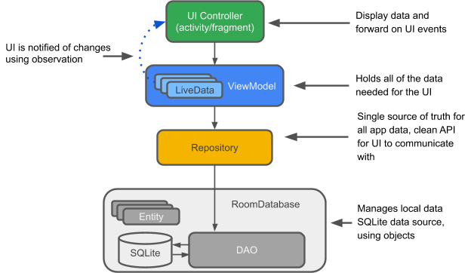
MVVM and Live Data

Slide 12
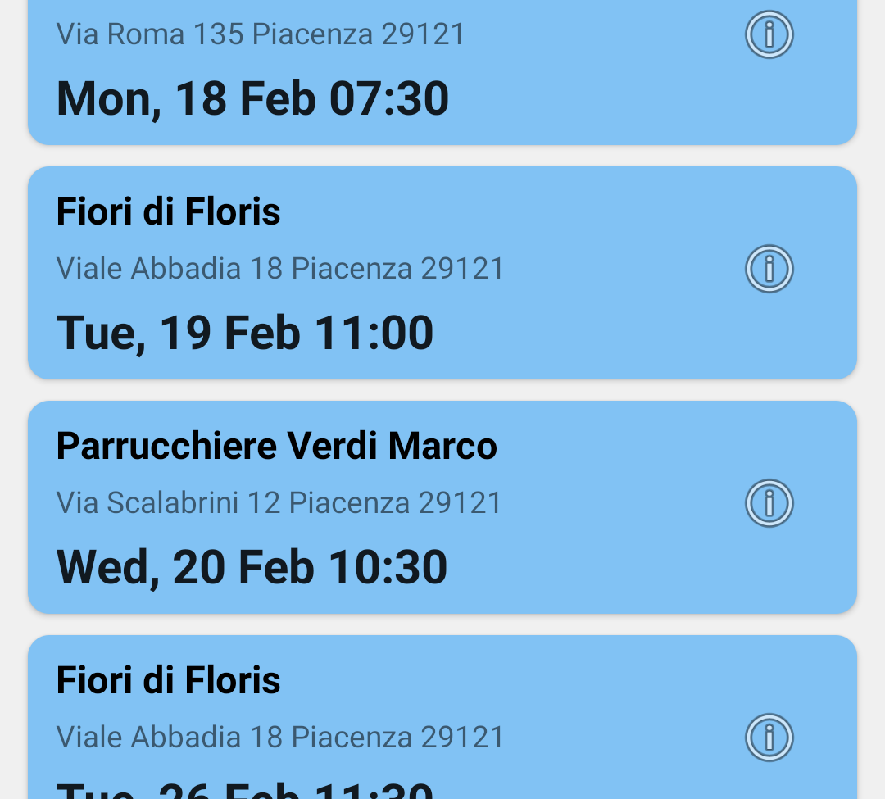
New design

Slide 13
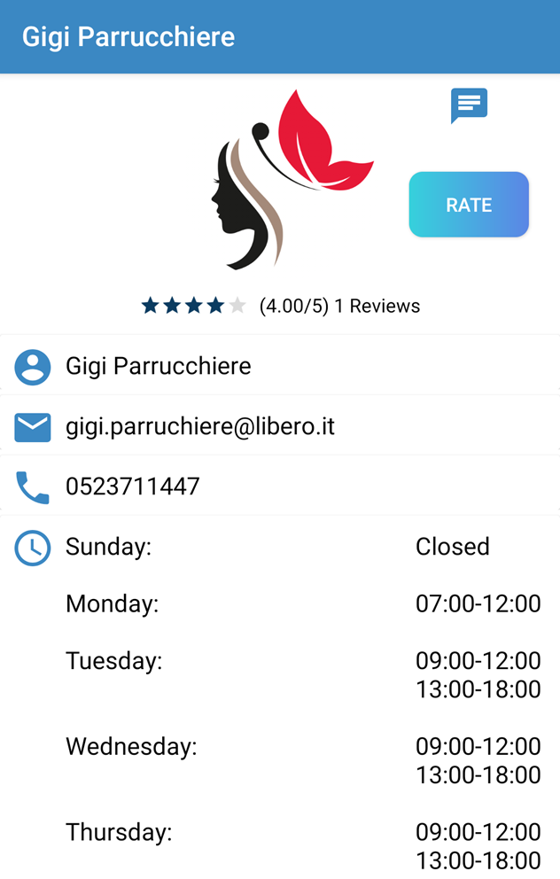
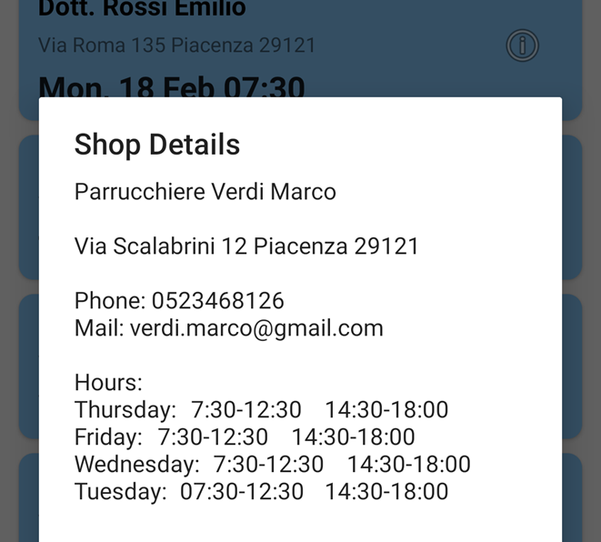
New design (cont.)

Slide 14
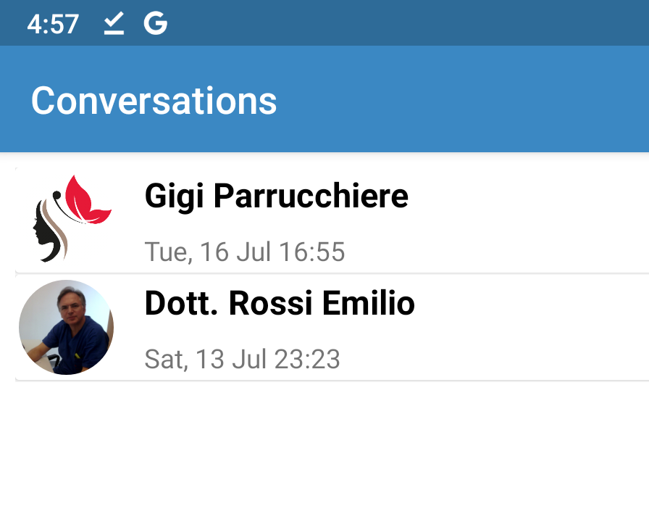
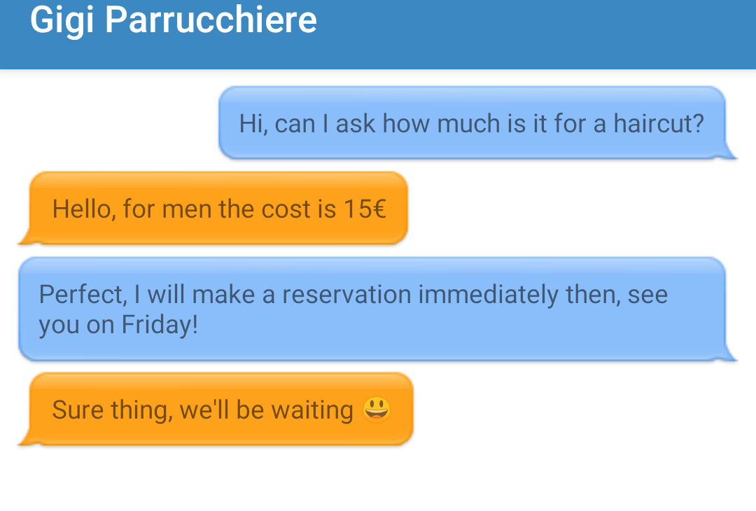
Chat

Slide 15
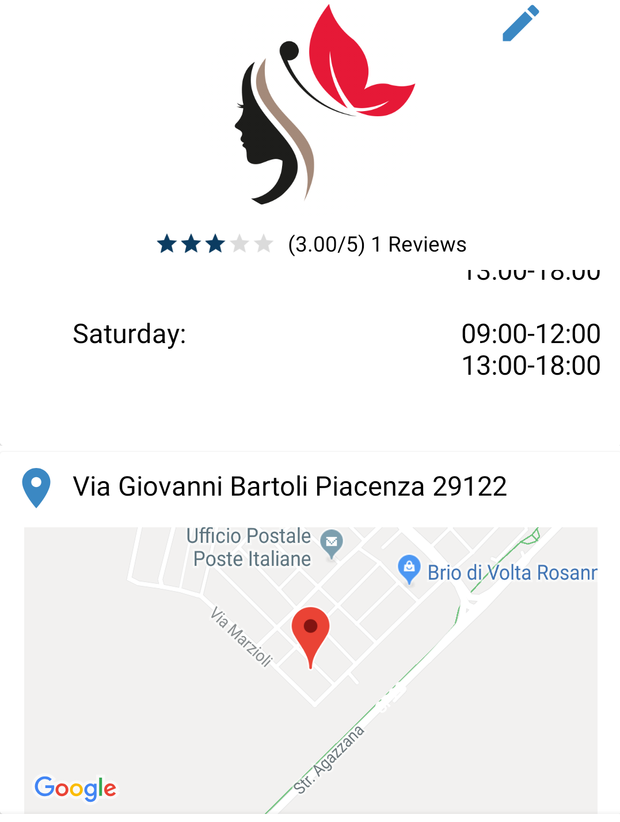
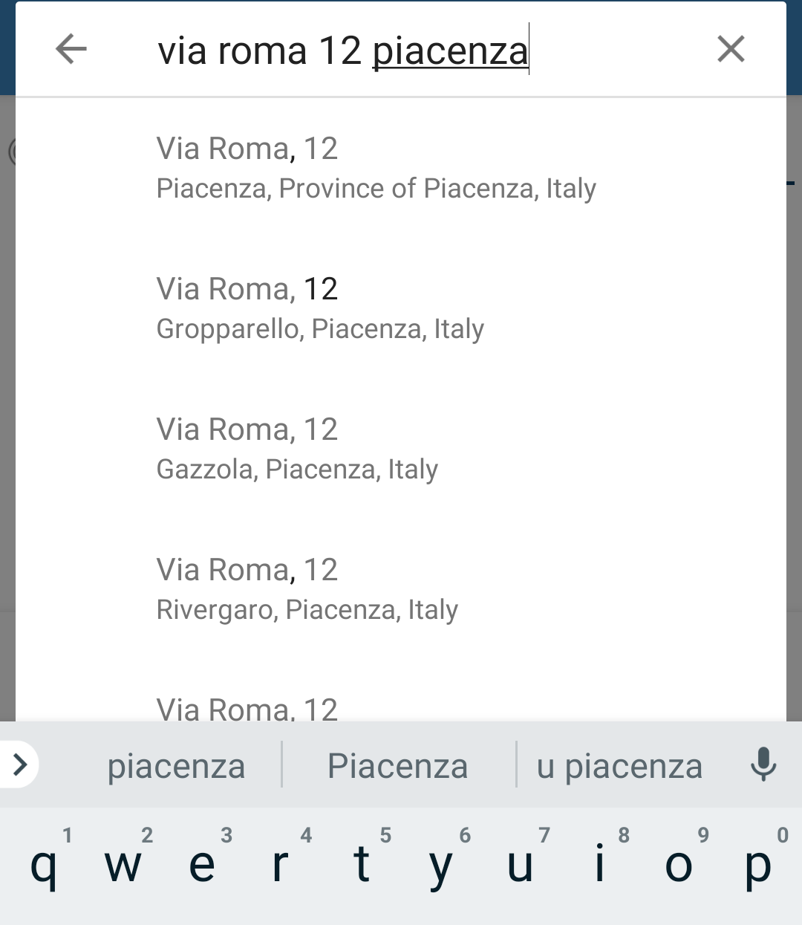
Google Maps Integration

Slide 16
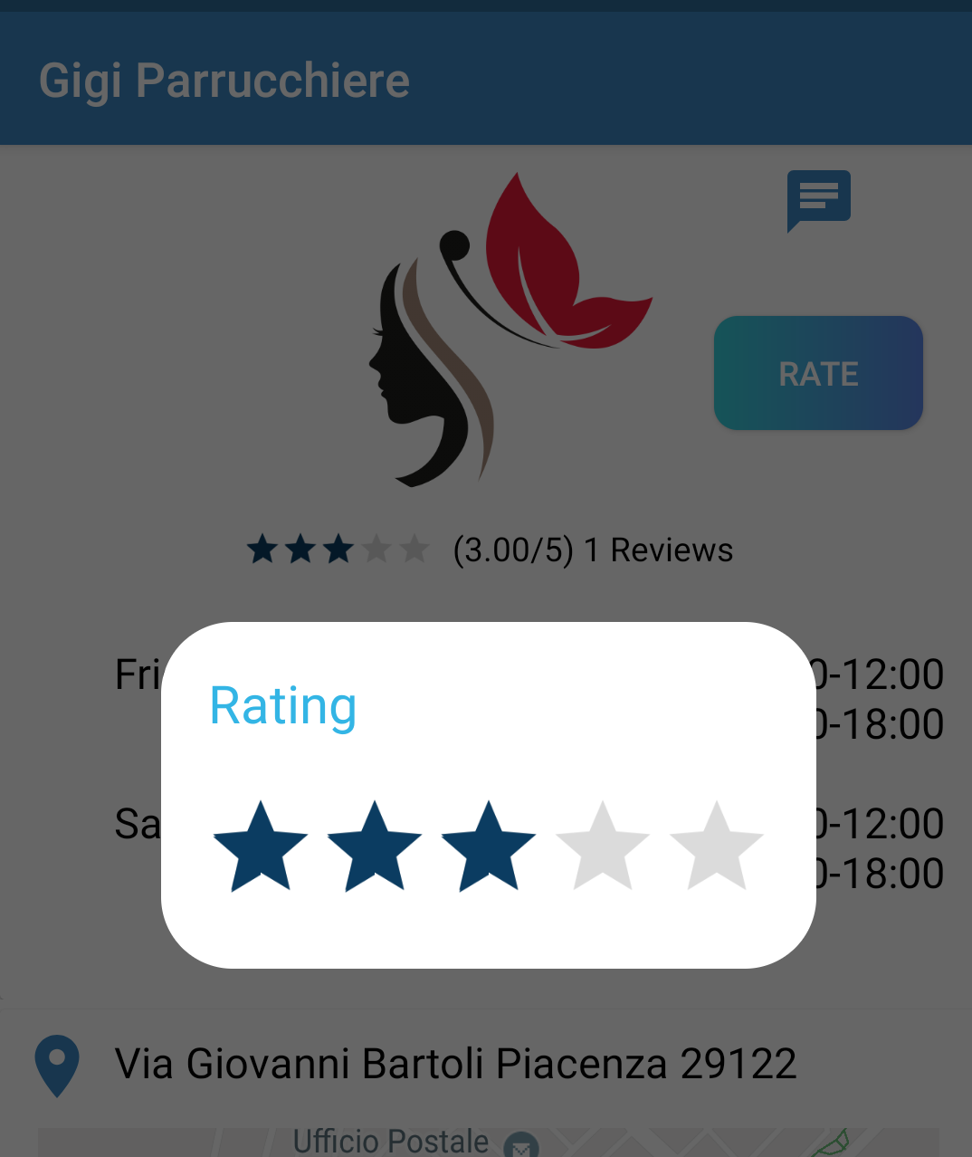
Ratings

Slide 17

Cloud Functions
JavaScript functions that will trigger when a specific event happens.
Useful to execute tasks using the back-end computation power instead of the user’s device.
Used to update average values of reviews and helping with notifications

Slide 18

Notifications
Achieved using Firebase Cloud Messaging and Cloud Functions.
Making a reservation or sending a chat message will trigger a notification if the user doesn’t have the application open.

