Slide 1

Sass
Syntactically Awesome Style Sheets

Slide 2
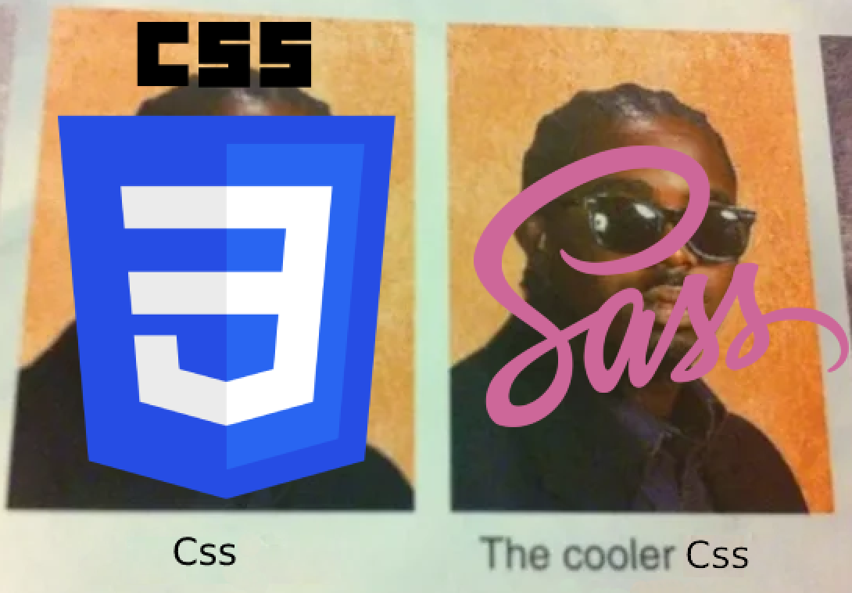
CSS? Sass?

Slide 3
Why it’s awsome
Does everything that CSS does… but better!
Fully compatible with every CSS version
Helps you write better style sheets
Avoid duplicated code
Variables
Split files
And so much more!

Slide 4
How to start
Run the following to create a project:
  npx create-react-app sass-pills --template typescript
  cd .\sass-pills\
  npm install node-sass@4.14.1
  npm start

Slide 5

Enough slides, show us the code already!
Official website: https://sass-lang.com/

