Slide 1
Aerospace Control Systems Exam Project
Robust control of the lateral dynamics of a multirotor UAV
Caironi Giacomo 10778766
Caccia Riccardo 10811815
Prof. Marco Lovera
A.Y. 2024-2025

Slide 2
Introduction
Assignement Overview
System Model
Performance Requirements
Closed-Loop Analysis
Robust Stability
Robust Performance
Montecarlo Analysis
Conclusions

Slide 3
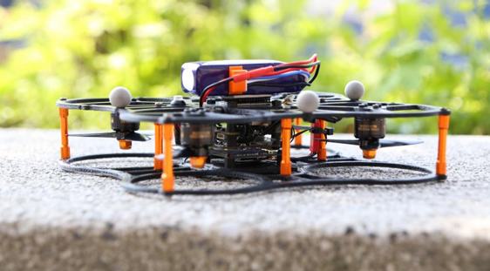
Assignement Overview
The ANT-X quadrotor is a small quadrotor drone designed for research and education.
Grey-box models of ANT-X have been identified from flight test data and are available for control law design.
The project task is to design and verify a robust single-axis attitude control system for the ANT-X quadrotor.

Slide 4

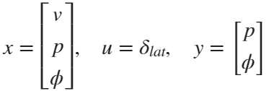
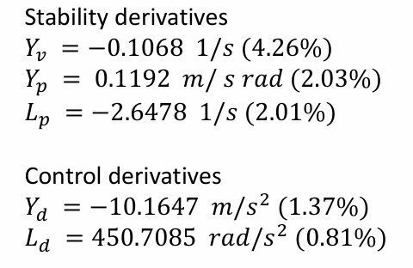
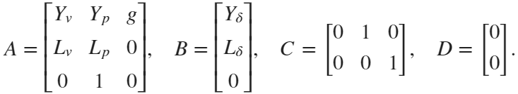

System Model

Slide 5
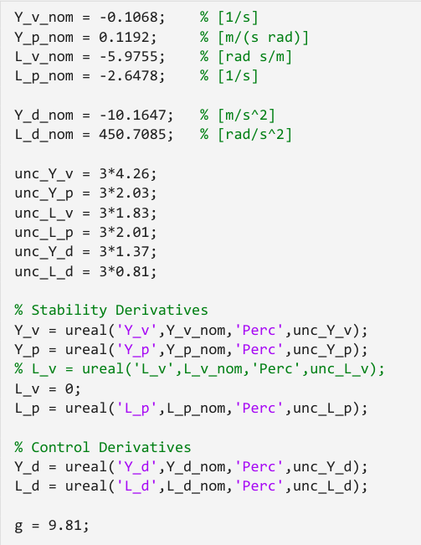
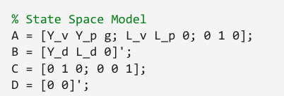
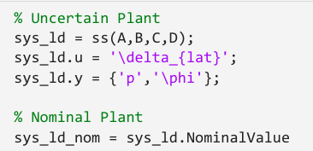

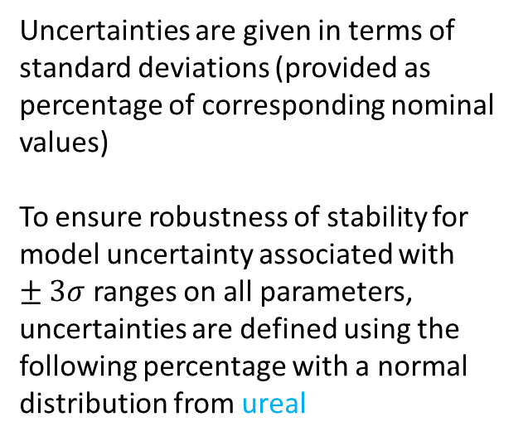
System Model
Uncertainties are given in terms of standard deviations (provided as percentage of corresponding nominal values)
To ensure robustness of stability for model uncertainty associated with $±3σ$ ranges on all parameters, uncertainties are defined using the following percentage with a normal distribution from ureal

Slide 6
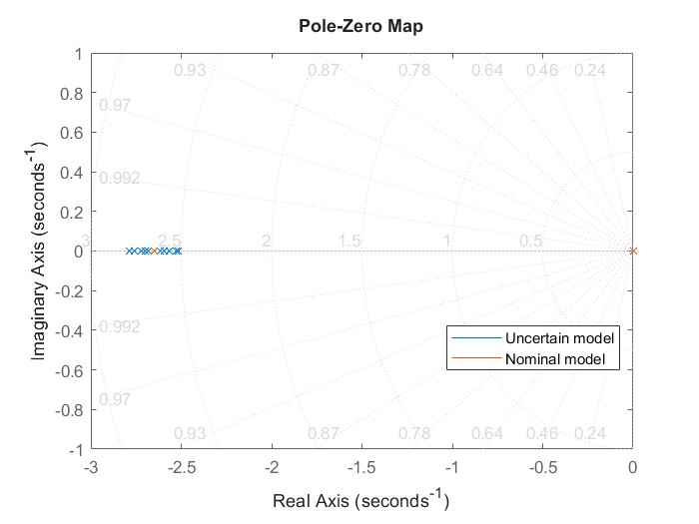
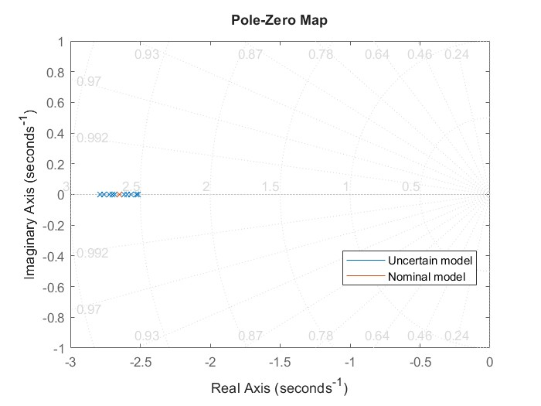
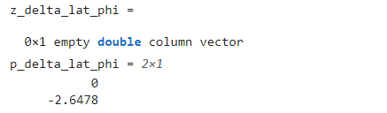

System Model – Poles and Zeros

Slide 7
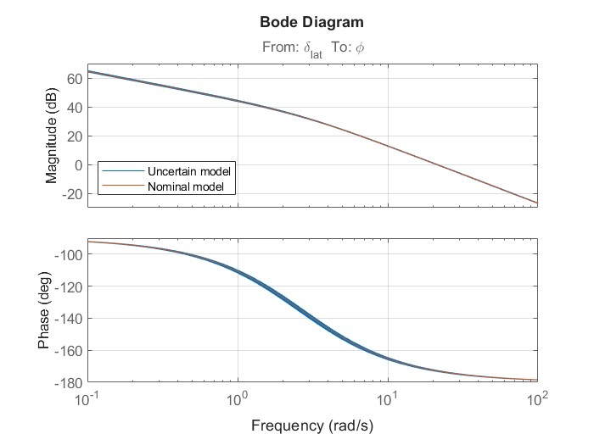
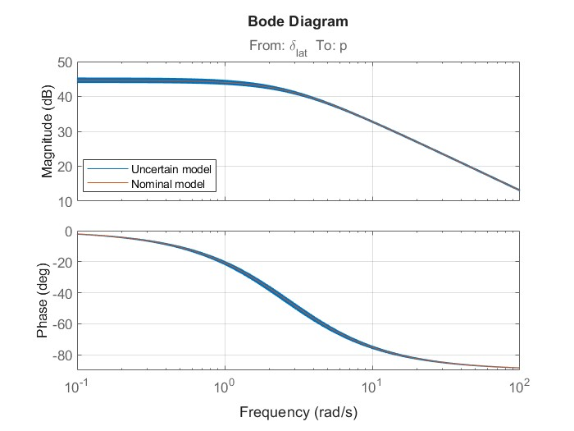
System Model – Bode Plot

Slide 8
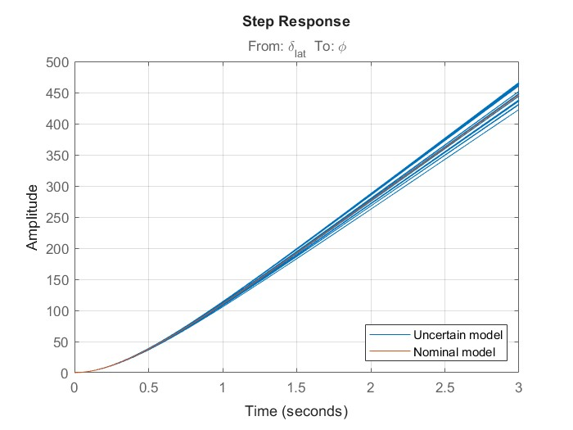
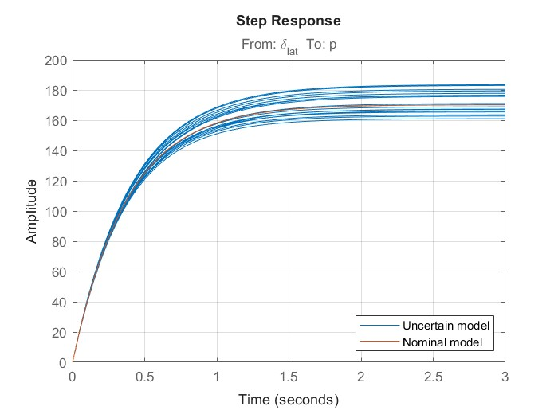
System Model – Step Response

Slide 9
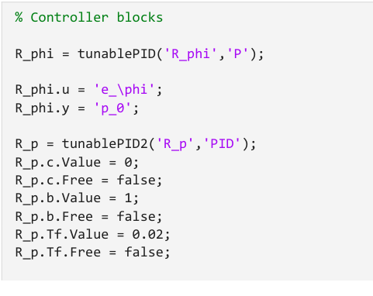
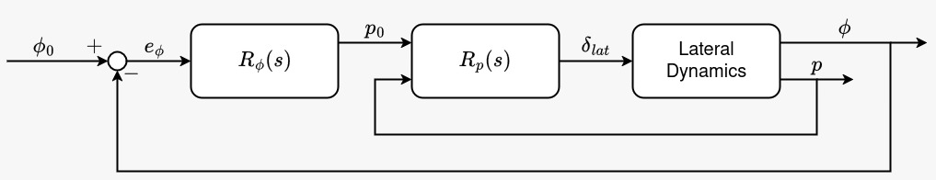

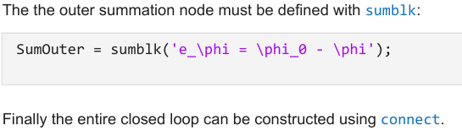

System Model - Closed Loop
The controller used for the lateral dynamics of the quadrotor is composed by a P - PID cascade
where the outer proportional controller for the roll angle R𝜑(𝑠) is:
p0 =𝐾𝜑𝑒𝜑 with 𝑒𝜑 = 𝜑0− 𝜑
and the inner PID controller for the roll rate 𝑅𝑝(𝑠) is:
with 𝑇𝑝=0,02 s 𝑒𝑝 = P0 − P

Slide 10
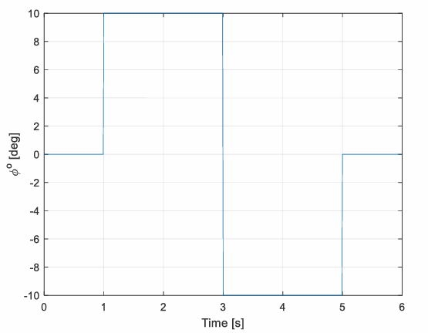
Performance Requirements
Nominal performance: response of 𝜑 to variations in 𝜑0 equivalent to a second order response with 𝜔𝑛 ≥ 10 rad/s and 𝜉 ≥ 0.9.
Control effort limitation: |𝛿𝑙𝑎𝑡| ≤ 0.05 fo for a given doublet change in 𝜑0 (with 10*(π/180) rad amplitude) given by →
Robust stability: ensure robustness of stability to model uncertainty associated with ranges on all parameters, treated as deterministic bounds (this will be analyzed separately)

Slide 11
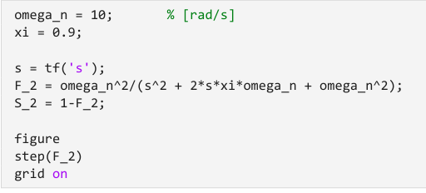

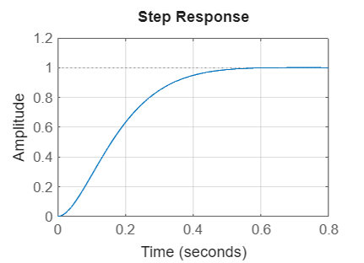
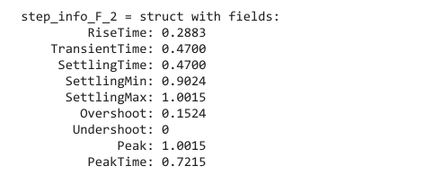
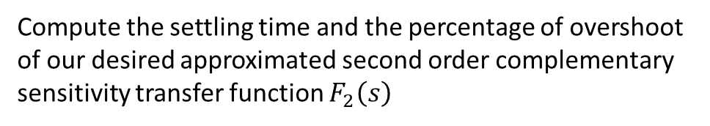
Performance Requirements - Nominal Performance
Compute the settling time and the percentage of overshoot of our desired approximated second order complementary sensitivity transfer function $F_{2}\left(s\right)$

Slide 12
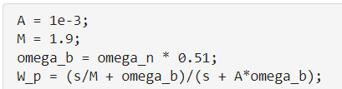
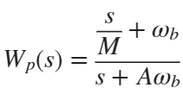
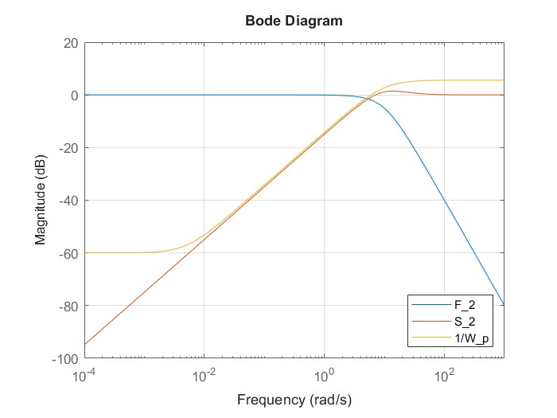
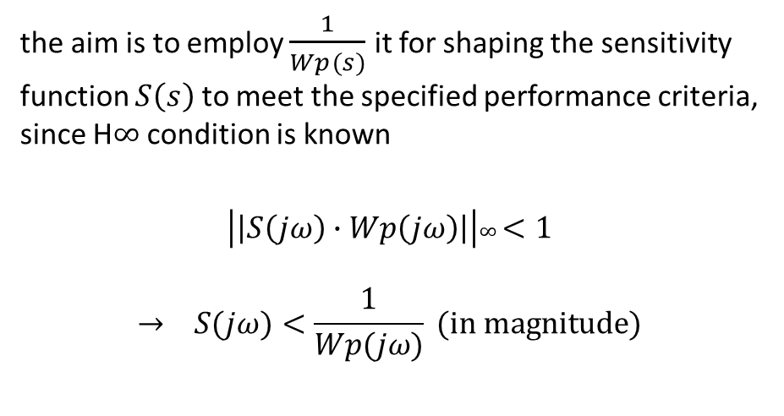
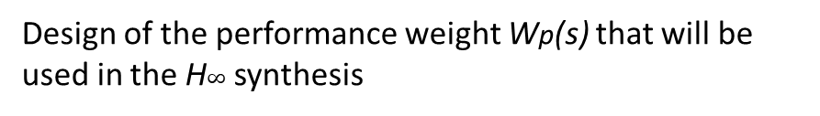
Performance Requirements – Nominal Performance
Design of the performance weight Wp(s) that will be used in the H$∞$ synthesis
Where M is related to the peak, A is related to the value at steady state and ωp is related to the cross-over frequency and so to the settling time of our response.
the aim is to employ $\frac{1}{Wp(s)}$ it for shaping the sensitivity function $S\left(s\right)$ to meet the specified performance criteria, since H$∞$ condition is known
$$\left|\left|S\left(jω\right)∙Wp\left(jω\right)\right|\right|∞<1$$
$$→ S(jω)<\frac{1}{Wp(jω)} (\text{in} \text{magnitude})$$

Slide 13
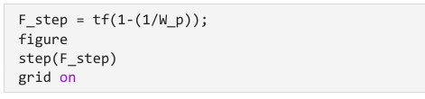
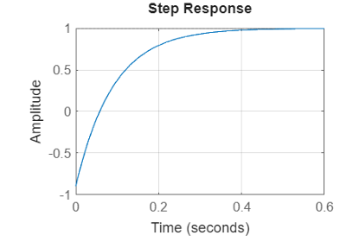
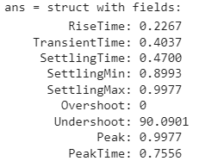
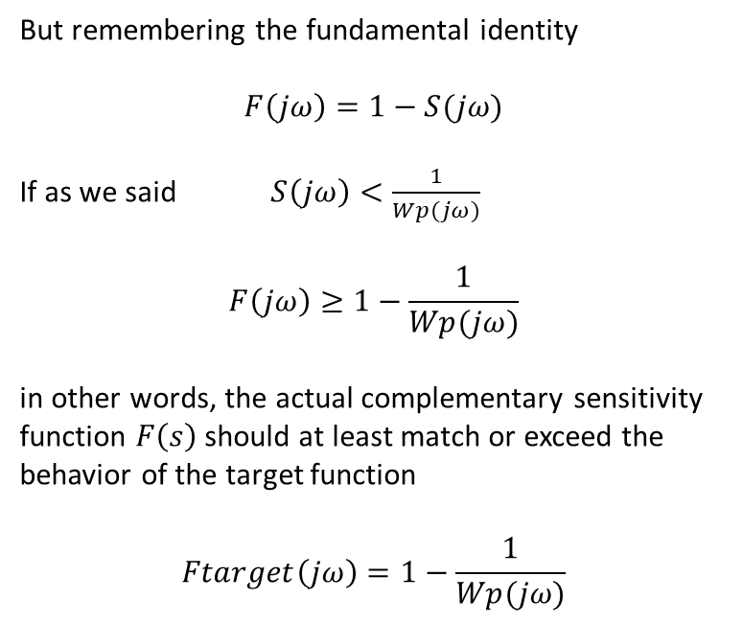
Performance Requirements – Nominal Performance
But remembering the fundamental identity
$$F\left(jω\right)=1−S(jω)$$
If as we said $S\left(jω\right)<\frac{1}{Wp(jω)}$
$$F\left(jω\right)≥1−\frac{1}{Wp(jω)}$$
in other words, the actual complementary sensitivity function $F\left(s\right)$ should at least match or exceed the behavior of the target function
$$Ftarget\left(jω\right)=1−\frac{1}{Wp(jω)}$$

Slide 14
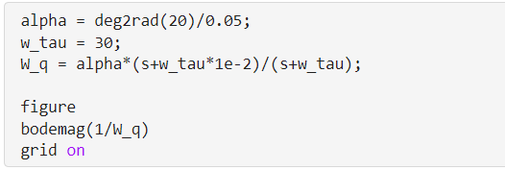
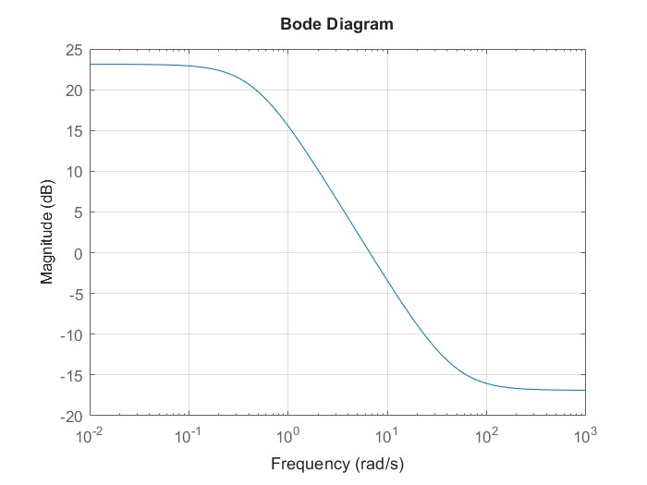

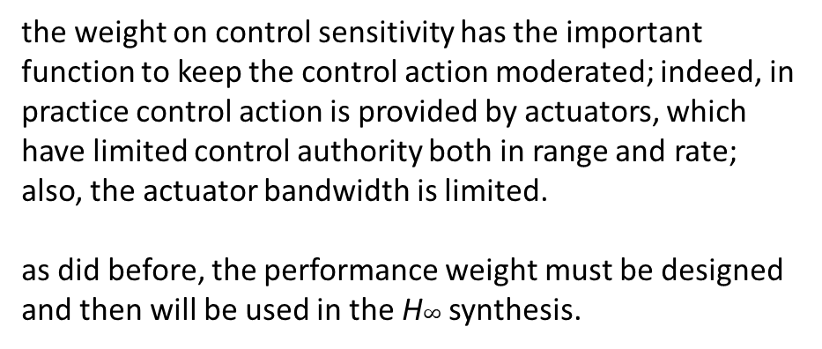
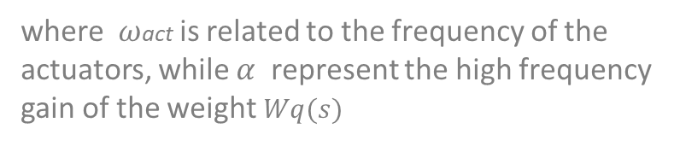
Performance Requirements – Control Effort
the weight on control sensitivity has the important function to keep the control action moderated; indeed, in practice control action is provided by actuators, which have limited control authority both in range and rate; also, the actuator bandwidth is limited.
as did before, the performance weight must be designed and then will be used in the H$∞$ synthesis.
where $ω$act is related to the frequency of the actuators, while $α$ represent the high frequency gain of the weight $Wq(s)$

Slide 15

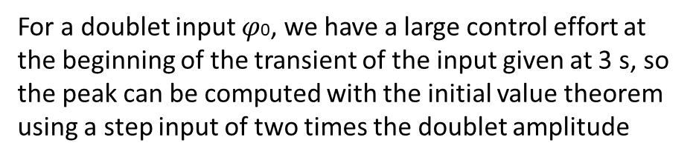
Performance Requirements – Control Effort
For a doublet input $φ$0, we have a large control effort at the beginning of the transient of the input given at 3 s, so the peak can be computed with the initial value theorem using a step input of two times the doublet amplitude

Slide 16
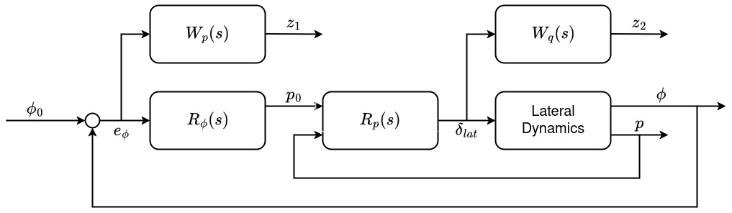
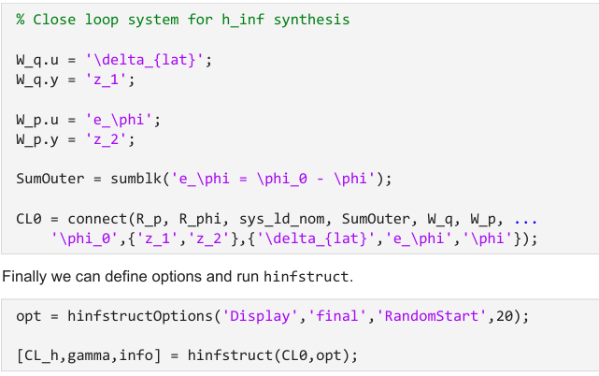
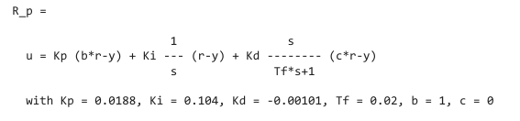
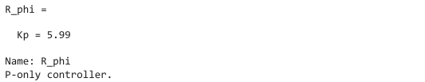
Closed-Loop Analysis
Now it’s possible to create a full closed loop and tune the controllers with $H_{∞}$ sintesys.
Through hinfstruct function we can tune the free parameters of the closed loop model to minimize its norm.

Slide 17
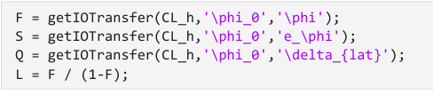
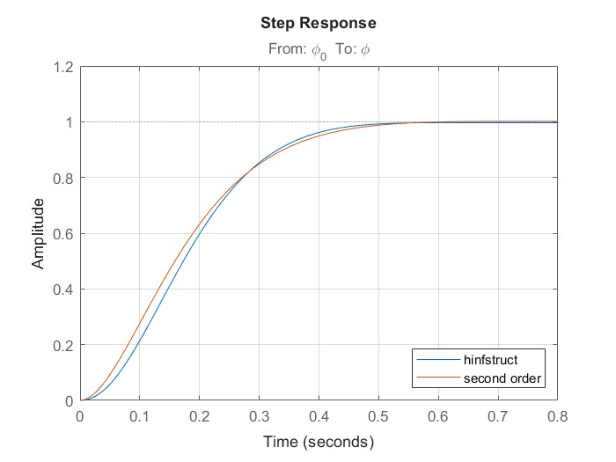
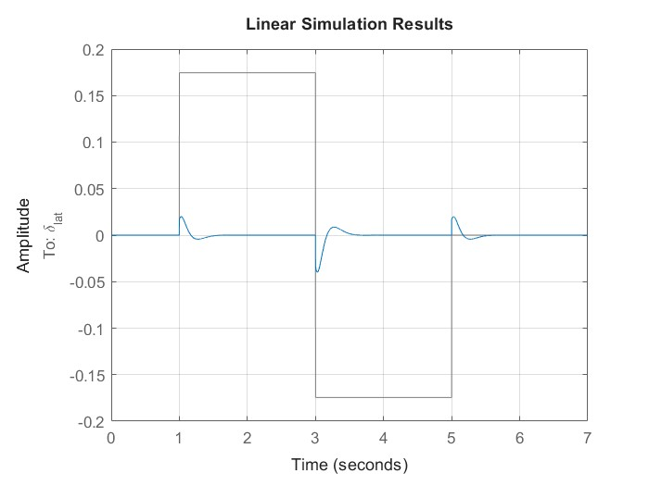
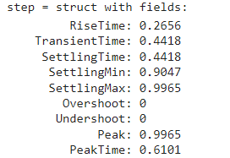

Closed-Loop Analysis – Nominal Time Response
Retrive the different functions →
Plot the step response and compare it to the desired one
Verify control effort limitation

Slide 18
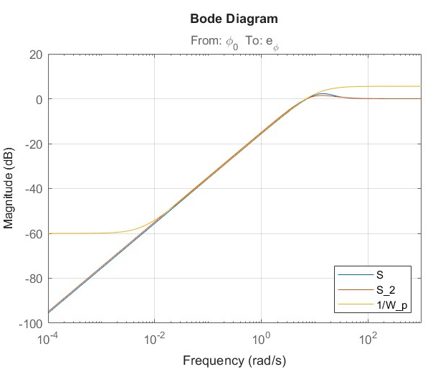
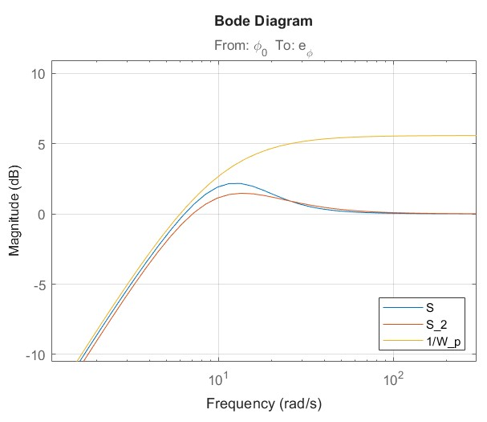
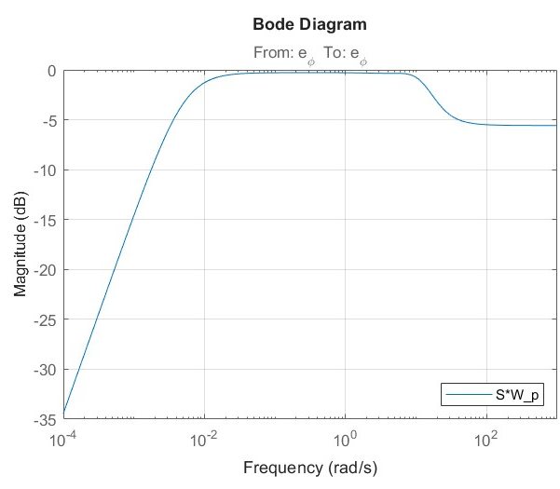
Closed-Loop Analysis – Nominal Performance
Sensitivity function $S\left(s\right)$and the performance weight $W_{p}\left(s\right)$can be plotted to verify nominal performance

Slide 19
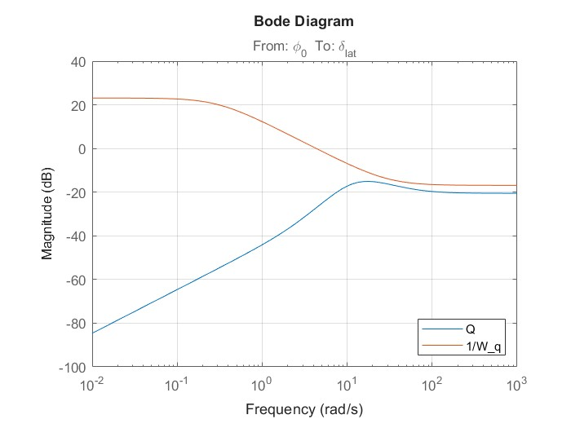
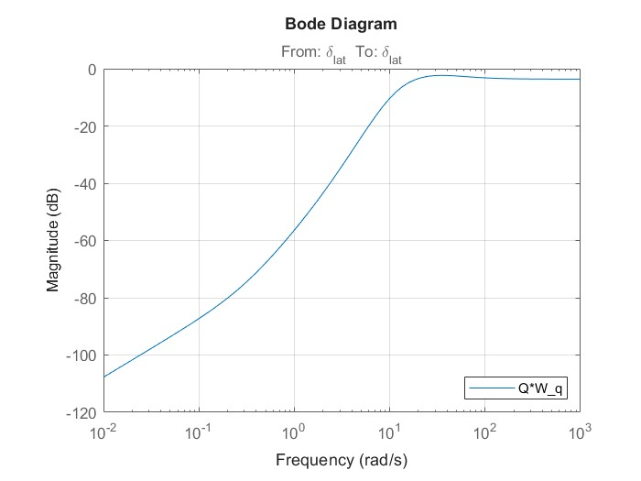
Closed-Loop Analysis – Control Effort
Same can be done for the control sensitivity function $Q(s)$

Slide 20


Closed-Loop Analysis – Stability Margins
Margins of Loop transfer function $L\left(s\right)$are shown
This margins are very good for both the gain and the phase

Slide 21




Robust Stability
To verify robust stability, we first express our uncertain system in M-Delta form.
For robust stability we need to verify that M is asymptotically stable and that its maximum singular value is less than one for every frequency.

Slide 22



Robust Stability
Check on the poles of M, because neccesary condition for the stability of $M\left(s\right)$ is that it must not have positive poles
Plotting poles of M we can observe that all of them are with negative real part, so M internal stability is satisfied

Slide 23



Robust Stability
Since our delta matrix is not full but diagonal, we can use D scaling: we use fsolve to find the diagonal D matrix that minimizes the maximum singular value
We can observe a very low maximum singular value, coherent with our very high stability margins

Slide 24




Robust Performance
From "S. Skogestad, I. Postlethwaite, Multivariable Feedback Control Analysis and Design" we know that robust performance is equivalent to the robust stability of our system with a perturbation.
Having expressed our perturbed system in M-delta form we perform the steps outlined previously

Slide 25



Robust Performance
Again we must check the poles of M, because neccesary condition for the stability of $M\left(s\right)$ is that it must not have positive poles
Plotting poles of M we can observe that all of them are with negative real part, so M internal stability is satisfied

Slide 26



Robust Performance
We observe a maximum singular value less than one, thus robust performance is verified for our system.

Slide 27



Robust Performance – Additional Analisys

Slide 28



Montecarlo Analysis
To correctly run the Montecarlo Analysis was crucial to have gaussian distribution for the uncertainties, which is obtained with normrnd
A struct with the new values of the system parameters is created and substitued in the system with usubs, this result as a better option than create the matrixes at every step, from a computational view point
Complementary sensitivity function $F(s)$ and control sensitivity function $Q(s)$ are retrived to compute nominal performance and control effort

Slide 29



Montecarlo Analysis – Nominal Performance
We notice that the settling time converges fairly quickly and from the histogram we see that all the values fall below the target treshold

Slide 30



Montecarlo Analysis – Nominal Performance
We observe the same for the maximum control effort.
In this case the threshold is even outside the picture

Slide 31




Montecarlo Analysis
Overshoot convergence is not smooth as the others because most of the vaues are zero and the few non-zero values cause spikes
Overshoot is expected to be below the target 99.7% of the cases with a 99.9% confidence

Slide 32
Conclusions
We obtained succesfully a controller for the lateral dynamics which allows the closed-loop system to meet all the requirements
We proved that stability and performance are robust with respect to uncertainties
We verified the validity of our analysis with montecarlo simulations
END
Thank you for the attention

