Slide 1
ALASTRIA
Riccardo Cecco – riccardo.cecco@estudiantat.upc.edu
Oriol Martínez Acón – oriol.martinez.acon@estudiantat.upc.edu

Slide 2
Process
Read Paper & Theory
Evaluation
Implementation Choices
Becoming an Alastria’s node
Write a smart contract
Deploy the smart contract locally
Deploy the smart contract on Alastria’s net

Slide 3





References
Know Your Customer (KYC) Implementation with Smart Contracts on a Privacy‐Oriented Decentralized Architecture – Authors: Nikolaos Kapsoulis *, Alexandros Psychas *, Georgios Palaiokrassas, Achilleas Marinakis, Antonios Litke and Theodora Varvarigou
An Experimental Framework for Improving the Performance of BFT Consensus For Future Permissioned Blockchains – Authors: Man-Kit Sit, Manuel Bravo, Zsolt István
Know Your Customer (KYC) Implementation with Smart Contracts on a Privacy‐Oriented Decentralized Architecture – Authors: Nikolaos Kapsoulis *, Alexandros Psychas *, Georgios Palaiokrassas, Achilleas Marinakis, Antonios Litke and Theodora Varvarigou
Comparison of DLT platforms – Authors: David Creer
Extended Stress Test of Alastria Blockchain Network by asvin.io - Authors: ASVIN

Slide 4








Implementation Choices
WHY?
Network T
Network B
(WIP)
Solidity
Truffle

Slide 5
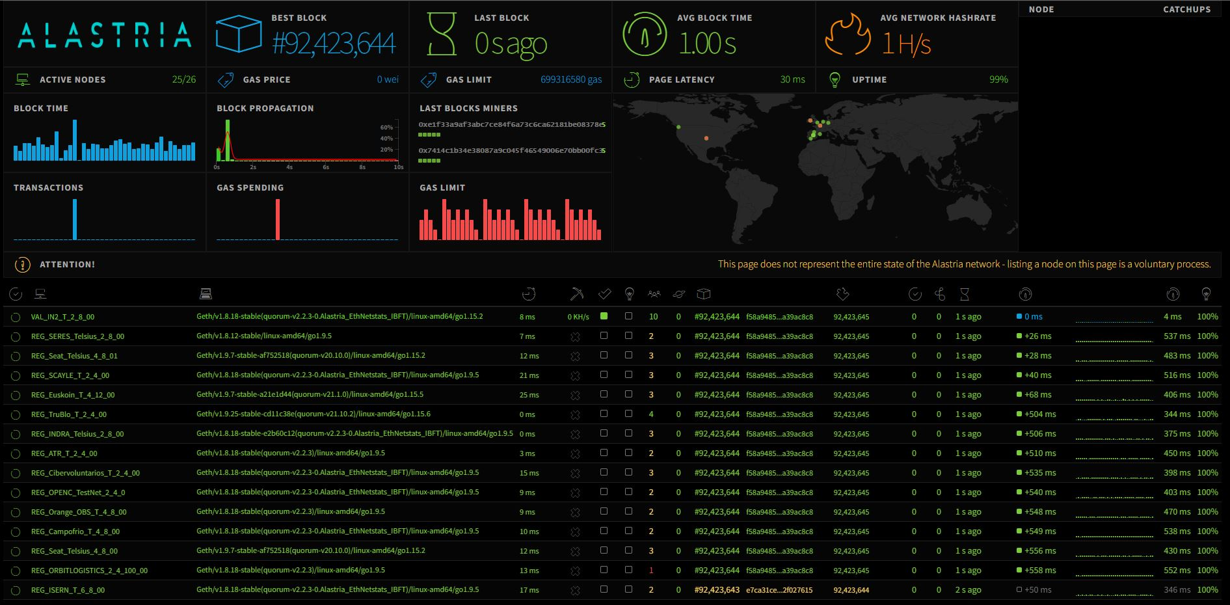
Status

Slide 6
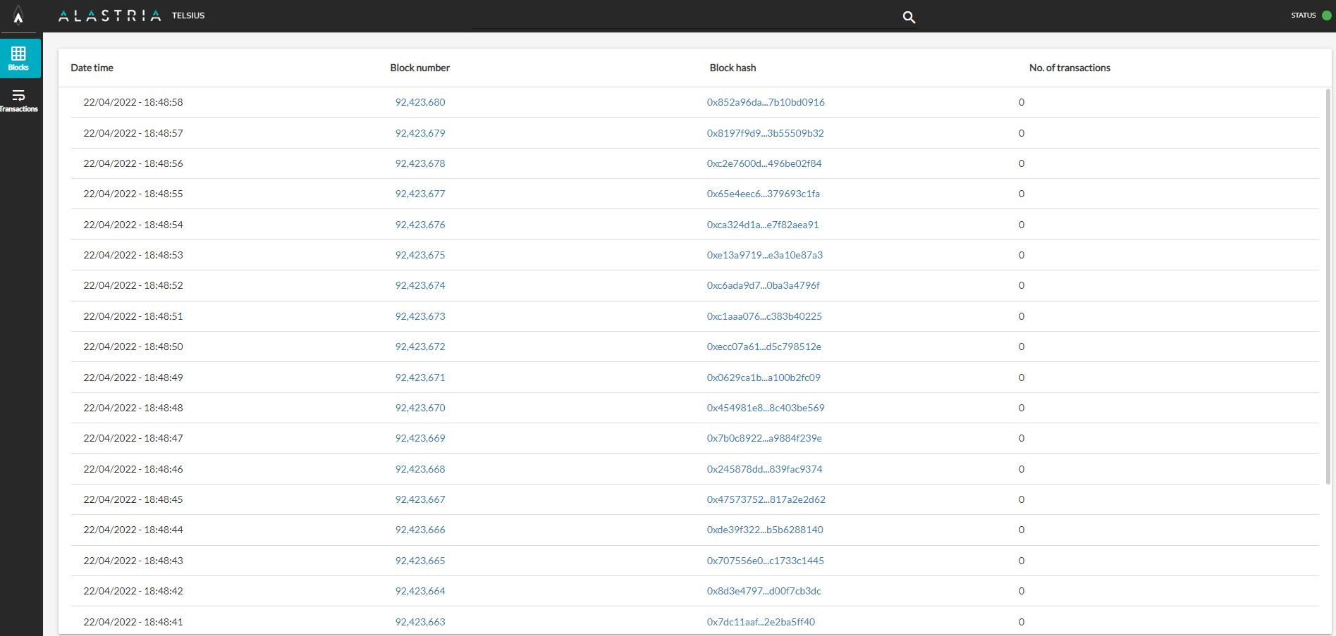
Blocks

Slide 7





Becoming an Alastria’s node

Slide 8

Evaluation
Cost/Benefit ratio
Time
Feasible
Comparison with others DLT

Slide 9
CLOSING
Alastria

